Slide 1
BMSW4006
GROUP E
Cristian Cuta
Razvan Trufia
Nicoleta Busu
Melania Chelu

Slide 2
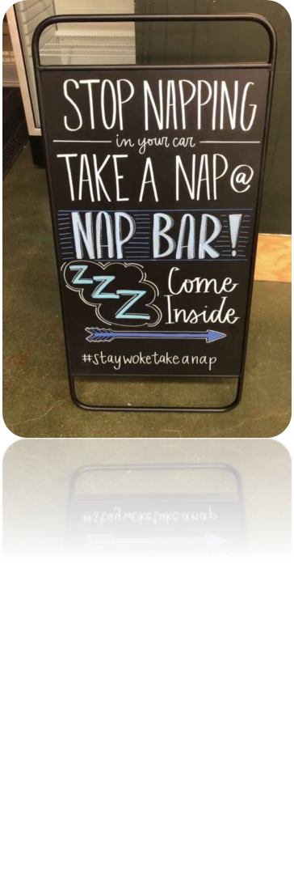
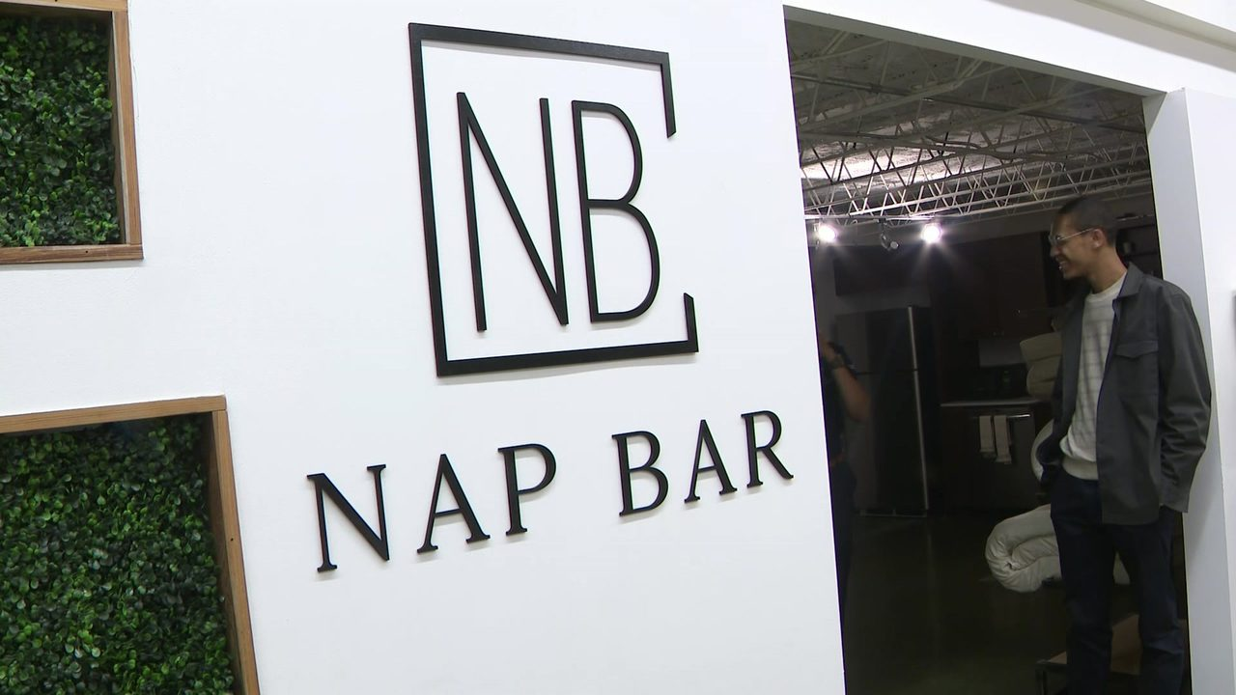
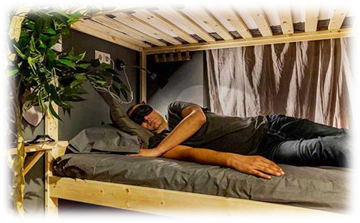
Nap Bar
-Sleep Better, Work Better
Logo:

Slide 3
Executive Summary
A few years back, the concept of napping on the job places may have sounded like an offence.
Many adults aren't getting enough sleep, and that can contribute to lowered productivity, crankiness and chronic diseases.
So, we are interested in starting a Nap Bar business.

Slide 4
Company Overview
Nap Bar offers a safe, calm and comfortable environment for people to nap, while increasing productivity in the workplace.
Nap Bar is a service industry that offers a relaxing environment for work-wellness and increased productivity.

Slide 5

Our goal is to promote wellness and turn sustainable rest into sustainable productivity for health-conscious humans.
Our Slogan is “sleep better, work better”.
Our vision is to be the market leader in Nap business.
Our mission is to help people to sleep well, stay fit, increase productivity and make life easier.

Slide 6

SWOT Analysis
Strength
Unique Business Idea.
Less Competitors
Focusing on the high earning executives
Weakness
Market Uncertainty
Financial Problem
Restricted government laws.
S
W
T
O
Opportunity
Business Establishment in the busiest location
Research on the impact of nap on productivity
People’s awareness regarding nap
Threats
Brexit Issue
Ukraine-Russia War.

Slide 7
SWOT Analysis
Strength: We are providing service to the people who work 8 to 12 hours a day. Taking a rest for 20 to 40 minutes can will allow one's energy to work, and it refreshes one's mind.
Weakness: Our business is about the Nap bar business, it is first, and there is no other nap bar business available now. We are hoping to be successful, but still, we are confused. Money can be the second problem and some new laws that Govt. has taken recently can affect our business.
Opportunity: We want to start a Nap Bar business in one of the busiest locations in the UK because the employees of banks and other corporate organizations work for 8 to 12 hours and need to take enough rest at break hour.
Threat: We are the first in the napping business, so money and experience are our main threats.

Slide 8
Management Team
Managing director (CEO)
Financing & Accounting manager (CFO)
Marketing manager (CMO)
Research development and operation manager (COO)
Sleep specialist

Slide 9

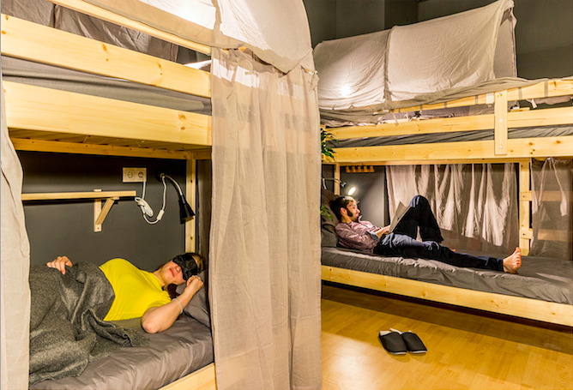
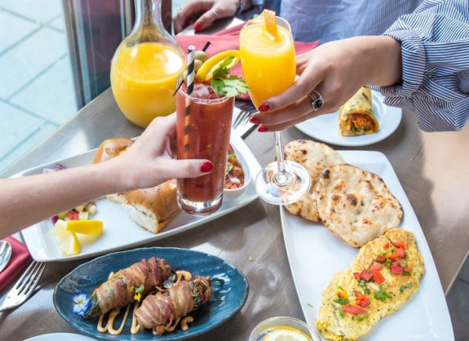
Product/Service Description

Slide 10
Nap Bar is located at Southampton, UK. It’s open Saturday through Thursday for 24 hours and Friday is closed.
We offer a white glove, health and wellness experience in Southampton, UK.
Our service offersplus organic new living Bungalow mattresses, freshly tossed organic cotton sheets, pillows, and swanky surrounding to help ease one into snooze Ville.
We also offer Fresh juice, drinks, snacks and we have proper meal system. We charge extra money for those items.
And we have silent, neat & clean zone for the people who need a room for meeting purpose. And we charge hourly for renting the room.
Memberships are 1500 per month. Individual naps are 50 for 30 minutes or one hour 100.

Slide 11
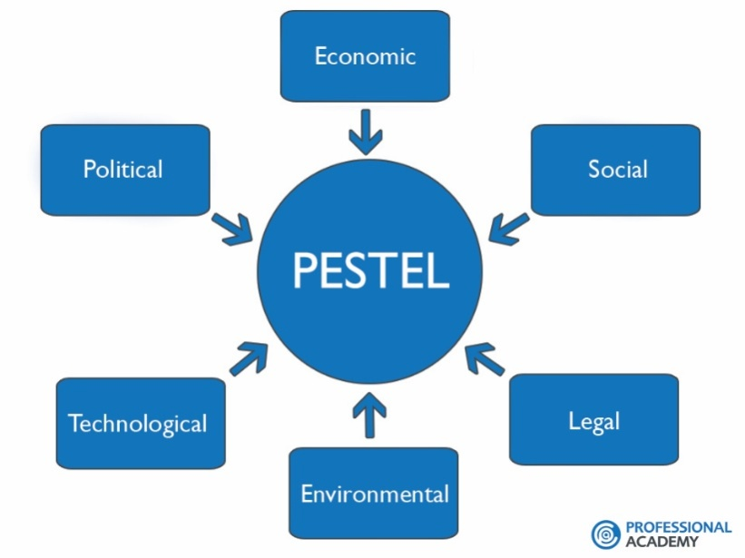
Industry Analysis

Slide 12
PESTEL
Political: Political factors affect businesses by affecting regulations, taxes, incentives, political stability, and terrorism. Before taking any strategy step, a businessman or woman should consider the impact of political factors on the business.
Economic: Financial factors can affect a business's drawn out possibilities in a market. Some of these factors include disposable income, unemployment, inflation, general and product-specific taxation.
Social: Social factors include changes in tastes and lifestyles of consumers, cultural, ethnic and religious factors, and laws that affect social factors.
Technological: The level of government spending on research and development is a major factor to consider under this heading in PESTEL Analysis. Technology can help businesses connect with their customers and apply feedback to the business immediately.
Environmental: Environmental factors include raw materials, components, energy sources and noise and water pollutions.
Legal: Every business is expected to operate within specific legal frameworks and regulations.

Slide 13
Market Segmentation
Geographic : Geographic segmentation assists in figuring out where to sell and promote.
Demographic Segmentation: Demographic segmentation is a way of dividing a market based on factors such as age, family size, race, orientation, occupation, identity, and so forth.
Behavioral Segmentation: Behavioral segmentation enables marketers to develop a more targeted approach based off purchase behaviors. For instance, Bankers and other employees may buy our service for boosting energy. They work long hour so it is important for them but for the teenagers it is not important and they won’t be interested also to take a nap.
Psychographic : Psychographic segmentation is used in the wellness market to sort customers by way of values, beliefs, and interests. We will use psychographic division to sort our clients into classes of individuals who care regarding sound living and exercise.

Slide 14
Market Positioning
Providing High technological products for Nap
Premium/Business/Standard category of service
Point 2
Point 4
Assistant will support the customers while taking nap
Offering Trial Version
Point 1
Point 3

Slide 15
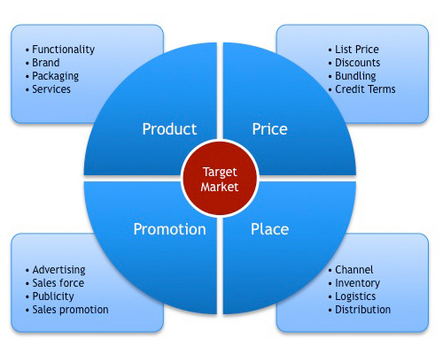
MARKETING PLAN

Slide 16
Operational Plan
Task Name | March | April | May | June | July | August | September | October | November | December
Creating a Website
Digital Marketing Plan including Facebook Marketing
News Portal Ads
Billboard
TVC/OVC
Initiating Loyalty Program

Slide 17
Cash Flow
Money usage plan
Total Invest | 800.000
Cost
Office arrangement | 350.000
Management & Staffs | 200.000
Adevertisment | 50.000
Marketing | 80.000
Research & Development Cost | 50.000
Other Cost | 20.000

Slide 18
INCOME STATEMENT FOR THREE YEARS
Content | 2022 | 2023 | 2024
Total revenue/Sales Cost of service/goods sold Gross profit | 1.000.000(1yr) 125.000 875.000 | 1.600.000(1yr) 325.000 1.275.000 | 3.200.000(1yr) 500.000 2.700.000
Other expenses: Office arrangement Management & staff Advertisement Marketing Research & Development Others Total | 350.000 200.000 50.000 80.000 50.000 20.000 ------------ 750.000 | 300.000 300.000 70.000 80.000 50.000 40.000 ------------ 840.000 | 320.000 350.000 80.000 80.000 50.000 50.000 ------------ 930.000
Net Income/Loss | 125.000 | 435.000 | 1.770.000

Slide 19
Conclusion
Nap Bar is a white-glove, health and wellness experience in Southampton, United Kingdom that helps people gently fall asleep and wake up refreshed.
We have a qualified and experienced managerial team to help us to take our business to our goal. We have also taken some innovative and effective marketing plan.
We think that our business plan is a better one for investing and we also think that our business plan is a realistic one and it has a potentiality of sustainable growth.

Slide 20
References
(2022) Scitepress.org. Available at: https://www.scitepress.org/Papers/2015/53375/53375.pdf (Accessed: 1 March 2022).
SAGE Business Cases - Sleep Cafés: Nap and Go (2020). Available at: https://sk.sagepub.com/cases/sleep-cafes-nap-and-go (Accessed: 1 March 2022).
Ulubeyli, S. and Kazanci, O. (2018) "Holistic sustainability assessment of green building industry in Turkey", Journal of Cleaner Production, 202, pp. 197-212. doi: 10.1016/j.jclepro.2018.08.111.
STEPE�Social, Technical, Economic, Political and Ecological Factor Model (2022). Available at: https://pages.gseis.ucla.edu/faculty/richardson/STEPE.htm (Accessed: 1 March 2022).
Islam, F. and Mamun, K. (2017) "Possibilities and Challenges of Implementing Renewable Energy in the Light of PESTLE & SWOT Analyses for Island Countries", Smart Energy Grid Design for Island Countries, pp. 1-19. doi: 10.1007/978-3-319-50197-0_1.
The impact of political, economic, socio-cultural, environmental and other external influences | Health Knowledge (2022). Available at: https://www.healthknowledge.org.uk/public-health-textbook/organisation-management/5b-understanding-ofs/assessing-impact-external-influences (Accessed: 1 March 2022).
Marketing Theories – PESTEL Analysis (2022). Available at: https://www.professionalacademy.com/blogs/marketing-theories-pestel-analysis/ (Accessed: 1 March 2022).
PESTLE Analysis: How to Use The #1 Macro Analysis Framework (2021). Available at: https://www.thepowermba.com/en/blog/pestle-analysis (Accessed: 1 March 2022).
Jurevicius, O. (2021) PEST & PESTEL Analysis: The Ultimate Guide - SM Insight, Strategic Management Insight. Available at: https://strategicmanagementinsight.com/tools/pest-pestel-analysis/ (Accessed: 1 March 2022).

Slide 21


