Slide 1
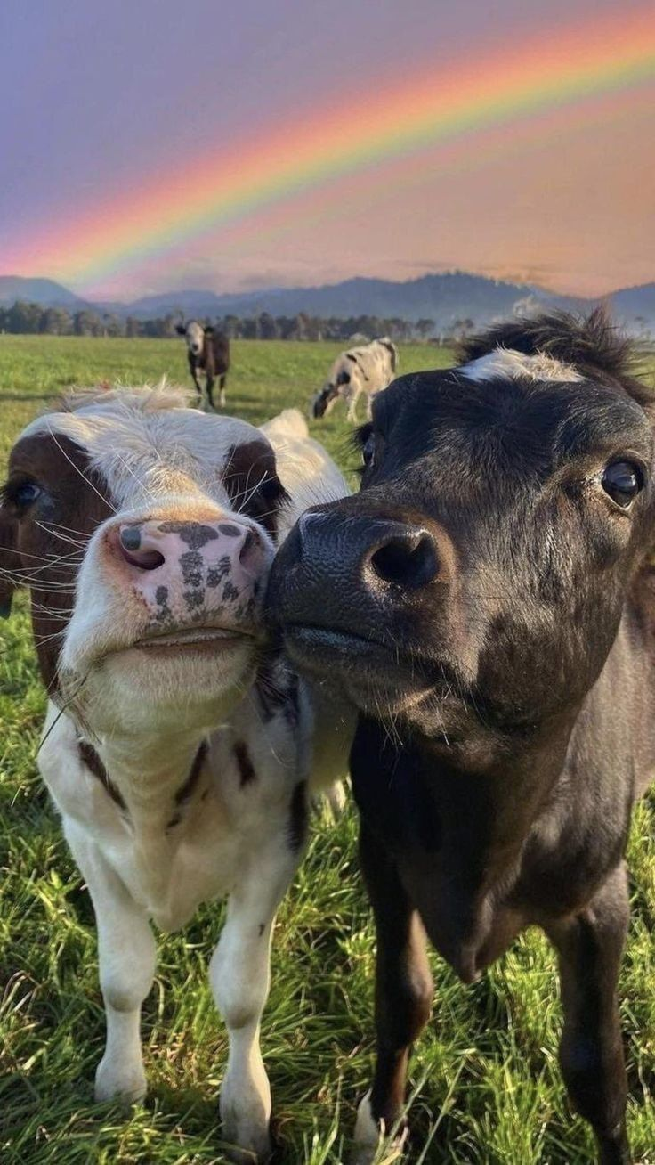
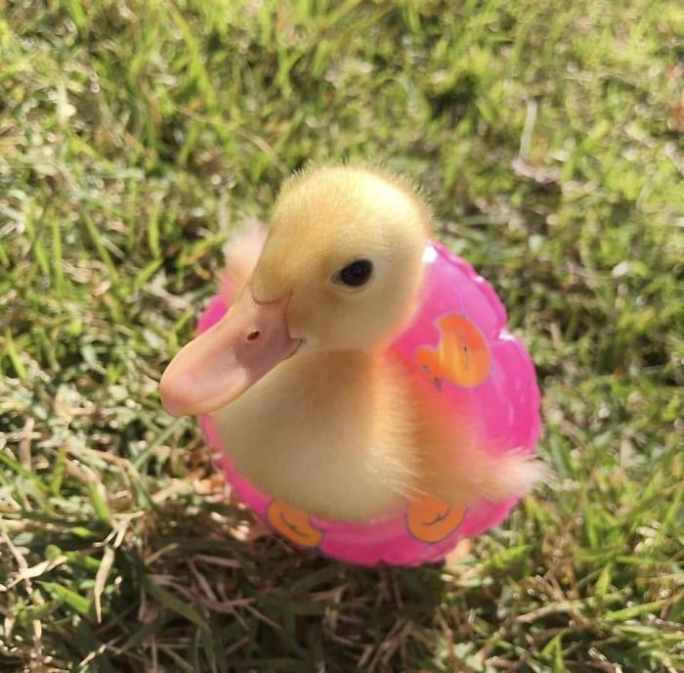



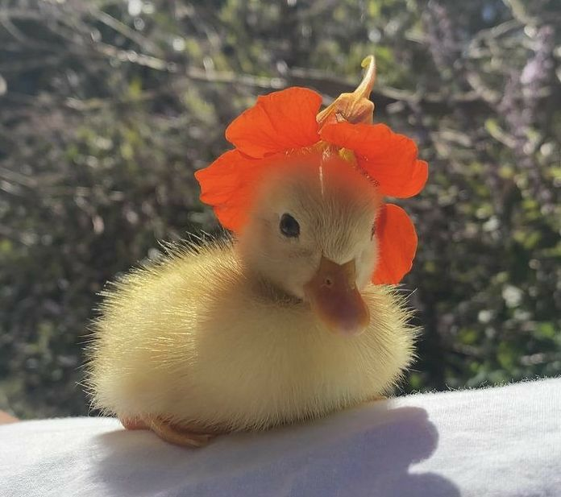
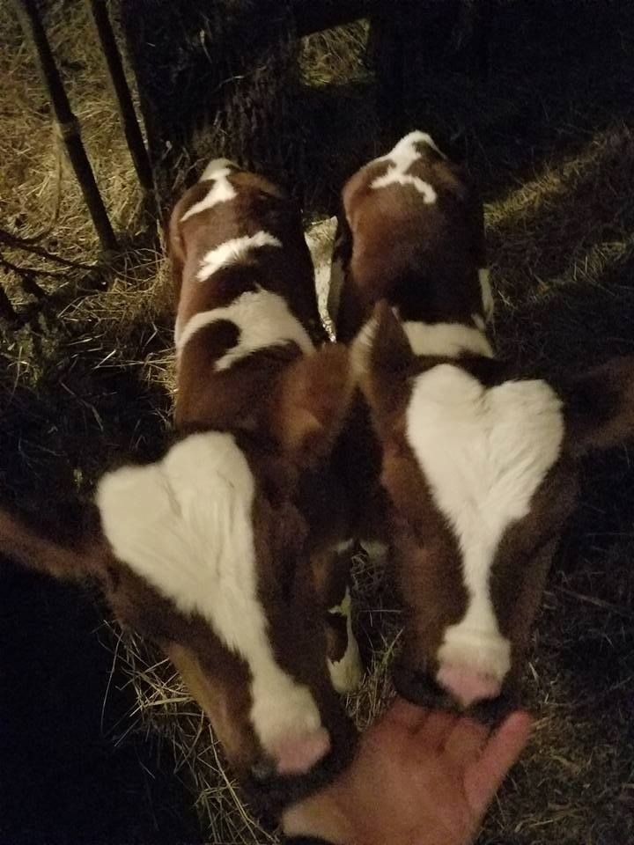

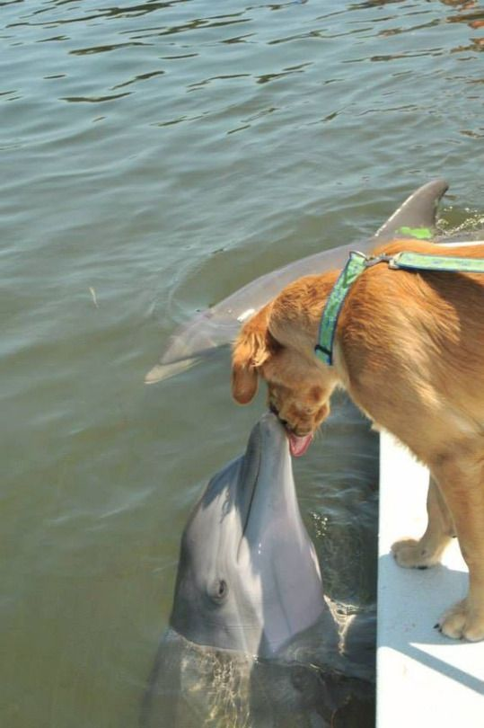
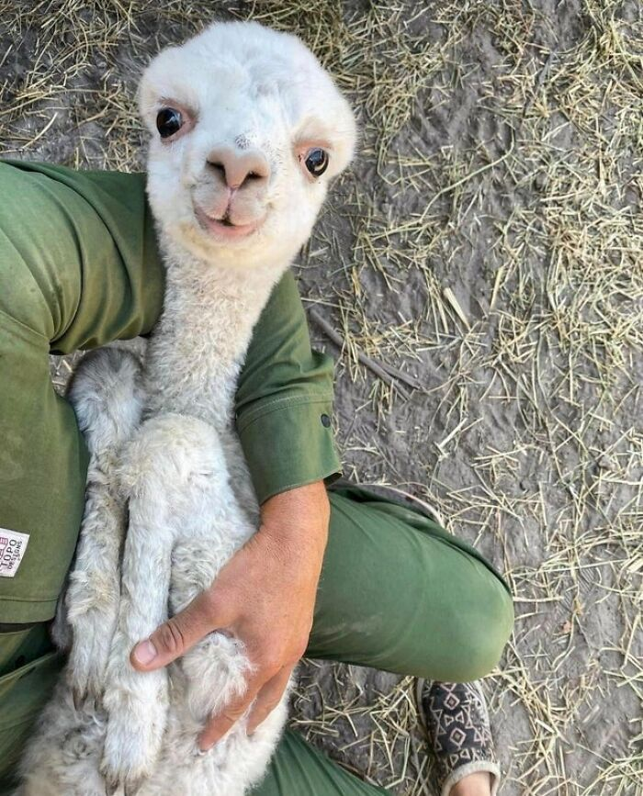
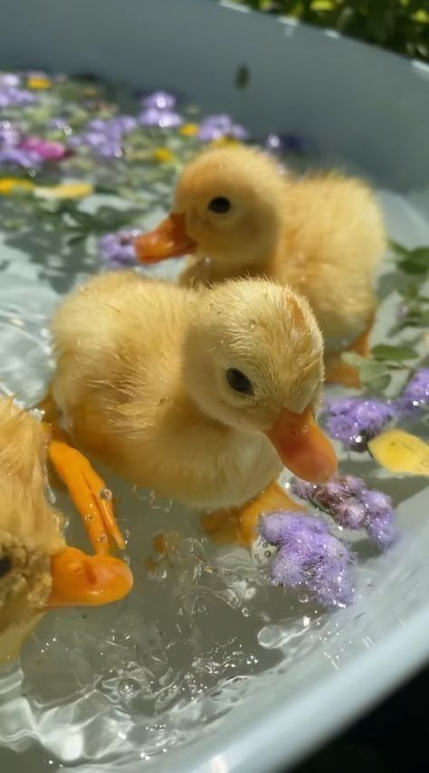
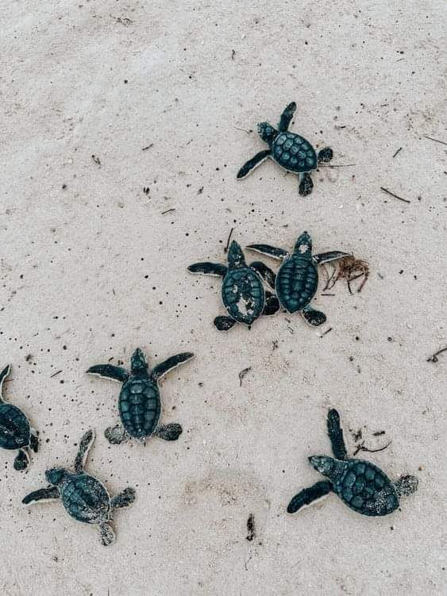


Slide 2
Reference list
Attfield, R. and Humphreys, R. (2016) ‘Justice and Non-Human Animals’, Bangladesh Journal of Bioethics, 7(3), pp. 1-11.
Callicott, J. B. (1988) ‘Animal Liberation and Environmental Ethics: Back Together Again’, Between the Species An Online Journal for the Study of Philosophy and Animals, 4(3), pp. 163-169.
Bandura, A. (2002) ‘Selective Moral Disengagement in the Exercise of Moral Agency’, Journal of Moral Education, 31(1), pp. 101-119.
Loughnan, S., Bratanova, B. and Puvia, E. (2012) ‘The Meat Paradox: How Are We Able to Love Animals and Love Eating Animals?’, In-Mind Italia, 1(1), pp. 15-18.
Singer, P. (2011) Practical Ethics. 3rd edn. Cambridge: Cambridge University Press.

