Slide 1
M7X02153C, M6X02151C
Mathemateg 1
Datblygiad Ysgol a Chynnydd Disgyblion:
Helpu plant i wneud cynnydd drwy ddeall camsyniadau
M7X02153, M6X02151
Mathematics 1
School Development and Pupil Progress: Helping children make progress through understanding misconceptions

Slide 2
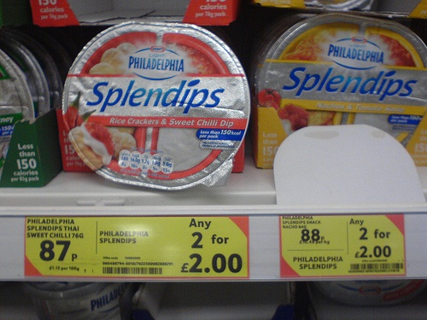
Beth sy’n digwydd? – What’s going on?

Slide 3
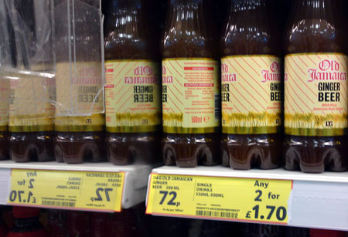

Slide 4
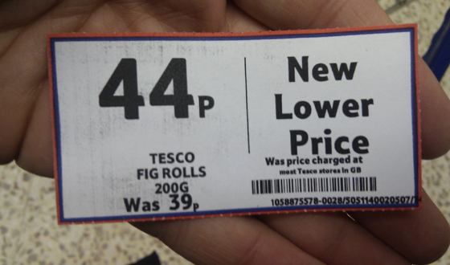

Slide 5
Amcanion y Sesiwn:
Cydnabod a nodi camsyniadau mathemategol nodweddiadol yn yr ysgol gynradd.
Deall mathau o gamsyniadau a pham maent yn digwydd.
Dewis strategaethau addysgol sy’n amlygu ac archwilio camsyniadau dysgwyr.
Bod yn gallu defnyddio strategaethau sy’n annog trafod a darganfod gan ddysgwyr wrth fynd i’r afael â chamsyniadau.
Session Objectives:
To recognise and identify typical mathematical misconceptions in the primary school.
To understand types of misconceptions and why they occur.
To select pedagogic strategies which expose and explore learner misconceptions.
To be able to employ strategies which encourage learner discussion and discovery in addressing misconceptions.

Slide 6
Meddwl – Paru – Rhannu
Think – Pair – Share
Beth yw’r gwahaniaeth rhwng gwall (camgymeriad) a chamsyniad?
A ydy pob gwall yn gamsyniad?
What is the difference between an error (mistake) and a misconception?
Are all errors misconceptions?

Slide 7
Gwallau | Camsyniadau
Gellir eu hachosi drwy ‘esgeulustod’ (e.e. camddarllen, cyfrifo’n anghywir neu ddim ond ‘dim yn gwybod’) | Y rhain yw canlyniad methu deall rhywbeth yn llwyr (neu yn ei ddeall yn anghywir)
e.e. Pan ofynnir faint yw 10 – 7 fel cwestiwn galw i gof cyflym, mae’r plentyn yn ateb 4 oherwydd nid yw’n gwybod ac nid oes digon o amser iddo weithio’r peth allan. | e.e. Pan ofynnir faint yw 10 – 7 , mae’n defnyddio llinell rif ac yn cyfrif tuag yn ôl 10, 9, 8, 7, cyn ateb 4.
NID YW GWALLAU O REIDRWYDD YN AWGRYMU CAMSYNIADAU, OND GALLANT FOD YN SYMPTOM OHONYNT. | NID CANLYNIADAU CAMSYNIADAU YW GWALLAU BOB AMSER (OS NAD YDY’R CYSYNIADAU YN CAEL EU HARCHWILIO’N GYFLAWN) e.e. Gall plentyn ddweud yn gywir mai 60 yw 6 x 10 a 340 yw 34 x 10, ac felly mae’n ymddangos ei fod yn deall lluosi gyda 10. Ond pan ofynnir iddo faint yw 3.6 x 10, mae’n ateb 3.60

Slide 8
Errors | Misconceptions
May be caused by ‘carelessness’ (e.g. misreading question, incorrect calculation or just ‘not knowing’) | Are the result of not completely understanding something (or having the wrong understanding)
e.g. When asked 10 – 7 as rapid recall child says 4 because they don’t know and don’t have time to work it out. | e.g. When asked 10 – 7 uses a number line and counts back 10, 9, 8, 7 and says 4
ERRORS DO NOT NECESSARILY IMPLY MISCONCEPTIONS BUT MAY BE A SYMPTON OF THEM | MISCONCEPTIONS MAY NOT ALWAYS RESULT IN ERRORS (IF THE CONCEPTS ARE NOT EXPLORED FULLY) e.g. A child may correctly say that 6 x 10 is 60 and 34 x 10 is 340 and seems to understand multiplying by 10. But when asked 3.6 x 10 they will say 3.60

Slide 9
Cynllunio ymlaen
Forward planning
Mae’n bosib rhagweld cyn y wers y bydd rhai o’r gwallau/camsyniadau hyn yn digwydd, ac felly, gellir mynd i’r afael â nhw yn ystod y cyfnod cynllunio er mwyn diddymu neu ddatrys camsyniadau posib.
Some of these errors/misconceptions could be predicted prior to a lesson and tackled at the planning stage to diffuse or unpick possible misconceptions.

Slide 10
Heb ei gynllunio
Unplanned
Mae hefyd yn ddefnyddiol pan mae camsyniadau yn codi mewn sesiynau.
Gellir eu defnyddio fel mannau cychwyn i’r dysgu.
Er mwyn mynd i’r afael â’r rhain, rhaid i’r athro wybod:
beth allai’r camsyniad fod
pam wnaeth y camsyniad ddigwydd
sut i ddatrys yr anawsterau er mwyn i’r plentyn barhau i ddysgu.
It is also useful when misconceptions arise during sessions.
These can be used as starting points for learning.
In order to address these, the teacher needs to know:
what the misconception might be,
why the misconception may have occurred
how to unravel the difficulties for the child’s continued learning

Slide 11
Adfyfyrio
Reflection
Gan gyfeirio ‘nôl at PAP1, ystyriwch enghreifftiau o wallau a chamsyniadau welsoch o fewn gwersi mathemateg.
Referring back to PTE1, consider examples of both errors and misconceptions you observed within mathematics lessons.
https://www.ncetm.org.uk/resources/30033
Notes:
Are there any common areas?
Why is it important to note misconceptions?

Slide 12

Mathau o gamsyniad
Types of misconception
Ryan, J. & Williams, J. (2007). Children's mathematics 4-15: Learning from errors and misconceptions. Maidenhead: McGraw-Hill/Open University Press
tt. 13 – 30
Ar gael yn y llyfrgell ar fel copi ar-lein
pp. 13 – 30
Available in the library and as an e-book
Notes:
(discussed by Ryan and Williams, pp.13 – 30, 2007)

Slide 13
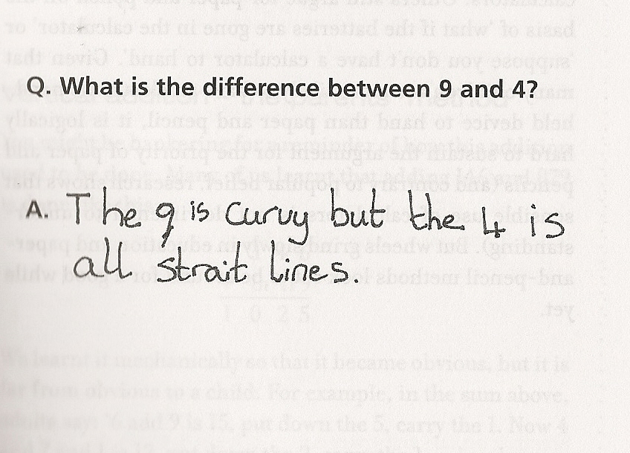
Modelu:
Yma, mae gan y dysgwr y ‘model anghywir’ – gallai hyn fod wedi’i achosi drwy gamddeall yr iaith: e.e.
Modelling:
Here the learner has the ‘wrong model’ – this could be caused by misunderstanding the language: e.g.
Notes:
(discussed by Ryan and Williams, pp.13 – 30, 2007)

Slide 14
Beth yw hanner 8?
What is half of 8?

Slide 15
Prototeip:
Yma, mae gan y dysgwr syniad ‘prototeip’ (nodweddiadol ond nad yw’n gyflawn) yn ei ben, ond nid oes ganddo brofiad o eraill.
e.e. Rhowch groes yn agos at unrhyw driongl.
Prototype
Here the learner has a ‘prototype’ (typical but not complete) idea in their head and haven’t had experience of others.
e.g. Put a cross near all the triangles
x

Slide 16
Gorgyffredinoli deallus
Dyma pan mae’r dysgwr yn gwneud tybiaeth ddealladwy wedi’i seilio ar ‘reol gyffredinol’ nad yw ef efallai yn ei deall yn gyflawn
e.e. 0.2 x 0.3 = 0.6
oherwydd mae’r plentyn yn dilyn patrwm dealladwy, ond yn yr achos hwn, nid yw’n gweithio oherwydd
2/10 x 3/10 = 6/100=0.06
nid yw lluosi bob amser yn gwneud rhywbeth yn fwy!
Intelligent Overgeneralization
This is where the learner makes an understandable assumption based on ‘general rule’ that they may not fully understand.
e.g. 0.2 x 0.3 = 0.6
because the child is following an understandable pattern but in this case it doesn’t work because
2/10 x 3/10 = 6/100=0.06
multiplication doesn’t always make something bigger!

Slide 17
Camsyniadau proses-gwrthrych
Yma, mae’r dysgwr wedi cysylltu’r fathemateg â phroses, neu mae’n gweld y ‘gwrthrych’ yn broses.
e.e. Pan ofynnir, faint yw ? – 3 = 20, gallai’r dysgwr ddweud 17, oherwydd mae’n cysylltu = â’r angen i wneud rhywbeth ac mae’r –3 yn golygu bod angen iddo dynnu 3.
Process-object misconceptions
Here the learner has associated the maths involved with a process, or may see an ‘object’ as a process.
e.g. When asked ? – 3 = 20, the learner may say 17 because they associate = as meaning they have to do something and –3 as meaning they take 3 away.

Slide 18
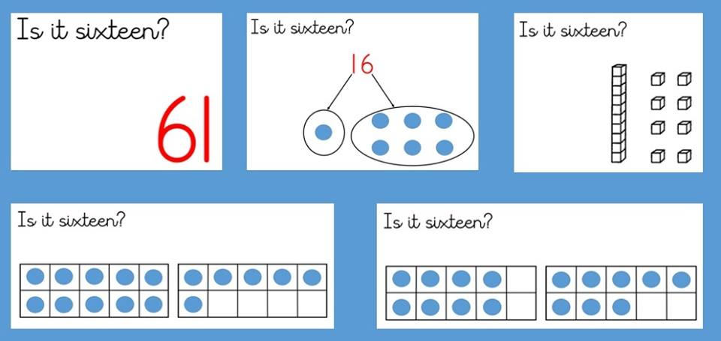
A yw’n un deg chwech?
A yw’n un deg chwech?
A yw’n un deg chwech?
A yw’n un deg chwech?
A yw’n un deg chwech?
https://www.facebook.com/Gareth-Metcalfe-Primary-Maths-697326023637017/

Slide 19
https://www.facebook.com/Gareth-Metcalfe-Primary-Maths-697326023637017/

Slide 20
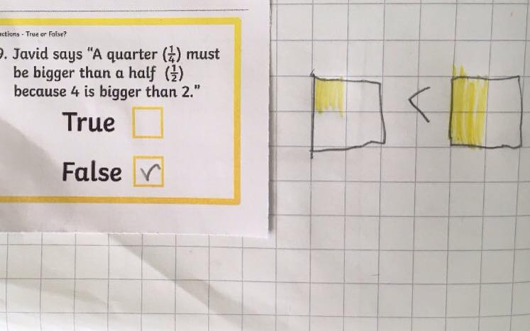
https://www.facebook.com/697326023637017/photos/a.858641257505492.1073741829.697326023637017/1165665096803105/?type=3&theater

Slide 21
Beth yw’r strategaethau addysgol a ddefnyddir gan athrawon?
Sbarduno amrywiaeth o ‘atebion’.
Gofyn i’r plant i wrando ar ei gilydd.
Aralleirio barnau eraill.
Chwilio am eglurhad pellach o’r pwyntiau.
Annog pob plentyn i siarad.
Chwilio am gefnogaeth neu anghytundeb (e.e. A ydych yn cytuno/anghytuno?).
Peidio ag ymyrryd pan fo’r ateb yn gywir.

Slide 22
What are the pedagogic strategies that teachers should use?
Eliciting a variety of ‘answers’.
Asking children to listen to each other.
Paraphrasing other viewpoints.
Seeking further clarification of points.
Encouraging all children to speak.
Seeking support or dissent (e.g. do you agree/disagree?).
Not intervening immediately with the correct response.

Slide 23
Gweithgareddau
Activities
Ewch ati i roi cynnig ar wneud y gweithgareddau sydd ar eich bwrdd:
Cartwnau camsyniad
Bob tro / Weithiau / Byth
Cyd-farcio gwaith plentyn (ffug)
Dadansoddi gwaith plentyn a marcio’r athro
Er mwyn amlygu ac archwilio camsyniadau, mae gweithgareddau o’r fath yn annog y dysgwr i drafod a darganfod ar yr un pryd.
Have a go at the activities on your table. You have examples of:
Concept cartoons
Always/Sometimes/Never statements
Shared marking of a (fictional) child’s work
Analysis of child’s work and teacher marking
Use of such strategies can expose and explore misconceptions whilst encouraging learner discussion and discovery

Slide 24
Cyswllt aseiniad – Ystyried dysgu plentyn i sicrhau cynnydd pellach
Ystyriwch senario a beth mae hwn yn adlewyrchu am ddysgu’r plentyn. Defnyddiwch y cwestiynau fel arweiniad.
Adnabyddwch beth fyddech yn gwneud fel athro i sicrhau cynnydd pellach.
Byddwch yn barod i gyflwyno i berson arall.
Assignment Link – Considering a child’s learning to ensure further progress
Consider a scenario and what this reflects about the child’s learning. Use the questions as a guide.
Identify what you would do as a teacher to ensure further progress.
Be prepared to present to another person.

Slide 25
Gweithgareddau dosbarth: adnabod camsyniadau
Classroom activities: identifying misconceptions
https://vimeo.com/83486435

Slide 26
Activities to encourage pupils to discuss and discover
Gweithgareddau sy’n annog dysgwyr i drafod a darganfod
Rhowch gynnig ar y gweithgareddau sydd ar eich bwrdd.
Sut mae’r gweithgareddau hyn yn amlygu/ archwilio camsyniadau ac yn annog y dysgwyr i drafod a darganfod?
Have a go at the activities on your table.
How do these activities highlight / explore misconceptions whilst encouraging learner discussion and discovery?
Notes:
Concept cartoons
Always/Sometimes/Never statements
Shared marking of a (fictional) child’s work
Analysis of child’s work and teacher marking

Slide 27
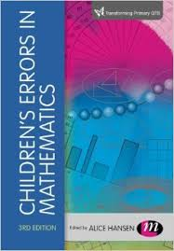
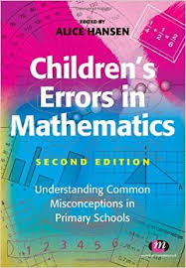
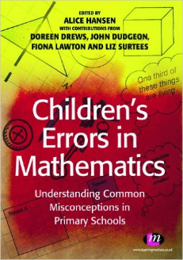
Darllen pellach /
Further reading:
Hansen, A. (2011). Children's errors in mathematics : Understanding common misconceptions in primary schools (2nd ed.). Exeter: Learning Matters.
Camau nesaf:
Ystyriwch dysgu eich plentyn ffocws mewn mwy o ddyfnder – wnaeth ef/hi arddangos unrhyw gamsyniadau? Os felly, sut allech sicrhau dealltwriaeth lawn?
Next steps:
Consider the learning of your focus child in more depth – did he/she display any misconceptions? If so, what you could do to ensure full understanding.

