Slide 1
Social Research for Professional Practice
ECYW5001
Lecture 2

Slide 2
Today’s lecture
Recap Monday
What is Social Research
Method and Methodology
Data Collection (Qualitative and Quantitative)
Assessment

Slide 3
Last lecture…
  Module Outline
  Assessment Question
  What is Research in Youth Work
  Key Things to Consider in Research with Young People

Slide 4
Why research in youth work?

Slide 5
Why research in youth work?
Why do you think we conduct research in youth work?

Slide 6
Why research in youth work?
      INFORM POLICY
      Political
      Best Practice
      Improve Services
      INFORM PRACTICE
      Youth Work
      Social Care
      Education,
      Health/Wellbeing
      Community Development,
      Evidence-based Practice …
      WHERE DOES YOUTH
      WORK START?
      Young People…
      Strengths/Potential
      Needs
      Experiences
      Values
      RESEARCH IS YOUTH WORK
      Educative Expressive Participative Inclusive Empowering

Slide 7
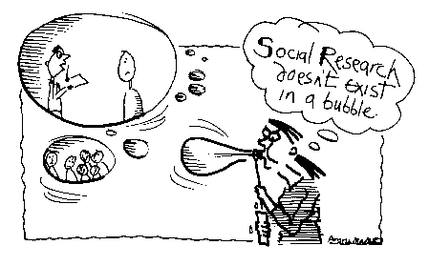
  ‘Social research does not exist in a bubble’ (Bryman 2001)
  Real-world problems need real-
world enquiry and research…

Slide 8

research in youth work
  Ethics
  Your Role
  Context
  RESEARCH
  DESIGN
  Theory
  Values
  Methodology
  Methods
  Practical Considerations

Slide 9
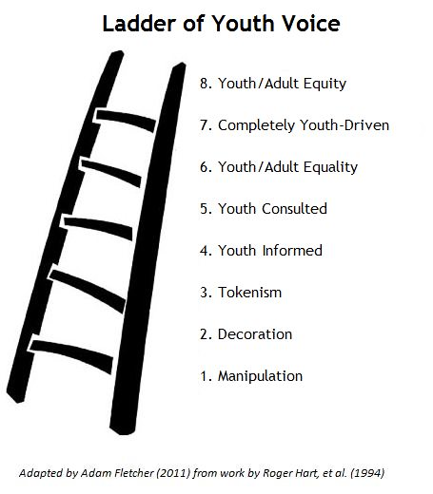
ACTIVE PARTICIPATION AS RESEARCH?
‘Young people become partners in, and share responsibility for, the opportunities, learning processes and decision-making structures which affect their own and other people's lives and environments’
(Youth Work in Wales Review Group, 2018).
We can use Hart’s Ladder of Participation to picture varying levels of participation ranging from nonparticipation to active participation.
(5-8) Degrees of Participation
(3-5) Tokenism
(1-3) Non-participation

Slide 10
Methodology and method
These are two concepts that are often seen as confusing but can be made simple.
They are both linked to the same ideas in research.
Both methodology and method depends on our paradigm…

Slide 11
Paradigm
A worldview or set of assumptions about how things work.
It includes our own personal cultural ideologies, mindsets and views of the world.
We will briefly look at 3 paradigms today in relation to research (there are more):
Positivism – there is one single reality or truth (black and white).
Constructivist – no single truth or reality but reality is created by individuals in groups.
Pragmatism – reality is constantly debated, renegotiated so that it is useful in new situations.

Slide 12
methodology
Your personal methodology approach is linked to your paradigm.
The theoretical framework that outlines the rules to follow in a study.
Why am I doing this research in this specific way?
For example, why might I use interviews in a piece of research and not focus groups?
The theory that underpins how and why a piece of research is being done.

Slide 13
Paradigm and methodology
How this might impact our methodology:
Positivist
Experimental research, survey research, hypothesis-testing…
Constructivist
Grounded theory, action research, discourse…
Pragmatist
Mixed-methods, use the right tool for the right job…

Slide 14
Method
The actual tools and steps taken when conducting a piece of research.
The practical ways research is gathered and designed.
How the research will be conducted and what you will do.

Slide 15
Paradigm and method
Positivist
Usually quantitative, eg. sampling measurement, statistical analysis, questionnaires, focus group, interviews.
Constructivist
Often qualitative, eg. qualitative interview, observation, case study, life history, narrative, focus groups, interviews.
Pragmatist
Use the best tool for the job, combination of positivist and constructivist, physical prototypes, testing questions, usability testing…

Slide 16
Who are you?
In research, it is important that you are able to identify where you stand in your approach to research.
Take 10 mins (in 2 groups) discuss how you might see yourself as a researcher…
Positivist
Constructivist
Pragmatist
Why?

Slide 17
Any questions so far…

Slide 18
Data collection - qualitative
Involves semi / unstructured interviews, observation, focus groups and content analysis, participatory methods of data collection.
Interested in the story and narrative of the participants.
Researchers interpret what is said by participants and analyse data.
Sometimes seen as non-scientific as results can be non-measurable.

Slide 19
Data collection - quantitative
Involves experiments, surveys, testing, and structured content analysis, structured interviews, and observation.
Interested in numbers.
Looks at correlation between action and reaction.
Looks at facts of results.
Not interested in the story or environment (other than maintaining the same environment/test conditions).

Slide 20
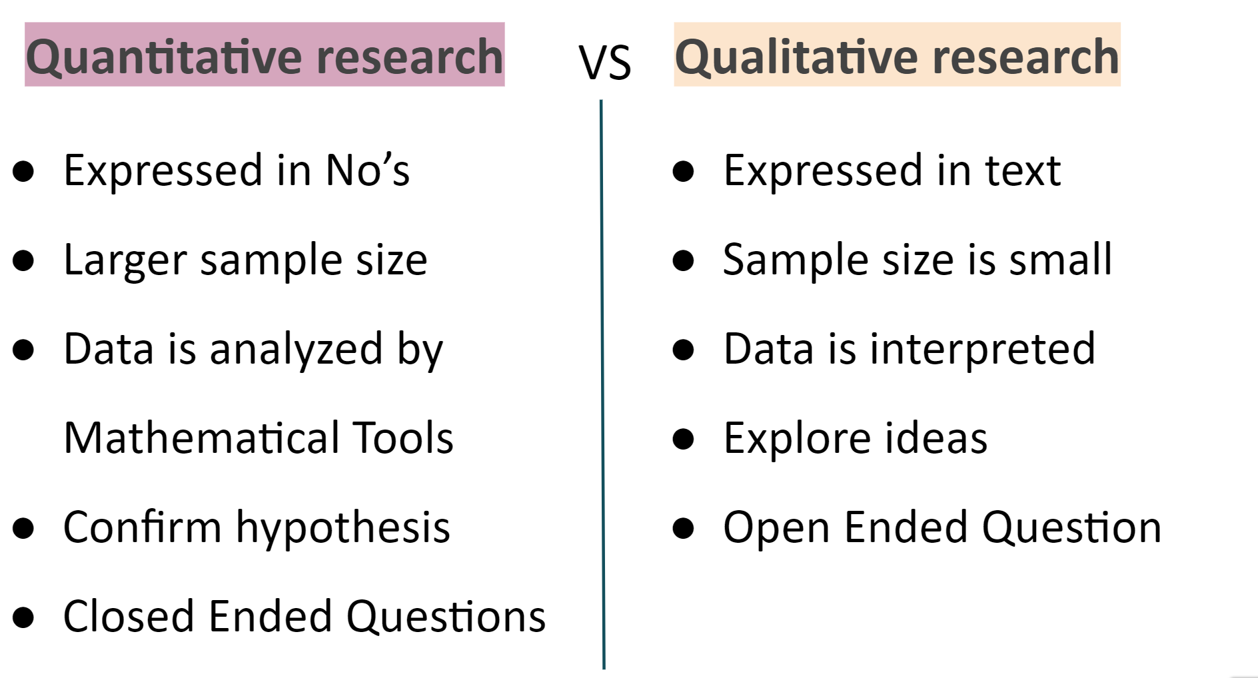

Slide 21
Mixed method – combining the two
Mixed methodology and mixed approaches often regarded as a practical solution to research.
Focus on using the right tool(s) for the specific research.
Not overly concerned with what method is used as long as it is appropriate to the piece of research being carried out.
Can be seen somewhere in the middle of qualitative and quantitative research…

Slide 22
Qualitative Methods
Case Study
Ethnography – observe in real life situations
Phenomenology – looking at lived experiences
Grounded Theory
Life History
Clinical Research - Healthcare (eg. determine safety of medicines…)
Action and Applied Research
Participatory Research

Slide 23
Group activity
In groups, look at one of the following methods of qualitative research ready to feedback to the main group and explain what it is:
Group 1 – Grounded Theory
Group 2 – Action Research
Group 3 – Life History

Slide 24
Group activity
Action Research
Concerned with using research to change things. Through/as a result of the research, action will be taken.
Grounded Theory
Concerned with generating ideas and hypotheses throughout the research and analysis of data, then producing theories as a result of those hypotheses.
Life History
Concerned with the documentation of participant/s life over a specific period of time. Focus on individuals’ own experiences, in their own words.

Slide 25
Quantitative Methods
Survey Research
Experiments
Customer Satisfaction Polls/Surveys
Cross-Sectional Survey (usually observational) – survey targets section(s) of the population
Correlational Research – establish the links between two (or more) entities
Internet Data Review
Census Data/Review
ONS (Office for National Statistics) Data

Slide 26
youth work RESEARCH
As an extension of practice…
Think about an area of your current practice that you would like to research or evaluate:
Meeting a need/solving a problem
Improving practice
Evaluating a new initiative to see if it works
Pause for Thought: Who should determine the research theme/need?

Slide 27
APPLIED RESEARCH EXAMPLES
Participatory Research
Action research
Applied Research seeks to provide direct solutions to problems or issues facing a society.
-Just remember that Young People are not problems to be solved!
-Applied Research – unlike Basic Research (Fundamental Research) – is not done for the sake of academic interest or curiosity.
-Practitioners have ownership of the research process (even if young people are co-facilitators)
-Democratic
-Reflection engenders personal or organisational change.

Slide 28
What can I research?
Almost any social, political, cultural, economic or aesthetic phenomenon, issue or problem can be the subject of research. The key thing is not what it’s about, but the way you approach the issue. If you are looking for a subject for your research, the best thing to do is to develop a real sense of curiosity about how the world around you works or let yourself be open to ideas, objects, experiences or events.
(Boden, Kenway and Epstein, 2005)

Slide 29
WHICH TYPE OF RESEARCH?
What kind of research methodology do you think would be best-suited to Youth Work?
Qualitative, Quantitative, Mixed-Methods..?
Discuss…

Slide 30
Assessment
4000 word Assignment
Due: 16th May 2022
Provisional Grade and Feedback: 15th June 2022
Question:
Part 1: 2000 words
Students are required to prepare a research proposal, which could be applied to their Level 6 Dissertation module. Students are asked to consider the background context and themes of their research topic, and to outline the proposed methodology and methods of this research proposal. The assignment should be supported by wider reading, and linked to the Youth Work National Occupational Standards (CLD Standards Council Scotland, 2019).
Part 2: 2000 words
Students are required to complete an Ethics Form which reflects their chosen research proposal.

Slide 31
Next lecture
What is Your Question?
Ethics
Self-directed Study

Slide 32
DIRECTED-STUDY FOR NEXT LECTURE
Think about a question you may want to answer in your practice with young people.
What Methodology and Methods might you use? Why?
What are some of the Ethical Considerations (we will start to look at these in more detail next lecture)?
Please be ready to feedback your question and a couple of points on each of the above next lecture.

Slide 33
references
  Boden, R. Kenway, J. and Epstein, D. (2005) Getting started on research. London: SAGE.
  Bryman, A. (2001) Social Research Methods. Oxford: Oxford University Press.
  Louis, Cohen, Manion & Morrison. (2000) Research Methods in Education. London: Routledge Falmer.
  Macintyre. (2000) The Art of Action Research. London: David Fulton Publishers.
  McNiff, J., Lomax, P. & White, J.(2003) You and Your Action Research Project. 2nd Edition. London: Routledge Falmer.
  Robson, C. (2002) Real World Research. Oxford: Blackwell Publishers

