Slide 1
BMSK4005
Professional Career development
Week 4
Personal Development Planning

Slide 2
Lesson Aims
To present a range of tools that can be used to enable students to consider and analyse their future career prospects
To support students in the use and application of these tools

Slide 3
Using management ‘tools’
Applying management theory to yourself provides a useful set of tools for self-analysis and self-awareness

Slide 4
Using management ‘tools’
SWOT analysis (or SWOT matrix) is a strategic planning technique used to help a person or organization identify the Strengths, Weaknesses, Opportunities, and Threats related to business competition or project planning

Slide 5
SWOT Analysis
What are your:
Strengths
Weaknesses
Opportunities
Threats

Slide 6
Using management ‘tools’
Think about your skills, opportunities etc. in terms of a
PROFIT & LOSS account

Slide 7
Johari window
A Johari window is a psychological tool created by Joseph Luft and Harry Ingham in 1955.
It's a simple and useful tool for understanding and training, self-awareness, personal development, and improving communications.

Slide 8
Using management ‘tools’
Johari Window:
 | Known to self | Unknown to self
Known to others
Unknown to others

Slide 9
Force Field Analysis
Some people struggle when they have tough decisions to make. They go through the pros and cons, and agonize over making the right decision
When you're making difficult or challenging decisions, you can use an effective, structured decision-making technique that will improve the quality of your decisions and increase your chances of success.

Slide 10
Using management ‘tools’
Force Field Analysis
Summary of skills and competencies I possess | ⇨ | Equilibrium | ⇦ | Requirements of organisation / job

Slide 11
Using management ‘tools’
What type of leader are you?
What roles do you take in groups and teams?

Slide 12
Using management ‘tools’
Which entrepreneurial characteristics do you have?
Which traits?

Slide 13
Using management ‘tools’
The 7 ‘P’s of Marketing
Product
Price
Place
Promotion
People
Process
Physical environment

Slide 14
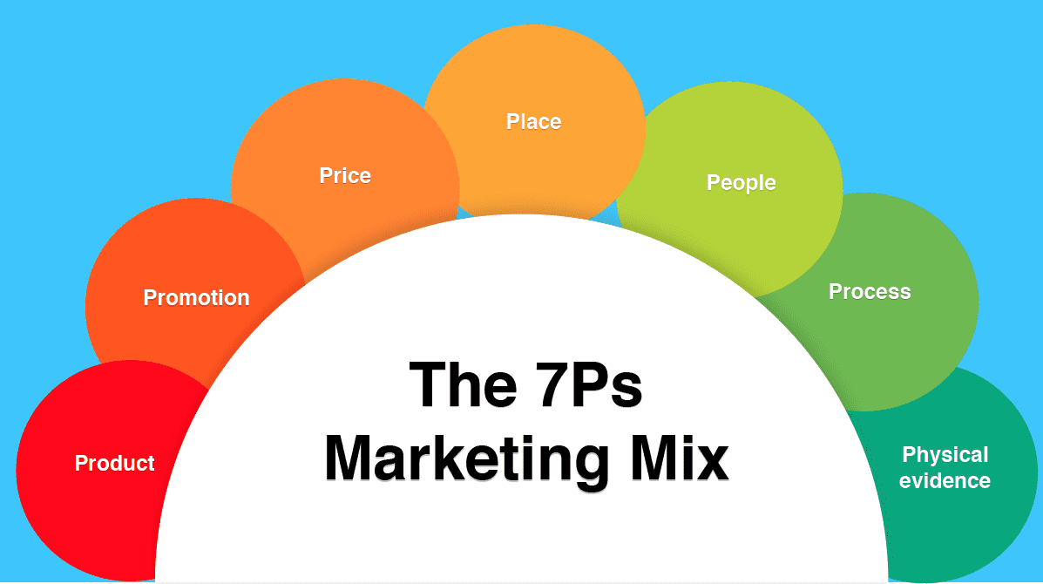
Image source: https://www.smartinsights.com/marketing-planning/marketing-models/how-to-use-the-7ps-marketing-mix/

Slide 15
Using management ‘tools’
Consider PEST factors:
Political
Economic
Socio-cultural
Technological

Slide 16
Using management ‘tools’
How about a personal:
MISSION STATEMENT
BUSINESS PLAN ?
Do you have
SMART OBJECTIVES ?

Slide 17
Tasks:
Apply various models, techniques and approaches to yourself
Complete some psychometric tests – reflect upon the conclusions

