Slide 1


Tuberculosis as a Long-Term Condition: Impact, Management, and Prevention in the UK and Globally
Programme: MSc Public Health and Social Care in Practice
Module: Community Care and Management of Longer-term Conditions
Module Code: LCHS7003
Assignment Title: Component 2 Individual Presentation
Lecturer’s Name: MUHAMMED KHAN
Student Name: darshankumar sureshbhai patel
Student ID: 2515501

Slide 2
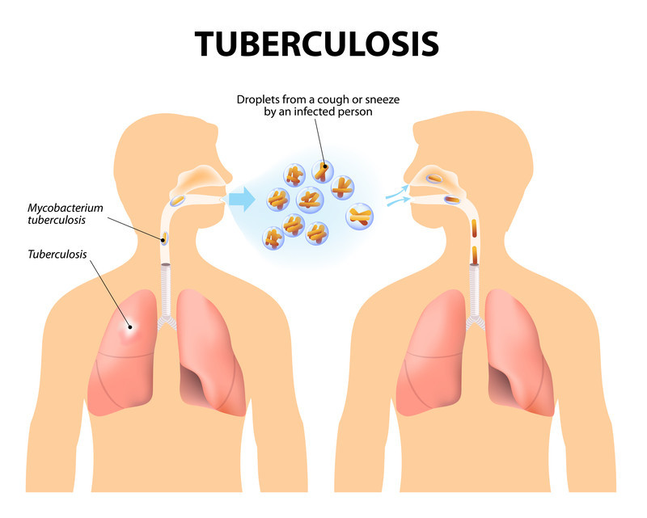
Overview of the long-term condition, including the definition, symptoms and aetiology
Tuberculosis is a bacterial disease which is mostly found in the lungs (Meghji et al., 2025).
It is transmitted as a result of airborne droplets and brings about cough, fever, and loss of weight.
The migrants, the elderly, the immunocompromised, and the low-income group are considered to be the high-risk groups (Network et al., 2023).
Notes:
Mycobacterium tuberculosis causes tuberculosis and is transmitted by inhaling infected droplets. The common symptoms include the existence of persistent cough, fever, night sweats and loss of weight. It is recommended to screen high-risk groups, including migrants, elderly people, immunocompromised people with HIV, and people who live in overcrowded and low-income situations.

Slide 3
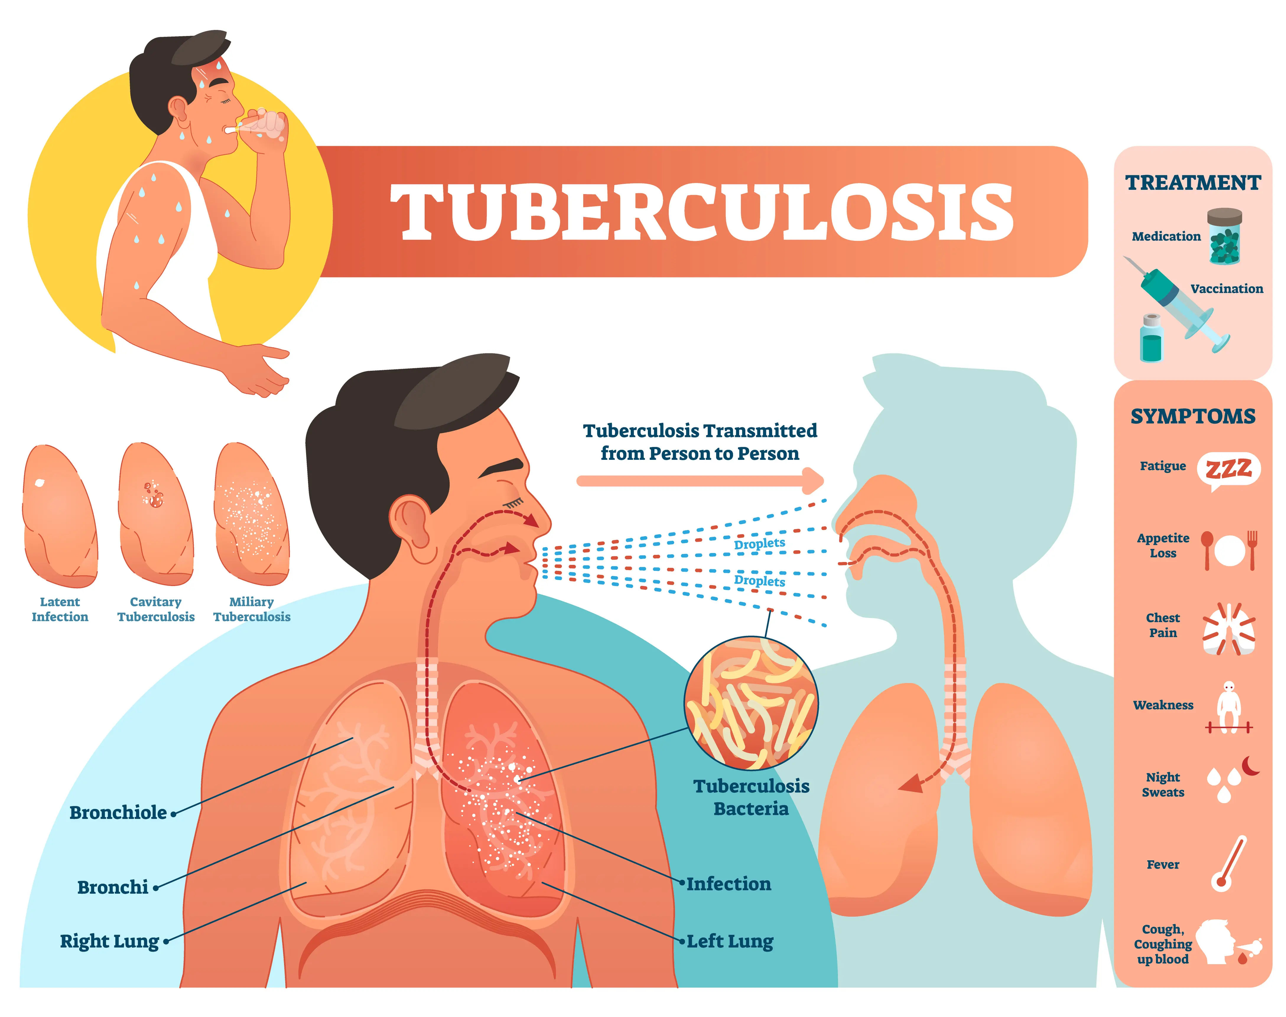
Prevalence of the long-term condition in the UK and worldwide
Tuberculosis is a health problem that is currently experienced throughout the world (Menzies et al., 2024).
The UK has a moderate incidence compared to the high-burden countries.
Poverty, overcrowding, and limitations to access healthcare are increasing in developing countries (Berrocal-Almanza et al., 2022).
Notes:
In the world, TB is one of the major infectious diseases that causes deaths, particularly in countries such as India and South Africa. The UK incidence is not so high. However, all urban and vulnerable populations have issues. Such factors as migration, socio-economic inequalities, and inaccessibility to healthcare are some causes of further transmission in the world.

Slide 4
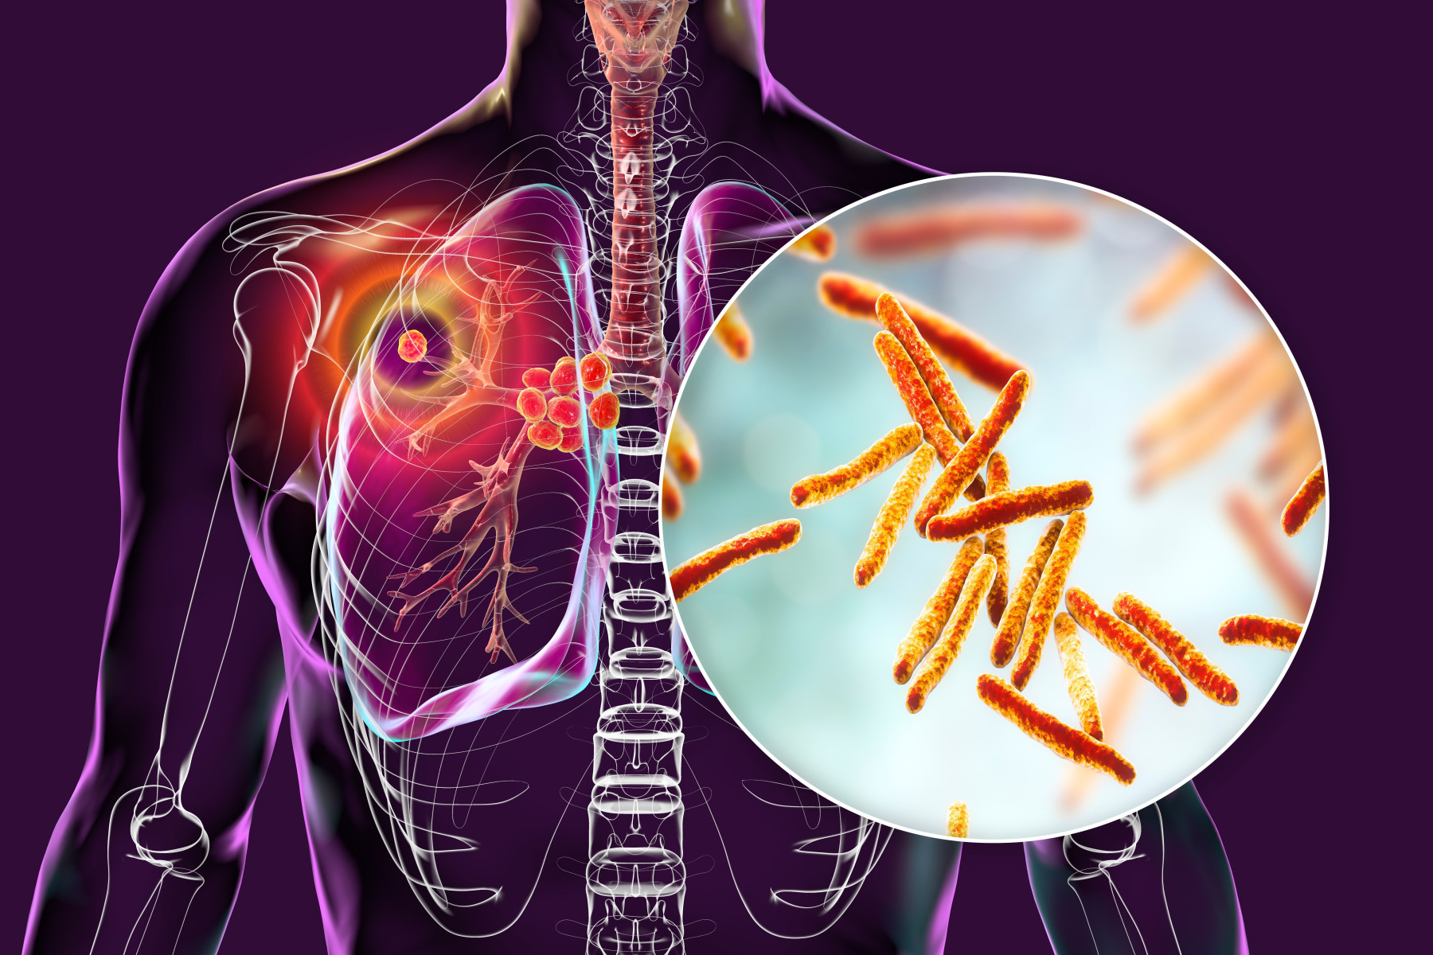
Economic Burden of the chosen long-term condition
Healthcare systems have a judicious economic cost due to Tuberculosis.
Financial pressure is augmented by long-term care, treatment and diagnosis (Nightingale et al., 2023).
The loss of productivity to sickness reduces the economy of the countries and their levels of household income (Khunti et al., 2023).
Notes:
The costs linked to TB in the economy involve both direct medical expenses that include diagnostics, medication and hospitalisation. Lost income and low productivity are considered to be indirect costs. TB can lead to families living in poverty, especially in low-income countries. The treatment of TB cases imposes a strain on the NHS resources even in the UK.

Slide 5
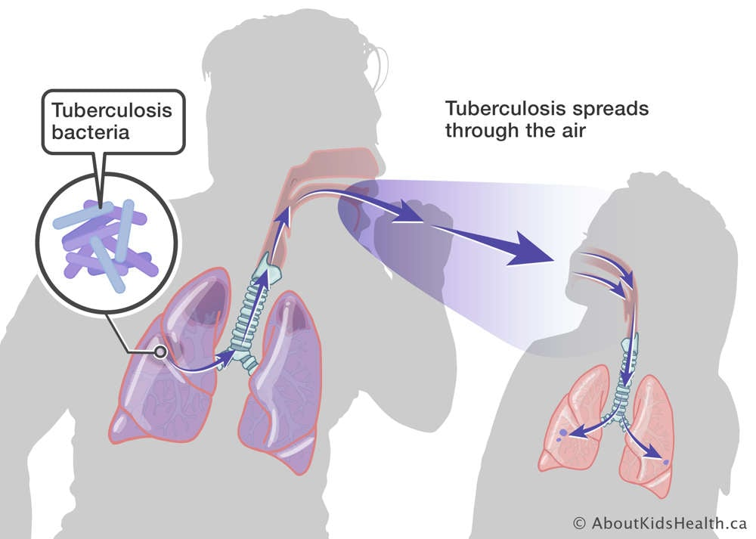
Social Burden of the chosen long-term condition
Tuberculosis brings about discrimination and social stigma in the world.
These patients tend to isolate, suffer mental stress and have a low quality of life (Allwood et al., 2024).
Applicable populations are vulnerable because of living in poor conditions and inequality (Martinez et al., 2023).
Notes:
TB is a severe occurrence to social wellbeing, with the patients being subjected to stigmatisation and shunning. This may result in late diagnosis and treatment compliance. Compromised populations, such as the migrants and the low earners, are more vulnerable, but this requires inclusive healthcare and community awareness programs.

Slide 6
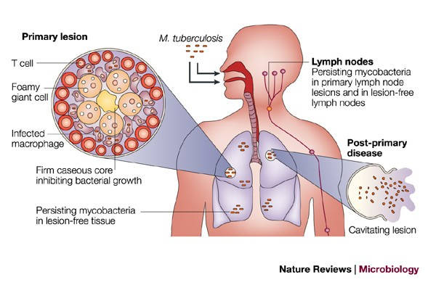
Diagnosis of the chosen long-term condition
Tuberculosis is diagnosed by conducting clinical and laboratory medical tests (Menzies et al., 2023).
Such typical techniques are chest X-rays, sputum tests, and a molecular diagnosis.
It is necessary to diagnose the diseases at an early stage to avoid their spread and complications (Goletti et al., 2025).
Notes:
TB can be diagnosed using microscopy of sputum, culture tests, chest radiography and fast molecular tests such as GeneXpert. The most important aspect is to diagnose the problem early and accurately so as to contain the spread and commence treatment in time. The late diagnosis of the disease raises the severity of the disease and the possibility of infecting other people.

Slide 7

Initial Assessment of the chosen long-term condition
Primary examination includes an evaluation of the symptoms, past medical history, and the exposure risk (Kunst et al., 2025).
Physical observation and diagnosis prove the extent of the disease.
Evaluation is useful in identifying the requirements of treatment plans and individual attention of a patient (Wang et al., 2022).
Notes:
The primary examination encompasses the examination of the symptoms, health history, risk factors, and potential exposure. The health care workers carry out physical check-ups and perform diagnostic tests. This phase promotes proper classification of TB (latent or active) and provides effective plans of treatment and patient-centred care.

Slide 8
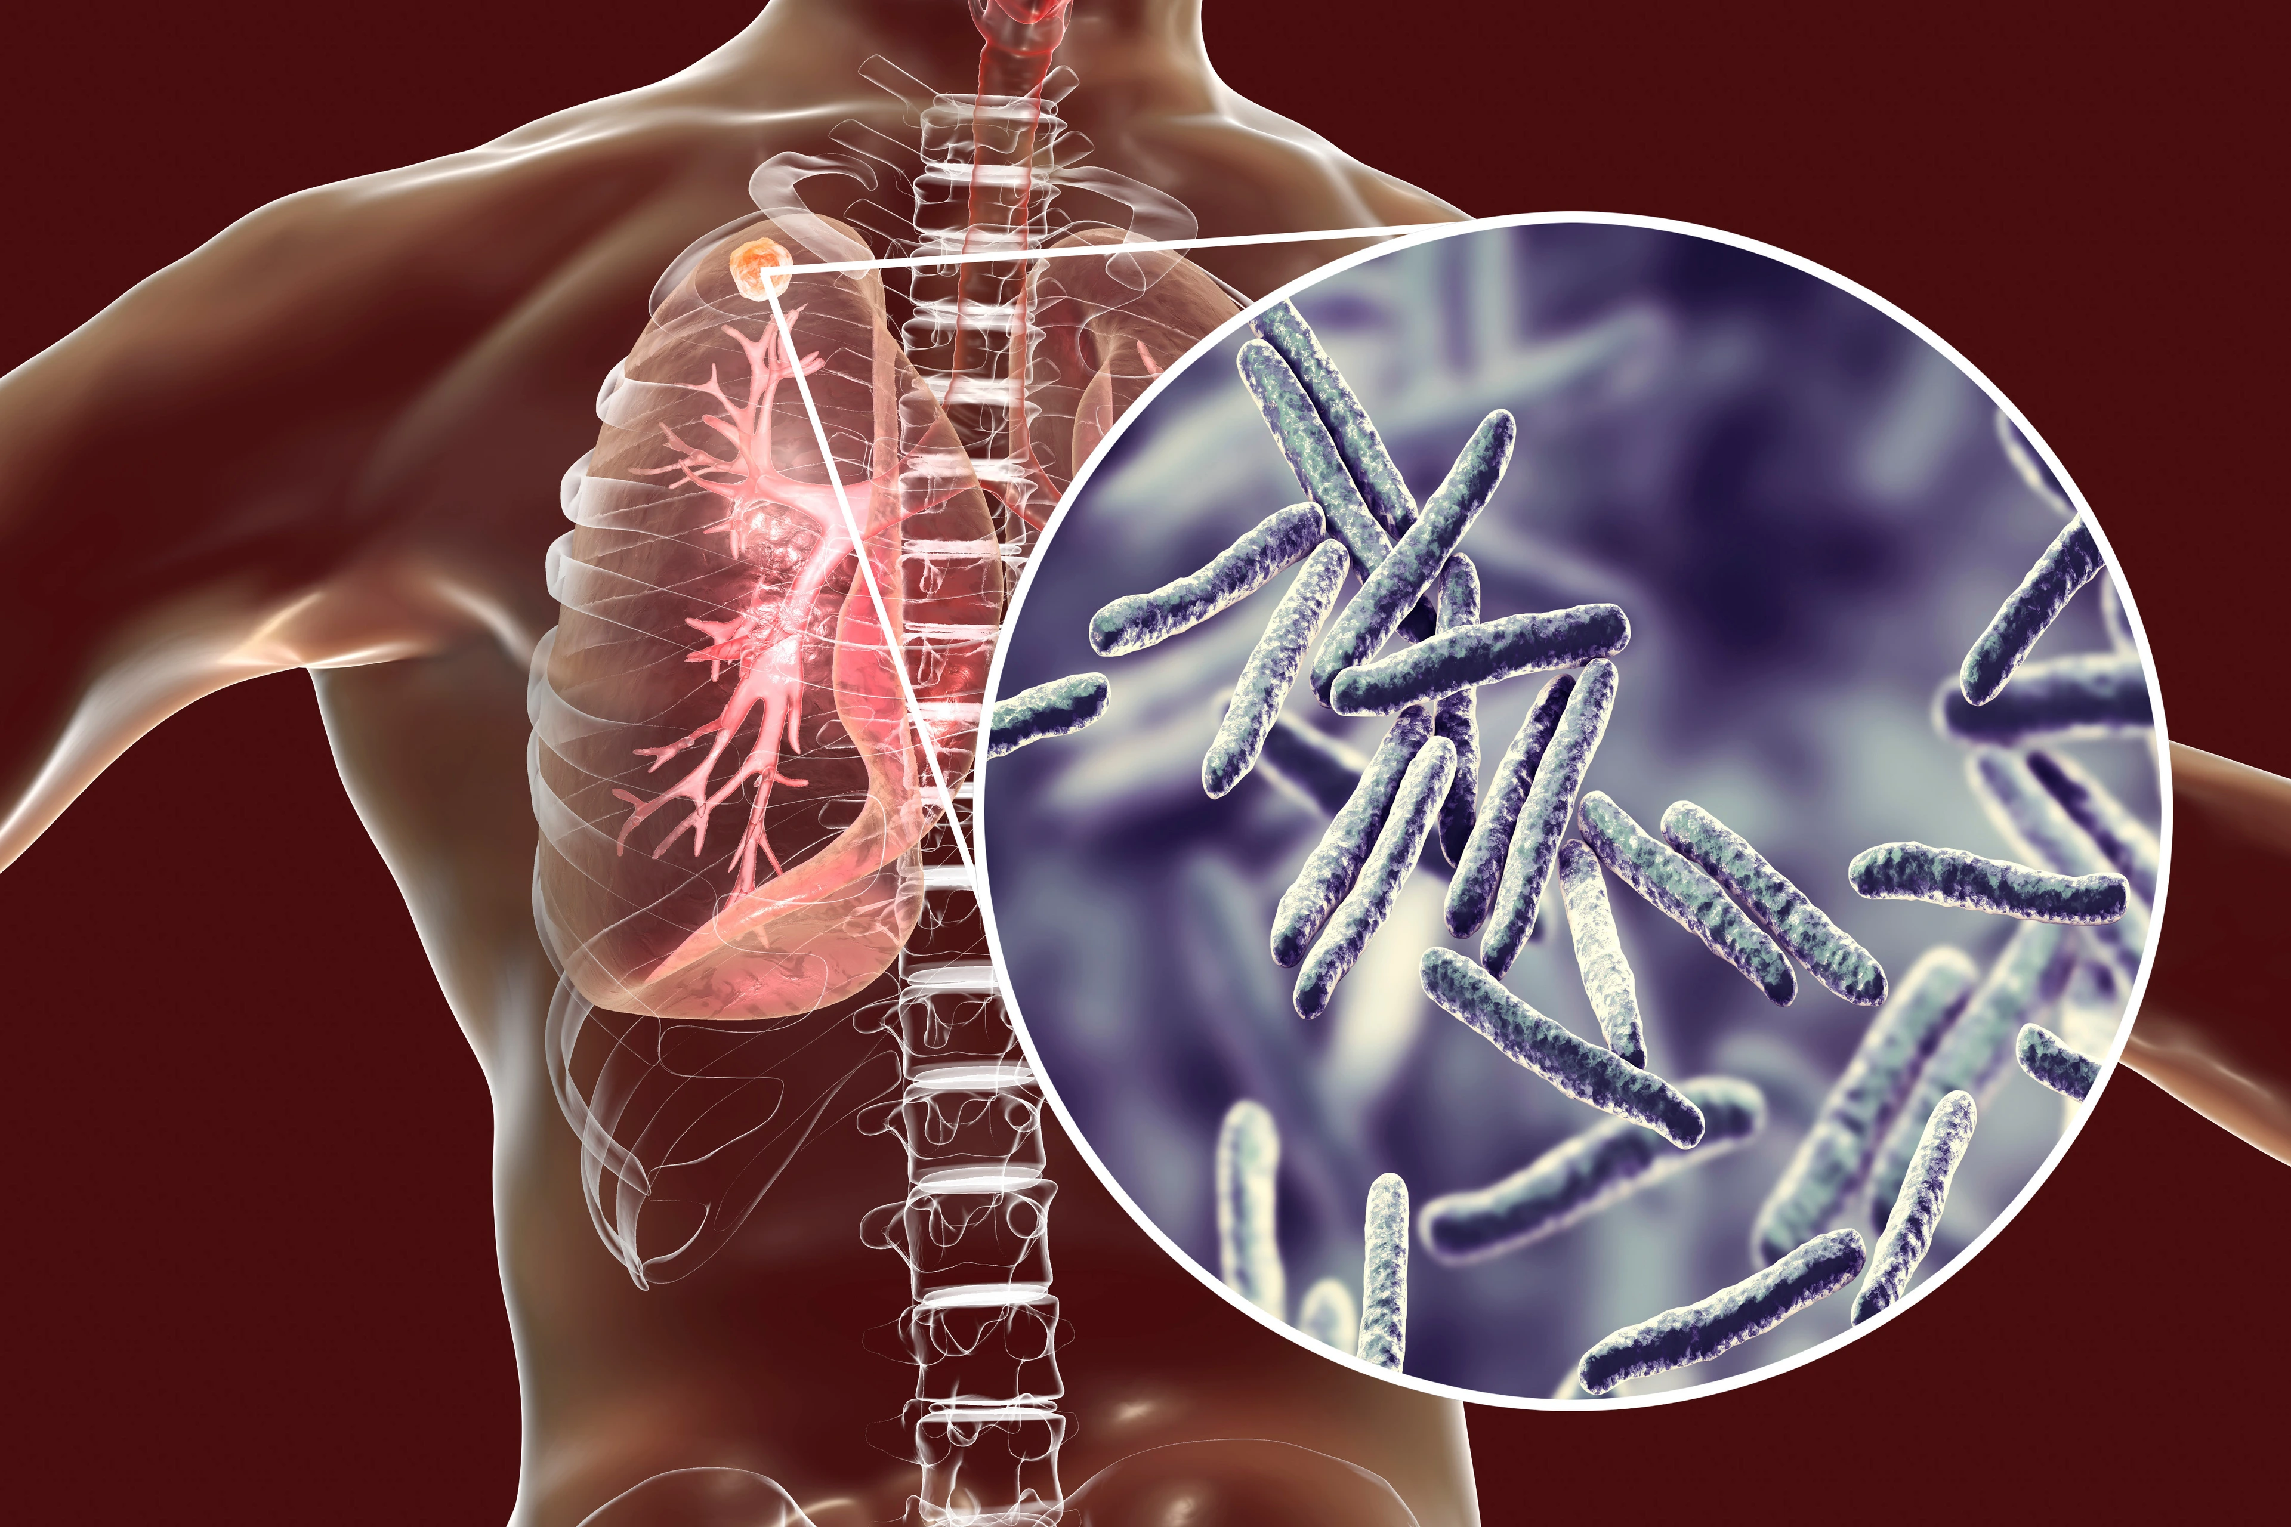
Management of the Long-term condition following a specific UK guidance
The management of Tuberculosis is in line with the UK guidelines, such as NICE standards (Butala et al., 2024).
It comprises systematic treatment, observation and patient care.
Interdisciplinary care enhances much better treatment compliance and health outcomes (Nalunjogi et al., 2023).
Notes:
TB management in the UK is based on NICE, which is more precise in the early diagnosis, standard therapy, and monitoring of the patient. Adherence is achieved through a multidisciplinary approach which incorporates the use of doctors, nurses and public health teams. Directly Observed Therapy (DOT) can be adopted to make patients treated successfully.

Slide 9
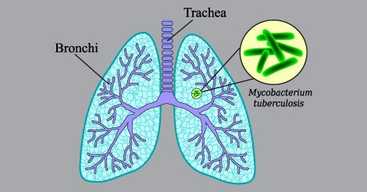
Management of the Long-term condition following a specific UK guidance (Cont.…)
Continuing care involves a regular check on the progress of treatment.
The elements of patient education and adherence are necessary (Valabhji et al., 2024).
The public health practices can be useful in reducing the spread and enhancing the general control of the disease (Dartois and Dick, 2024).
Notes:
Constant observation guarantees the effectiveness of treatment and leads to the early observation of complications. Education educates the patients on higher adherence and relapse prevention. Contact tracing and vaccination programs, taken as a type of public health intervention, have a significant contribution to the containment of TB and the good health results of populations.

Slide 10
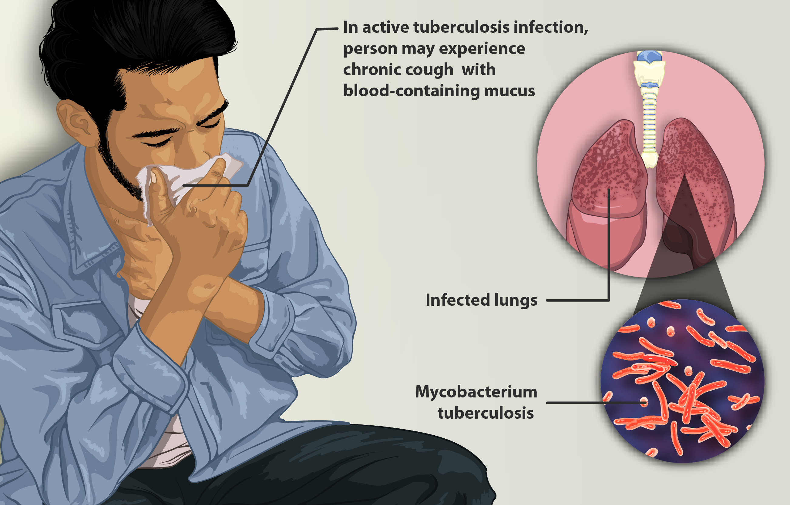
Treatment options available for the long-term condition in the United Kingdom
The treatment of Tuberculosis entails the use of a combination of antibiotics for a number of months (Saunders et al., 2026).
The most popular ones are isoniazid, rifampicin, pyrazinamide and ethambutol (Martinez et al., 2024).
Taking drugs must be adhered to avoid drug resistance.
Notes:
The treatment of TB in the UK normally takes six months, consisting of antibiotics. This is followed by the intensive phase, then a continuation phase. Compliance is necessary to prevent multidrug-resistant TB. Counselling and monitoring assist patients in achieving positive results with the care providers.

Slide 11
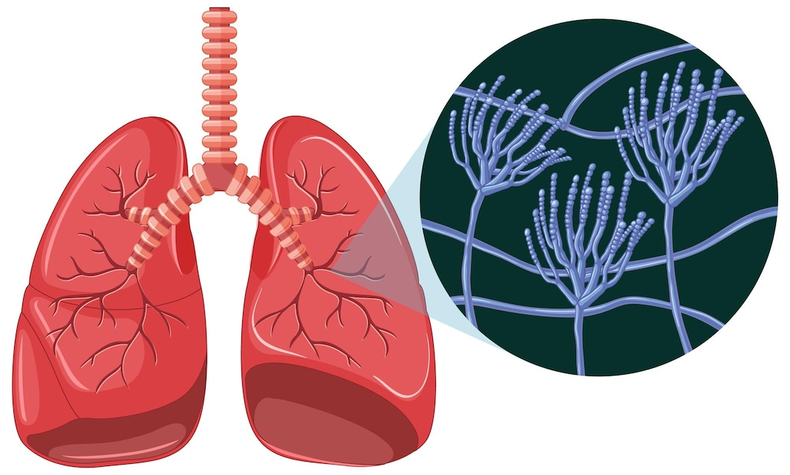
Comorbidities that can accompany the chosen long-term condition
Other health conditions are, in most cases, accompanied by Tuberculosis (Smith, 2026).
The most prominent comorbidities are HIV, diabetes and malnutrition (Jeong and Min, 2023).
Such conditions deteriorate the disease outcomes and make the management of treatment rather hard (Barnes, 2023).
Notes:
TB is often UTI side by side with such diseases as HIV, diabetes, and malnutrition, which undermine the immunity. These comorbidities add to the severity of diseases and make them hard to treat. Both TB and related conditions are important to manage so that patient outcomes have a positive shift, and the mortality rates will decrease.

Slide 12
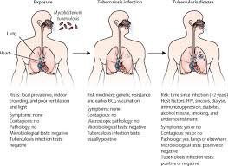
How the chosen long-term condition can be prevented
Strategies of prevention of tuberculosis involve vaccination and early identification (Villar-Hernández et al., 2023).
BCG is given to protect against severe forms partially.
Better living conditions to live and the prevention of the infection lower the risks of its spread (WHO, 2024).
Notes:
The strategies that are used in prevention entail Vaccination, early diagnosis and treatment of active cases in the prevention of BCG. This should be improved by improving the living conditions, lessening overcrowding, and enhancing hygiene. Screening high-risk populations constitutes the improvement of TB spread in the UK and worldwide through the provision of short-term measures by the state and other stakeholders.

Slide 13

Skills, values and behaviours required to provide co-productive care to a person suffering from a long-term condition
Medical staff require the ability to communicate and empathise, and they also require cultural sensitivity skills (Roberts and Buikstra, 2025).
The partnership and shared decision-making are promoted by patient-centred care.
Ethical practice, respect, and trust enhance adherence and patient outcomes of treatment (WHO, 2022).
Notes:
To manage TB, caregivers and patients are supposed to interact correctly, treat the patient with empathy and cultural competence. Co-productive care entails decision-making by patients. Respect and ethical practice, teamwork ought to be expressed by healthcare professionals. Trust results in compliance with an intervention and a more positive health outcome in the long-term period.

Slide 14
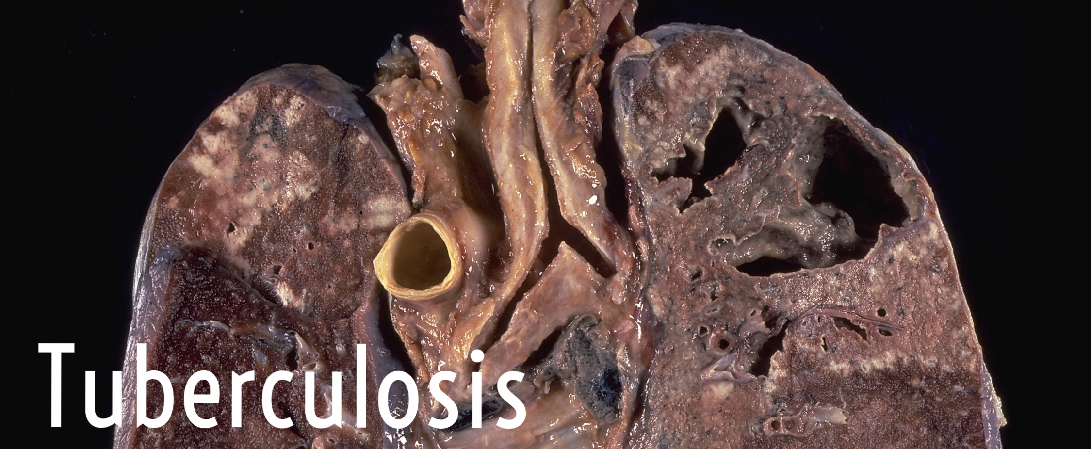
Recommendations
Gather the efforts on raising awareness and early screening efforts in the whole world (WHO, 2025).
Improve the accessibility of treatment and healthcare (Li et al., 2023).
Invest in researches and innovations to raise the rates of prevention and management of tuberculosis (Nafisah and Muhammad, 2024).
Notes:
Among the recommendations, increasing the level of population awareness is offered, early detection is encouraged, and access to healthcare is also recommended. The governments need to invest in research and novel treatment. Community-based support systems and social determinants of health will go a long way in alleviating TB in the world.

Slide 15
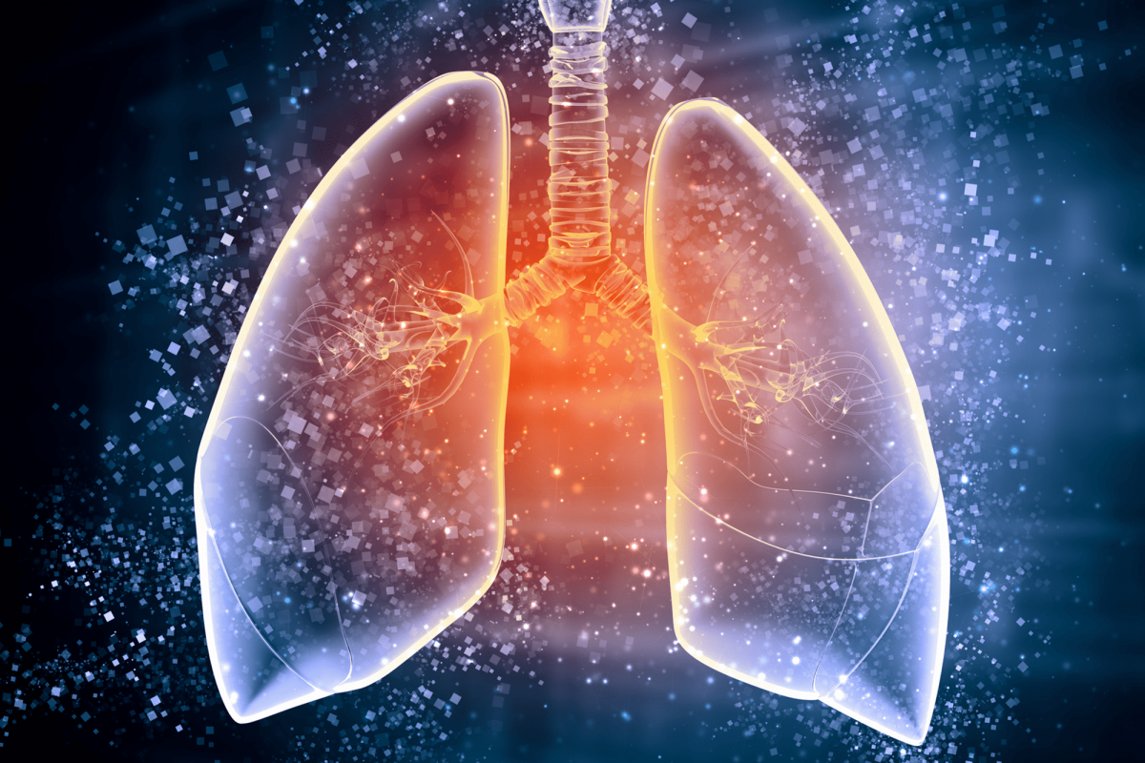
Recommendations (Cont.…)
Empower multidisciplinary work in the healthcare systems.
Risk target populations and reduce the health disparities (Vasiliu et al., 2024).
Such a step as setting up policies indicating the sustainable management of TB and improved patient outcomes on the worldwide level has to be made (Boadu et al., 2024).
Notes:
Other recommendations include the strengthening of the multidisciplinary healthcare and its orientation towards the vulnerable population. Social inequalities ought to be addressed through policies that will result in equal healthcare access. The management of TB is a long-term activity that necessitates the interplay of governments, healthcare providers, and society in ensuring that the long-term gains are realised.

Slide 16
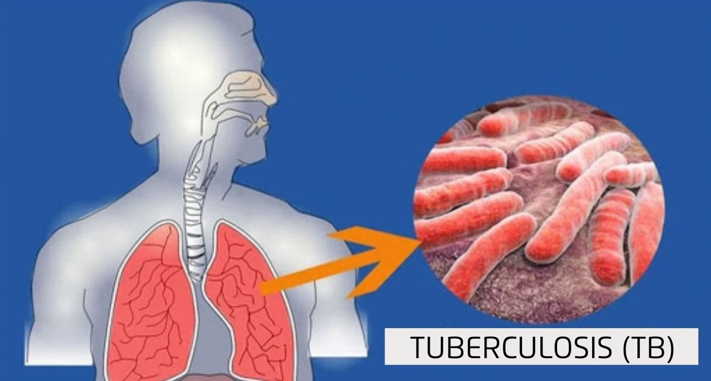
Conclusion
The problem of Tuberculosis is still an issue that affects world health.
Proper prevention, diagnosis, and management techniques are needed.
Teamwork has the potential to diminish disease load and enhance the quality of life of patients to a great extent.
Notes:
TB remains a severe public health problem on the international level and in the UK. There is a need to get general solutions which consider prevention of it, early diagnosis and proper treatment. Collaboration with the healthcare systems, governments and the communities is necessary to ensure that the rate of TB is reduced and that the outcomes of patients are improved.

Slide 17
Reference List
Allwood, B.W., Nightingale, R., Agbota, G., Auld, S., Bisson, G.P., Byrne, A., Dunn, R., Evans, D., Hoddinott, G., Günther, G. and Islam, Z., 2024. Perspectives from the 2nd International Post-Tuberculosis Symposium: mobilising advocacy and research for improved outcomes. IJTLD open, 1(3), pp.111-123. http://dx.doi.org/10.5588/ijtldopen.23.0619
Barnes, D.S., 2023. The making of a social disease: Tuberculosis in nineteenth-century France. Univ of California Press.
Berrocal-Almanza, L.C., Harris, R.J., Collin, S.M., Muzyamba, M.C., Conroy, O.D., Mirza, A., O'connell, A.M., Altass, L., Anderson, S.R., Thomas, H.L. and Campbell, C., 2022. Effectiveness of nationwide programmatic testing and treatment for latent tuberculosis infection in migrants in England: a retrospective, population-based cohort study. The Lancet Public Health, 7(4), pp.e305-e315. https://www.thelancet.com/journals/lanpub/article/PIIS2468-2667(22)00031-7/fulltext
Boadu, A.A., Yeboah-Manu, M., Osei-Wusu, S. and Yeboah-Manu, D., 2024. Tuberculosis and diabetes mellitus: The complexity of the comorbid interactions. International Journal of Infectious Diseases, 146, p.107140. https://doi.org/10.1016/j.ijid.2024.107140
Butala, C.B., Cave, R.N.R., Fyfe, J., Coleman, P.G., Yang, G.J. and Welburn, S.C., 2024. Impact of COVID-19 on the neglected tropical diseases: a scoping review. Infectious Diseases of Poverty, 13(1), p.55. https://doi.org/10.1186/s40249-024-01223-2
Dartois, V. and Dick, T., 2024. Therapeutic developments for tuberculosis and nontuberculous mycobacterial lung disease. Nature Reviews Drug Discovery, 23(5), pp.381-403. https://doi.org/10.1038/s41573-024-00897-5
Goletti, D., Meintjes, G., Andrade, B.B., Zumla, A. and Lee, S.S., 2025. Insights from the 2024 WHO global tuberculosis report–more comprehensive action, innovation, and investments required for achieving WHO end TB goals. International Journal of Infectious Diseases, 150. https://doi.org/10.1016/j.ijid.2024.107325
Jeong, Y. and Min, J., 2023. Impact of COVID-19 pandemic on tuberculosis preventive services and their post-pandemic recovery strategies: a rapid review of literature. Journal of Korean Medical Science, 38(5). https://doi.org/10.3346/jkms.2023.38.e43
Khunti, K., Chudasama, Y.V., Gregg, E.W., Kamkuemah, M., Misra, S., Suls, J., Venkateshmurthy, N.S. and Valabhji, J., 2023. Diabetes and multiple long-term conditions: a review of our current global health challenge. Diabetes Care, 46(12), pp.2092-2101. https://doi.org/10.2337/dci23-0035
Kunst, H., Lange, B., Hovardovska, O., Bockey, A., Zenner, D., Andersen, A.B., Hargreaves, S., Pareek, M., Friedland, J.S., Wejse, C. and Bothamley, G., 2025. Tuberculosis in adult migrants in Europe: a TBnet consensus statement. European Respiratory Journal, 65(3), p.2401612. https://doi.org/10.1183/13993003.01612-2024
Li, L.S., Yang, L., Zhuang, L., Ye, Z.Y., Zhao, W.G. and Gong, W.P., 2023. From immunology to artificial intelligence: revolutionizing latent tuberculosis infection diagnosis with machine learning. Military Medical Research, 10(1), p.58. https://doi.org/10.1186/s40779-023-00490-8
Martinez, L., Gray, D.M., Botha, M., Nel, M., Chaya, S., Jacobs, C., Workman, L., Nicol, M.P. and Zar, H.J., 2023. The long-term impact of early-life tuberculosis disease on child health: a prospective birth cohort study. American Journal of Respiratory and Critical Care Medicine, 207(8), pp.1080-1088. https://doi.org/10.1164/rccm.202208-1543OC
Martinez, L., Seddon, J.A., Horsburgh, C.R., Lange, C., Mandalakas, A.M., Seddon, J., Liu, Q., Villaorduna, C.A., Bonnet, M., Carvalho, A.C.C. and Chan, P.C., 2024. Effectiveness of preventive treatment among different age groups and Mycobacterium tuberculosis infection status: a systematic review and individual-participant data meta-analysis of contact tracing studies. The Lancet Respiratory Medicine, 12(8), pp.633-641. https://doi.org/10.1016/S2213-2600(24)00083-3
Meghji, J., Auld, S.C., Bisson, G.P., Khosa, C., Masekela, R., Navuluri, N. and Rachow, A., 2025. Post-tuberculosis lung disease: towards prevention, diagnosis, and care. The Lancet Respiratory Medicine, 13(5), pp.460-472. https://doi.org/10.1016/S2213-2600(24)00429-6
Menzies, N.A., Allwood, B.W., Dean, A.S., Dodd, P.J., Houben, R.M., James, L.P., Knight, G.M., Meghji, J., Nguyen, L.N., Rachow, A. and Schumacher, S.G., 2023. Global burden of disease due to rifampicin-resistant tuberculosis: a mathematical modeling analysis. Nature Communications, 14(1), p.6182. https://doi.org/10.1038/s41467-023-41937-9
Menzies, N.A., Swartwood, N.A., Cohen, T., Marks, S.M., Maloney, S.A., Chappelle, C., Miller, J.W., Asay, G.R.B., Date, A.A., Horsburgh, C.R. and Salomon, J.A., 2024. The long-term effects of domestic and international tuberculosis service improvements on tuberculosis trends within the UK: a mathematical modelling study. The Lancet Public Health, 9(8), pp.e573-e582. https://www.thelancet.com/journals/lanpub/article/PIIS2468-2667(24)00150-6/fulltext
Nafisah, S.I. and Muhammad, G., 2024. Tuberculosis detection in chest radiograph using convolutional neural network architecture and explainable artificial intelligence. Neural Computing and Applications, 36(1), pp.111-131. https://doi.org/10.1007/s00521-022-07258-6
Nalunjogi, J., Mucching-Toscano, S., Sibomana, J.P., Centis, R., D'Ambrosio, L., Alffenaar, J.W., Denholm, J., Blanc, F.X., Borisov, S., Danila, E. and Duarte, R., 2023. Impact of COVID-19 on diagnosis of tuberculosis, multidrug-resistant tuberculosis, and on mortality in 11 countries in Europe, Northern America, and Australia. A Global Tuberculosis Network study. International Journal of Infectious Diseases, 130, pp.S25-S29. https://doi.org/10.1016/j.ijid.2023.02.025
Network, G.T., Casco, N., Jorge, A.L., Palmero, D.J., Alffenaar, J.W., Fox, G.J., Ezz, W., Cho, J.G., Denholm, J., Skrahina, A. and Solodovnikova, V., 2023. Long-term outcomes of the global tuberculosis and COVID-19 co-infection cohort. European Respiratory Journal, 62(5). https://publications.ersnet.org/content/erj/62/5/2300925.abstract
Nightingale, R., Carlin, F., Meghji, J., McMullen, K., Evans, D., Van Der Zalm, M.M., Anthony, M.G., Bittencourt, M., Byrne, A., Du Preez, K. and Coetzee, M., 2023. Post-TB health and wellbeing. The International Journal of Tuberculosis and Lung Disease, 27(4), p.248. https://doi.org/10.5588/ijtld.22.0514
Roberts, C.A. and Buikstra, J.E., 2025. The bioarchaeology of tuberculosis: a global view on a reemerging disease. University Press of Florida.
Saunders, M.J., Boccia, D., Khan, P.Y., Goscè, L., Gasparrini, A., Clark, R.A., Pescarini, J.M., Charalambous, S., Fekadu, L., da Costa Johansen, F.D. and Vasilyeva, I., 2026. Climate change and tuberculosis: an analytical framework. The Lancet Respiratory Medicine, 14(3), pp.267-280. https://doi.org/10.1016/S2213-2600(25)00329-7
Smith, F.B., 2026. The retreat of tuberculosis 1850–1950. Taylor & Francis.
Valabhji, J., Barron, E., Pratt, A., Hafezparast, N., Dunbar-Rees, R., Turner, E.B., Roberts, K., Mathews, J., Deegan, R., Cornelius, V. and Pickles, J., 2024. Prevalence of multiple long-term conditions (multimorbidity) in England: a whole population study of over 60 million people. Journal of the Royal Society of Medicine, 117(3), pp.104-117. http://dx.doi.org/10.1177/01410768231206033
Vasiliu, A., Martinez, L., Gupta, R.K., Hamada, Y., Ness, T., Kay, A., Bonnet, M., Sester, M., Kaufmann, S.H., Lange, C. and Mandalakas, A.M., 2024. Tuberculosis prevention: current strategies and future directions. Clinical Microbiology and Infection, 30(9), pp.1123-1130. https://doi.org/10.1016/j.cmi.2023.10.023
Villar-Hernández, R., Ghodousi, A., Konstantynovska, O., Duarte, R., Lange, C. and Raviglione, M., 2023. Tuberculosis: current challenges and beyond. Breathe, 19(1). https://doi.org/10.1183/20734735.0166-2022
Wang, Q., Guo, S., Wei, X., Dong, Q., Xu, N., Li, H., Zhao, J. and Sun, Q., 2022. Global prevalence, treatment and outcome of tuberculosis and COVID-19 coinfection: a systematic review and meta-analysis (from November 2019 to March 2021). BMJ open, 12(6), p.e059396. http://dx.doi.org/10.1136/bmjopen-2021-059396
WHO, 2022. WHO consolidated guidelines on tuberculosis. Module 5: management of tuberculosis in children and adolescents. World Health Organization.
WHO, 2024. WHO operational handbook on tuberculosis. Module 1: prevention-tuberculosis preventive treatment. World Health Organization.
WHO, 2025. WHO consolidated guidelines on tuberculosis. Module 4: treatment and care. World Health Organization.

Slide 18


