Slide 1


Training and Development needs for an HR officer
Name: Vladimir Totev (2024467)
Lecturer: Rexon Nting
Module: DRW – BMSW 5102-A1
Programme: BA Leadership And Management Skills for the WorkPlace

Slide 2
Table of Contents
Introduction
Key Expectations of HR
KSB Addressed to Company’s Development
Performance Management Cycle
SWOT Analysis and Skills Audit
Benefits Of Training
Conclusion
Refferences + Appendix C

Slide 3


INTRODUCTION
Established after the lockdown 2021 with simply one aim: to produce and deliver high quality traditional organic yogurt
Our product is unique for the UK market regarding the special bacteria that we use in the yogurt, which is called: Bacillicus Bulgaricus, that makes it natural pro biotic
Product with potential endless benefits
Small scale yogurt company growing on the Dorset Market
Currently staff of 5
Sourcing our raw milk from Jersey cow breed only
Notes:
Our Product Name is Bournemouth Yogurt, it is targeted to the local Community Serving and Supporting since 2021
We Source our Bacteria from One Specific Bulgarian Region, that is what makes our product unique.

Slide 4
Key Expectations for me as HR officer in Trade Planet
Developing an environment and experience that promotes employee engagement.
The HR department is supposed to improve the business they support.
Advise and apply polices relating to the organisation and staff in this organization.
Notes:
By empowering individuals to make the most of their abilities, realize their potential for the good of the business and themselves, and find fulfilment in their job, it plays a crucial role

Slide 5
KSB addressed to Trade Planet’s design and development
People analytics – analyzing Trade Planet staff potential to grow
Workforce planning – Planning the Whole process from Manufacturing to Distribution and Orders collection
Recruitment and selection – Hiring high quality specialist for the production
Learning and development – The staff must be aware of the exact
Performance management – High standard for Quality
Employment relations – Fair working rota, good community engagement
Employee wellbeing – Analyzing the staff fatigue, mood and motivation
Health and safety, compliance with legal requirements,
Handling employment law issues, and HR administration
Notes:
To determine how effective the HR function is at both the strategic level and in terms of service delivery and support, it is vital to assess its contribution.
The ability of the function to operate strategically and its capacity to provide the requisite levels of services are the main criteria for evaluating my HR responsibilities and results

Slide 6
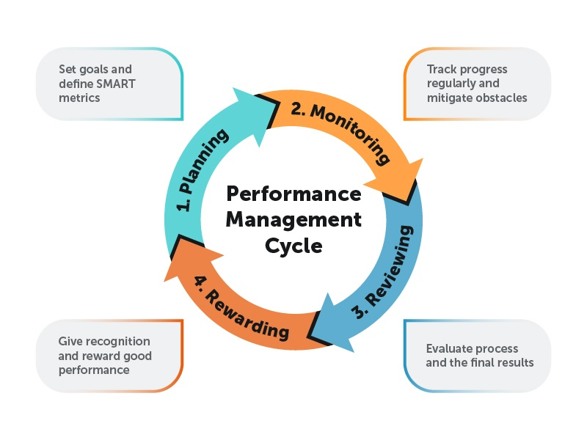
Implementing Performance Management Cycle will improve the Process
Planning
Monitoring
Reviewing
Rewarding

Slide 7
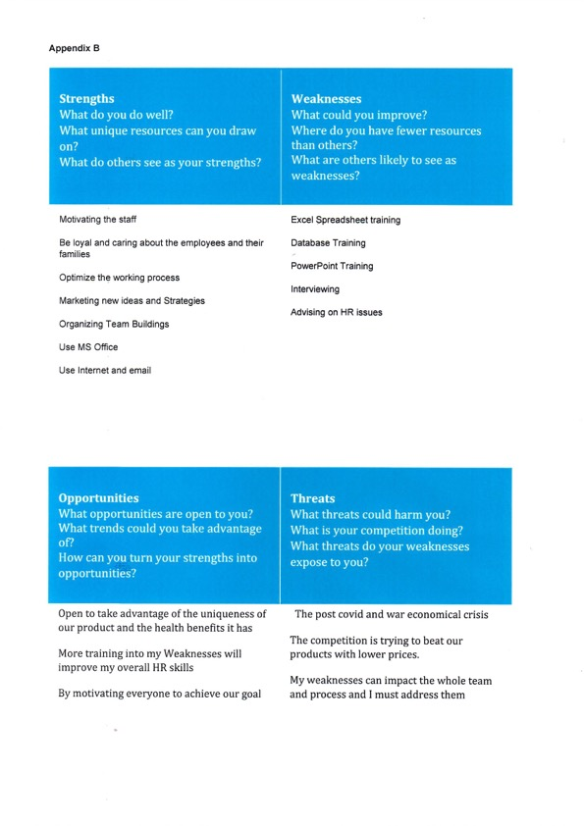
Personal skills Audit

Slide 8

Skills Audit
Improve My Excel spreadsheet skills
Improve to very good the use of Specialist HR Software
Improve my Interviewing and HR Advising Skills
Improve the use of Database
Handle the complex data better

Slide 9
Benefits of training for HR specialist
As an HR specialist I masters myself on Excel spreadsheets and using properly database with staff, payroll etc.
Use the Trade Planet’s software for optimizing the working process(orders , deliveries, payroll, rotas etc.
Conducting better advertisement and improving interviewing questions to the candidates
Mindful of considering the ideas of others to help solve any problems within company
Meeting the standards and procedures within the company more detailed

Slide 10
Benefits of training for Trade Planet LTD
save time and money
attract top talent,
strengthen the onboarding process,
enhance employee benefits,
decrease compliance difficulties,
boost employee retention,
secure top personnel.

Slide 11
Conclusion
I need to cover certain expectations with Trade Planet LTD.
I need to perform good quality of KSB and be aware of organization’s standards and procedures.
SWOT analysis conducted and I understand my pros and cons as an HR on certain areas
Benefits of the training and development after the analysis.
Reflection of the training to the working process
Evaluation of HR specialist key expectation

Slide 12

References
Armstrong, M. and Taylor, S. (2017). Armstrong’s handbook of human resource management practice. 15th ed. New York: Kogan Page.
‌Mullins, L.J. and Mclean, J.E. (2019). Organisational Behaviour in the Workplace. 12th ed. Harlow, England ; New York: Pearson.
Adams, J. (2007). Managing people in organizations : contemporary theory and practice. Basingstoke, Hampshire: Palgrave Macmillan.
Williams, K. (2006). Introducing management [electronic resource]. Amsterdam, London: Butterworth-Heinemann.

Slide 13


