Slide 1
Role of the Events Manager
and the skills required.
Elenid Marsh- 1800819.

Slide 2
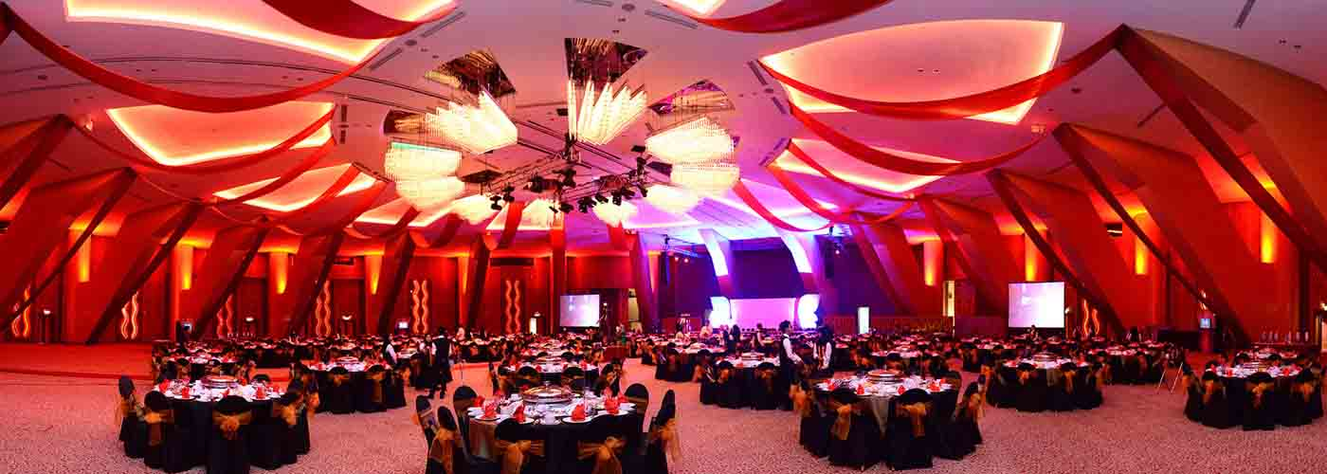
Introduction.
For a successful event to take place, all the roles in this industry must come together to create the event to be able to meet the customer’s needs.
Before the event, during the event and after the event takes place.
Event Management organisation has many layers and is varied. It contains various steps of management and consideration.
Different events needs different roles / workers.

Slide 3
The different roles in the event industry.
The list of roles in this industry goes on and on. Such as:
Event Operations Manager
Conference Planner
Event Planner
Marketing Coordinator
Executive Assistant
Sponsorship Coordinator
Development Director
Campaign and Event Coordinator
Event management is not a simple career as it is not based on one thing.
The event industry relies on everyone coming together internally and externally.

Slide 4
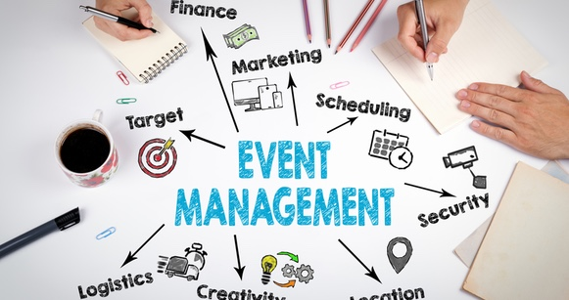
Skills required…
To be successful in this work industry you must have
Organisational skills
Communication skills
Time-management skills
The ability to work under pressure
Finding solutions to problems
Being creative
Budgeting
The basic Planning and organising
“Many people involved in the event management industry find themselves juggling multiple projects daily, with crazy deadlines and challenging obstacles”.
McCrae . L(2012)

Slide 5
“Event management is a powerful blend of creative and technical skills, essential for the creation and delivery of any live experience”
[Armstrong.L]

Slide 6
Planning the Event.
One of the main skills in this industry is the knowledge in planning the event.
One thing every event has in common is the planning and strategies behind them.
The model by Masterman (2009) will help you to re-sure satisfied customers and to prove you have achieved your aims and objectives.
Planning events is the most important thing to do.
Why we plan?
What if we don’t plan?
They will engage in the process of producing a successful event and happy customers that return.
“They dominate the media, fill transport systems, hotels and venues, meet business objectives,
motivate communities and create positive and negative impacts”.
Bowdin.G (2012).

Slide 7

The Setup of an event.
The importance of setup before an event.
Clients must enquire about how much time they will need to set up, as this is critical.
This includes the health and safety aspect as well as ensuring that there is enough time to run full rehearsals and technical cues.

Slide 8

Shut-down
What is shutdown?
Why do you need this?
May consider an Event cleaning services.

Slide 9

The Event industry in years to come…
By today, more people are demanding more events on a regular basis and the number of attendees are increasing based on technology, which proves in the future there will be a growth in the job requests.
Trends will change.
Sustainability-Focused- energy efficiency.
Harder to plan totally different events that hasn’t happened?

Slide 10
Overview…
As this presentation has shown:
There isn’t just 1 role in the event management industry.
Requires many skills and abilities.
It requires your role from start to finish.

Slide 11
References..
Mccrae.L (2012) Available at - http://www.themarketingsite.com
Armstrong. L.
Bowdin.G (2012) Available at Events management. Routledge.
Masterman (2009) – The planning Process.

Slide 12
Thank you for listening!

