Slide 1
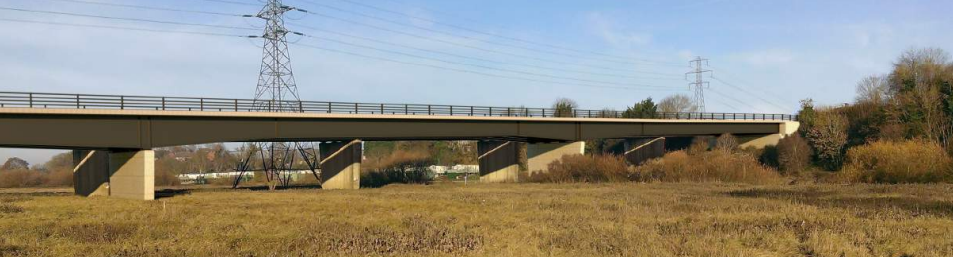
Environmental Impact Assessment Evaluation for the A4440 Worcester Southern Link Road Phase 4
MSc Environmental Conservation and Management
Energy and Resource Management (ACBA7004)
June 2021
John Hitchens (2007360)
(WCC 2017a)
(Herrmann 2012)

Slide 2
Contents
3. Case Study: Worcester Southern Link Road Phase 4 – A4440
4. Some Main Areas of Consideration
5. Consultation
6. Theory and Practice
7. Mitigation, Monitoring, and Alternatives
8. Mitigation, Monitoring, and Alternatives Continued
9. Conclusion
10. References

Slide 3

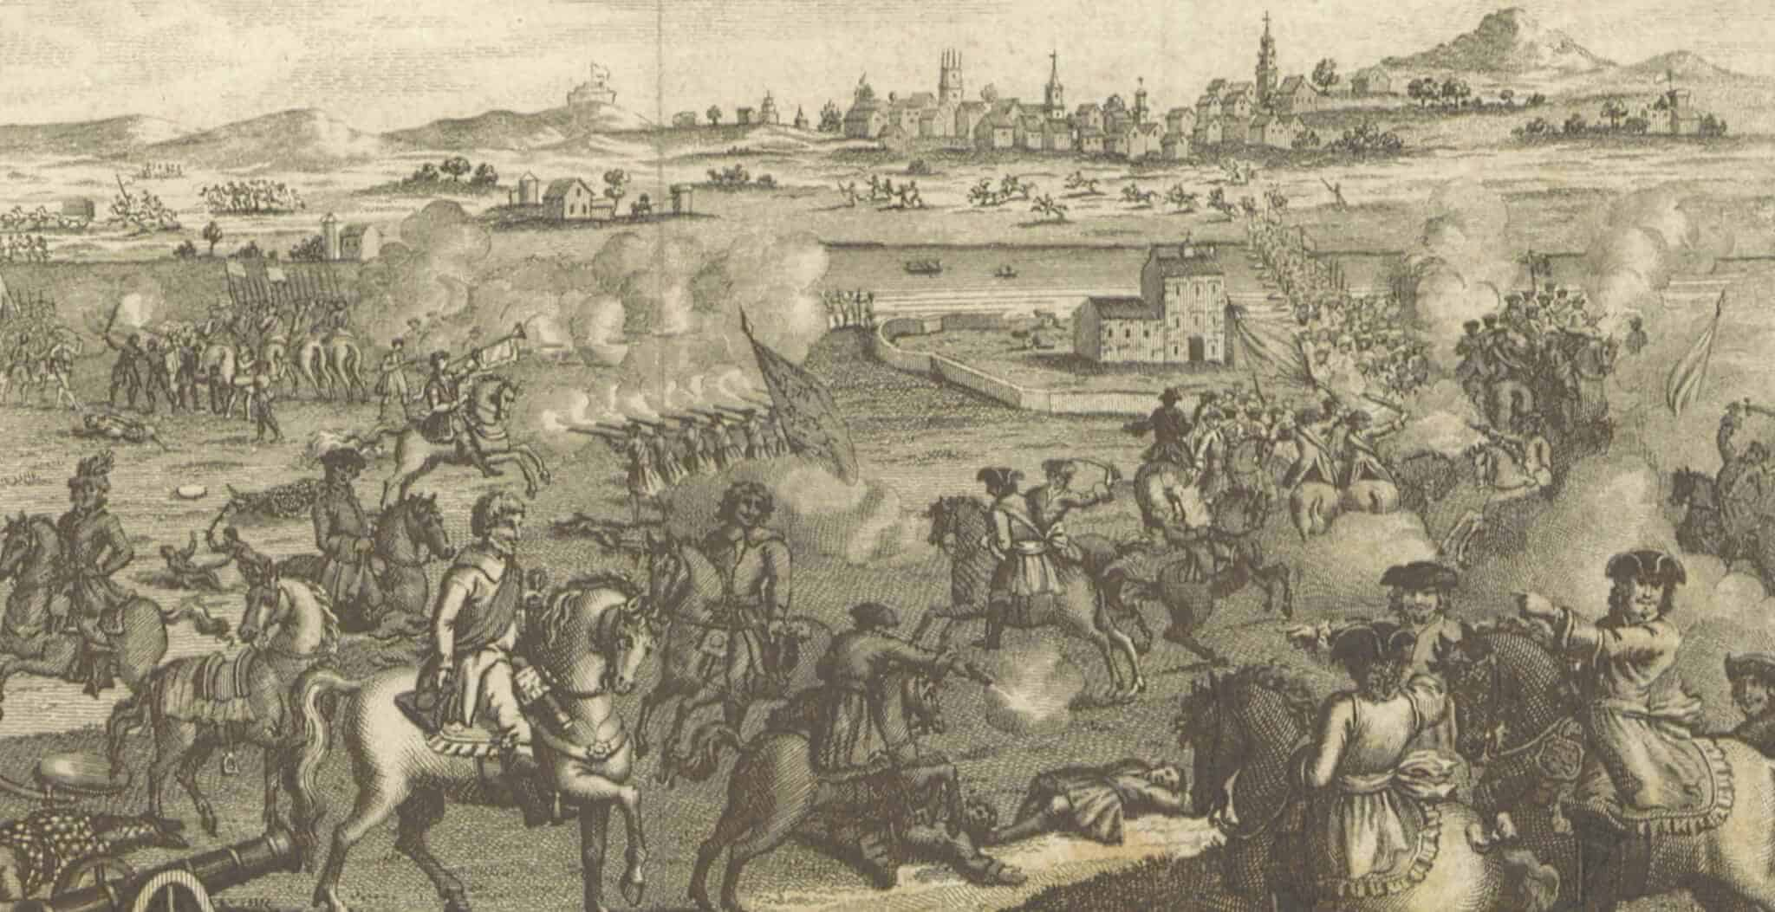
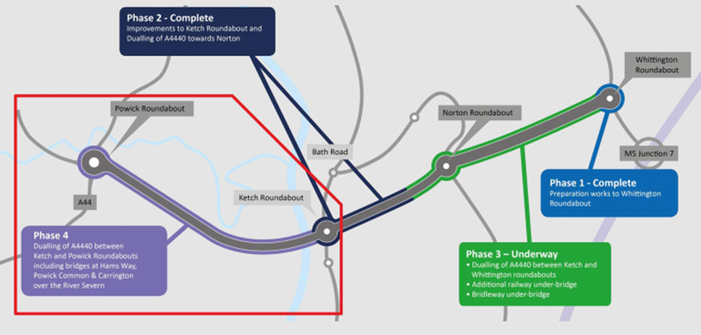
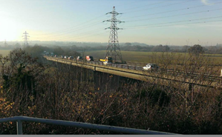
Worcester Southern Link Road Phase 4 – A4440
WCC 2017b
Worcestershire County Council
Upgrade of Southern Link Road from single to dual-carriageway
Reduce through traffic/pollution in Worcester City Centre
Relieve congestion/increase attractiveness to motorists
Improved rights of way, pedestrian and cycle bridges
River Teme SSSI
River Severn Local Wildlife Site
Powick Conservation Area
Registered Battlefields 1642 & 1651
Scheduled Ancient Monument- Powick Bridge
WCC 2017b

Slide 4
June 2017- Public Consultation/Exhibition
- General information about the project with feedback forms, questionnaires
June 2017 - An Environmental Liaison Group (ELG) meeting:
to confirm the scope of the EIA and develop the proposals for Planning Submission
Further Groups: ‘Regular’ meetings
- Local Authority Liaison Group
- Community Liaison Group
- Formal discussion with landowners, tenants, and representatives
June-October 2017 - Consultation has continued through meetings, site visits, email communication and telephone calls:
Including:
Hawkins Estate, Highways England, Ketch Caravan Park and Moorings, Malvern Hills AONB, Malvern Hills District Council, Natural England, Western Power and Distribution, Worcester City Council, Worcestershire Archive and Archaeological Service
September 2017 - The Draft ES was circulated to external consultees
Public Notices:
November 2017, February 2018, April 2018
Full-time Public Liaison Officer
Consultation

Slide 5
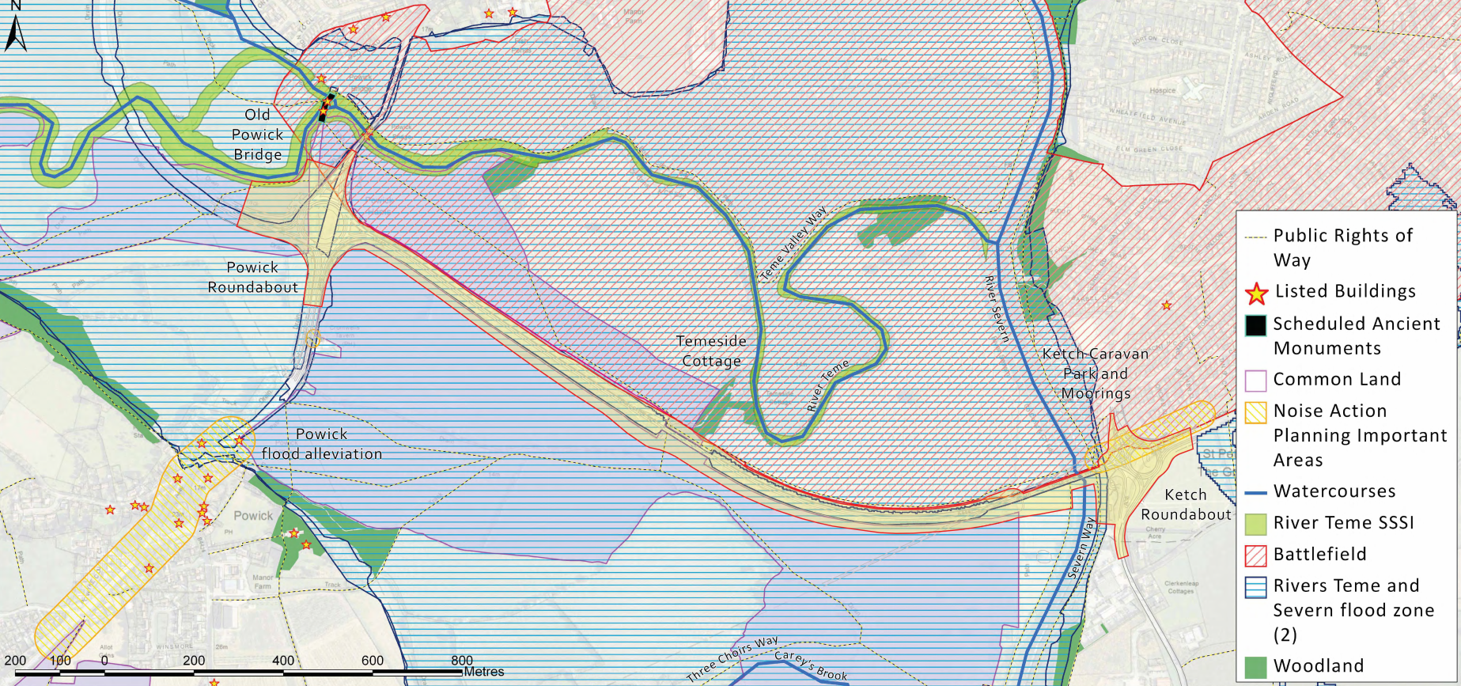
From Consultation Process
• Protection of the River Teme SSSI from pollution during construction and run-off during operations
• Views of the site from sensitive receptors, the Malvern Hills AONB and the viewpoint at the Ketch Roundabout
• Location of relocated Ketch viewpoint
• General construction impacts and traffic management
• Potential impacts related to Air Quality
• Impacts on the registered Battlefield to the north
• Flooding and flood
compensation
• Design of Hams Way
Cycle and Footbridge
• Width of shared
cycleway/footpath
• Drainage of the site
WCC 2017c
Some Main Areas of Consideration

Slide 6
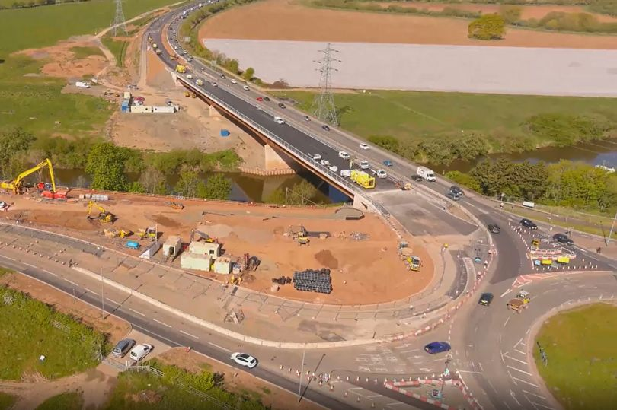
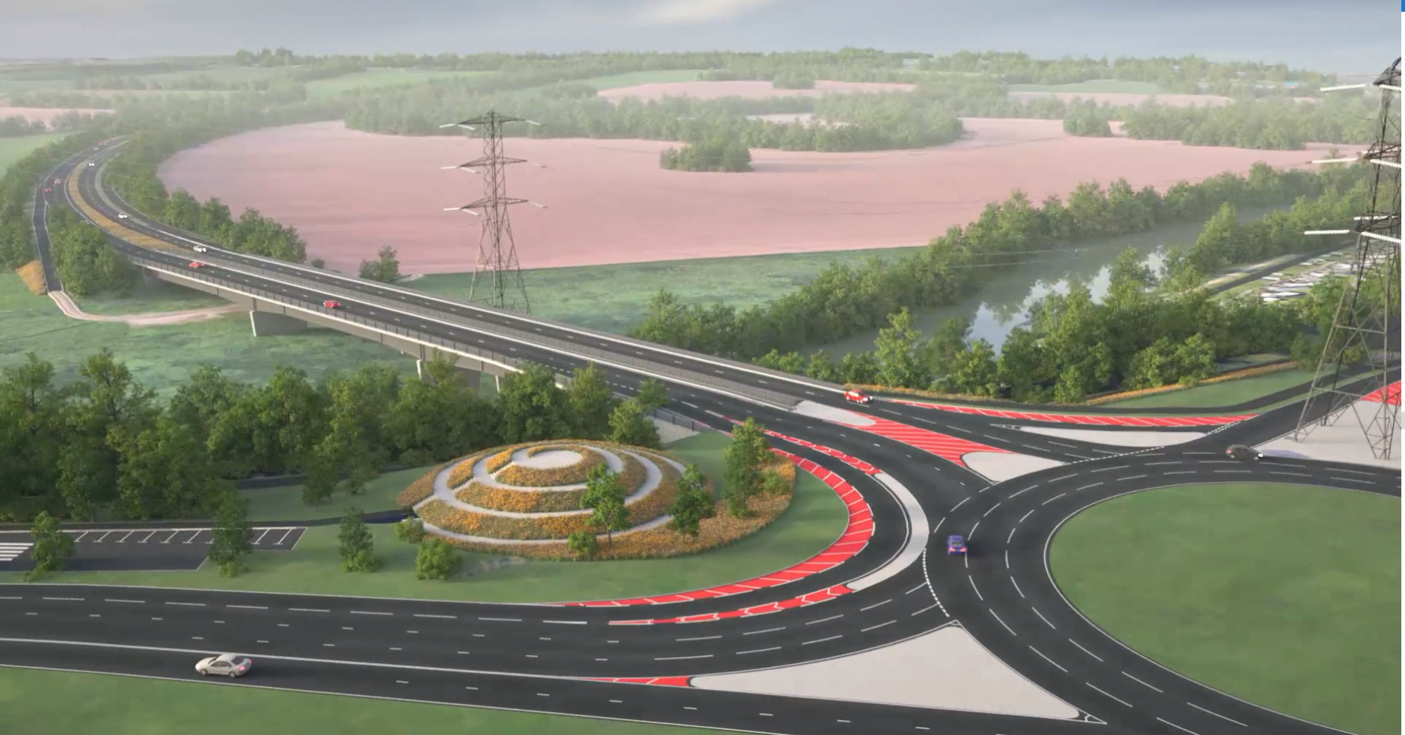
Theory & Practice
(Lawson 2020)
Based on The Town and Country Planning (Environmental Impact Assessment) Regulations 2011 due to transitional provisions. Initiation of project prior to 2017 Regulations coming into force.
Environmental Impact Assessment | Project Reality
Scoping Process Followed | Self-addressed thorough scoping
Production of Environmental Statement | Thorough, broad ranging ES by qualified experts
Production of Non-Technical Summary | Easily Accessible NTS
Biodiversity (No net-loss 2011/net-gain 2017) | Loss of woodland compensated with wetland
Conservation of Habitats and Species Regulations 2010 | Licences, monitoring, surveys completed appropriately
Consultation | Consultation throughout with public, stakeholders and statutory bodies
Tyler 2021
Griffiths 2017

Slide 7
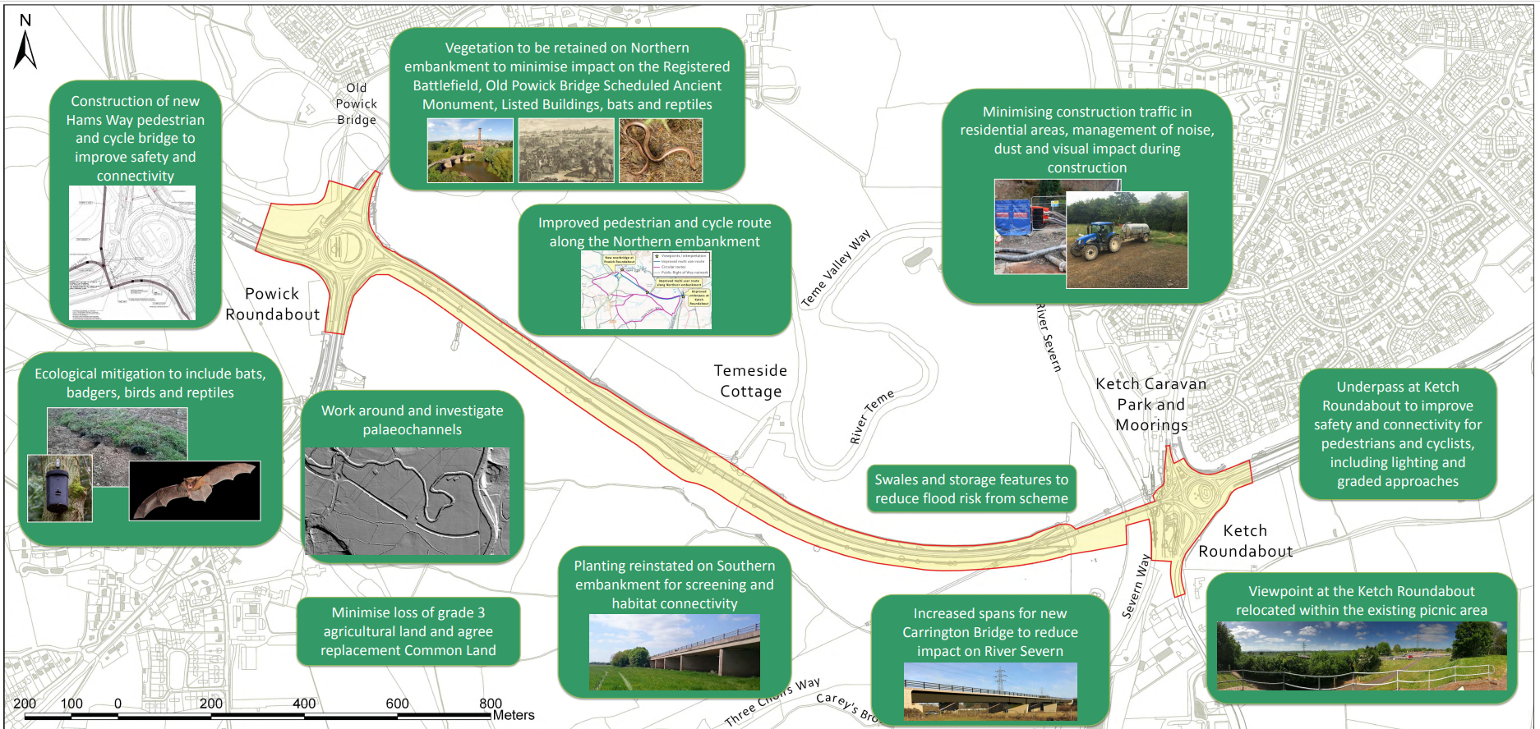
Mitigation and Compensation
-Destruction of badger sett:
Artificial replacement sett
-Felling of tree with bat roost:
Licenced by Natural England, bat boxes
-Removal of woodland:
Biodiversity net-gain through wetland habitat creation
-Removal of embankment vegetation:
Improved planting and seeding
-Loss of Ketch viewpoint:
Replacement near to original location
-Harm to riverbed habitat:
Longer stretches of bridge/less construction in/near channel
Monitoring
-Archaeological monitoring during construction
-Ongoing air quality monitoring scheme
-Local Environmental Management Plan (LEMP) and Construction Environmental Management Plan (CEMP) for post-construction monitoring of wildlife impact
WCC 2017c
Mitigation, Monitoring, and Alternatives

Slide 8
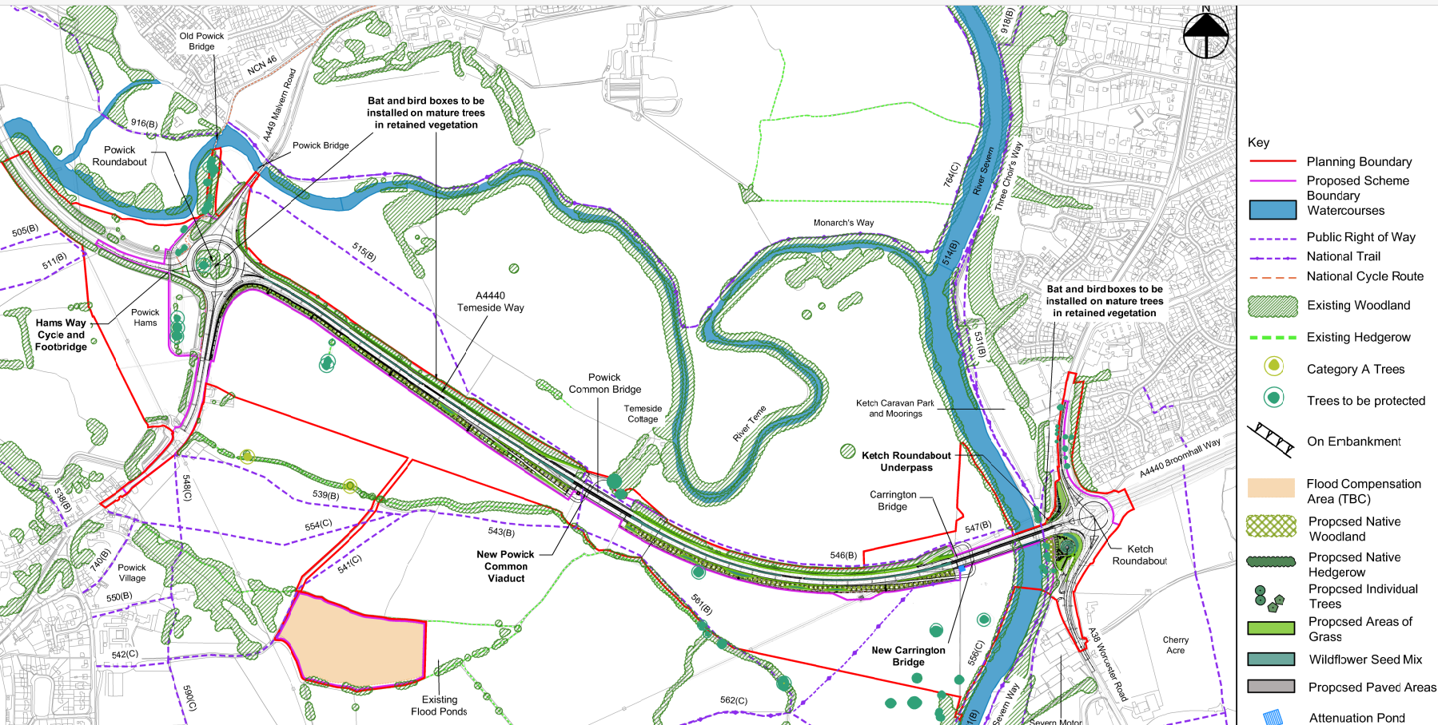
Alternatives
1. Do minimum – minor improvements only to the SLR between Ketch and Powick (minor alterations only to junction configurations, no additional lanes)
2. 2 + 1 lanes – additional lane added in either the westbound or eastbound direction
3. Dualling – between Ketch and Powick Roundabouts, to achieve a consistent 2 lanes in each direction
4. Alternative scheme 1 – no further work on the SLR after completion of Phases 1 -3 Whittington to Ketch. Instead construct a new North West Link Road
5. Alternative scheme 2 – no further work on the SLR after completion of Phases 1-3 Whittington to Ketch. Instead, construct a new road link between the M5 and Malvern
Mitigation, Monitoring, and Alternatives Continued

Slide 9
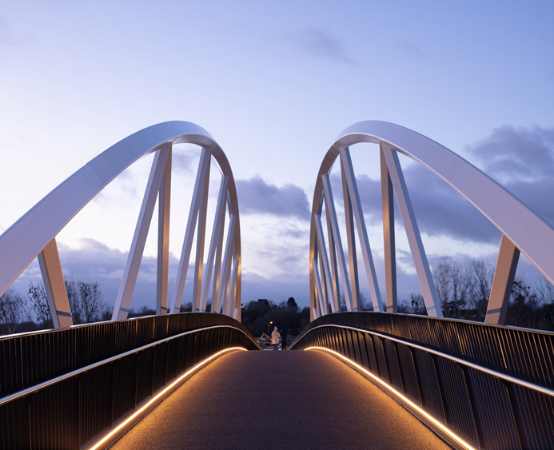
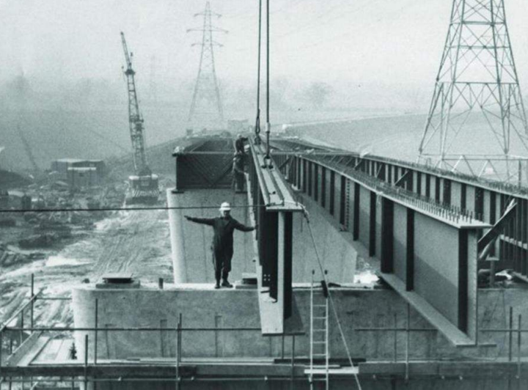
Original Construction of A4440 Carrington Bridge 1983 (WCC 2017a)
WCC 2021
CONCLUSION

Slide 10
References
Castelow 2020. The Battle of Worcester, 1651 (historic-uk.com) https://www.historic-uk.com/HistoryMagazine/DestinationsUK/The-Battle-of-Worcester/ Accessed 10/6/21
Griffiths 2017. Southern Link Road Phase 4 – Ketch to Powick Roundabouts - Alun Griffiths (Contractors) Ltd Community https://community.alungriffiths.co.uk/projects-in-your-area/worcestershire-county-council-ietc-and-slr4-contracts/southern-link-road-phase-4-ketch-to-powick-roundabouts/ Accessed 10/6/21
Tyler 2021. Major Worcester route to be shut all weekend for Carrington Bridge and Temeside Way works - Birmingham Live (birminghammail.co.uk) https://www.birminghammail.co.uk/news/midlands-news/major-worcester-route-shut-weekend-20587168 Accessed 10/6/21
WCC 2017a. WSLRP4 ES - Volume 1 - Technical Assessment Report (compressed).pdf file:///C:/Users/44742/Desktop/Environmental%20Planning%20and%20Policy/WSLRP4%20ES%20-%20Volume%201%20-%20Technical%20Assessment%20Report%20(compressed).pdf
WCC 2017b. Worcester Southern Link Road Phase 4 Environmental Statement – Non-Technical Summary
WCC 2017c. Worcester_Southern_Link_Phase_4_Public_Information_Exhibition.pdf file:///C:/Users/44742/Downloads/Worcester_Southern_Link_Phase_4_Public_Information_Exhibition.pdf
WCC 2021. Worcestershire walking and cycling bridge wins national award | Worcestershire County Council https://www.worcestershire.gov.uk/news/article/2546/worcestershire_walking_and_cycling_bridge_wins_national_award

