Slide 1

Nutty Buddy

Slide 2
group 1
Program: Certificate in Higher Education Skills for the Workplace
Writing Module: Managing Enterprise in the 21st Century
Module Code: BMSW 4006
Student names: Angel Stoyanov 2106796
Adriana Grigore 2024754
Sergiu Ungureanu 2108198
Rasheda Khanam 2109776
Lecturer Name: Olu Adegbite

Slide 3
Table of content
Executive summery
Business Overview
Product and Services
Market audit
Competitors
SWOT Analysis
PESTLE Analysis
Target Market
Marketing Plan
Management Team
Financial Plan
Cashflow
Forecast
Profit
References

Slide 4
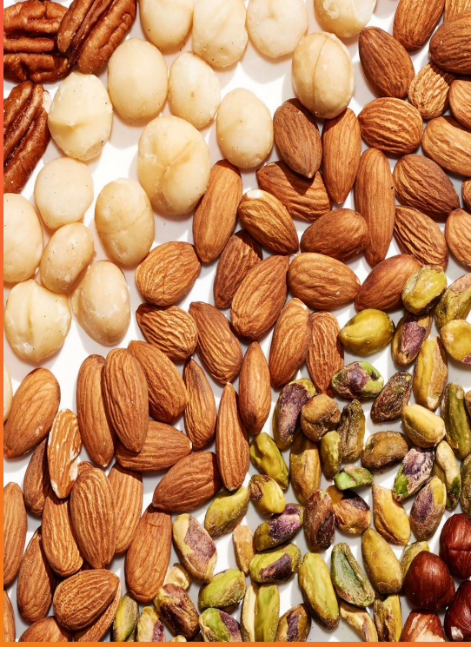
Executive summery
Nutty Buddy is a business company that uses 100% natural products such as Almond, Cashew, Himalayan salt and Macadamia. Has been created to bring healthy fats to the all age groups including athletic/gym industry. Our natural products provide the body with necessary protein and minerals when consumed within the necessary quantities.
Nutty Buddy is a new business corporate created from four person partnerships Angel, Adriana, Rasheda and Sergiu with intention to grow all over the world with first year profit forecast of £82,500. The profit forecast came thanks to our marketing strategy and experience that we used and it has been explained in the next slides.

Slide 5
Business Overview
Company name Nutty Buddy
Who we are and what we do?
Our partnership is composed by 4 qualified individuals
Our Mission?
To reduce the use of chemical products and increase the use of natural rpoducts
Where you can find us?
Birmingham city Center
Why to choose Nutty Buddy meals?
We produce100% natural product to boost human energy
Our Vision
Provide naturals products to bring joy
Natural products with higher content of unsaturated fatty acids are more vulnerable of oxidative breakdown (Nadeem et al, 2013)

Slide 6


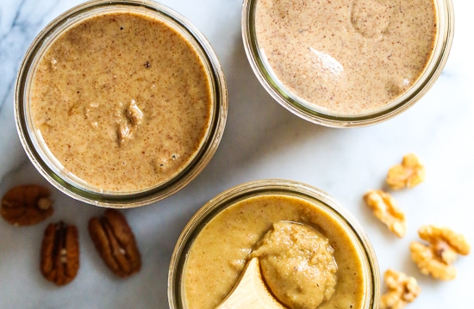
Product and services
Almond - Almonds include calcium and phosphorus, which strengthen bones and prevent fractures.
Cashew - Fiber, protein, and healthful fats are all abundant in cashews. They also include a range of vitamins, minerals, and advantageous plant components that safeguard the body.
Macadamia - They may aid in losing weight, enhancing gut health, and preventing diabetes, metabolic syndrome, and heart disease.
Himalayan Salt - More than 80 minerals and components, including calcium, iron, and potassium, are present in Himalayan salt.
- Vegan friendly,
- Keto-friendly
- PALEO friendly
- Gluten-free
‘’The best business plans are straightforward documents that spell out the who, what, where why and how much’’
(Grow Think, 2022)

Slide 7

Market audit
Entering and expanding exist market to increase competitive and ineffective economic.
Creating entirely new market by offering innovation products which presents profit opportunity to others.
(Minniti and Bygrave,2004; Autio,2007).

Slide 8

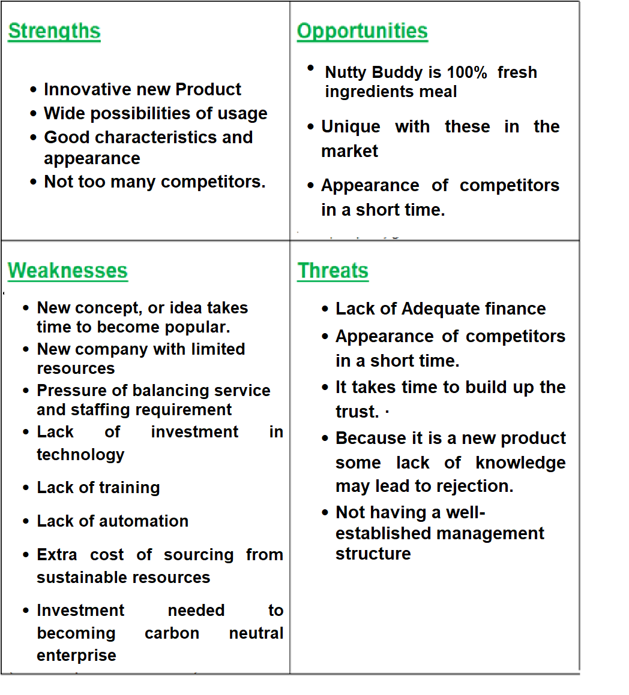

SWOT Analysis

Slide 9
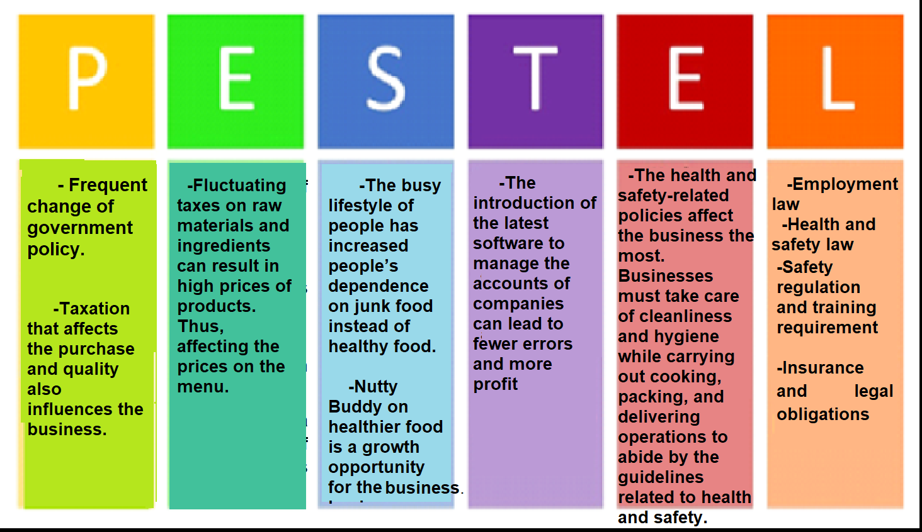
PESTEl Analysis

Slide 10

Target market can be defined as the group of people that a company wants to sell their products or services(Linkedin.com, 2019).
Target Market
Target market is also used to evaluate the attractiveness of the different segments and to identify most profitable subject
(Mullins & Walker, 2013).

Slide 11


Slide 12

Marketing plan
Product - Our products and services are designed to help people increase their pre-workout energy levels by consuming products made from 100% natural ingredients.
Price - Single pack of 10 pouches (£19.99)
Subscription price 1. - Two packs of 10 pouches (£34.99)
Subscription price 2. - Three packs of 10 pouches (£49.99)
Place – Nutty Buddy headquarter can be found in Birmingham, United Kingdom
Promotions - Influencers will work together to promote Nutty Buddy, giving our product a respected online presence. Additionally, the promotion will be done online, via radio, email, and posters. Other platforms will be used such as Instagram, Facebook, Twitter

Slide 13
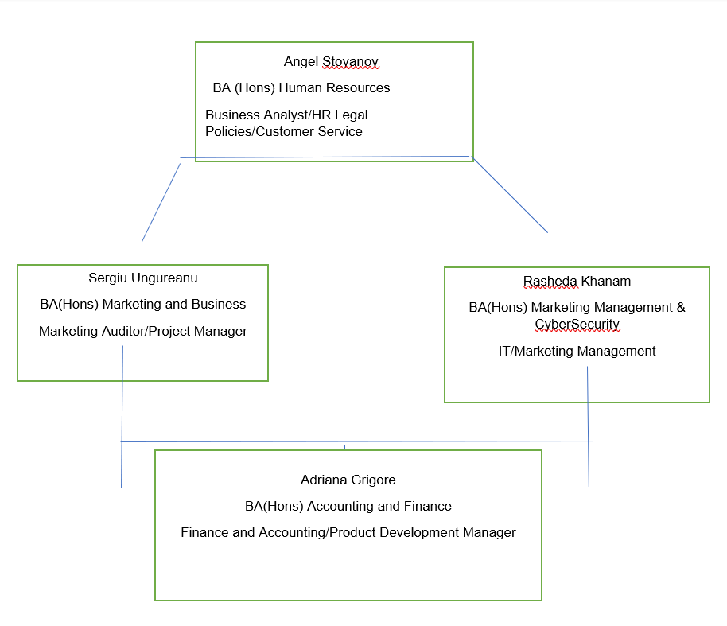
Team management
Angel Stoyanov Business Analyst/HR Legal Policies/Customer service
Rasheda Khanam, IT/Marketing Management
Adriana Grigore, Finance and Accounting/Product Development Manager
Sergiu Ungureanu, Marketing Auditor/Project Manager

Slide 14
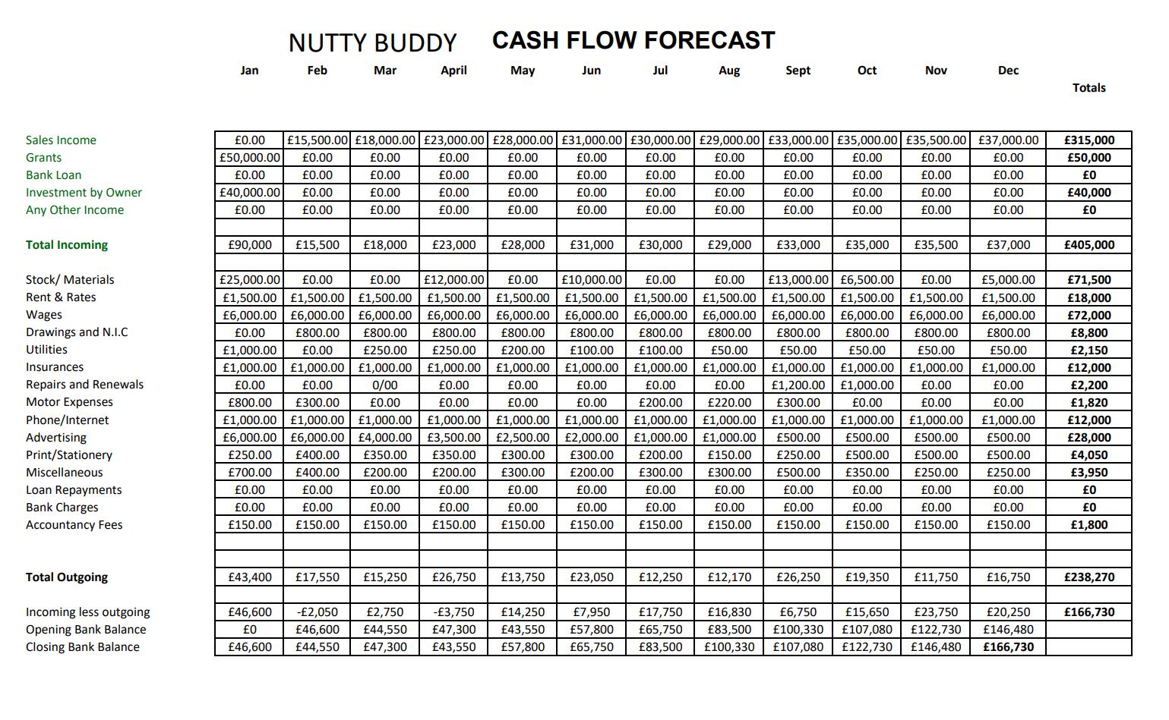

Slide 15
Financial plan
Profits/losses cannot be identified just for few months and it is changeable over time (Helen,2002)
Lottery UK Grant £50000
Personal investment £10000 each member

Slide 16
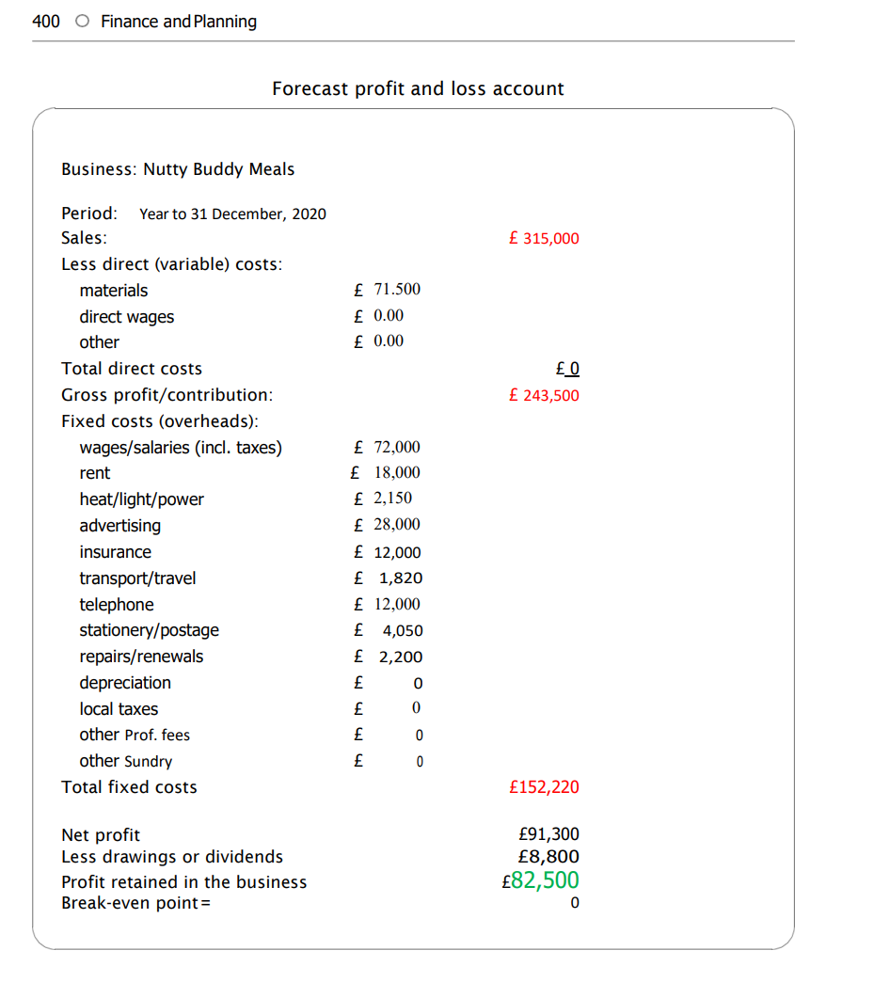
Profit/loss sheet

Slide 17
REFERENCES
Autio, E. (2007) Global Report on High Growth Entrepreneurship, Babson College and London, London Business School, Wellesley MA, UK
B plan (2022) 8 Quotes to Motivate You to Make a Plan and Stick to it
Available at: https://articles.bplans.com/8-quotes-to-motivate-you-to-make-a-plan-and- stick-to-it/ (Accessed on 14th July 2022)
Cambridge University Press (2022) Meaning of Target Market
Available at: https://dictionary.cambridge.org/dictionary/english/target-market
(Accessed 06 July 2022)
Commonwealth of Australia (2021) Identify Your Target Market
Available at: https://business.gov.au/marketing/identify-your-target-market
(Accessed 06 July 2022)
Grow Think (2022) The Perfect Business Plan Layout & Outline for a Great Plan
Available at: https://www.growthink.com/businessplan/help-center/business-plan-layout-how-design-your-plan
(Accessed on 14th July 2022)
Kuratko, D.F. (2009) Entrepreneurship: Theory, Process, Practice, Cengage/South- Western. Publishers, Mason, OH
Madison (1990) Small business forum: the journal of the Association of Small Business Development Centres., WI: University of Wisconsin-Extension Small Business Development Center

Slide 18
Minniti, M. and Bygrave, W.D. (2004) Global Entrepreneurship Monitor, Kauffman Center for Entrepreneurial Leadership.
Nadeem, M. et al. (2015) ‘Enhancement of the Oxidative Stability of Whey Butter through Almond (Prunus dulcis) Peel Extract’, Journal of food processing and preservation, 39(6), pp. 591–598
Nugus, S. (2009) Financial planning using Excel forecasting planning and budgeting techniques. 2nd ed. Amsterdam :CIMA.
Zalengera, C., Blanchard, R.E., Eames, P.C., Juma, A.M., Chitawo, M.L. and Gondwe, K.T., (2014). Overview of the Malawi energy situation and A PESTLE analysis for sustainable development of renewable energy. Renewable and Sustainable Energy Reviews, 38, pp.335-347.

