Slide 1
Psychological Classifications and Provisions BMHP6029
Tomy Adattu Chacko
Halimah Saleem (2314746)

Slide 2
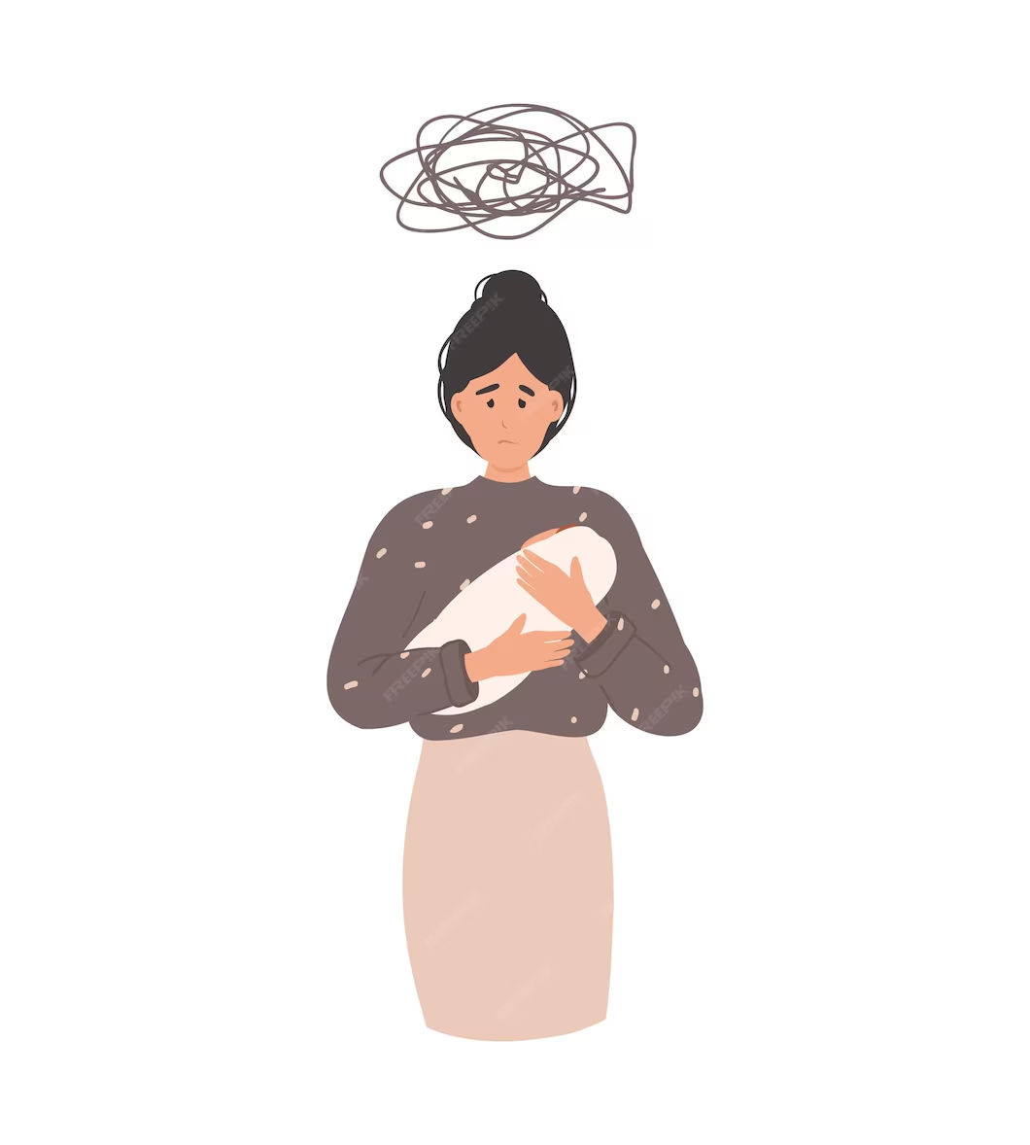
Postpartum Depression
Postpartum Depression (ICD-11 6E20) is a mood disorder that develops six weeks after childbirth and is marked by functional impairment, lack of interest and ongoing happiness (World Health Organization, 2025).
Impacting more than 1 in 10 women (NHS, 2022).
Postpartum Depression occurs in the weeks or months following childbirth.
It affects individuals, leading to persistent feelings of sadness, anxiety and despair (Postpartum Depression, 2024).
(Sad, 2022)

Slide 3
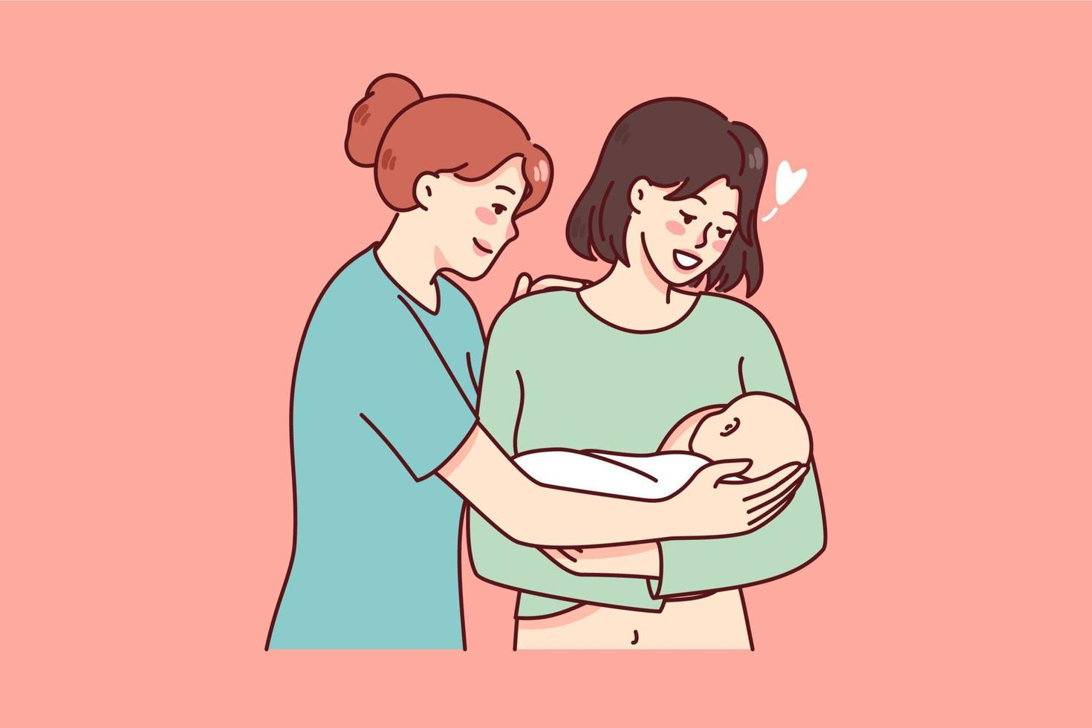
Historical and Contemporary Understanding
During the 19th century when women experienced depression, many did not reveal their symptoms and those who did were often diagnosed as anxious (Wolf, 2010).
Before modern times, women were often cared for within their local community rather than by doctors. However, because their experiences were not studied, many women’s struggles with Postpartum Depression remained hidden and misunderstood (Hollingworth, 2023) .
Today, NICE guideline covers the routine postnatal care that women and their babies should receive in the first 8 weeks after the birth (National Institute for Health and Care Excellence, 2021).
Critical Analysis
Postpartum Depression is recognised as a serious mental health condition that requires treatment and is not something women should go through in silence (Tommy's, 2024).
Support is now available for women suffering with Postpartum Depression such as, NHS Therapy and Counselling Services which, a GP can refer for talking treatment and self-referral is also available (NHS, 2020).
Since 2020, GP practices must offer every woman a postnatal check up between 6 and 8 weeks after birth. The guidance is to help GPs carry out appointments properly (England, 2023).
NICE sets clear guidance for staff to routinely ask about mood during pregnancy and the first year after birth, assess any risks, and make sure women can quickly access treatments and support (National Institute for Health and Care Excellence, 2020).
Recommendations
Train NHS staff on cultural competency.
Routine screening during every stage of pregnancy and delivery.
Expand local perinatal mental-health hubs for early intervention (NHS England, 2018).
Encourage partners to help (Plan, 2018).
(Kateryna Petruk, 2025)

Slide 4
Reference List
England, N. (2023) NHS England» GP six to eight week maternal postnatal consultation – what good looks like guidance, England.nhs.uk. Available at: https://www.england.nhs.uk/publication/gp-6-to-8-week-maternal-postnatal-consultation-what-good-looks-like-guidance/ (Accessed 15th October 2025).
Hollingworth, T. (2023) The historiography of puerperal psychosis: a Cinderella sub-specialty. https://www.britishjournalofmidwifery.com/content/professional/the-historiography-of-puerperal-psychosis-a-cinderella-sub-specialty (Accessed 15th October 2025).
Kateryna Petruk (2025) Happy Midwifes holding newborn babies. Asian, African and European nurses in medical suits and hats. Female doctors with newborn babies of different genders and nationalities., Vecteezy. Available at: https://www.vecteezy.com/search?qterm=happy-nurse-and-young-mother-holding-newborn-baby-on-hands&content_type=vector (Accessed 15th October 2025).
National Institute for Health and Care Excellence (2021) Overview | Postnatal Care | Guidance | NICE, www.nice.org.uk. Available at: https://www.nice.org.uk/guidance/ng194 (Accessed 18th October 2025).
NHS (2020) Mental health problems and pregnancy, nhs.uk. Available at: https://www.nhs.uk/pregnancy/keeping-well/mental-health/ (Accessed 17th October 2025).
NHS (2022) Postnatal Depression, NHS. Available at: https://www.nhs.uk/mental-health/conditions/post-natal-depression/overview/ (Accessed 17th October 2025).
NHS England (2018) Perinatal mental health, England.nhs.uk. NHS. Available at: https://www.england.nhs.uk/mental-health/perinatal/ (Accessed 18th October 2025).
NICE (2020) Antenatal and Postnatal Mental Health: Clinical Management and Service Guidance (CG192). London: National Institute for Health and Care Excellence. Available at: https://www.nice.org.uk/guidance/cg192 (Accessed 16th October 2025).
Plan, N.L.T. (2018) Partners of new mums with mental illness set to get targeted support on the NHS, NHS Long Term Plan. Available at: https://www.longtermplan.nhs.uk/partners-of-new-mums-with-mental-illness-set-to-get-targeted-support-on-the-nhs/ (Accessed 18th October 2025).
Postpartum Depression (2024) Middletonpcn.nhs.uk. Available at: https://www.middletonpcn.nhs.uk/depression-after-childbirth (Accessed 16th October 2025).
Sad, D. (2022) Postpartum depression, sad woman with baby and chaos line. Cartoon..., iStock. Available at: https://www.istockphoto.com/vector/postpartum-depression-sad-woman-with-baby-gm1438396209-478910931
Tommy's (2024) Postnatal Depression (PND) | Tommy’s, www.tommys.org. Available at: https://www.tommys.org/pregnancy-information/im-pregnant/mental-health-wellbeing/postnatal-depression-pnd (Accessed 20th October 2025).
Wolf, R. (2010) A History of Postpartum Depression, Health Guide Info. Available at: https://www.healthguideinfo.com/postpartum-depression/p99788/ (Accessed 20th October 2025).
World Health Organization (2025) ICD-11 for Mortality and Morbidity Statistics, Who.int. Available at: https://icd.who.int/browse/2025-01/mms/en

