Slide 1
Project Posters
Freely adapted from http://www.cns.cornell.edu/documents/ScientificPosters.pdf ☺

Slide 2
Why make a poster?
In order to pass the module ☺
More seriously…
  To summarise and advertise your work
  It is (effectively) an illustrated abstract
Your project proposal should contain an abstract that details
  Why your project is important/interesting
  What hardware/software you intend to use
  What you intend to do
  What you hope to find out

Slide 3
Why make a poster?
Final project posters look at the whole project
Your project report should contain an abstract that details
  Why your project is important/interesting
  What hardware/software did you use/develop
  How you did it
  What you found out/recommend
These will involve more graphs and tables than a proposal poster

Slide 4
What goes onto the poster?
Now turn that abstract into a poster
Think of it as a short story
Describe a few major points
Give it graphics and a title that will grab the reader’s interest
Limit it to 250-300 words

Slide 5
Who is this for?
Your project proposal poster is not aimed at experts in the field
Target audience may include
  Students in your cohort
  Students in your year
  Students in your degree line
  Your lecturers
  Lecturers in related fields
  …
The audience is assumed to have at least some related technical knowledge

Slide 6
Poster design
All posters should have two main elements
Simple, effective data displays
  Make it easy for people
Small supporting blocks of text
  Who, what, where, when, why?
  Don’t make people stand in front of your poster for too long
Powerpoint works okay, but Adobe Illustrator is better. LaTeX is great but uses a markup language

Slide 7
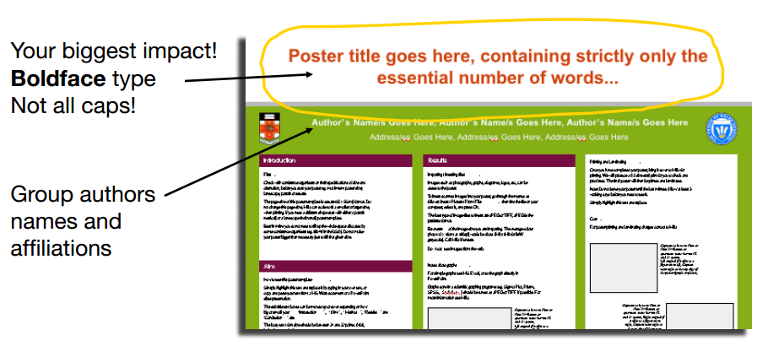
The title
Your poster title should be big
Really big
Really, really big

Slide 8
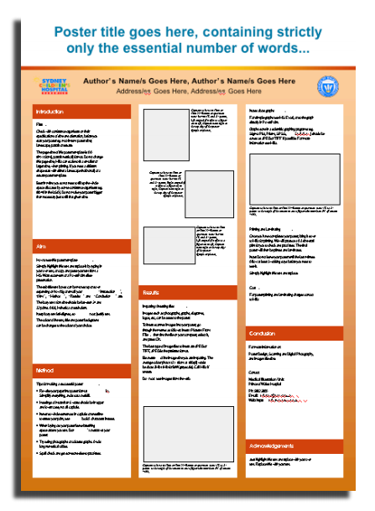
The text
Leave white space around the text
Use easy-to-read fonts
Use the same styles and sizes throughout
Left-aligned text (not fully justified) is easier to read

Slide 9
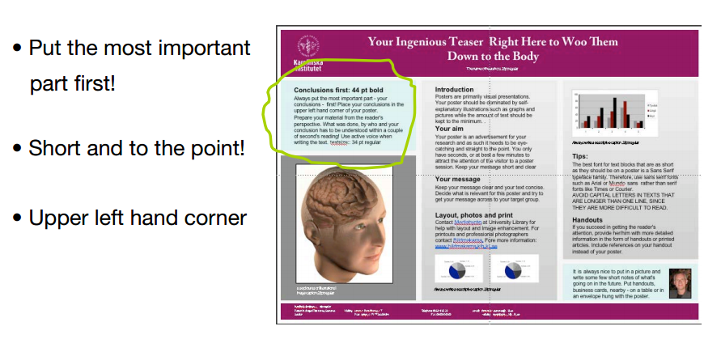
The text
Put the conclusions first
  That way people will know what you’ve done without having to read the entire poster

Slide 10
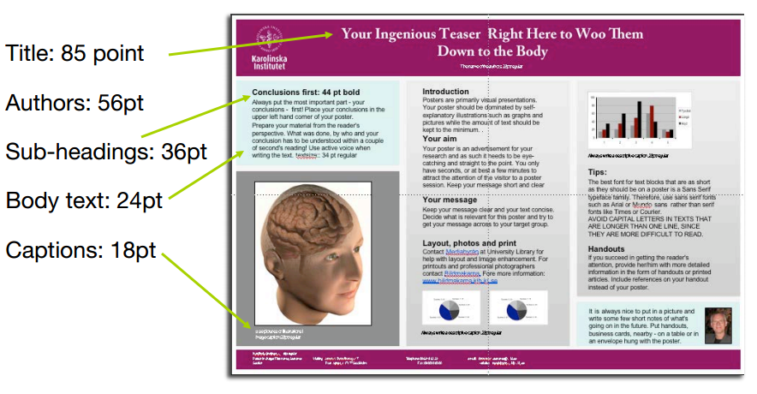
The text
Make sure the text is not too small

Slide 11
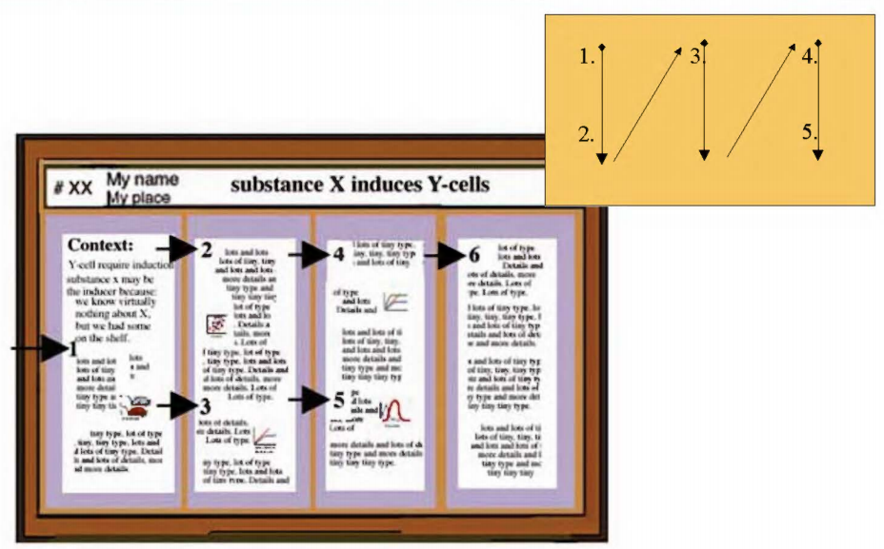
The text
Organise your text in a logical manner
  Up/down
  Side to side
  Make it easy to follow the message

Slide 12
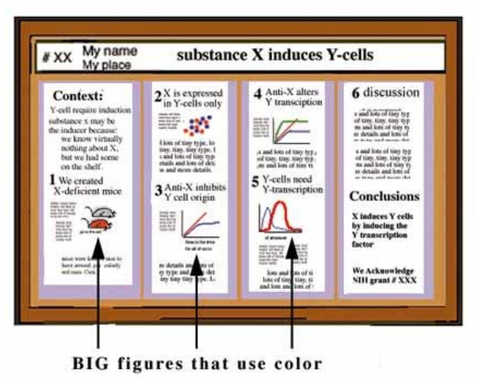
The graphics
Use graphics to
  Break up the text
  Replace text
  Catch the eye
Label things!

Slide 13
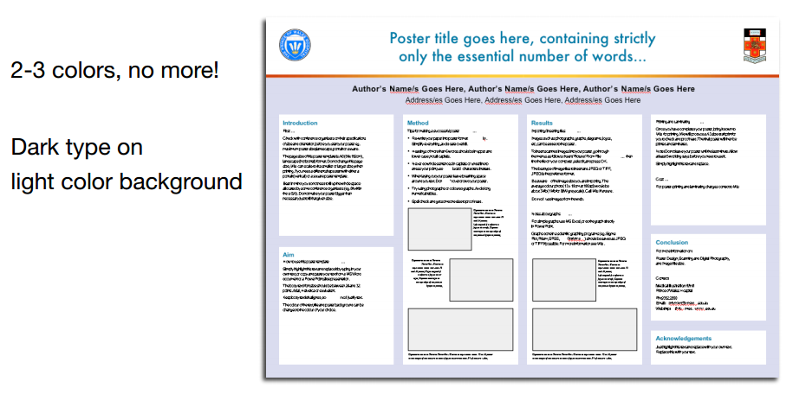
The graphics
Colour is your friend, but use it carefully!

Slide 14
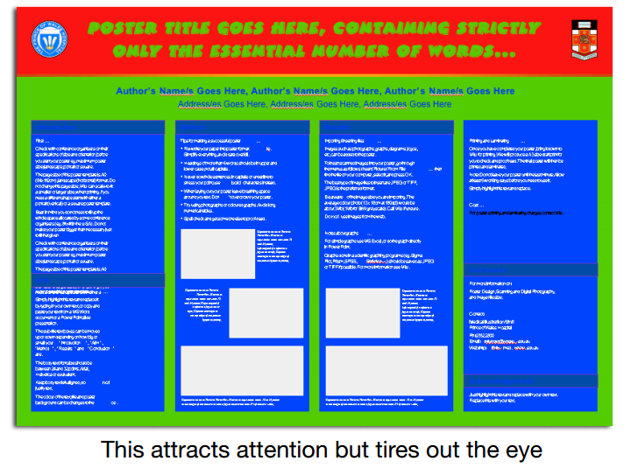
The graphics
Don’t get carried away with colour…

Slide 15

The graphics
Be careful with patterned backgrounds

Slide 16

The graphics
Plain white backgrounds are acceptable

Slide 17
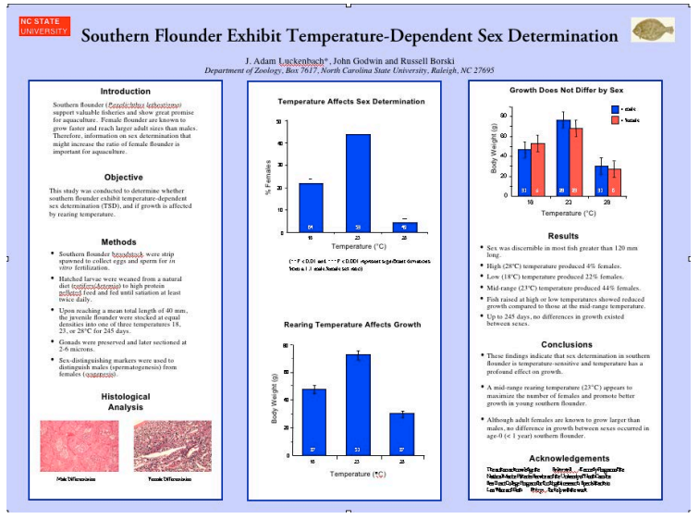
The graphics
Coloured backgrounds add definition

Slide 18
Test print
Once you are happy with the design, print your poster in full colour at A4 size
  Can you read the type?
  Are the colours effective?
  Does it look too busy?
  Are the main points obvious?
  Does the message pop out at the reader?
If it looks good then you can now print it at full size

Slide 19
Presenting your poster
At the evening poster session you will be there to answer questions about your research
Prepare a 3-5 minute explanation verbal that you can give to anyone who asks about your work
  What was the problem?
  What did you do?
  What were your results?
Have A4 copies of your poster to give away to people who are interested
  Remember to include your contact details
  Useful for potential employers ☺

Slide 20
Some example posters
Good or bad?

Slide 21



Slide 22
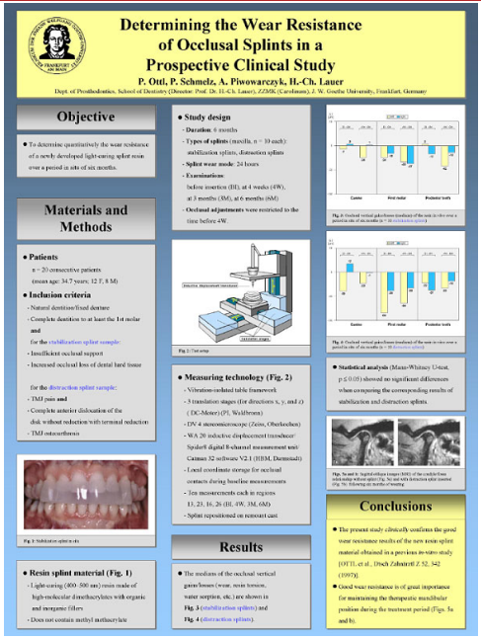


Slide 23
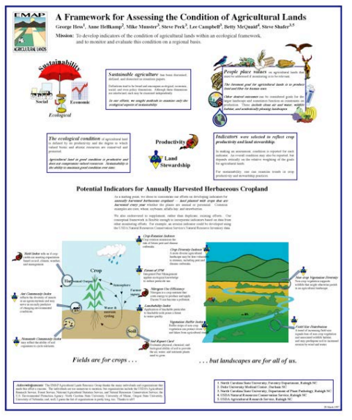


Slide 24



Slide 25
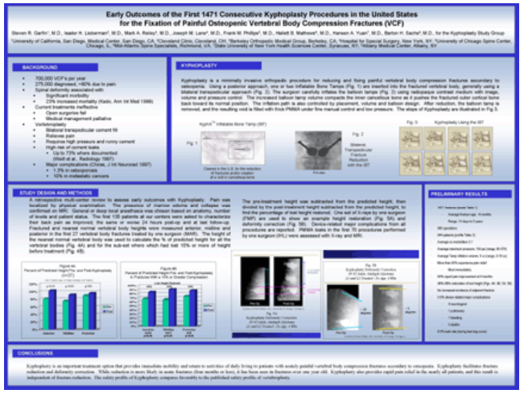


Slide 26
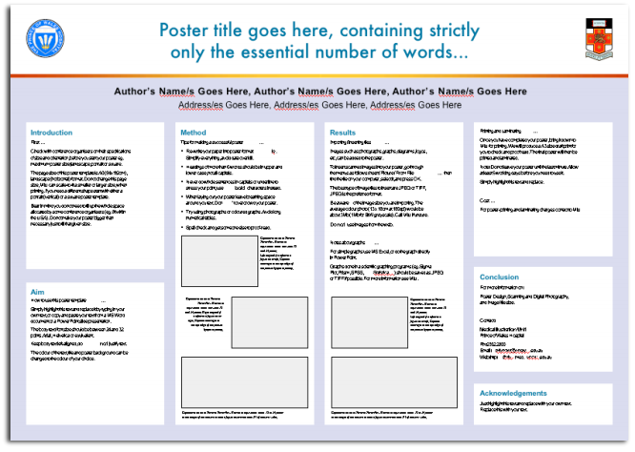


Slide 27



Slide 28
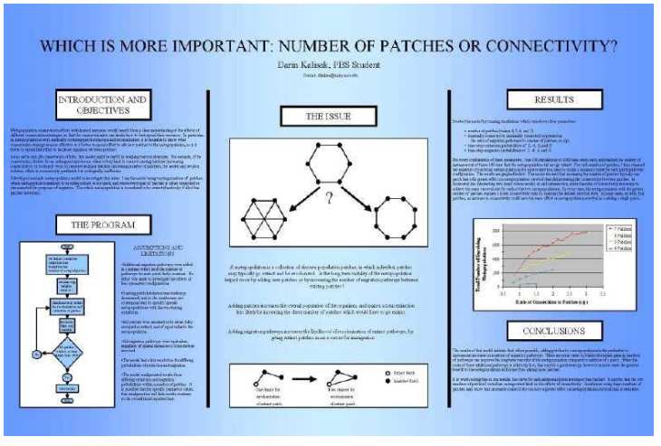


Slide 29



Slide 30



Slide 31



Slide 32
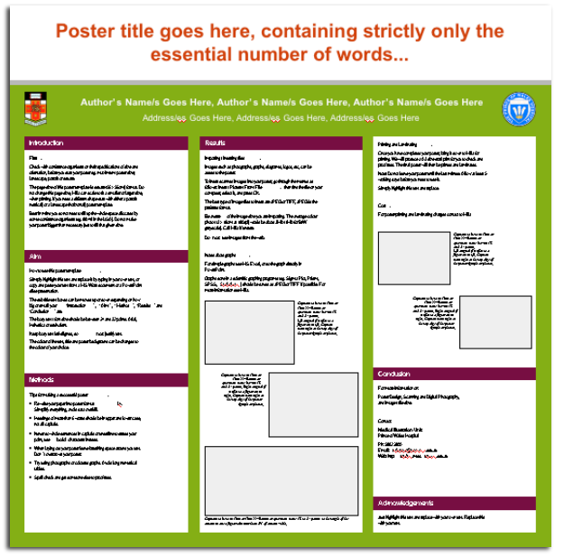


Slide 33
Useful sites
The following sites have more in-depth information about academic poster design, including downloadable PowerPoint templates
http://colinpurrington.com/tips/academic/posterdesign
http://www.ncsu.edu/project/posters/
http://betterposters.blogspot.co.uk/

