Slide 1
HPID5022/6022 Part 2:
New States, Rogue States and Failed States:
Governance and Globalisation
The changeover from colonial administration to political independence, looking particularly at processes of state-building and the problems which faced newly independent countries in finding a viable place in the world economy.
We'll explore the question "What is the State?" and will review cases and relevant literature dealing with what have been described as weak states, rogue states and failed states. We'll examine issues of democracy, coups and military rule - and the relevance of human rights and civil society as a component in sustainable, democratic rule.

Slide 2
HPAN5022/6022
The State (and Civil Society)
What is “the State”?
Different views
The State:
Things a state must do to be a state
Things a state can do because it is a state
Concepts:
State and Nation/Nation State
The State and Civil Society

Slide 3
HPAN5022/6022
The State (and Civil Society)
What is “the State”?
Different views
European borders
https://www.youtube.com/watch?v=RJfQ8-M2-j0
Nations, States and Nation States: 7:03
https://www.youtube.com/watch?v=sa-41DBGHfw
Wagah Border (India)
https://www.youtube.com/watch?v=TAx5LlPDcbM
Wagah Border (Pakistan)
https://www.youtube.com/watch?v=xTQP2vKuycc

Slide 4
Nations, states and nation states
Nations:
“nations and regions of the UK”
nationalities of the Austro-Hungarian Empire
The national question in the Russian Empire/USSR
States:
What is the state?
City states (antiquity, Italian city states)
Nation states – a phenomenon of modern history

Slide 5
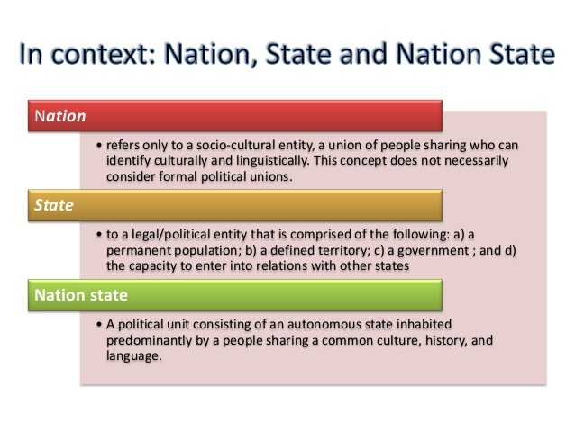
What is the state?

Slide 6
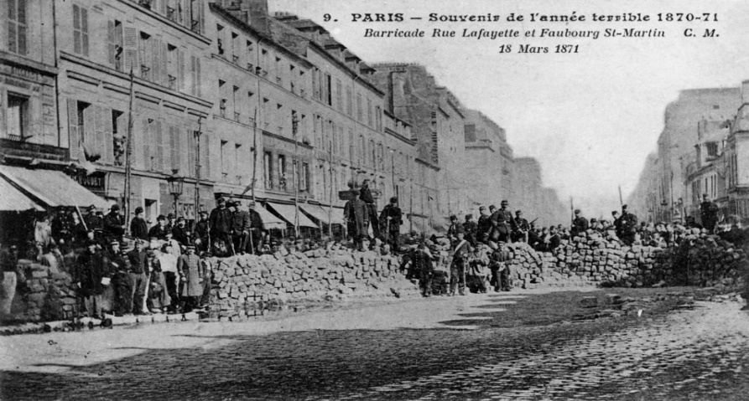

The State
Marxist view of the state: “armed bodies of men”; “a machine for the oppression of one class by another”; the state arises with the emergence of class society
We need to look at processes of state decay (e.g. pre-1914 multi-ethnic Empires) and state formation (modern nation states)

Slide 7
Modern nationalism
One Euro-centric size fits all?
European narratives: the rise of the nation state
Case studies: England, France, Germany, Italy
European hegemony: colonialism – and Postcolonial States worldwide
The nation state in the Americas: 4 Spanish vice-royalties and the Empire of Brazil become at least 20 nation states
Liberation, independence and artificial borders

Slide 8
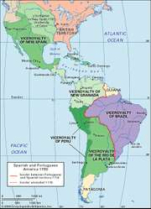
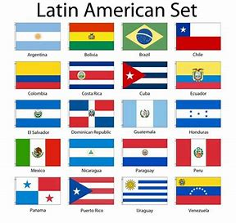
Nation states in the Americas

Slide 9
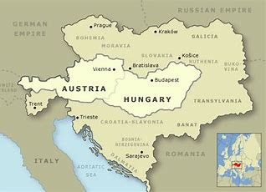
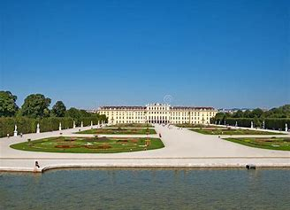
Nation states in constant flux
Nationalism in Europe since 1914: demise of the old Empires (Schönbrunn Palace/Austria Hungary above)
Nationalism in Europe since 1945: post-war migrations
Nationalism in Europe since 1991: Baltic states, Yugoslavia, Czechoslovakia

Slide 10
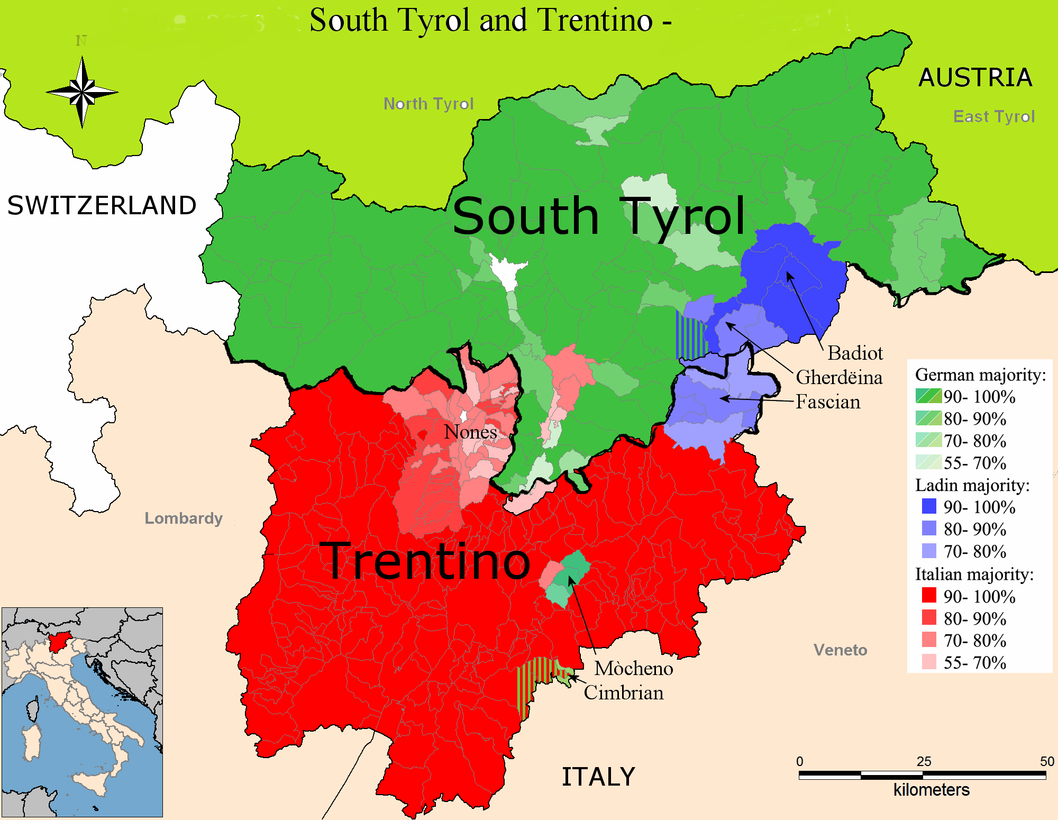
Ethnic nations in Europe (1)
…after World War 1
Attempts at “rationalising” national boundaries and basic national boundaries on nationalities/ethnic/ language groupings after WW1 (Woodrow Wilson’s 14 points)
Ottoman Empire:
Austro-Hungarian Empire
Exceptions to the rule
e.g. South Tirol

Slide 11
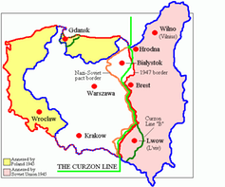
Ethnic Nations in Europe (2)
…after World War 2
Another iteration of the same process at the end of WW2:
Massive change to the shape and location of Poland
Mass migration of displaced persons and refugees
(including at least 250,000 east European Jews – holocaust survivors – and 12m ethnic Germans

Slide 12
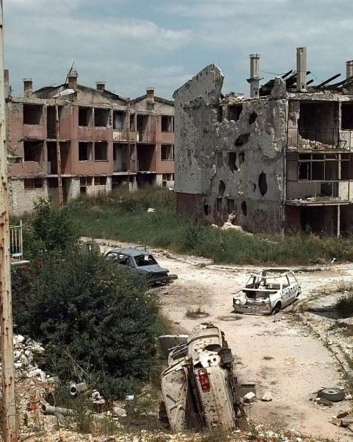
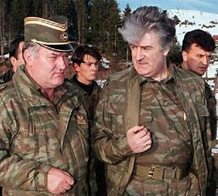
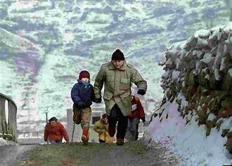
Ethnic Nations in Europe (3)
…after the Cold War
Break-up of Yugoslavia: a new term in international politics: Ethnic Cleansing
The Collapse of the USSR: independence for the Baltic States and the former satellite states of Eastern Europe – gravitation towards the EU
Separation of Slovakia and Czechia

Slide 13
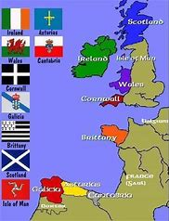
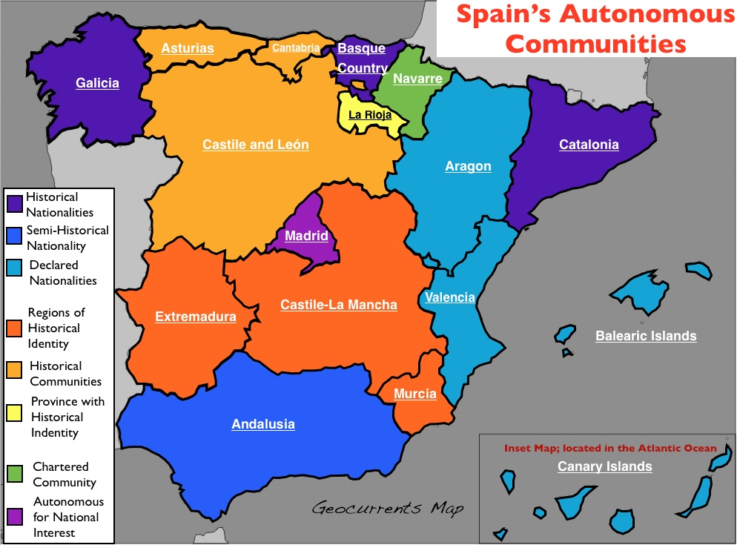
Stateless Nations in Europe
Celtic nationalisms
Basque and Catalan nationalism

Slide 14
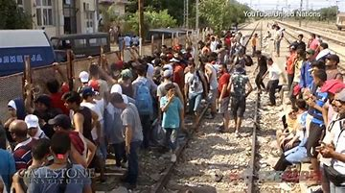
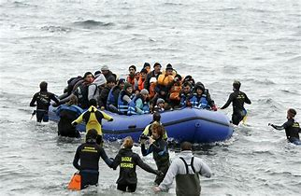
The Nation State: Migration and Borders
We'll continue the theme of the nation state and competing nationalisms, examining real cases of failed and failing states, and states under pressure.
We'll also consider the drivers behind human migration, the problems of borders and boundaries - and the prospects for transnational or cosmopolitan democracy.

Slide 15
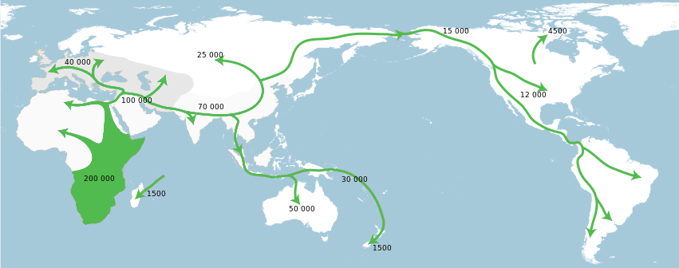
Human migration – a 200,000 year overview

Slide 16
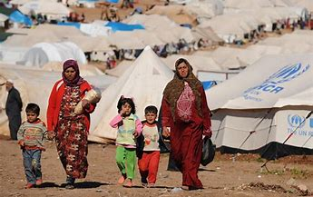
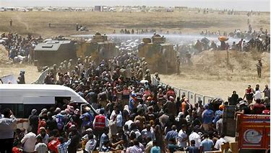
Human migration in the 21st century
Libya > Italy (Boat people)
Syrian diaspora
Migration “crisis” for Europe
Xenophobia and nationalism
Myanmar > Bangladesh

Slide 17
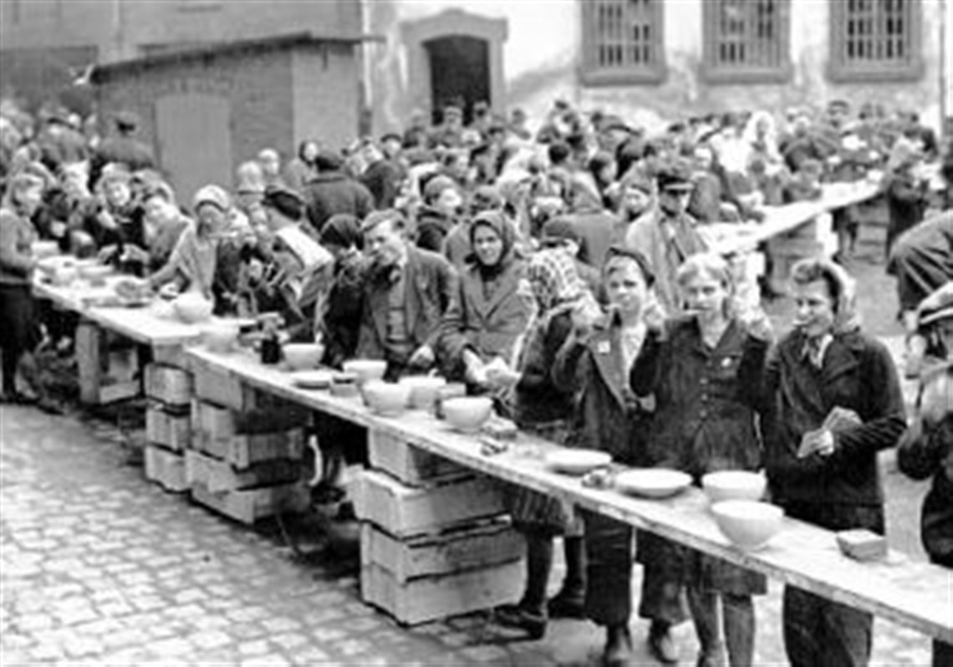
In the aftermath of war…
Forced migrations
After World War II (1945)
60 million displaced people
That included roughly 12 million Germans, many of whom were forced to leave their homeland when large chunks of Germany's eastern borders were annexed to Poland. Many ethnic Germans were expelled or chose to leave their homes in Eastern Europe.

Slide 18
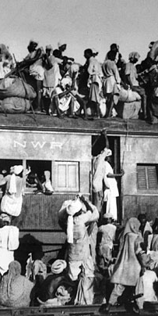
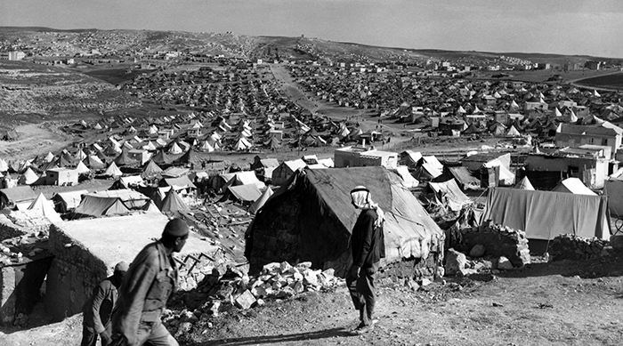
Palestine 1945-India/Pakistan 1947
PPalestine 1945-48
India/Pakistan 1947 alestine 1945-48
India-Pakistan 1947

Slide 19
Other crises of displacement (cited in the Wall Street Journal report, 22 Sept. 2015)
Korean War (1950-53) 1 million to 5 million displaced people
Iraq (2003-present) 4 million displaced people
Vietnam War (ended in 1975) 3 million displaced people
Former Yugoslavia conflict (1991-95) 2.7 million displaced people
Afghan conflict (since 1979) 2.6 million displaced people
Rwanda (1994) 1.5 million displaced people
Somalia (since 1991) 1.1 million displaced people
Central African Republic (2013) 850,000 displaced people
Sudan-South Sudan (1955-72; 2013) 660,000 displaced people
Democratic Republic of Congo (1996-1998) 516,800 displaced people
and Myanmar…

Slide 20
Case Study: Myanmar 2012-present
479,000 already displaced people (at 22/9/2015)
In 2012, violence erupted in Rakhine State, forcing around 140,000 people to flee their homes. At the end of 2014, the UNHCR estimated that refugees originating from Myanmar totalled 479,000, making it the seventh-largest source country.
NB Since the end of 2017, we need to add at least 600,000 more Rohingya refuges, forced to flee from Rakhine to Bangladesh

Slide 21
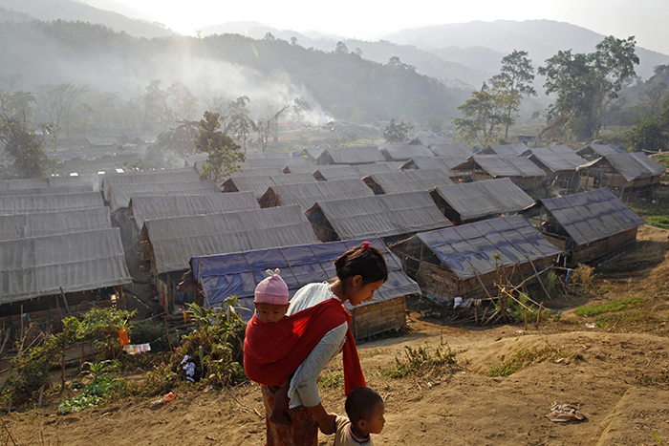
A mother walking with her children in a refugee camp in Laiza, Myanmar, in 2012. PHOTO: VINCENT YU/ASSOCIATED PRESS

Slide 22
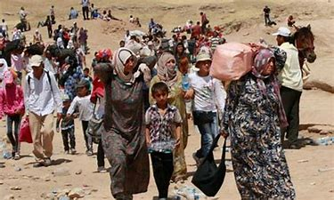
Case Study: Syria
Syria (2011-present)
11.6 million displaced people
The continuing conflict and Islamic State offensive forced 1.5 million people to flee abroad in 2014, mainly to neighbouring countries. The number of Syrian refugees now exceeds 4 million and another 7.6 million are internally displaced.

Slide 23
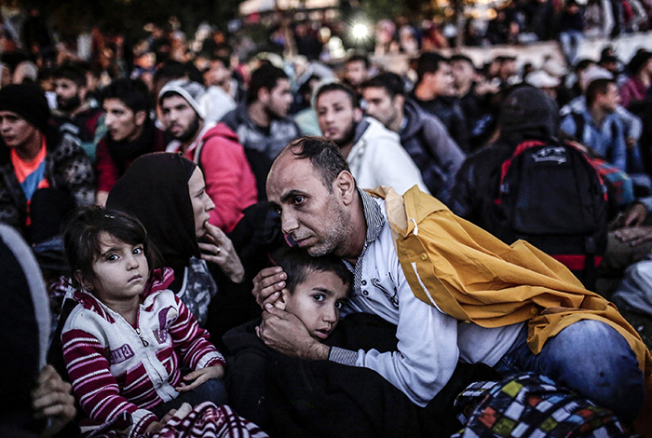
People waiting in the Turkish city of Istanbul for buses to the Greek border in 2015. PHOTO: YASIN AKGULYASIN AKGUL/AGENCE-FRANCE PRESSE

Slide 24

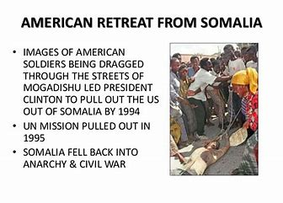
Failing and
Failed states
What gave rise these categories and
definitions?
End of the Cold War (1989)
Gulf War 1 (1991)
Mogadishu and Black Hawk Down (1993)
Bosnia and Rwanda (1992 and 1994)
Bombings at US Embassies in Dar es Salaam and Nairobi 1998
9/11 and Afghanistan: safe haven for Al Qaeda
2001 Afghanistan and 2003 Gulf War 2

Slide 25
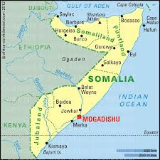
Somalia
Borders and boundaries – Greater Somalia
Colonial borders arbitrarily imposed on the Somali people

Slide 26
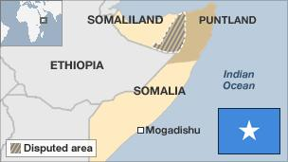
Breakaway states/statelets
British Foreign and Commonwealth Office (FCO) Travel Advice for Somalia, 10 May 2019:
https://www.gov.uk/foreign-travel-advice/somalia

Slide 27

Somalia country profile
4 January 2018
Created in 1960 from a former British protectorate and an Italian colony, Somalia collapsed into anarchy following the overthrow of the military regime of President Siad Barre in 1991.
As rival warlords tore the country apart into clan-based fiefdoms, an internationally-backed unity government formed in 2000 struggled to establish control, and the two relatively peaceful northern regions of Somaliland and Puntland effectively broke away.
The seizure of the capital Mogadishu and much of the country's south by a coalition of Islamist shariah courts in 2006 prompted an intervention by Ethiopian, and later, African Union, forces.
Since 2012, when a new internationally-backed government was installed, Somalia has been inching towards stability, but the new authorities still face a challenge from Al-Qaeda-aligned Al-Shabab insurgents.

Slide 28
Al Jazeera. Somalia – A Forgotten Story. 46 mins: https://www.youtube.com/watch?v=DptQdIhMGZk
The film clip above is a very good 46-minute Al Jazeera documentary, made in 2016, about Somalia by Hamza Ashrif.

Slide 29
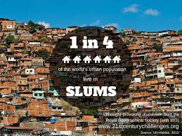
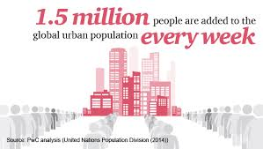
Other mass migrations:
Rural > Urban (e.g. Africa, South Asia and China)

Slide 30
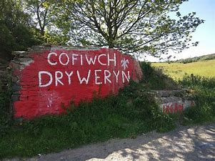
General questions of Nationalism
Is nationalism reactionary or progressive?
Xenophobic nationalism
Self-determination

