Slide 1
Supply Chain Vulnerability
Andrew Thorn

Slide 2
Supply Chain Vulnerability
Is a point of weakness and/or possible threat to the supply chain network
An exposure to serious disturbance, arising from risks within the supply chain as well as risks external to the supply-chain
Is a function of certain supply chain characteristics and the loss a firm incurs as a result of its supply chain vulnerability to a given supply chain disruption

Slide 3
Supply Chain Vulnerability
Key issues
Key parameters of vulnerability are the stress to which a system is exposed, its sensitivity, and its adaptive capacity (Adger, 2006)
Sheffi & Rice (2005) state that reducing vulnerability means reducing the likelihood of a disruption and increasing resilience

Slide 4
Supply Chain Vulnerability Assessment
Key Issues
The necessity to define the variable drivers of vulnerability (supply chain complexity)
Potential disruptions identification and categorisation according to their probability occurrence and consequences
Defining the main interrelations between the defined drivers and disruptions
Developing a multi-dimensional measure of supply chain vulnerability

Slide 5
Methods Used to Measure Vulnerability
Failure Mode and Effect Analysis (FMEA)
Failure Mode, Effects and Criticality Analysis (FMECA)
Cause-Consequence Analysis (CCA)
Supply Chain Event Management (SCEM)
Supply Chain Risk Management (SCRM)
Business Continuity Planning (BCP)

Slide 6
Vulnerability Indicators

Slide 7
Vulnerability Focus on
Three main elements
The degree of loss and damages due to the impact of a hazard
Degree of exposure to the hazards
Degree of resilience

Slide 8
Vulnerability Measurement
Mathematically vulnerability can be measured in terms of “risk” – a combination of the likelihood of an event and its potential severity
A risk perspective is defined as (A, C, U) where A represents threats, C the consequences of A and U the associated uncertainties
R = (A, C, U)

Slide 9
Goals of Vulnerability Analysis
Identification of the set of events and event sequences that can cause damages and loss effects – providing the information about system end state
Identification of the relevant set of initiating events which affect the system performance
Identification of the set of events respective to event consequences that would cause the given end state of the system
Identification and determination of events and observed outcomes dependencies

Slide 10
Vulnerability Priority Number
V_{N} = (Readiness x Response x Recovery)

Slide 11
Business Factors Contributing to Supply Chain Vulnerability
A focus on efficiency rather than effectiveness
The globalisation of supply chains
Focused factories and centralised distribution
The trend to outsourcing
Reduction in the supplier base
Volatility of demand
Lack of transparency and control procedures
Notes:
Focus on efficiency Opportunities for inventory reduction
JIT practices widely adopted
Organisations more dependent on suppliers
Volatility of demand increases
Globalisation
Move from ‘local for local’
Offshore sourcing
Global supply chains, for example components sourced in Taiwan, sub-assembled in Singapore final assembly U.S.
Motivation behind offshore sourcing in manufacturing cost
Rarely are total supply chain costs considered
cost based decisions result in higher levels of risk
- Extended lead times
- Greater buffer stocks
- Higher levels of obsolescence
Cross border mergers and acquisitions
Focused factories
Economies of scale if greater quantities are produced at fewer sites
Focus factories- produce fewer products exclusively at a single site
Production costs lower product has to travel further
Volatility
Shorter life cycles
Technology change means higher risk of obsolescence
Higher levels of competitive activity
Increasing variety within product range
Forecasting more difficult
Visibility
Problems arise when:
Disturbances are not recognised in time
Time lag for the action to take effect
Action taken makes situation worse

Slide 12
Business Factors Contributing to Supply Chain Vulnerability
Just-in-time
Stockless production
Lean manufacturing/operations
Increasingly complex SCNs
ERP Systems
partnerships

Slide 13
Other Factors Contributing to Supply Chain Vulnerability
Corruption (fraud, counterfeit products)
Quality failures
Quotas, Taxes
Lack of visibility in the SC
Difficulties in forecasting demand and planning
Capacities in supply chain/network

Slide 14
Supply Chain Vulnerability
Disruptions arise from
Japanese Tsunami
Thailand floods
Icelandic volcanic ash
Natural disasters - foot and mouth 2001
Terrorist incidents - 9/11
Industrial action
Operational difficulties

Slide 15
Supply Chain Vulnerability
Disruptions arise from
Climate change effects
Demand fluctuations
Misguided investments
Cyber espionage
Political risk

Slide 16
Supply Chain Vulnerability
Modern supply chain complex
Move towards leaner supply networks, increased vulnerability
Little safety stock in system
Disruptions have rapid impact

Slide 17
Managing Risks in the Supply Chains
Four standard ways:
Diversification
Stockpiling
Building redundancy- maintaining excess production or transport capacity
Insurance - against loss caused by supply chain disruption

Slide 18
Managing Risks in Supply Chains
Other measures
Supplier selection- capability and risk of dealing with certain supplier
Supplier development- working closely, sharing information, collaborative initiatives
Contractual obligation- penalties for non-delivery
Collaborative initiatives- joint continuity plans
Rationalisation of the product range-
Localised sourcing- reduces risk of delivery being disrupted or delayed

Slide 19
Risks in Supply Chains
Supply chain risks- arising from interactions between organisations within the supply chain
External risks- risks “to” the various links in the supply chains.

Slide 20
Improving Supply Chain Vulnerability
Learn from experiences of failures
Gain better knowledge and understanding of markets and suppliers
Learn from experiences of others
Perform risk evaluation
Assess the impact of supply chain vulnerability

Slide 21
Improving Supply Chain Vulnerability
Ensure effective resourcing
Consider alternative supply chain solutions (Agile or fully flexible)
Get rid of silos (department focus)
Consider the effects of specification on downstream supply

Slide 22
Activity 1
Select a product of your choice that is purchased from a central African country. Examine the potential issues that could lead to supply chain vulnerability and how they could be mitigated.

Slide 23
Activity 2
Using a logistics service of your choice that imports fresh produce from overseas examine the potential issues that could lead to supply chain vulnerability and how they could be mitigated.

Slide 24
Supply Chain Resilience
By
Andrew Thorn

Slide 25
What is Supply Chain Resilience
The ability and time needed to recover the supply chain’s original shape and level of performance following a disruption
It implies a capacity to absorb and bend with impact, and to bounce back
Issues of flexibility and adaptability

Slide 26
Evolving Landscape
Systemic risks are created or magnified by the way supply chain systems are configured
Problems are not resolved by individuals actions
Major disruptions have the potential to cascade through supply chains and other systems

Slide 27
Supply Chain Risk
These issues can be treated as supply chain risks, but supply chain set up can concentrate or amplify disruptions

Slide 28
Issues to Consider
Has outsourcing exacerbated risks by creating hidden pools of risk concentration?
Has government security efforts over react to issues and made supply chain less able to respond to disruptions?
Organisational risk profiles have changed

Slide 29
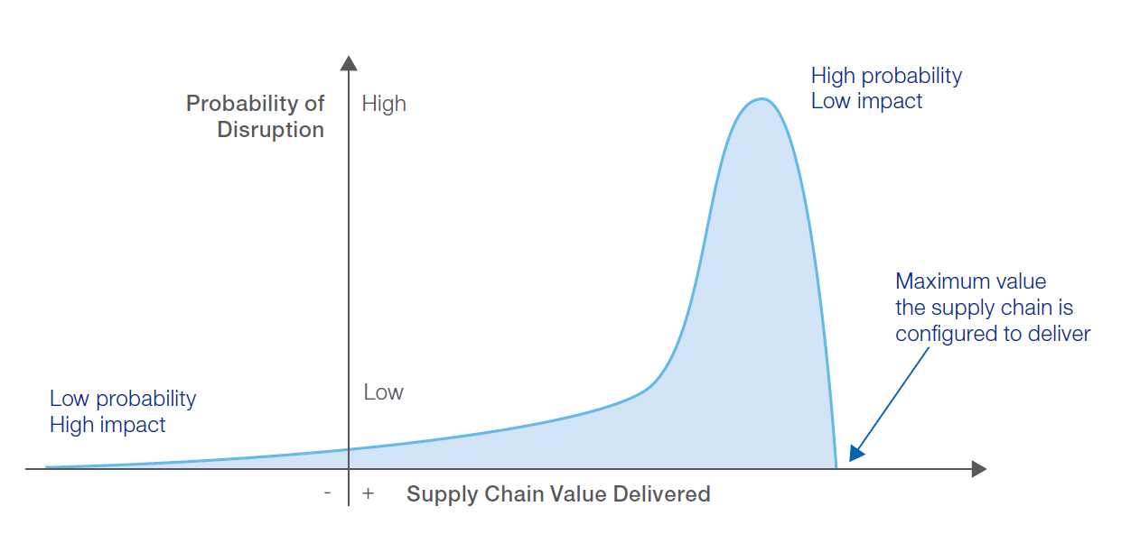

Slide 30
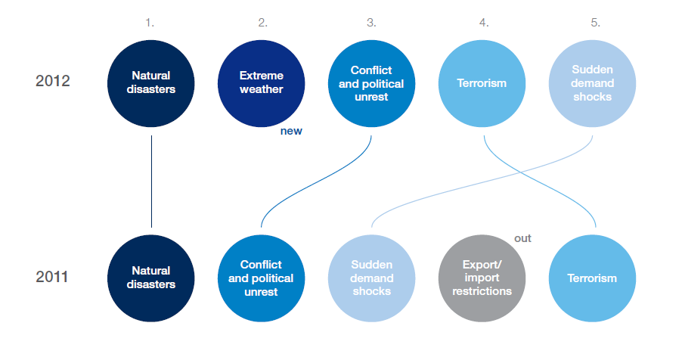
Top Five Disruption Triggers

Slide 31
Risk Management
The way forward: -
Shared responsibility between public and private sectors and functional decision makers in companies
Align organisational agendas around the most important challenges to address

Slide 32
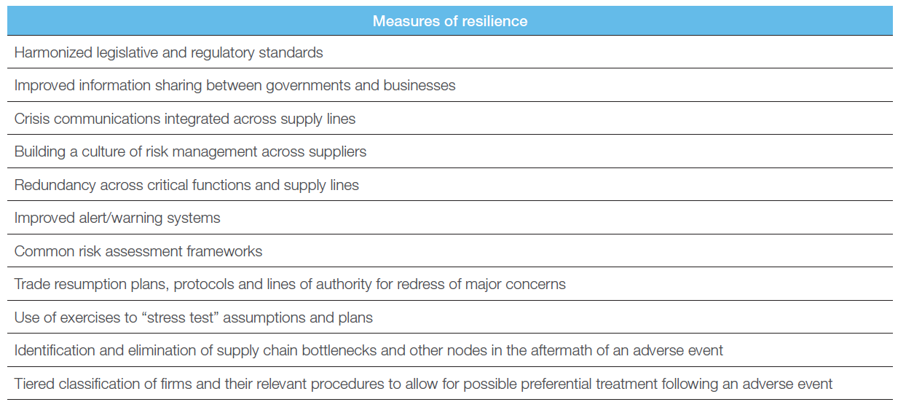

Slide 33
Building Resilient Supply Chains
Issues to Consider
Determine the interconnecting pipeline of suppliers through which information, products and cash must travel to the end user
Predict the time it would take to re-establish service in the event of disruption

Slide 34
Building Resilient Supply Chains
Issues to Consider
Better assessment of risk
More clear communication and discussion of vulnerability
Highlight over reliance on particular suppliers

Slide 35
Building Resilient Supply Chains
Issues to Consider
Supplier failure – where it can occur
Collaboration
Supply base rationalisation
Postponement
Supply chain agility
Supply chain visibility
Supply chain velocity
Acceleration

Slide 36
Supply Chain Agility and Visibility
Supply Chain Agility: - is the ability to respond to changes in demand or supply
Supply Chain Visibility: - is the ability to see all stages of the supply chain from one end to the other (both upstream and downstream)

Slide 37
Supply Chain Velocity and Acceleration
Supply Chain Velocity: - is the time taken for the initial inputs to the supply chain to reach the end-user
In reality the organisation will be more interested in the time taken from when it places the order until it receives the goods or service specified
Acceleration: - measures how rapidly the supply chain reacts to changes in demand, whether upwards or downwards

Slide 38
Key Aspects of Supply Chain Resilience
Readiness – probability of disruption occurrence
Response – the level of consequences of those disruptions occurrence
Recovery – time to recover to normal state from disruption state

