Slide 1

Counselling, Mindfulness and Therapeutic Practice (ECYW4004)
By Rachael Major
Student Number: 2204546

Slide 2
Introduction/Index
Introduction
Building relationships
Chosen Method
Conclusion
Your questions
Reference List

Slide 3

Building relationships - definition
Building positive relationships with young people is essential for Youth Practice = Youth grow and thrive in a relationship that provides love and nurturance, security, and responsive interactions
A positive adult-youth relationship is built on "trust, understanding, and caring which will enable young people to co-operate better and enable an increase in motivation" (Webster-Stratton, 1999).

Slide 4

Building relationships – why it's important?
For Youth workers, good-quality relationships are important within their work as explained by Open University (Open Learn, Professional relationships with young people, 2016) "the trust built by those strong relationships enables them to encourage young people to have new experiences, take some risks and gain new learning".

Slide 5
Building relationships – where it takes place
Building relationships takes place in a wide range of Youth settings, wherever young people are.
Some of which include:
Youth clubs and Youth centres
Youth counselling units,
Youth action and participation groups
Drug and alcohol projects

Slide 6

Factors to consider when working with young people
To develop meaningful relationships there are several factors to consider as they come with different interpretations.
Some factors explained by Egan (The skilled helper, pg 67, 2002) include:
Bodily behaviour
Eye behaviour
Facial expressions
tone of voice (pitch, volume)

Slide 7
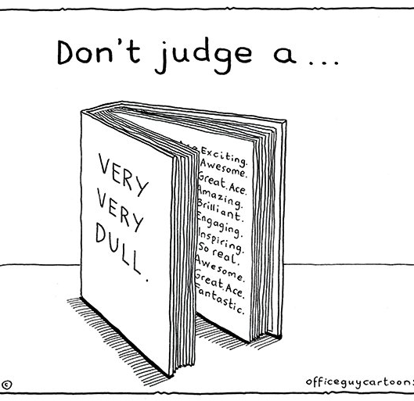
First impressions
It is important for Youth workers to provide new members with an appropriate welcome that suits their circumstances and needs to be able to start building a positive relationship
The method of welcoming young people as explained by kate Sapin (Essential Skills for Youth Practice, 2nd edition, pg 58, 2013) requires a Youth worker who "embraces participative and anti-oppressive values"

Slide 8

Building relationships – Skills and characteristics needed (In groups or one to one)
Communication and listening skills
Psychological knowledge
Sensitivity, empathy and patience
Positive Attitude
Observation skills
Considering culture. What do you know about the things that are influencing the way they understand the world?

Slide 9

Additional Skills - Understanding Youth work roles and responsibilities
Sapin (Essential Skills for Youth Practice, 2nd edition, pg 20, 2013) explains the essential skills based on roles and responsibilities. Here are some below:
Identifying Youth work values and applying them to practice
Recognising role conflict
Identifying unacceptable Youth work behaviour
- Keeping up to date with legal constraints
Respect for young people is at the heart of Youth work values as it's profession that works with young people through a positive and participative approach – enables them to build relationships

Slide 10

Building relationships - boundaries
The National Youth Agency (Guidance, on Personal, Professional and Environmental Boundaries, pg 2, September 2021) explains the values of boundaries by stating that "Successful youth work is built upon a trusted relationship. Boundaries are there with the intention to support this relationship, whilst identifying appropriate behaviours in that relationship"
Based around the idea that you are friendly but not friends. = Ensures a safe space for all and avoid unhealthy relationships.

Slide 11

Building relationships – tools needed
The tools needed for Youth workers to build a relationships:
Activities/session plans. Such as Naomi model
Carrying a risk assessment
Information on Meic Cymru
A list of ideas using participatory and therapeutic methods to use in their practice
NOS (CLD Standards Council Scotland,2019) function map as a reminder about Youth work values

Slide 12
Building relationships – approaches needed
Person centred approach (self-actualization, a young person could do this themselves) – Carl Rogers theory (1959)
5 pillars approach (Youth Work in Wales: Principles and Purposes (2022) - Youth workers should always work in accordance with the 5 pillars. Building relationships through Empowerment by encouraging young people to engage in social activities to build relationships.
Educative Expressive Participative Inclusive Empowerment

Slide 13
Building Relationships through understanding theories
According to Tuckman (1965), groups need to fully explore four stages to be able to progress and work effectively as a team.
Forming Storming Norming Performing
Enables young people to understand each other and build a positive relationship

Slide 14
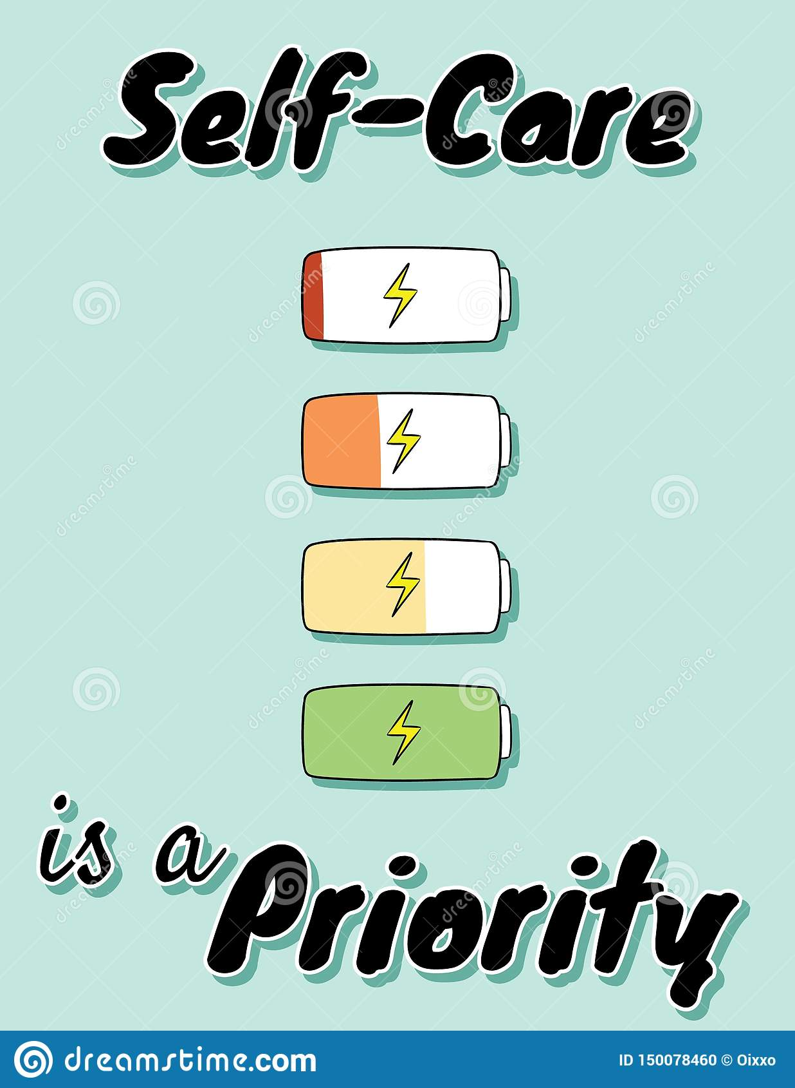
Building relationships – self-care
Youth workers show a concern for the well-being of young people.
As explained by the Global Self-Care Federation (What is self-care?, 2023) "It is a decision-making process that empowers individuals to look after their own health efficiently and conveniently"
Why is it important?
Self-care is also a way to remind a Youth worker that they are a person before an employee – might forget to look after themselves
Knowing what steps Youth workers can take to support their mental well-being can help them feel better and have better relationships with the people around them

Slide 15
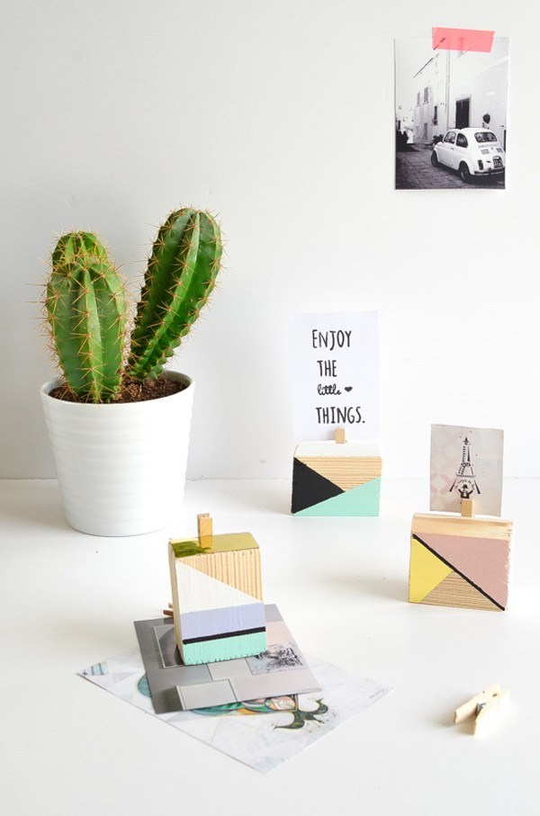
Picture block
Step 1 - Grab your materials
Step 2 - Stick the peg onto the block
Step 3 - Get your card and get creative
Step 4 - Attach your card to the peg
Now it is your turn

Slide 16

Method – Arts and Crafts background
Why do Youth workers use art and crafts and why is this approach effective?
Self-Expression and Managing Feelings
Art and crafts are also proven to have a "positive impact on mental health and well-being" (Amber Gravenell, Kent-Tech.com, The Many Benefits of Arts and Crafts for Children, 28/06/2021)
2) Fine Motor Skills
3) Patience
4) Organisational Skills

Slide 17

Chosen Method – picture block holders
Why I chose it
1 - Doesn't need words
2 - Suitable for any Youth ages
3 - Can be used in group work or individual
4 - Can be used for emotions
5 - Doesn't cost much to use/work with what you have at home/materials are accessible.
6 - Anyone with physical disabilities such as wheelchair users are included so they won't feel left out.
7 - No right or wrong answer/can interpretate in different ways

Slide 18

Skills developed through picture blocks
Creative skills
Thinking skills
Communication skills
Concentration
Confidence
Imagination/problem solving skills
Planning skills
Fine Motor skills

Slide 19

Chosen method – how this approach can be used to build meaningful relationships (in groups or one to one)
Non-formal activity (no pressure put on them to get it right/no need for perfection) = no conflict
Youth workers can get to know them with their interests
Teamwork
Understanding emotions
Self-care (building a relationship with themselves)

Slide 20

Chosen method – links for building a relationship
Can take place in any Youth setting and used in a variety of different ways
The skills, tools, approaches needed and factors to consider for a Youth worker to build relationships can be applied and used during this method
Self-care for both the young person and Youth worker (a relaxing activity to deliver and do).
Theories such as Rogers and Egan can be applied to this method

Slide 21

Conclusion

Slide 22

Any Questions?

Slide 23
Reference List
Egan, G. (2002) The Skilled Helper, Pacific Grave, C.A: Brookes/Cole.
Kate Sapin, Essential skills for Youth Work Practice, 2nd edition, London, Sage Publications ltd, 2013
https://centerstone.org/our-resources/health-wellness/tips-for-happier-relationships/#:~:text=Listening%20strengthens%20relationships%20and%20demonstrates,interruption%20is%20like%20a%20release.
https://exchangepress.com/eed/view/4447/#:~:text=Observing%20helps%20you%20build%20relationships,and%20preferred%20mode%20of%20expression.%22

Slide 24
Reference List
https://cldstandardscouncil.org.uk/resources/standards-and-benchmarks/national-occupational-standards/youth-work-nos/
https://inyous.teachable.com/courses/inyous/lectures/11564892
https://naaweb.org/professional-development/item/380-10-tips-for-building-relationships-with-youth#:~:text=Building%20positive%20relationships%20with%20youth,%2C%20security%2C%20and%20responsive%20interactions.
https://www.coe.int/en/web/european-youth-foundation/definitions
https://www.kent-teach.com/Blog/post/2021/06/28/the-many-benefits-of-arts-and-crafts-for-children.aspx#:~:text=Art%20can%20improve%20confidence%20and,communicating%20how%20they%20are%20feeling.

Slide 25
Reference List
https://www.nya.org.uk/wp-content/uploads/guidance-on-personal-professional-and-environmental-boudnaries.pdf
https://www.open.edu/openlearn/health-sports-psychology/professional-relationships-young-people/content-section-0/?printable=1#:~:text=For%20practitioners%20working%20with%20young,and%20perhaps%20acquire%20new%20learning.
https://www.selfcarefederation.org/what-is-self-care#:~:text=Self%2Dcare%20is%20the%20practice,social%20care%20professionals%20as%20needed.

Slide 26
Reference List
https://www.simplypsychology.org/carl-rogers.html#:~:text=Carl%20Rogers%20(1959)%20believed%20that,human%2Dbeingness'%20we%20can.
https://www.youngminds.org.uk/professional/community-support/building-supportive-relationships-with-young-people/
https://www.youthscotland.org.uk/youth-work-essentials/up-running/what-is-youth-work/#:~:text=Effective%20youth%20work%20takes%20place,projects%20%2D%20wherever%20young%20people%20are
https://www.cwvys.org.uk/wp-content/uploads/2022/10/YOUTH-WORK-IN-WALES-2022-ENGLISH.pdf
https://www.wcupa.edu/coral/tuckmanStagesGroupDelvelopment.aspx#:~:text=These%20stages%20are%20commonly%20known,more%20collaborative%20or%20shared%20leadership.

