Slide 1
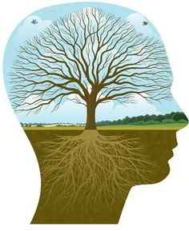

Does Ecotherapy reduce anxiety in adolescents?
This Photo by Unknown Author is licensed under CC BY-ND
This Photo by Unknown Author is licensed under CC BY

Slide 2



Key words
Counselling
Physical Activity
Youth
Societal Change
Creativity
Green Space
Mental Health
Technology
Wellbeing
(Sackett, 2010)

Slide 3

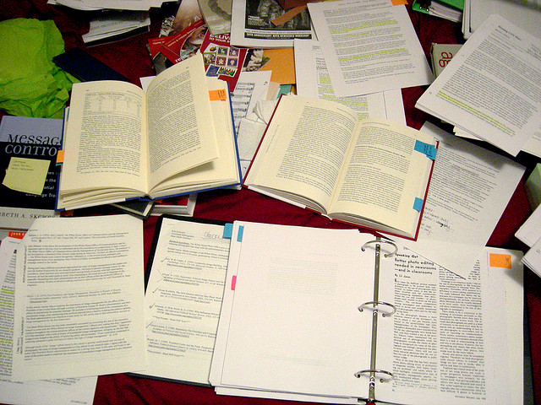
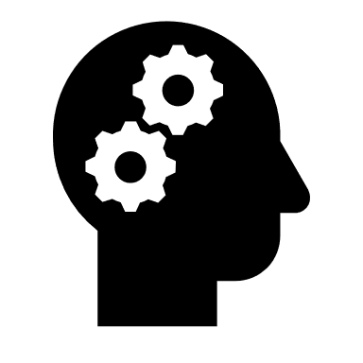
Research Method
Literature Review –
Narrative style
Qualitative
Peer reviewed journals
Findings of authors
This Photo by Unknown Author is licensed under CC BY
(Green, Johnson & Adams, 2006)

Slide 4
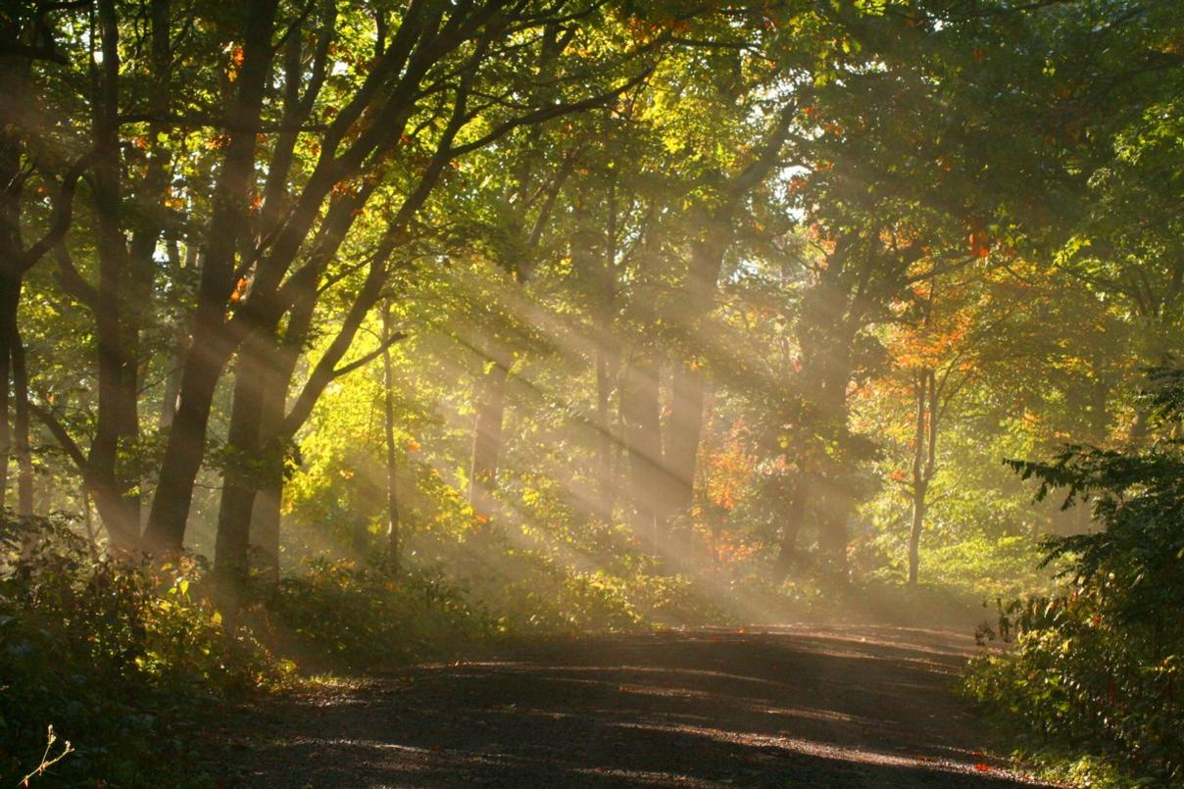
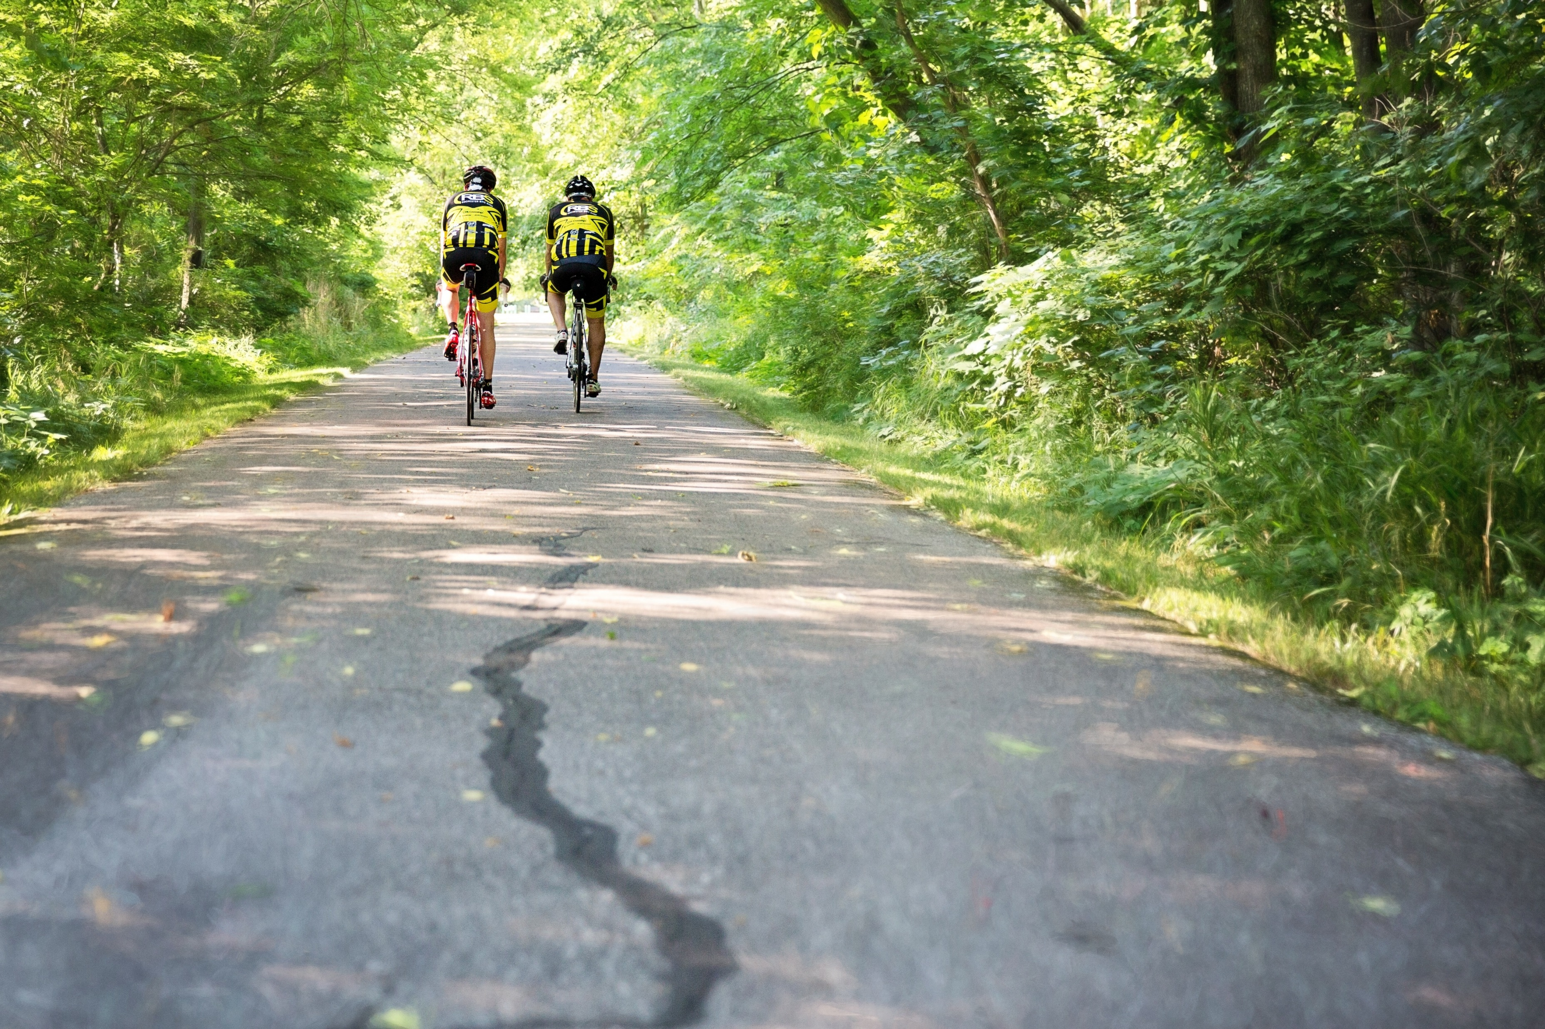
Research Question
Does Ecotherapy reduce anxiety in adolescents?
Inquiry questions:
How does Ecotherapy help with anxiety? – exercise, nature, sunshine?
Interest towards research question
This Photo by Unknown Author is licensed under CC BY-ND

Slide 5
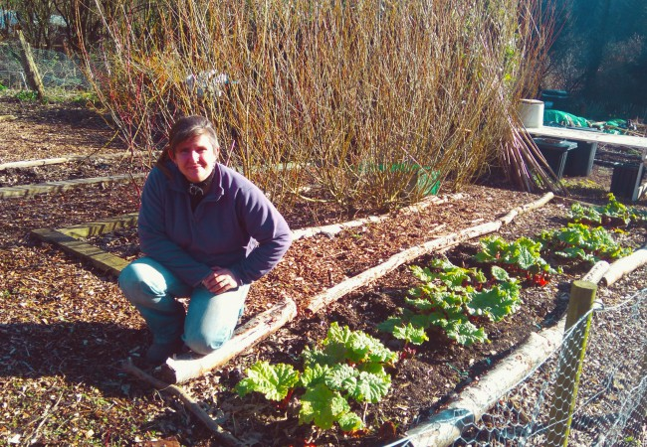
Background and context
What is Ecotherapy?
Aims to improve mental health as well as physical wellbeing by involvements of activities in nature.
Belief that people can obtain lots of health benefits by connecting with nature (Mind, 2019).
What activities does it involve?
Walking
Gardening
Therapeutic conversations outdoors
Animal-assisted therapy
Nature meditation
Cycling
Camping
(Jordan & Hinds, 2016)
This Photo by Unknown Author is licensed under CC BY-NC-ND

Slide 6
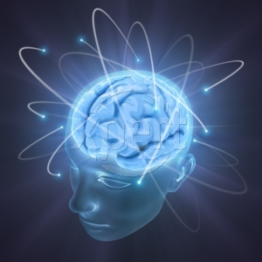
Background and context
History of Ecotherapy? – Was first explored in the early 1990’s with environmentalism and psychology. Gradually merged both to form eco-psychological work. Introduction to the new therapy was believed to be introduced after publication of first few essays and publications, including the book Ecopsychology: Restoring the earth, Healing the Mind (1995). (Orr, 2010).
This Photo by Unknown Author is licensed under CC BY-SA-NC

Slide 7
Discussion points
Does it work? – Growing evidence demonstrates that direct contact with nature is beneficial for our psychological, emotional and physical health (Jordan & Hinds, 2016).
Study example – 104 students of the first, second and third year of Education for Primary School Population.
Presented with a descriptive survey determining if there was an association between health – relaxation and relaxation – natural environment.
Answers were then categorised to obtain numerous variants of chosen locations to relax.
Results showed that the most significant category was nature with a score of 60.6% whilst also acknowledging that there is a strong link between “knowing how to relax” and human health, with 81.7% of participants agreeing (Horka & Hromadka, 2010).

Slide 8
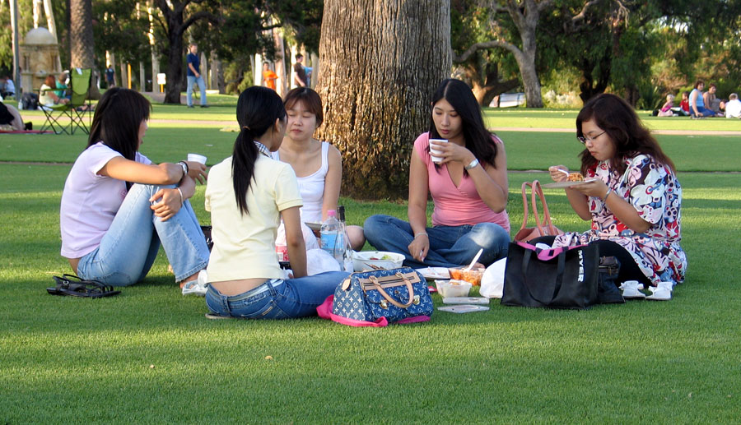
Discussion points
How does it work? – The successful effects of ecotherapy are believed to be due to:
Engaging in physical activity
Social interaction with others – prevent loneliness, boost self-esteem
Being within nature – boost mood and sense of wellbeing
Activities not only help the individual but helps the environment too
(Mind, 2019)
This Photo by Unknown Author is licensed under CC BY-SA
Questions to explore –
Is it recognised?
What is the availability of the therapy?
What are the benefits?
Is it suitable for all ages?
Are there alternative activities for those with disabilities?

Slide 9

Authors under consideration
Authors
Martin Jordan & Joe Hinds – Theory, Research and Practice
Martin Jordan – Registered Counselling Psychologist
Linda Buzzell - Psychotherapist
Ronen Berger – Founder of the Nature Therapy Centre and the Nature Therapy Training Programme
Craig Chalquist – Psychologist
(Jordan & Hinds, 2016).
Organisations that acknowledge the therapy
Mind
Do-It
Groundwork
Let Nature Feed Your Senses
Sustrans
(Mind, 2019)
This Photo by Unknown Author is licensed under CC BY-NC-ND

Slide 10
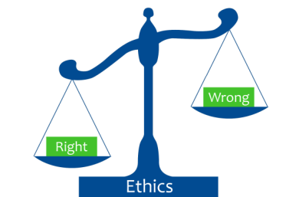
Ethical Considerations
Although a literature review wouldn’t pose many ethical concerns, it would be beneficial for the researcher to consider the effects of the theme or topic of research. As discussions of anxiety and depression can sometimes be an upsetting subject, if the researcher themselves had experienced these mental health issues or know somebody that does, it would be essential to consider the ethical safety of researching such topic (Malacrida, 2007).
This Photo by Unknown Author is licensed under CC BY-SA-NC

Slide 11

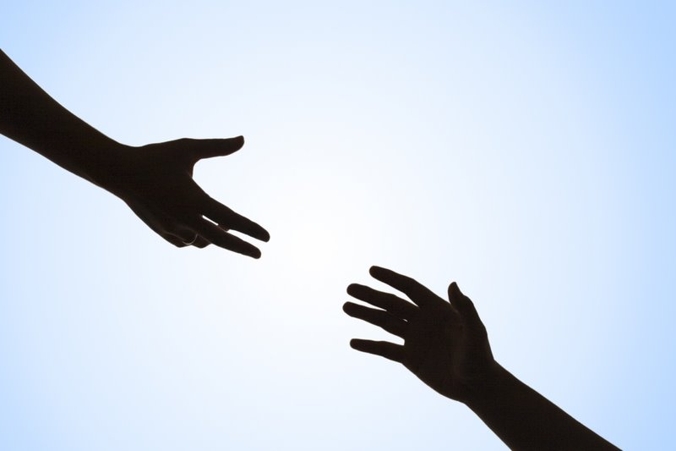
Potential arguments/implications
Does the therapy work as successfully as suggested individually, or is it due to the fact that people are accompanied by others?
Could be an alternative option for individuals awaiting for therapy suggested by their GP
Is availability as high in colder seasons?
How secure, formal and confidential is this therapy?
This Photo by Unknown Author is licensed under CC BY-SA
This Photo by Unknown Author is licensed under CC BY-NC-ND
(McGeeney & Jeffery, 2011), (Jordan, 2014)

Slide 12
Reference List
Green, B., Johnson, C., & Adams, A. (2006). Writing narrative literature reviews for peer-reviewed journals: secrets of the trade. Journal Of Chiropractic Medicine, 5(3), 101-117. doi: 10.1016/s0899-3467(07)60142-6
Horka, H., & Hromadka, Z. (2010). The ecotherapeutic potential of nature and taking care of ones health. Řehulka, E.(ed.) SCHOOL AND HEALTH 21. Papers on Health, 1, 201-212.
Jordan, M. (2014). Moving beyond counselling and psychotherapy as it currently is – taking therapy outside. European Journal Of Psychotherapy & Counselling, 16(4), 361-375. doi: 10.1080/13642537.2014.956773
Jordan, M., & Hinds, J. (2016). Ecotherapy: Theory, research and practice. (p. 15, 138). Macmillan International Higher Education.
Malacrida, C. (2007). Reflexive Journaling on Emotional Research Topics: Ethical Issues for Team Researchers.

Slide 13
Jordan, M., & Hinds, J. (2016). Ecotherapy: Theory, research and practice. (p. 15, 138). Macmillan International Higher Education.
Malacrida, C. (2007). Reflexive Journaling on Emotional Research Topics: Ethical Issues for Team Researchers.
Qualitative Health Research, 17(10), 1329-1339. doi: 10.1177/1049732307308948
McGeeney, A., & Jeffery, S. (2011). The perceived multiple benefits of ecotherapy for mental health service users.
Mind. (2019). Retrieved from https://www.mind.org.uk/media/2699029/making-sense-of-ecotherapy-2015.pdf
Orr, D. W. (2010). Ecotherapy: Healing with nature in mind. Catapult.
Sackett, C. (2010). Ecotherapy: A Counter to Society's Unhealthy Trend?. Journal Of Creativity In Mental Health, 5(2), 134-141. doi: 10.1080/15401383.2010.485082

