Slide 1


BA (Hons) Leadership and Management Skills for the Workplace
Module: Managing Projects in the Organisation.
Module code: BMSW 5104
Student: Rupia Hussain-ID: 2010133
Lecturer: Charles Nwaogwugwu
Assignment Title: Presentation- Proposal of Project Management Plan

Slide 2
Table of Contents
What is Project Management
Introduction to project- Revamp
Project Statement
Quad Chart
Stakeholders and Communication plan
Work Breakdown Structure
Cost Breakdown Structure
Risks Identification and Risks Register
Risk Management- Matrix and Contingency Plan
Evaluation
Recommendations
References
Appendix

Slide 3
What is a Project Management
A group of people assembled with necessary quality and skills to work together to achieve common goal or an objective, for or within an organisation.
Project life cycle - Start and End.
Project phases: planning, initiation, execution, monitoring and closing of the project.
Project has 3 major constrains:
Scope: refers to deliverables and tasks needs doing to achieve the goal.
Cost: total amount required to complete a project. Or can be fix budget to complete the project within the budget.
Time: to complete projects or given fix time to a project it’s also called the work schedule (Coursera, n.d.).

Slide 4
The project is motivated by Covid-19 Pandemic.
Children gaining weight:- prone to illness, such as non-alcoholic fatty liver disease, diabetes type 2 and cardiovascular disease (Lubrecht et al., 2022).
Netflix sales went up by 16 millions (Thomas, 2020).
Gaming sales increased by 30% only in the first 3 months into lockdown (Morris, 2021).
Bromley Health Club - Project Revamp
Increase Health Club Subscriptions

Slide 5
Project Statements
Key Objective- Targeted for children 11-16 years,
Introduce children to physical activity
12 weeks project
2 hours weekly
Team consist of project manager, fitness instructors, nutrition
Major deliverables:- Approval, Assembling of team, advertising, Activation, Monitoring.
Milestones:- 1. Reaching Activation. 2. Reaching Evaluation. 3. Ending
Encourage to join Health club

Slide 6
The Quad Chart- Revamp
Objectives Create health-conscious mind Promote healthy lifestyle Tackle overweight/obesity Make Physical activity fun Encourage subscription to health club | Stakeholders Health club Instructors Parents/Guardians Children Other club users
Desired end results Demands for more similar project Joining health club Being more health conscious Continuing health programs Adapting to healthy living styling | Measures of success Children enjoying the physical activities Parents and children showing interest to similar projects Increased monthly/yearly contracts Positive feedbacks

Slide 7
Stake holder Analysis and Communication Plan
Instructors- meetings every 2 weeks and each milestones
Health club- email update on reaching the milestones and Projective Activations- every 4 week
Parents- email updates with all relevant information at the start and when required, any change happens
Club users- advance notice display of any event / Class/ room change when required.
Children- Send emails once with activity details

Slide 8
Work Breakdown Structure – Project Revamp
Task- Deliverables: Work Packs | Description | Date
1. Approval WP- 1.1. Senior approval | Contact line manager. Discus plans and get signed approval. Arranging funding from account department | Beginning March. 2 weeks
2. Assigned Team WP- 2.1. fix date and time, Hall | funding authorised, assign instructors/ assistants, decide date and times slots. Allocate hall, finalize, organize equipment. | 2 Weeks
3. Advertising WP- 3.1. Link online registration | Printing flyers, poster around the health club. Design online registration forms. | March 4 Weeks
Achievement of | First Milestone | April
4. Activation of the projects WP- 4.1. Meeting children | Introducing project, duration, activities, explain the objectives of the projects. | 6 Weeks. May
5. Monitoring WP- 5.1. Activities effectiveness | Observing interaction to the activities children are doing. | 6 Weeks. May
Achievement of | Second Milestone | June
6. Evaluations- 12 weeks WP- 6.1. Children/Parent feedbacks. | Collect feedbacks, encourage stay healthy and active. | 1 week
7. Ending- Revamp WP-7.1. measuring the success | Reporting overall achievements of the projects, improvements, closing of the projects. | 1 Week End of June

Slide 9
Cost Breakdown Structure |  | Resources | Cost- Total £ 1,960
Team leader- £15.50 hour | Rupia | Access to all IT materials, admin systems | 290
Fitness Instructor -£14.70 hour | Elena | Physical activity Equipment-ball mats, rackets, rope, cones, timers, whistle. Sanitations materials | 550
Assistants coach- £13.50 hour | Andrew
Nutrition- £12.30 hour | Ana | Online resource, printing, water supply | 370
Advertising – £11. 25 hour | Maria | Printer, papers, online access | 750

Slide 10
Risks Identification and Risks Register
Risks | Chance | Trigger | Impact | Mitigation
1. Spread of Covid | likely | Hygiene | Shut down | Use gels/wipes
2. Accidents | likely | In proper use of equipment | Cost to health club | Supervision. clear instructions
3. Staff of sick | low | Covid and general health | Reducing activity | book bank staff/instructor
4. Funding | low | Change in activity/ miss calculations | Reducing activity | Stay with the plan and budget
5. High many interest | Most likely | It free, too many interests | Costs rise, difficult to manage | Limit registrations, first come basis

Slide 11
Risks Managements - Matrix and Contingency Plan
Email reminder to parents to check health day before.
Have Covid- testing kit available
Brief children the rules every session.
Book bank staff
Continuous monitoring of risks to eliminate existing or prevent of new risks

Slide 12
Evaluation- project Revamp
Activities suitability- not all activities was not suitable for older children
Nutrition advise- some talk session was too long, less attractive to children
Sessions duration- 2 hours needs reviewing
Duration of project- 12 weeks was adequate to get understanding the need of staying active
achieve the objectives, encourage children stay active, like before the covid-19
Have more various skilled team members
Project did not have necessary time for marketing

Slide 13
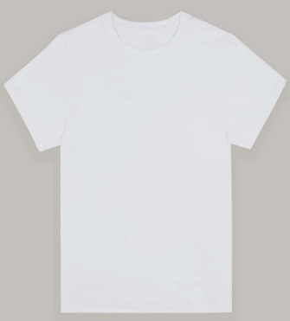
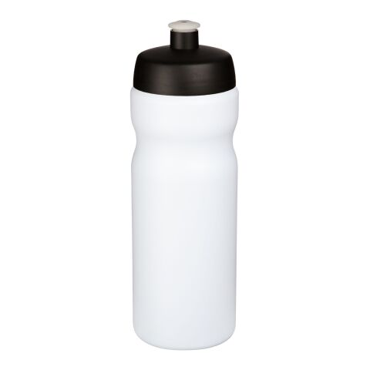
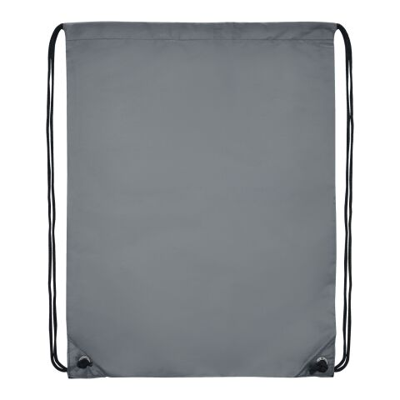
Recommendations
Keeping the nutrition talk short- making more interactive, fun, get kids involved
Variety of games- suitable for all ages
Project success- project has popularity should be run more often: holidays
Run similar project to encourage people to join the health club
Give away goodies reminder of the project
Increase work team and project size
Revamp
Revamp
Revamp

Slide 14
Reference
1. Coursera. (n.d.). What Is the Project Management Triangle? [online] Available at: https://www.coursera.org/articles/project-management-triangle?isNewUser=true&showOnboardingModal=1 [Accessed 29 Nov. 2022].
2. Lubrecht, J., Arayess, L., Reijnders, D., Hesselink, M.L., Velde, G. ten, Janse, A., von Rosenstiel, I., van Mil, E.G.A.H., Verweij, M. and Vreugdenhil, A.C.E. (2022). Weight Gain in Children during the COVID-19 Pandemic and the Protective Effect of Lifestyle Intervention in Children with Obesity. Obesity Facts, 15(4), pp.600–608. doi:10.1159/000525298 [Accessed 14 Nov. 2022].
3. MORRIS, C. (2021). One year into the pandemic, video game sales aren’t slowing down. [online] Fortune. Available at: https://fortune.com/2021/04/16/video-game-march-sales-npd-monster-hunter-rise-ps5/ [Accessed 14 Nov. 2022].
3. Thomas, Z. (2020). Netflix Adds 16 Million sign-ups in Lockdown Boost. BBC News. [online] 22 Apr. Available at: https://www.bbc.co.uk/news/business-52376022 [Accessed 14 Nov. 2022].

Slide 15
Thank you for listening, any questions??

