Slide 1

Suspects with mental ill health and vulnerabilities
BMLC4003

Slide 2
Learning objectives
By the end of the session, you should be able to:
Explain the legal responsibilities of police when dealing with vulnerable suspects.
Identify common indicators of vulnerability during suspect interviews or custody processes.
Apply knowledge to real-world cases and suggest good practice responses.

Slide 3
“What comes to mind when you hear the word vulnerable suspect?”

Slide 4
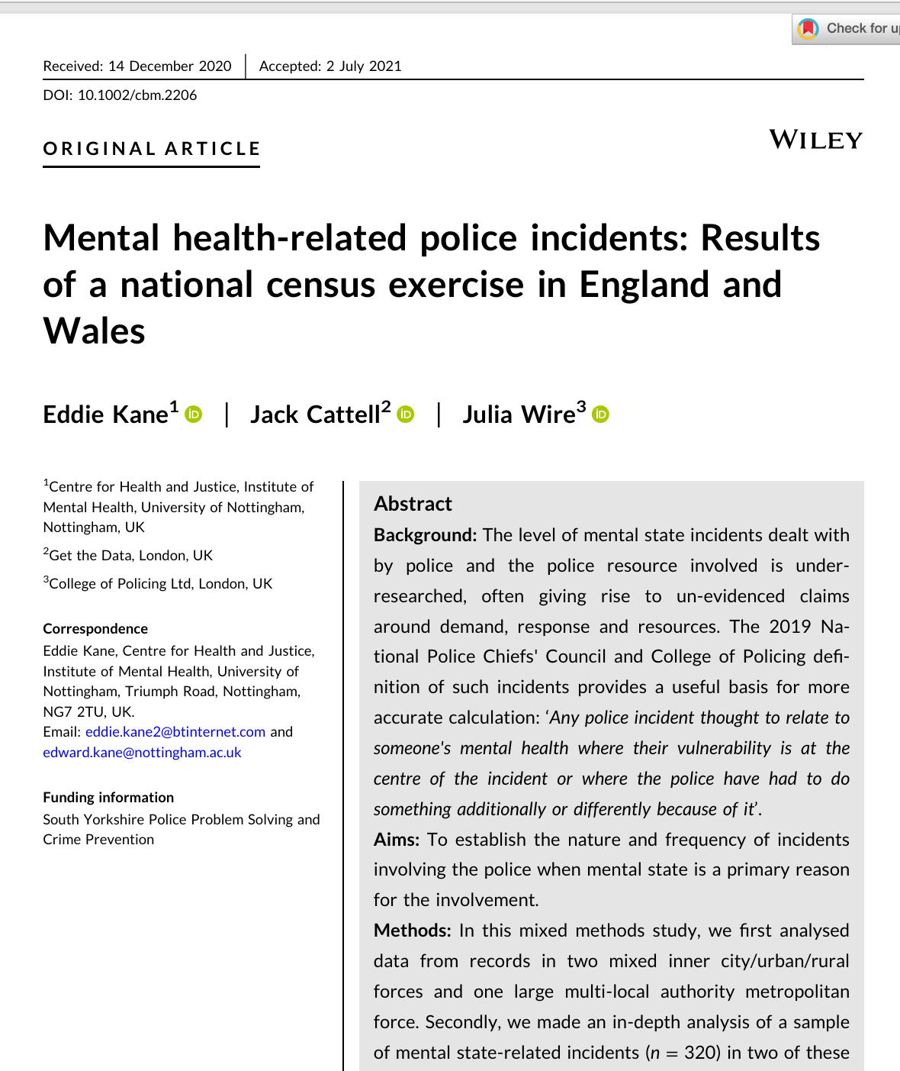
Prevalence of mental ill health among suspects in the UK.
There is no official statistic describing ‘mental ill health among suspects’.
Research on police-recorded mental state related incidents is the most reliable indication.
Kane at al (2021)
5.1% of all recorded police contacts involved a mental-state related issue
Generic mental health data shows:
Rising mental ill health, particularly among young adults and people in deprived communities.
1 in 5 adults now report a common mental-health problem

Slide 5
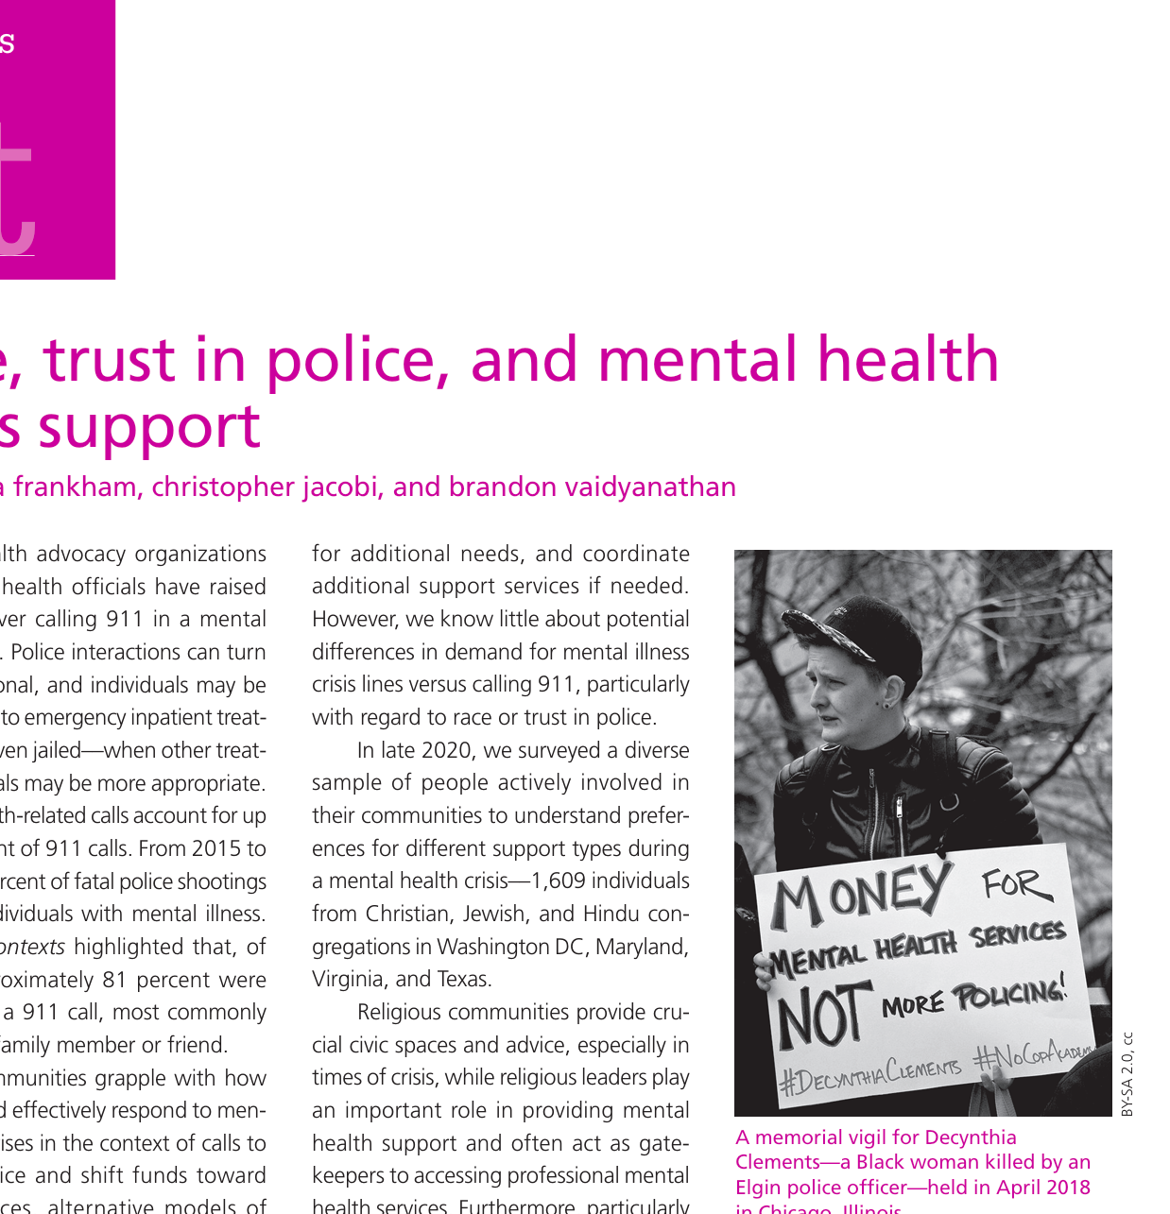
Impact of mentally vulnerable suspects
Greater likelihood of being detained
Vulnerable individuals often end up in custody for low‑level offences due to gaps in mental‑health services and lack of diversion options.
Difficulty understanding rights
Mental‑health conditions can impair comprehension, making suspects confused, suggestible or acquiescent without an Appropriate Adult.
Higher risk of false or unreliable statements
Anxiety, cognitive impairment or distress increases the likelihood of compliant false confessions or misunderstanding of questions.
Inconsistent identification of vulnerability
Officers often rely on a “hunch” rather than clear criteria; some regions use safeguards less frequently.
Longer time in custody
Delays in mental‑health assessments and limited clinical availability lead to extended detention times.
Custody used as a risk‑management tool
When health‑based places of safety are unavailable, police may detain individuals as a “safer to detain” decision.
Pressure on police resources
Lack of specialist training and limited collaboration with mental‑health services leave officers unprepared, increasing reliance on custody.

Slide 6
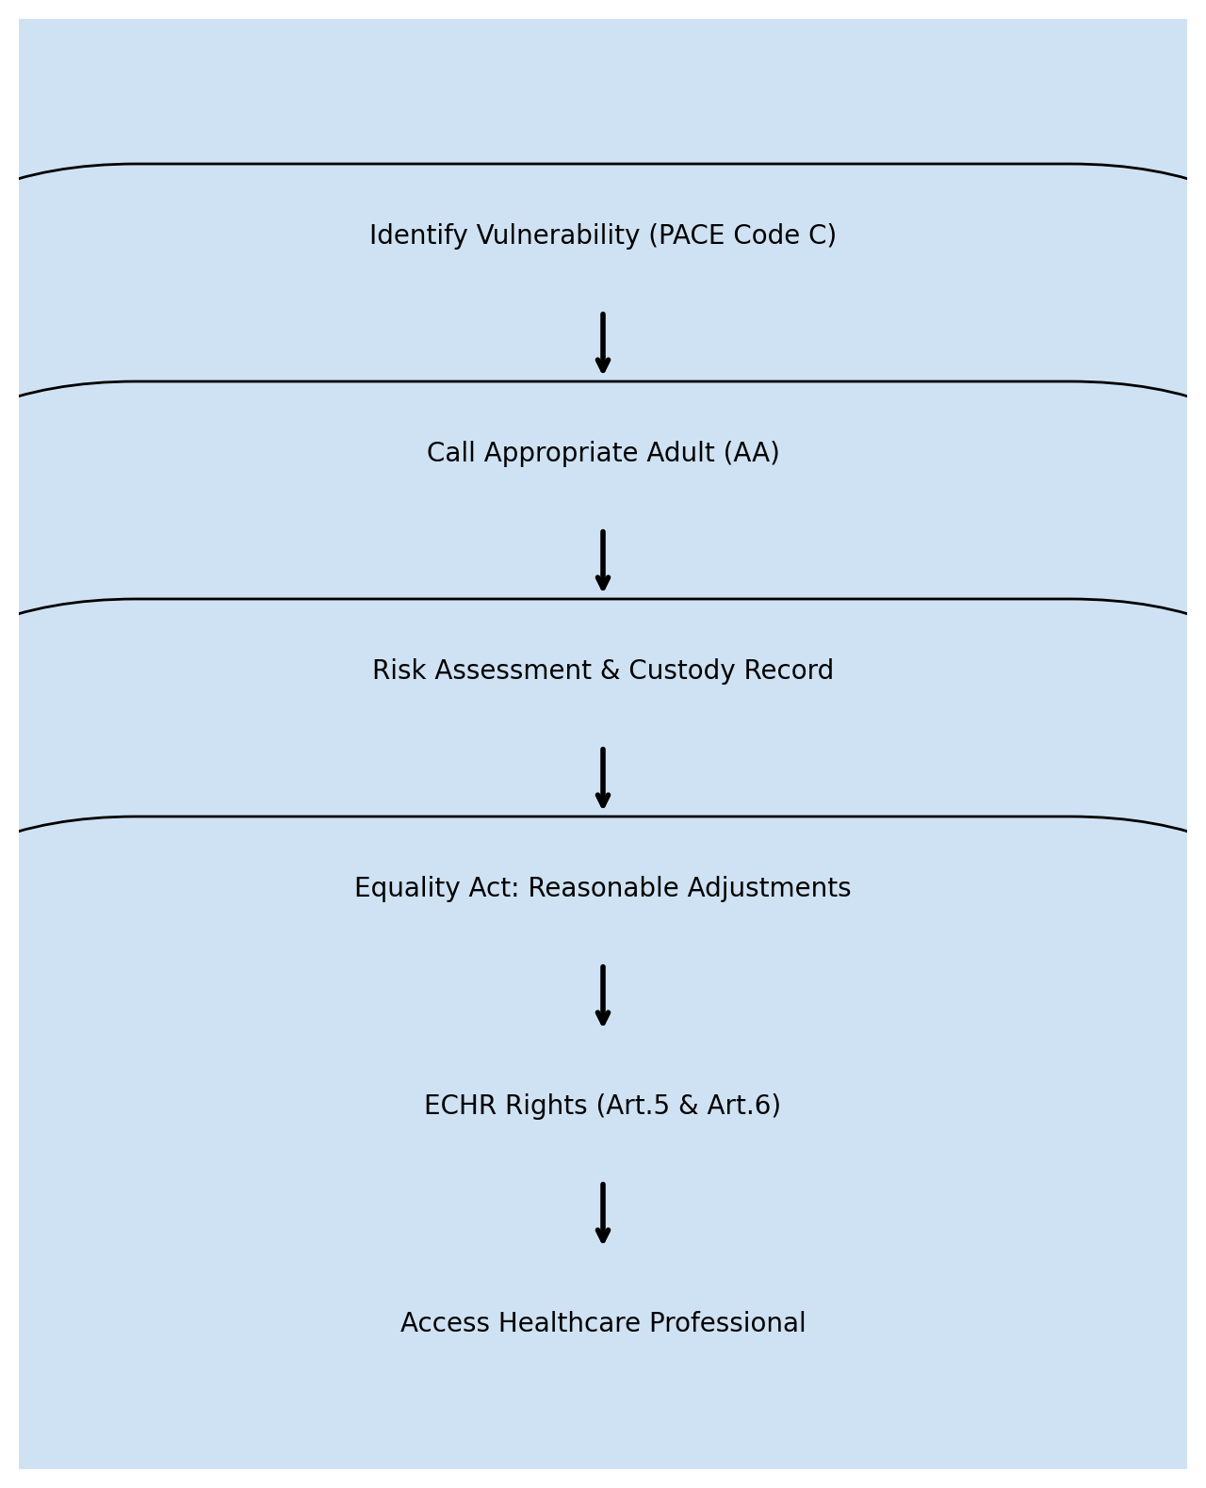
Protections for Vulnerable suspects

Slide 7
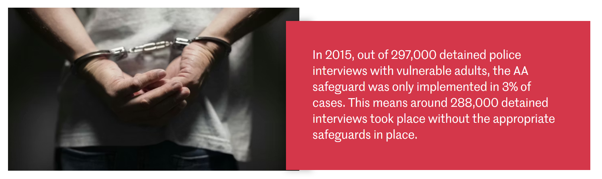
Protections for vulnerable suspects
- Dr Roxanna Dehaghani
Impact of the Research
The research had significant practical and policy outcomes:
Legislative reform: Findings contributed to revisions in PACE Code C, helping clarify definitions and expectations around vulnerability.
Improved national standards: The work influenced NAAN’s national standards for Appropriate Adult provision.
Enhanced safeguarding practice: By identifying gaps and proposing clearer frameworks, the research strengthened the protection of vulnerable individuals during police detention and interrogation.

Slide 8
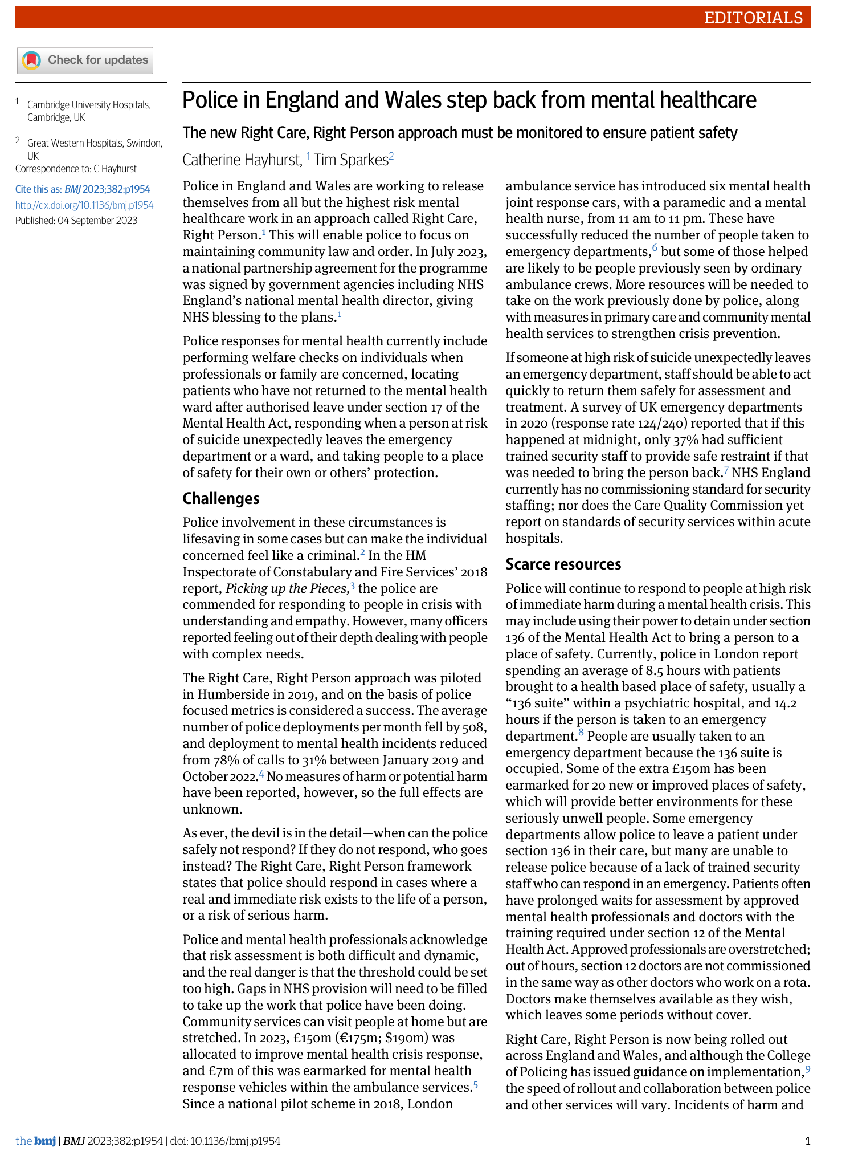
Consequences of Mishandling Vulnerable Suspects
Legal breaches: Violations of PACE Code C and human‑rights law; lost or overturned cases.
Reputational damage: Loss of public trust; national scrutiny.
Operational risk: Safety incidents in custody; increased workload and liability.
Ethical failings: Inequitable treatment; risk of miscarriages of justice.
Disciplinary outcomes: Complaints, IOPC investigations, officer sanctions.
System pressures: Reforms and policy changes (e.g., RCRP) increasing oversight.

Slide 9
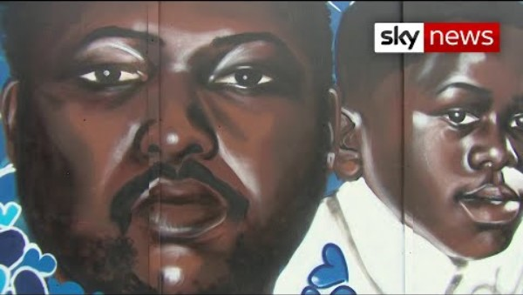
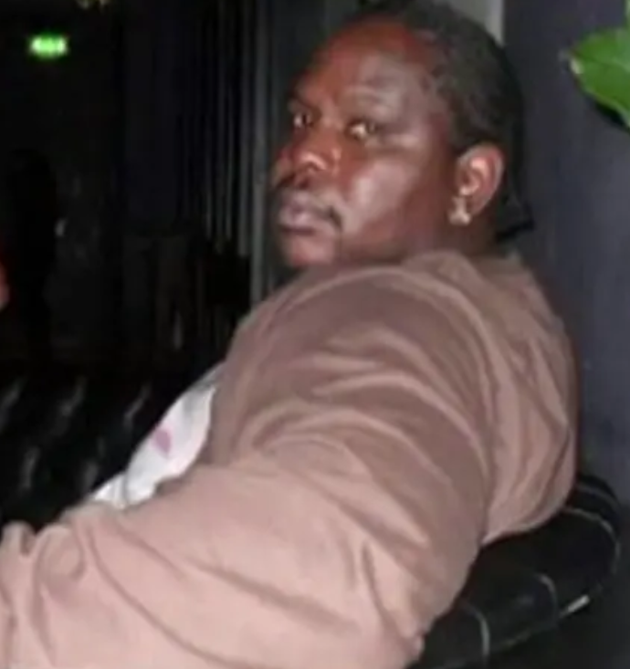
Kevin Clarke
A 35 year old man with paranoid schizophrenia
Died in police custody in March 2018
Experiencing an acute mental health crisis at the time
Restrained by up to 9 Met police officers during an episode in South-East London
Officers failed to recognise the medical emergency or provide the necessary duty of care while restraining him.
Clarke suffered acute behavioural disturbance and later went into cardiac arrest.

Slide 10
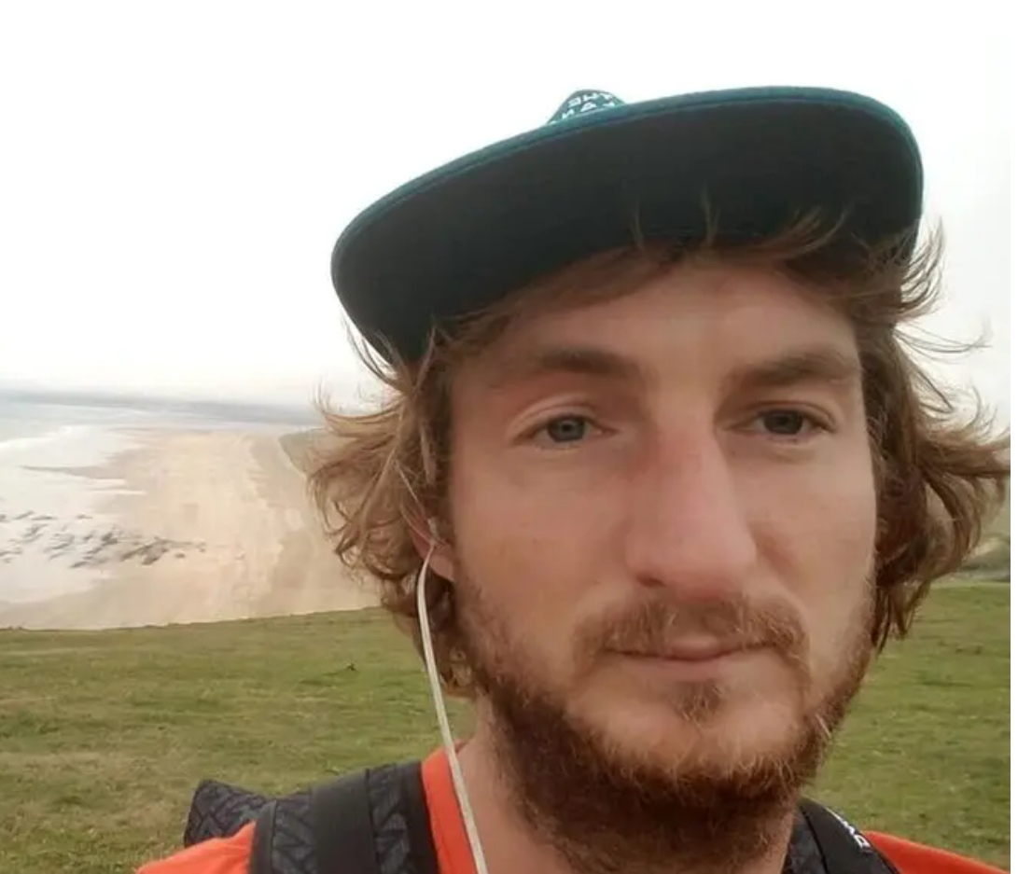
Case studies:
Timeline of custody
8 February - Lewis-Ranwell is arrested and charged with burglary. He exhibits "bizarre behaviours" at Barnstaple police station
9 February - Released from custody then rearrested after attacking an 82 year-old farmer. Tries to grab an officer's Taser, is aggressive and exhibits more bizarre behaviour
10 February - Released again on bail, subject to conditions. Travels to Exeter where he kills Anthony Payne, 80, and then 84-year-old twins Dick and Roger Carter
11 February - Arrested for a third time after attacking a worker at the Rougemont Hotel

Slide 11

Nottingham attacks (2023) – Valdo Calocane
Notes:
*20 minute true crime documentary* - The Nottingham attacks (2023)

Slide 12
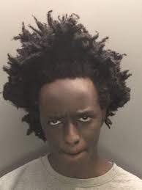
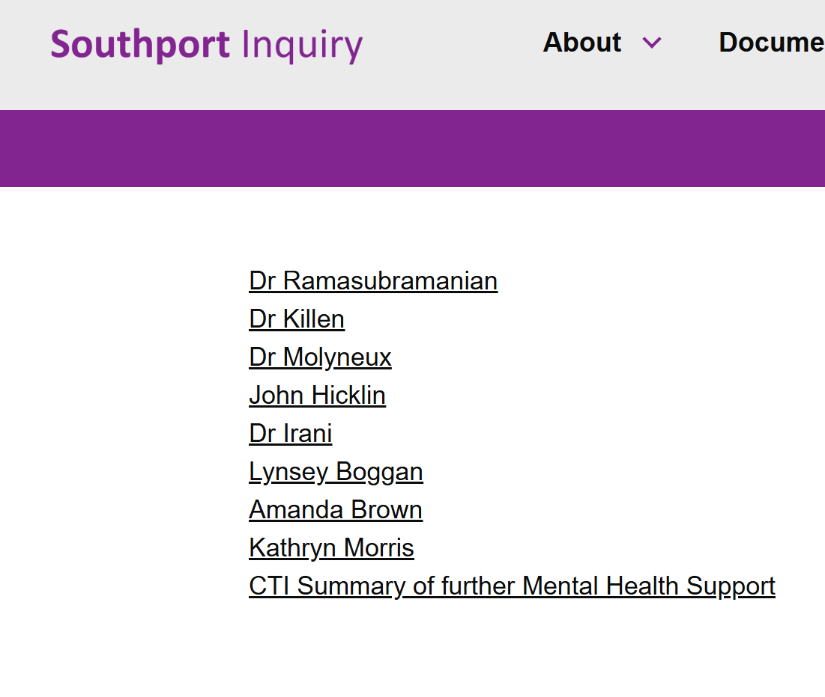
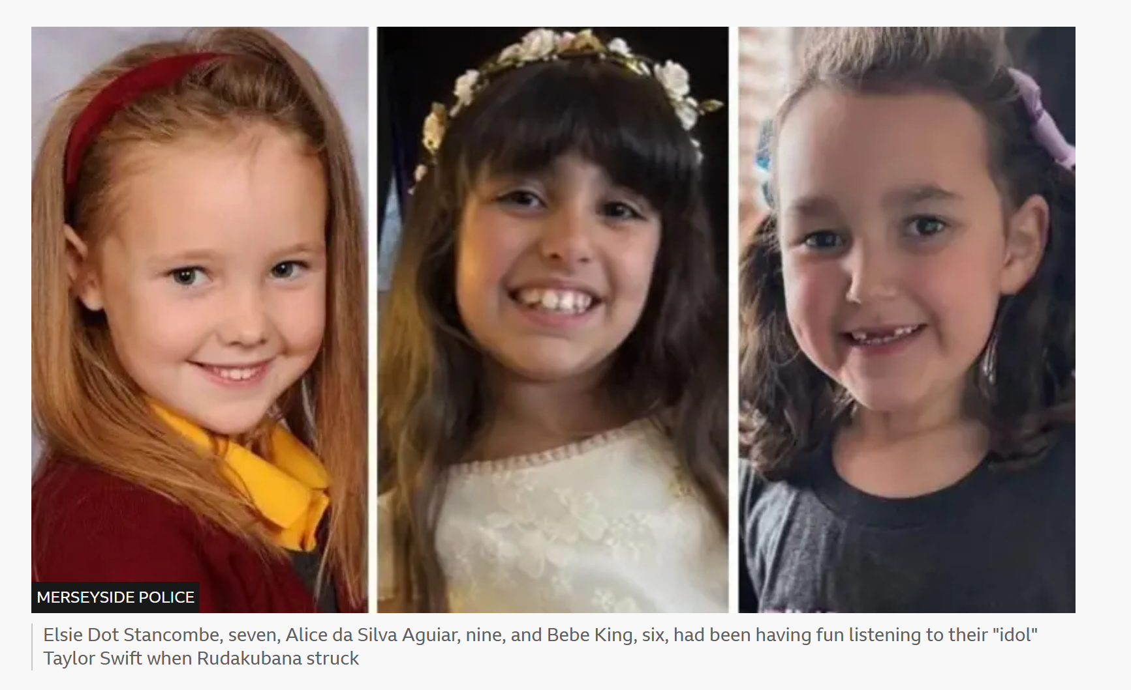

Southport killings - Axel Rudakubana

Slide 13
“Why are people with mental ill health disproportionately represented in police custody?”

Slide 14

Case study carousel
What vulnerabilities are present?
What should the police legally be doing?
What risks are present (false confession, self‑harm, misunderstanding of rights)?
What good practice actions should be taken?

