Slide 1

Terrorism and Cybercrime
Week 4 – Terrorism and Human Rights
Dr. Luke Roach
L.roach@uwtsd.ac.uk

Slide 2
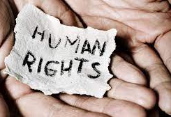
The Dilemma
For Governments to provide Safety and Security whilst protecting Human Rights.

Slide 3
Historical Context – England 1939
January to June 1939 127 bombings – IRA
Coventry August 1939 5 killed and 80 injured = Peter Barnes and Frank McCormick, were hanged for the Coventry Street bombings
Prevention of Violence (Temporary Provision) Act of 1939.
Last for two years, but reviewed yearly until 1954
Powers –
  powers of search to the Police
  power of detention for five days
  Power of immediate deportation
  Suspected IRA sympathisers required to register with the Police

Slide 4
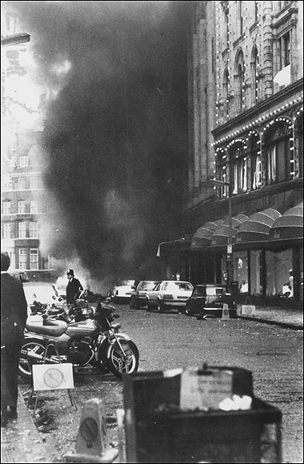
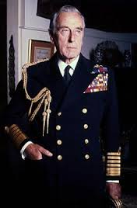
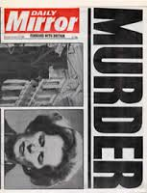
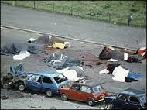
Historical Context
The Prevention of Terrorism (Temporary Provisions) 1989 act was in force for 12 years, and was very much focused on countering Irish Related Terrorism (IRT) activity, until the introduction of The Terrorism Act 2000 on the 19th February 2001.

Slide 5
Counter Terrorism (CT) Offences
The Terrorism Act 2000 (known as TACT2000) is the primary legislation relating to terrorism, from which all current offences are based. This was enacted in the year 2000 following on from temporary legislation that had existed for some years beforehand.
There are a number of other key pieces of legislation that have become enacted since 2000 which have sought to enhance and refine the 2000 act, and to give CT officers more powers such as:
Anti terrorism, Crime and Security Act 2001
Criminal Justice Act 2003
Terrorism Prevention and Investigation Measures Act 2005
Terrorism Act 2006
Counter Terrorism Act 2008
Terrorist Asset-Freezing Act 2010
Counter Terrorism and Security Act 2015
& Counter Terrorism and Border Security Act 2019

Slide 6
Amendments to Terrorism Act 2000
The Anti-Terrorism section amends some of 2000 Act extended powers of stop and search to include internal flights.
The Prevention of Terrorism Act 2005. This legislation created control orders – effectively a house arrest for suspected terrorists. This was repealed and replaced with the Terrorism Prevention & Investigation Measures Act 2011.
The Terrorism Act 2006 which has introduced some 9 new terrorism offences and amends some of the 2000 Act powers.
The CT Act 2008 – persons convicted under CT legislation to be registered, to live at approved premises, have their photographs taken and regularly updated, to report to a police station under certain circumstances
The Terrorist Asset freezing etc. Act 2010 has little bearing on Police work and was introduced to allow the treasury to freeze bank accounts of suspected terrorists
Terrorist Prevention & Investigation Measures Act - Persons who can not be charged and brought before a court may be subject to a TPIM measure i.e. relocate to a certain part of the country, restriction on association, restriction on mobile phones, restriction on bank accounts, restriction on computer use, restrictions on travel.
CT & Security Act 2015 – this legislation made amendments to parts of the terrorism Act 2000 and Aviation Security Act 1982 to deal with travellers. Most importantly it brought in a lot of PREVENT directives to Higher Education & Further Education organisations.

Slide 7
Powers of These Acts
Do these, in your evaluation, infringe on human rights in any serious way?
Are they justified in the response to perceived threat of terrorism?

Slide 8
Human Rights Act 1998
Right to life
Freedom from torture / degrading treatment / slavery
Right to security
Right to fair trial / no punishment without law ruling
Respect of family / private life
Freedom of speech
Freedom of assembly and association
Right to education / free participation in elections
Abolition of death penalty

Slide 9
Wilkinson (2007)
Spoke of the dangers of:
  Overreaction,
  Over reliance on military force
  Measures that involve curtailment of democracy,
  Abuses of Human rights and the Rule of law and the threat that these pose to democracy.

Slide 10
Northern Ireland- Discrimination
1966 : Catholic minority population discriminated against-politically, socially and economically.
Many had no vote as they were not ratepayers,
Electoral wards were ‘gerrymandered’ so that even where there was a Catholic majority there was still a Protestant council
Harland and Wolff shipbuilders had a workforce of 100,000 only 400 were Catholic.
The Catholic Community described itself as “an oppressed minority”-they had plenty to be angry about.
Allocation of Housing,
Employment: “ When I went for jobs, I found out I was asked if I was Catholic, not whether I had the qualifications. If I said I was Catholic, I was told the job was not available” (Belfast woman)

Slide 11
Norther Ireland – Civil Rights
The Catholic minority were persecuted – homes burnt down / driven from the areas they live in.
Demanded Civil Rights, the Protestant majority resisted
The Catholic community blamed the Police (largely Protestant), no action = violence
Enter the Troops:
The British Army were temporarily deployed to NI in 1969.
On their arrival they were welcomed by the Catholic community who saw the army as ‘protectors’ they were the ‘Good Guys’ – birth of the PIRA
The sight of heavily armed troops on the civilian streets did not fit well within communities

Slide 12
Overreaction – A Recruitment Tool
Community Unrests -
‘Operation Motorman’ saw the deployment of 31000 troops tasked with tearing down barricades protecting Catholic ‘no go’ areas,
Internment without trial (almost entirely against Catholics),
Bloody Sunday (30th Jan 1972 British Soldiers shoot dead 13 during a Civil Rights march)

Slide 13
Think back to Wilkinson
Overreaction?
Over reliance on military force?
Curtailment of democracy, Human rights and the Rule of law?

Slide 14
Community Effects
Stigmatisation of Community
Fuel Resentment
Support for Terrorist movements
Suspect Community

Slide 15
The Troubles
Whilst the combined Military/Police approach failed to deal with the PIRA there were arguably some successes:
  Numbers of those killed as result of terrorist attack reduced significantly:
    1972 – 467 deaths
  The late 1980's - 90’s less than 100 per year
  Prevented escalation of troubles to civil war and made the peace process possible

Slide 16

The UK’s CT Network

Slide 17
Scotland Yards Anti Terrorist Branch (SO13)
The main burden of containing and defeating terrorists lies with the Police as the methods use to detect and prosecute persons for terrorism are similar to those used to detect and prosecute criminality.
Prior to the events of 7th July 2005 the National responsibility for the Investigation of terrorism lied with Scotland Yards Anti Terrorist Branch, a section of the Metropolitan Police Service

Slide 18
Scotland Yards Anti Terrorist Branch
The partnership forged between the ATB and MI5 (supported by MPSB) had reaped rewards as the combination of the intelligence agencies together with the specialist knowledge relating to the terrorists, weapons, tactics, bomb disposal and bomb scene management skills possessed by the specialist resources within the ATB paid off.

Slide 19
PIRA on the Back-Foot!
Arguably it was the successes of this partnership and the successful prosecution of a number of key PIRA players that brought about the ‘ceasefire’ called in 1994 and ultimately led to the ‘Peace Process’ following the election of the Labour government in 1997.

Slide 20
MI5 and Crime
Following it’s success in gathering intelligence against PIRA there were calls for the Service to be used to tackle Serious Crime most significantly the illicit drug trade.
However, whilst MI5 focussed upon serious crime, PIRA and more latterly RIRA, as a result they neglected to identify the emergence of Al Qaeda and its affiliated groups

Slide 21
The Contemporary Wave of Islamism
The successes of the Iranian Revolution in 1979 and the multinational campaign against the Soviets in Afghanistan between 1979 and 1989 instilled in the minds of many young Muslims that they could ‘take on’ the US and were attracted by the ideology of a global jihad that appealed to a wide and disparate following in the Muslim world.

Slide 22
Birth of Al Qaeda
Following the Soviet withdrawal from Afghanistan in 1989 the group known as al-Qaida al Sulbah (‘The Solid Base’) began to support and assist local jihadist groups who opposed their governments in Muslim countries such as Algeria, Bosnia, Chechnya before developing its own Operational capability in close cooperation with a number of Egyptian Terrorist Groups (Egyptian Islamic Jihad, Islamic Group of Egypt) and becoming simply Al Qaida (The Base).

Slide 23
11th September 2001
The transformation of AQ from the ‘supporter’ or ‘facilitator’ seen during it’s early days to becoming Operational culminated in the attacks on the Twin Towers during which by recruiting Western educated Islamists they were able to strike deep inside the West. The resulting focus of the worlds security service forced the organisation to switch their attention to countries where it was easier to operate such as Indonesia, Pakistan and Chechnya.

Slide 24
THE CHANGING THREAT

Slide 25
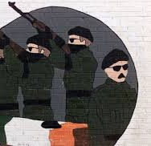
Irish Republican Terrorism
United Ireland
Hierarchal
Coded warnings
Non-suicidal
Infra structure
Targets and Collateral Death
Dialogue with HMG

Slide 26
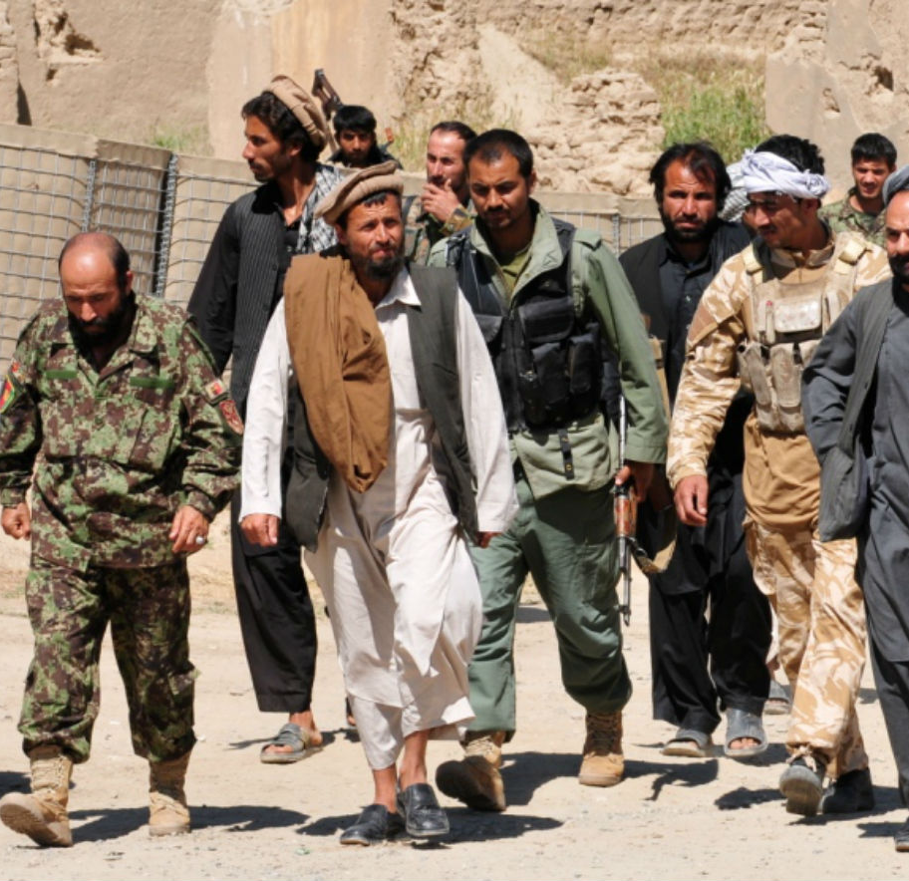
International Terrorism
An Interpretation of Islam
Disparate groups / individuals
Suicide
High collateral deaths
Vengeance
No dialogue with HMG
Recruited locally
Single Narrative

Slide 27
Change of Intelligence Function
Following the Cold War MI5 were handed the intelligence function for Countering the PIRA on the UK mainland previously the responsibility of the Metropolitan Police Special Branch (MPSB)
They quickly Identified significant Intelligence ‘gaps’ and working in partnership with the Metropolitan Police’s Anti Terrorist Branch had substantial successes in capturing key PIRA suspects planning terrorist attacks.
Arguably these successes led to the PIRA ceasefire of 1994 and paved the way for the ‘Peace Process’.

Slide 28
11th September 2001
The invasion of Afghanistan that followed the Twin Towers attacks forced AQ to alter its hierarchical structure into a movement that comprised of loosely affiliated or ‘localised groups and in order to continue to spread it’s ideology to resort to intensive networking.

Slide 29
The Threat to the UK
As early as 2003 the Head of MI5 and the Commissioner of Police for London had expressed the view that it was not ‘if’ but ‘when’ the UK would be attacked by Islamist extremists associated with AQ.
The attacks that took place on the 7th July 2005 bore all the hallmarks of such an attack (no warning, mass casualties, maximise publicity)

Slide 30
CTU's and CTIU's
HMIC recommended regionalisation of CT activity to provide coordination of intelligence gathering activity
Intel gathering and handling in accordance with NIM
Through Tasking and coordination process they provide regional strategic assessments of terrorism and other threats
Standardisation of Special Branch procedures

Slide 31
Policing Terrorism – Government Responses

Slide 32
Muslims in Britain today
The ONS 2018 revealed there is 3M Muslims living in Britain, by 2030 this number is estimated to grow to 5.5M,
In 2011 a study conducted at Durham University on behalf of the Equality and Human Rights Commission by Choudhury and Fenwick revealed that:
60% of Muslims are under 34,
In 2010 87% of terrorist prisoners were Muslim,
There appeared a disconnect between what the Government described as the major threat to communities (CT) and what the communities believed were the major threats (Criminality).

Slide 33
But who are the Terrorists?
Whilst the UK Muslim population is acknowledged as being law abiding and peaceful research conducted post 7/7 indicated some support for the bombings one MP commented:
“Few terrorist movements have lasted for long without a ‘supportive community’.

Slide 34
But who are the Terrorists?
“A supportive community does not condone violence, and certainly, most people in it would not want to become personally involved...whether or not they condone violence they see terrorists are sharing their world view, part of the struggle to which they belong.” (McGhee 2008:69).

Slide 35
So who are the Terrorists?
The suggestion of a ‘supportive’ rather than suspect community is a key point in the discourse surrounding the way in which Muslim communities are viewed as it implicates a far greater percentage of the Muslim population and it is this community support, sympathy or merely ‘seeing no evil’ which provides terrorists with the ability to plan and carry out their attacks (Lambert 2008).

Slide 36
UK Govt Responses to Terrorism
Body Scanners,
Section 44 Terrorism Act,
Schedule 7 Terrorism Act,
CONTEST (PREVENT),
CT Network,
ANPR
CCTV

Slide 37
Muslims in Britain Today:
The new Suspect Community?
Many Muslims believe that they are treated as the new ‘suspect community’ and question the Governments stance that International Terrorism is the greatest threat to communities.
Many believe that the threat from drugs, gangs, unemployment and racist violence is greater than that of terrorism.

Slide 38
Muslims in Britain Today:
The new Suspect Community?
Since 9/11 and 7/7 the overwhelming focus of CT work has been toward Muslim Communities,
The words “Muslim” and “terrorist” have become almost synonymous,
Concerns about the compliance of CT laws and policies with Human Rights (Section 44)

Slide 39
Remember Wilkinson
Overreaction?
Curtailment of democracy,
Human rights, and
The Rule of law?

Slide 40
Terrorism Legislation

Slide 41
Why Do we need Terrorism Legislation
To Provide the Police with Powers
To authorise Action to be taken
To Regulate Police Action

Slide 42
Why Do the Police need Powers
Need to Question People
Need to Search People and Premises
Need to Arrest People
Need to Seize and detain Property

Slide 43
The Terrorism Act 2000
Defined Terrorism *
Outlawed ‘Proscribed Organisations’
Provided new Stop and Search Powers
Provided new Border Powers
Provided new offences of Weapons handling/Training
Introduced new ‘fund raising’ offences
Introduced 'snooping charter’ re mobile telephone data

Slide 44
Terrorism Act 2000:
Problems with Police Powers
Allegations that Police Officers abused this power as it required no ‘Reasonable Suspicion’
Less than 1% of stops under this power resulted in arrest
Many Photographers, tourists and train-spotters were stopped

Slide 45
Stop and Search
Section 44 of the Terrorism Act allowed Police officers to Stop and Search people without Reasonable Suspicion
Section 44 also states that it is an offence to intentionally obstruct a police officer who is carrying out such a search.
A Ruling by the European Court of Human Rights declared this power to be unlawful and it has since been repealed

Slide 46
Stop and Search
Section 44 was Replaced via a Parliamentary Remedial Order.
It States that:
"Authorising Officers should only use the power when they reasonably suspect that an act of terrorism will take place, and he / she considers it necessary to prevent such an act".

Slide 47
Stop and Search at Ports
The Guardian 2011 Reported:
“Asian people 42 times more likely to be held under terror law
People from ethnic minorities more likely than white people to be stopped under schedule 7 of the Terrorism Act”

Slide 48
Additional Legislation
Even though Lord Lloyds review of Terrorism Legislation and the Introduction of the Terrorism Act 2000 was supposed to bring terrorism legislation together more legislation was introduced following the 9/11 attacks most notably:
  The Anti Terrorism Crime and Security Act 2001

Slide 49
The Anti - Terrorism Crime and Security Act 2001
This Act permitted the Home Secretary to indefinitely detain without charge or trial foreign nationals suspected of terrorism.
The Tory/Lib Dem Coalition scrapped Control Orders which had been ruled unlawful by the House of Lords and replaced them with Terrorism Prevention and Investigation Measures (TPIM’s)

Slide 50
Terrorism Prevention and Investigation Measures
If you are subject to the TPIM’s you might not be able to:
Leave your house overnight, Go beyond the geographical boundaries decided by the Home Office
Take off your electronic monitoring tag, Talk to or meet with whoever you wanted
Have friends or family to your home unless approved by the Home Office, approval which can be removed at any time, Travel overseas
Stop the police or staff from the monitoring company entering and searching your home without a warrant
If you did any of these things in breach of the TPIM’s notice you could be put in jail for up to five years.

Slide 51
Investigatory Powers Act 2016
The so called 'Snoopers Charter' which allows the authorities 'hack' thousands of devices en masse,
Requires internet providers to collect browsing histories and make them available to public bodies,
Permits the mass collection of data .
Liberty (2019)

Slide 52
Policing Terrorism – Some UK Statistics
Since June 2002 865 people convicted on terrorism related charges
Over 70 people murdered including three police officers
Innocent member of public mistakenly shot

Slide 53
Grieve 2014 – Advice to those concerned in CJS
'Do not overreact that is what the terrorists want you to do'
'Do not leave a festering mess for your successors'
'Try not to do anything stupid'
Contribute toward finding a balance between protecting a community and keeping its confidence'

Slide 54
Dilemma
Striking the balance between maintaining community trust and confidence without compromising secret intelligence operations

Slide 55
The Future? - English (2009)
Learn to live with some aspects and incidents of terrorism
Address the underlying causes
Avoid over militarisation
Follow Rule of Law
Recognise central role of intelligence
Coordinate all erasures e.g. finance, technology, forensic
Counter narrative against terrorist to undermine credibility

Slide 56
Any Questions?
About the content?
About the Assessment?
About anything else?

Slide 57
References
https://www.bbc.co.uk/news/uk-england-birmingham-54573551
https://terrorismlegislationreviewer.independent.gov.uk/wp-content/uploads/2014/07/2014-Public-Law-403-20.pdf
https://www.equalityhumanrights.com/en/human-rights/human-rights-act
Wilkinson, P. (2011). Terrorism versus democracy : the liberal state response (3rd ed.). Routledge.
https://www.ohchr.org/documents/publications/factsheet32en.pdf
http://www.liberty-human-rights.org.uk/human-rights/terrorism/control-orders/index.php
http://www.guardian.co.uk/uk/2011/may/23/counter-terror-stop-search-minorities
http://www.guardian.co.uk/commentisfree/libertycentral/2009/jan/22/explainer-terrorism-legislation
http://www.independent.co.uk/news/uk/home-news/photographers-snap-over-use-of-section-44-by-police-officers-1833839.html
http://www.homeoffice.gov.uk/publications/counter-terrorism/terrorism-act-remedial-order/
https://www.ons.gov.uk/aboutus/transparencyandgovernance/freedomofinformationfoi/muslimpopulationintheuk
https://www.gov.uk/government/statistics/operation-of-police-powers-under-the-terrorism-act-2000-quarterly-update-to-june-2021

Slide 58

Week 4 Complete!
Thank you for listening!
See you all next week!

