Slide 1
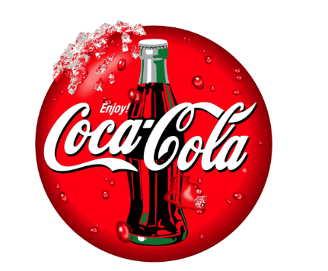

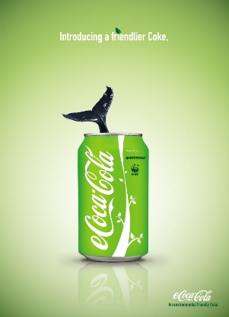
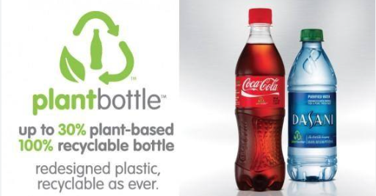
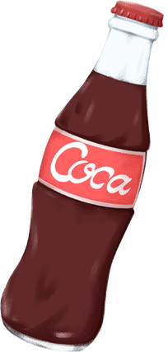
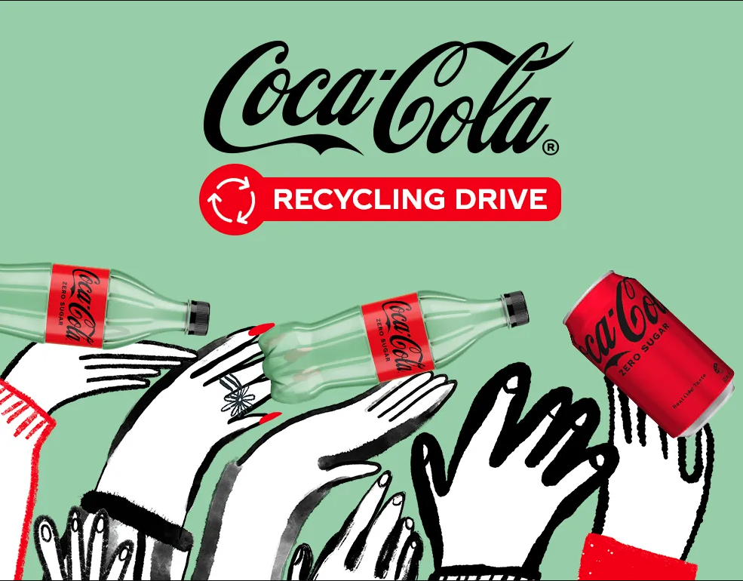
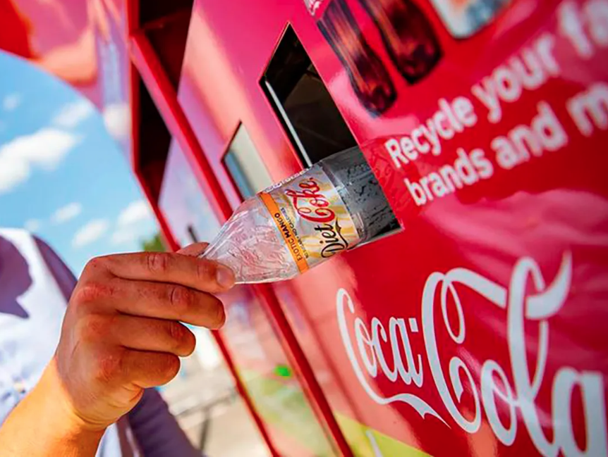
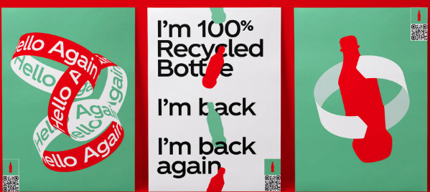


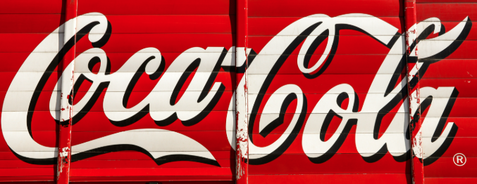
SUSTAINABLE BRAND EXTENSION POSTER CONTENT (COCA-COLA)
INTRODUCTION
Coca-Cola EcoRefill
Founded in 1892, the Coca-Cola Company is one of the world’s largest and most recognised beverage companies, serving over 200 countries and territories (Coca-Cola, 2026).
It produces carbonated soft drinks, bottled water, juice, sports drinks, tea and coffee, serving millions of consumers every day (Garcia and Proffitt, 2022).
Coca-Cola has great brand value and reputation worldwide for its product quality, innovation, and vast distribution network.
The company is also working on sustainability with its World without Waste strategy, which targets reducing packaging waste, enhancing recycling systems, reducing carbon emissions and promoting responsible water management, in addition to business growth (Coca-Colacompany, 2026).
With heightened environmental awareness, Coca-Cola needs to develop innovative products that meet evolving consumer demands and align with its sustainability goals.
Coca-Cola EcoRefill is a new and proposed sustainable brand extension, which involves the use of a smart reusable stainless-steel bottle, alongside Coca-Cola refill stations being installed in shopping centres, universities, airports, offices and sports venues (GS1, 2026).
Instead of buying a new plastic bottle every time they drink, buy one premium reusable bottle they can refill as needed from Coca-Cola’s self-service refill stations.
All bottles have a different QR code that links to the Coca-Cola mobile app, so customers can pay securely, earn loyalty points and redeem discounts for subsequent purchases (GS1, 2026).
Consumers can enjoy a variety of Coca-Cola products and minimise the use of one-use plastics.
Branding extension trends
Brand extension & sustainability program
Consumers are increasingly demanding eco-friendly business practices from companies (Savale et al. 2023).
Consumers from Generation Z and Millennials are turning to brands that proactively minimise plastic waste and carbon emissions and are genuinely committed to the environment (TANASE, 2026).
Digital technology has also impacted consumer behaviour (Suherlan and Okombo, 2023).
Coca-Cola EcoRefill aligns to these trends by combining reusable packaging (with the right digital technology), making it easy and rewarding to refill.
World governments are implementing tougher laws on single-use plastics that will push companies to create eco-friendly packaging options.
Meanwhile, the growing trend of investors looking at businesses based on their Environmental, Social and Governance (ESG) performance is also significant to the success of businesses in the long term.
The EcoRefill system allows Coca-Cola to meet these market trends by boosting customer loyalty, supporting responsible consumption and reinforcing its brand image as a progressive, sustainable global brand.
Coca-Cola EcoRefill is firmly committed to delivering environmental, social and economic sustainability, generating value for customers, investors and the community at large.
The reduction of single-use plastic bottles will provide for environmental sustainability (Kim and Lee, 2022).
The refill system is a key component of Coca-Cola's World Without Waste initiative, which aims to help bring about a circular economy by promoting bottle recycling and reuse.
Consumer behaviour that is encouraged towards a sustainable environment also contributes to social sustainability, which is achieved through the availability of refill options that are easy and affordable (Jiménez et al. 2024).
Reusable, not disposable packaging is the key to economic sustainability, and the reusability of packaging is achieved through a recurring revenue model (Ellsworth et al. 2022).
Investors gain from enhanced ESG performance, a more positive corporate reputation, and better readiness for future environmental laws and regulations (Agbakwuru et al. 2024).
CONCLUSION
Reference List
Consumer mindset changes and growing environmental awareness make Coca-Cola EcoRefill a novel and innovative brand extension that "takes action" on sustainability.
The brand extension increases the reusability of packaging, helps towards the Coca-Cola sustainability targets and generates long-term value for consumers and investors with digital technology and convenient refill points.
The project is an example of the potential of sustainability and innovation to come together and strengthen Coca-Cola's market place position, and also open the way to a cleaner greener, and more sustainable future.
Agbakwuru, V., Onyenahazi, O.B., Antwi, B.O. and Oyewale, K., 2024. The impact of environmental, social, and governance (ESG) reporting on corporate financial performance. International Journal of Research Publication and Reviews, 5(9), pp.3629-3644. https://www.researchgate.net/profile/Victoria-Agbakwuru/publication/384533952_The_Impact_of_Environmental_Social_and_Governance_ESG_Reporting_on_Corporate_Financial_Performance/links/66fc4427b753fa724d561989/The-Impact-of-Environmental-Social-and-Governance-ESG-Reporting-on-Corporate-Financial-Performance.pdf
Coca-Cola, (2026). Our History https://www.coca-cola.com/in/en/about-us/history
Coca-Colacompany, (2026). Creating a World Without Waste: The Coca-Cola Company Teams Up with Bill Nye to Demystify Recycling in Striking Animation https://investors.coca-colacompany.com/news-events/press-releases/detail/1052/creating-a-world-without-waste-the-coca-cola-company-teams-up-with-bill-nye-to-demystify-recycling-in-striking-animation
Ellsworth-Krebs, K., Rampen, C., Rogers, E., Dudley, L. and Wishart, L., 2022. Circular economy infrastructure: Why we need track and trace for reusable packaging. Sustainable Production and Consumption, 29, pp.249-258. https://pureportal.strath.ac.uk/files/153174521/Ellsworth_Krebs_etal_SPC_2021_Circular_economy_infrastructure_track_and_trace.pdf
Garcia, C.J. and Proffitt, J.M., 2022. “We are Coca-Cola and so much more”: political economic analysis of non-carbonated SSB Coke brands. Food, Culture & Society, 25(5), pp.796-813. https://www.researchgate.net/profile/Christopher-Garcia-36/publication/352196698_We_are_Coca-Cola_and_so_much_more_political_economic_analysis_of_non-carbonated_SSB_Coke_brands/links/69779549a50a1926b459aac7/We-are-Coca-Cola-and-so-much-more-political-economic-analysis-of-non-carbonated-SSB-Coke-brands.pdf
GS1, (2026). Coca-Cola’s reusable, refillable bottles benefit from innovative QR Codes powered by GS1. https://www.gs1.org/insights-events/case-studies/coca-colas-reusable-refillable-bottles-benefit-innovative-qr-codes-powered-by
Jiménez Romanillos, E., Williams, H. and Wever, R., 2024. Unpacking behaviours: a literature study and research agenda on consumer behaviour in packaging‐free systems. Packaging Technology and Science, 37(9), pp.821-840. https://onlinelibrary.wiley.com/doi/pdf/10.1002/pts.2825
Kim, T. and Lee, S.D., 2022. Designing for green and grey: insights from single-use plastic water bottles. International journal of environmental research and public health, 19(3), p.1423. https://www.mdpi.com/1660-4601/19/3/1423
Savale, T.K., Byram Anand, P., Perumalla Varalaxmi, A.B. and Quaye, J.A., 2023. Green marketing strategies: Assessing consumer perception and adoption of eco-friendly products. Remittances Review, 8(4), pp.2490-2503. https://www.academia.edu/download/121595838/19_2023_GREEN_MARKETING_STRATEGIES_ASSESSING_CONSUMER.pdf
Suherlan, S. and Okombo, M.O., 2023. Technological innovation in marketing and its effect on consumer behaviour. Technology and Society Perspectives (TACIT), 1(2), pp.94-103. http://journal.literasisainsnusantara.com/index.php/tacit/article/download/57/58
TĂNASE, C., 2026. Conscious and Circular Consumerism for Gen Z & Gen Alpha: Key Trends in 2026 FMCG Retail. TĂNASE, C., 2026. Conscious and Circular Consumerism for Gen Z & Gen Alpha: Key Trends in 2026 FMCG Retail. http://crd-aida.ro/RePEc/rdc/v17i2/3.pdf

