Slide 1
Inner cultivation
What is inner cultivation, and how we can use it to have a deeper connection with ourselves, each other and our world around us?
By Nicola Sperry

Slide 2
What it really means to cultivate ones own inner being.
To allow your own nature to flow with the Dao
To not be governed by social mind
Being guided into action effortlessly, allowing spontaneity; for this is nature.

Slide 3
Short video by Alan watts
https://www.youtube.com/watch?v=fo-gNXdiiI4&fbclid=IwAR25N0T5Pa5sq0KW3M6nQY7SxMseLWIQa6vP0jmDl5Js-LANRZoX42ayU0o

Slide 4

Resonance of being
Resonance of being, is related to your inner wholeness being reflected into your day to day lives.
Allowing the natural flow of the Dao
Having relation to the practice is of importance for you to cultivate your own inner being.

Slide 5
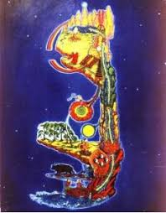
A Daoist view of inner unity, and the Balance of Ying & Yang
To allow the polarity of human life to be balanced naturally
Ying and yang is the dance of polarity, and can signify all opposites.
It is not to rid yourselves of yourselves but to unite your nature with the nature of the Dao; to allow a mutual arising.
Inner unity is to take into consideration the whole picture; this being the whole system working in cohesion.

Slide 6
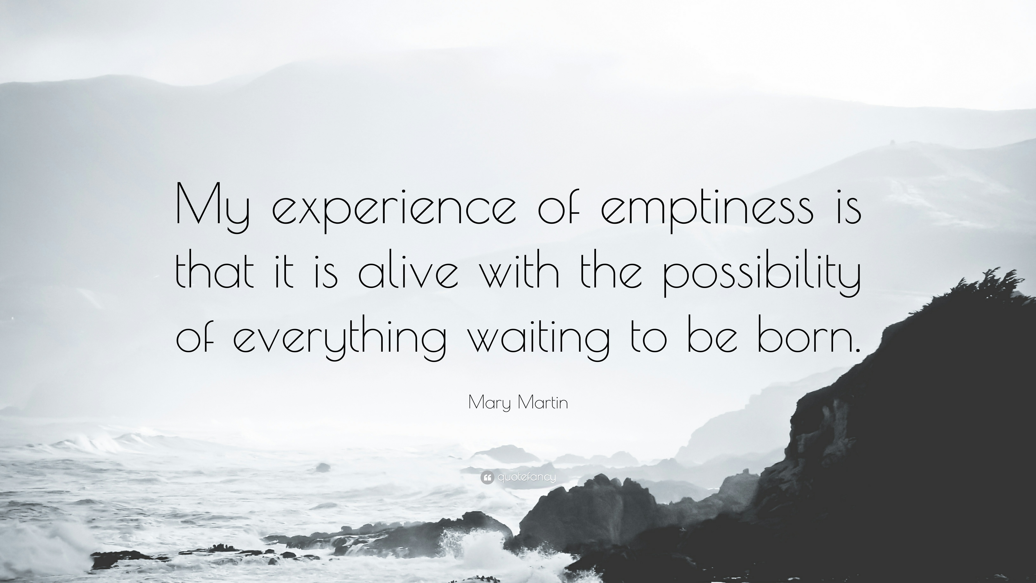
Overall conclusion
Notes:
Please not there is not a bibliography; as all the information in this presentation is that in which I have learnt in class, and of my own thoughts.

