Slide 1
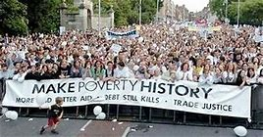
MAKE POVERTY HISTORY
MPH G8 Summit in Edinburgh July 2005

Slide 2
MAKE POVERTY HISTORY
What was it about?
The World Bank and IMF (International Monetary Fund)
Debt crisis
Jubilee 2000 (Jubilee = fallow year and/or debt cancellation; 7 year and 50-year cycles)
G8 Promises in 2005 after a worldwide campaign
Financial crash of 2007/8
http://www.bbc.co.uk/music/thelive8event/whylive8/povertyhistory.shtml
G8 Promisegate, June 2007 (Avi Lewis): https://www.youtube.com/watch?v=ZY6Mw7uQyZU

Slide 3
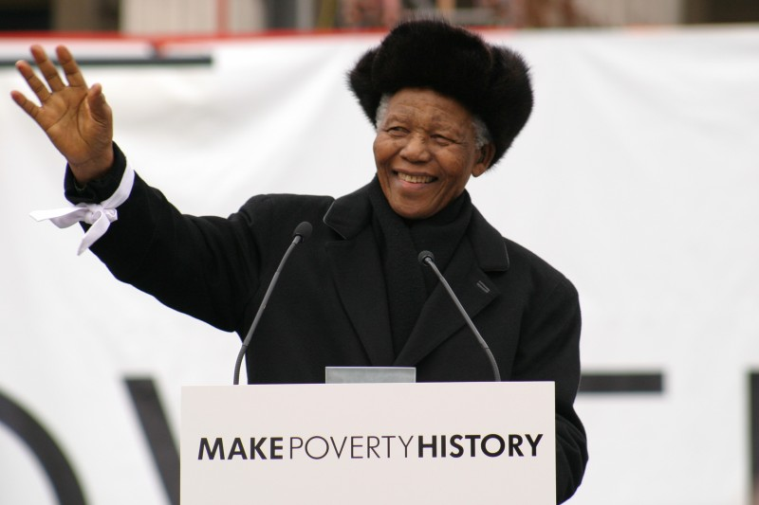
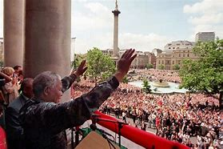
MAKE POVERTY HISTORY
Nelson Mandela’s Trafalgar Square speech 3/2/2005
(9:02)
https://www.bing.com/videos/search?q=make+poverty+history+campaign&&view=detail&mid=C6EC1FA518205C5C409DC6EC1FA518205C5C409D&&FORM=VRDGAR

