Slide 1
UML
System Behaviour

Slide 2
UML Modelling
Architectural
  System structure
Behavioural
  System Behaviour

Slide 3
What sort of things need to be looked at ?
What actions / processes a software system performs
Why it performs such actions
How it performs such actions
Outcome of those actions
Special Cases

Slide 4
Where is the bounding box ?
How low can you go ? – (No, we are not doing the limbo)
  This all depends on your perspective and that of your colleagues

Slide 5
So what do we need ?
Isolate each of the functionalities of a system
Categorise or couple similar or dependent behaviours within a system
Note the interactivity been dependent modules
Draw some pretty pictures………

Slide 6
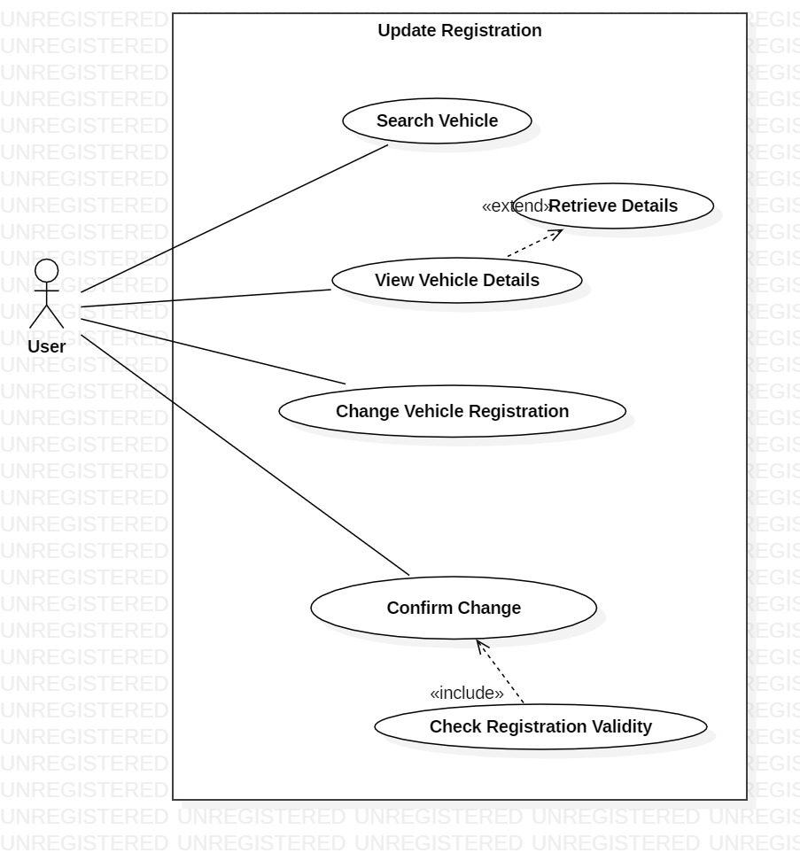
Somewhat confusing ?

Slide 7
System behaviour
How the system does what it does
There are some examples of ways of representing this

Slide 8
How have we represented system behaviour ?
Enter Vin
Flowcharts
Is valid VIN ?
Display Invalid Message
No
Yes
Update Vin
Display Updated Message

Slide 9
Behavioural documentation
UML is an architectural description language, as such it can contain ….
  Graphical depictions
  Text

Slide 10
Textual representation of system
Descriptions
Pseudocode cards
Naming conventions within diagrams

Slide 11
What is my system being used for ?
What is the purpose of your system ?
What challenge are you trying to overcome ?
What problem are you solving ?
All of these are first answered in the requirements analysis stages by….
  User stories

Slide 12
A User Story ?
A user story is ….
  Outline of a process in a system
  Technically a requirement
  A users perspective on what the system is required to achieve

Slide 13
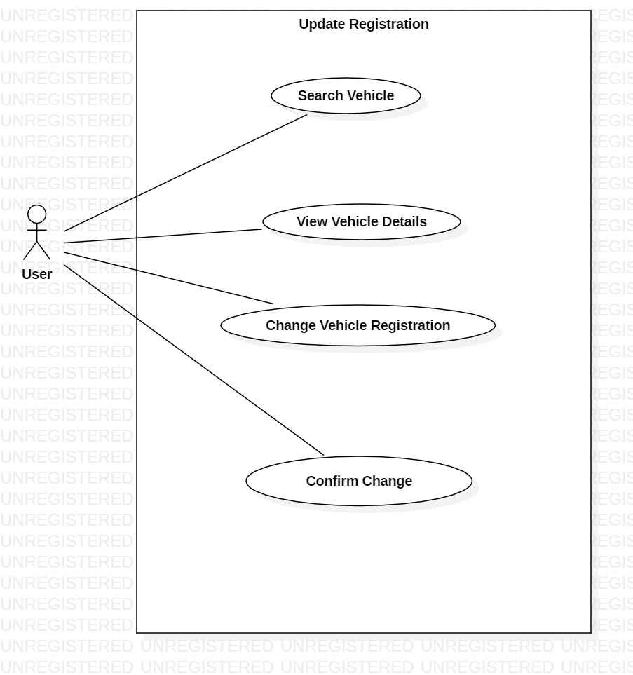
How can I paint a pretty picture of a user story?

Slide 14
What do all those stick men blowing bubbles mean ?
Each element represents an entity within the system
Use-case bubbles are the process
The system is bounded by a box
Association is evidenced by the arrows and connections utilised

Slide 15
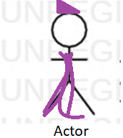
Use-Case Notation
Use-Case
The System

Slide 16
What about dependencies ?
Extends – Optional external
Functionality use.
Include – Mandatory external
Function use.

Slide 17
Remember that UML also includes text ?
Use-cases can also be represented in text form
Each of the use-cases can be thought of as individual processes and described in prose
Text representations make it far easier to describe the events path

Slide 18
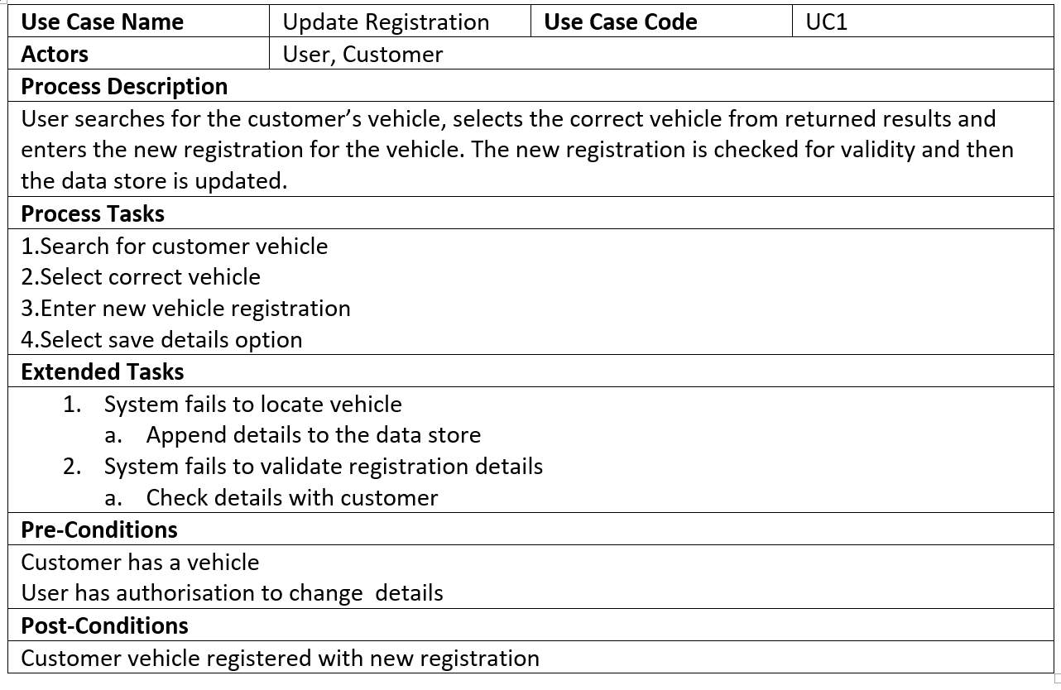
Use-case Descriptions

Slide 19
Process Progression
I have outlined my processes, now what ?
  Show the method of activation of each of those processes
  Show the chronology of activation of each of those processes
  Show the dependency of each of those processes

Slide 20
Can we show these with the use-cases ?
No – use cases are a way of representing the functionalities of the system, not when they occur.
What about the fact that they appear in a linear progression down the diagram ?
  This does not show chronology, rather a means of placing the functionality on the diagram in a way that will fit

Slide 21
So how do we show the SEQUENCE of events ?
With another diagram – the SEQUENCE diagram.
The sequence diagram represents the order in which calls are made to and from each entity within the system.

Slide 22
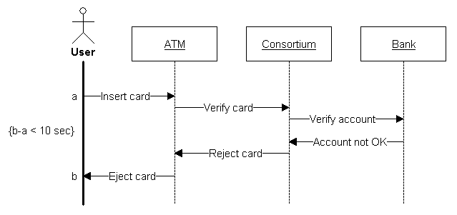
Sequence Diagram depiction

Slide 23
Speed-Bumps
Sometimes things don’t quite go to plan
Sequence diagrams are equipped to deal with this utilising:
  Alternative flows
  Optional flows
  Guard Conditions
Sometimes operations are concurrent

Slide 24
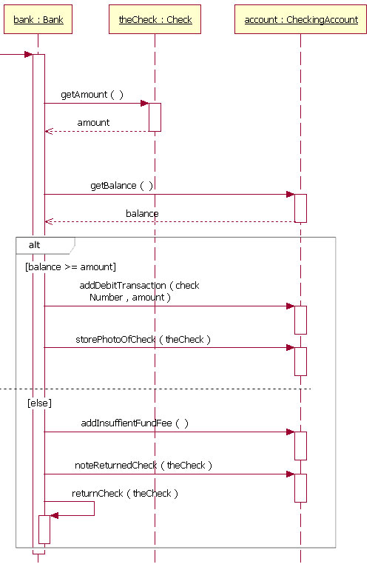
Alternative Flows

Slide 25
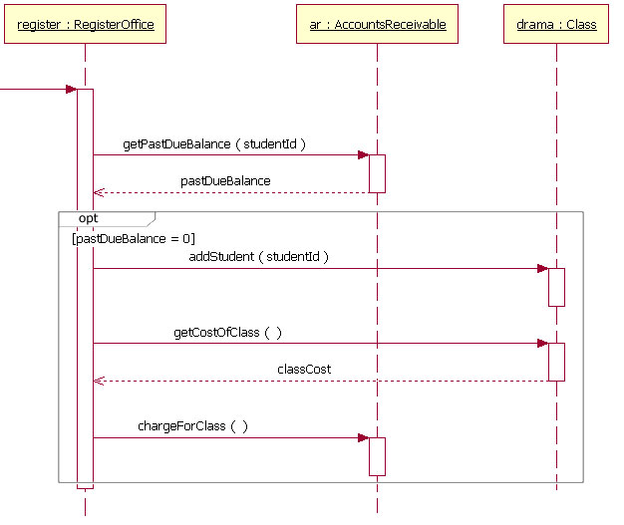
Optional Flows

Slide 26
Sequence diagram notation
Message
Actor
Lifeline
Return Message

Slide 27
Framing the picture
Frames are important in annotating the level of functionality and the conditions of its execution.
There are a number of frame types, mostly we are concerned with only two:
  Alt – Provides view for alternative program flow situations
  Opt- Provides view for optional program flow situations

