Slide 1
BMSP6006
Strategies for Resilience and Prosperity
g.behenna@uwtsd.ac.uk
Glenn Behenna

Slide 2
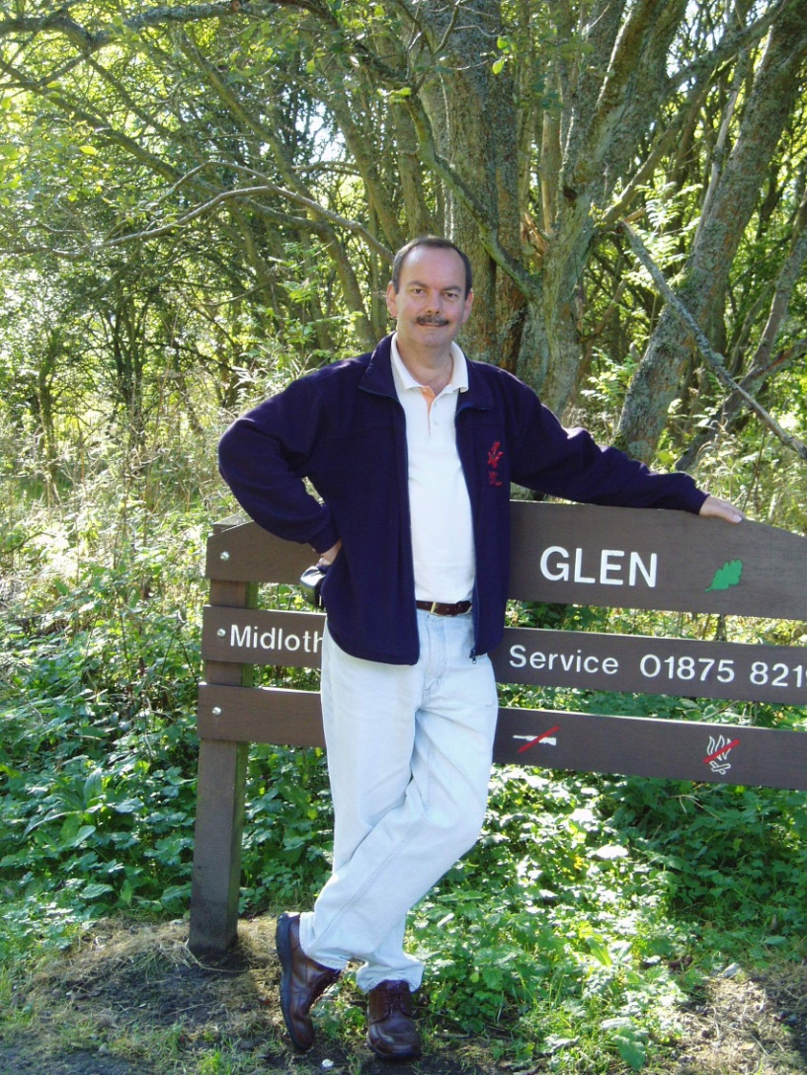
A bit about me
You know me as a lecturer at UWTSD.
I also consult to the UK and Welsh Governments:
  Knowledge Management
  Project Management
  Learning & Development
  Leadership and Management
  Security & Intelligence
Loads of other jobs e.g.
  Steelworker
  Police
  Ford Motor Company
  Management Consultant
  Programme Manager (UK Gov)
  Self Employed
  University Lecturer (20 years)

Slide 3
What you want to learn from this module?
  Post your ideas in the forum please. There is no right or wrong answer, so feel free to share your views and to comment on the views of others.

Slide 4
Where should Strategy
Start and Why?
Post your ideas in the forum please. There is no right or wrong answer, so feel free to share your views and to comment on the views of others.

Slide 5
What are Stakeholders?
  Post your ideas in the forum please. There is no right or wrong answer, so feel free to share your views and to comment on the views of others.

Slide 6
Aspects of Strategic Management
Take a look on the Internet and find examples of the following:
  Mission Statement
  Vision
  Objectives
  Post your ideas in the forum please. There is no right or wrong answer, so feel free to share your views and to comment on the views of others.

Slide 7
What are some of the major influences on strategic management today?
  Post your ideas in the forum please. There is no right or wrong answer, so feel free to share your views and to comment on the views of others.

Slide 8
Assessment Submission Dates
1st Assignment on or before Friday 30th October
2nd Assignment on or before 6th November
See the Moodle module page for further information please.

Slide 9
Your Tasks Reminders
  Post remember to post your ideas in the forum please.
  There is no right or wrong answer, so feel free to share your views and to comment on the views of others.

