Slide 1
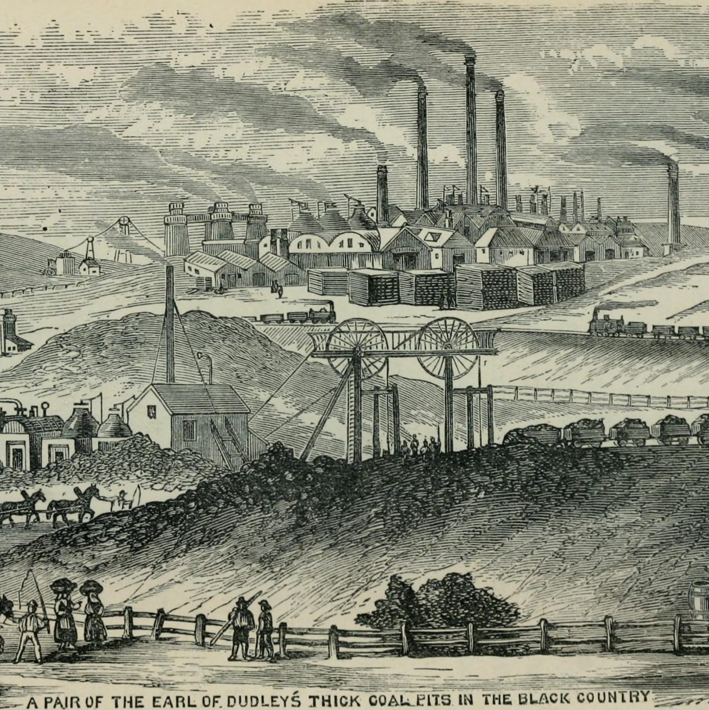

The Industrial Revolution: Prosperity in Hafod and Lower Swansea Valley
An overview of key factors.
By: Ethan Thomas
Student Number: 2416742
BA Business and Management
Distinctiveness and Regeneration
(Team, 2022)

Slide 2
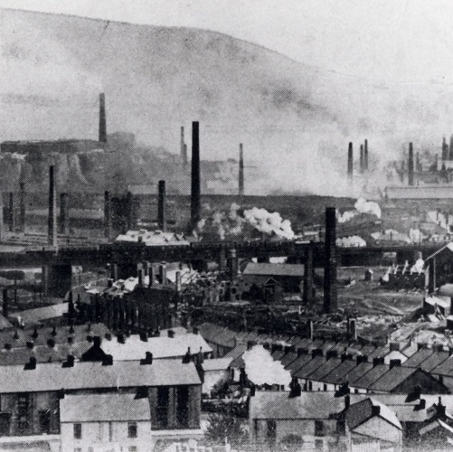
Hafod and the Lower Swansea Valley & The Industrial Revolution
Located in South Wales, which became a centre for coal and iron production.
Hafod Ironworks established in the late 19th Century. In the time that the industry was very successful.
(Newell, 1990).
Main industries included copper, iron and coal.
(Construction, 2020)​

Slide 3
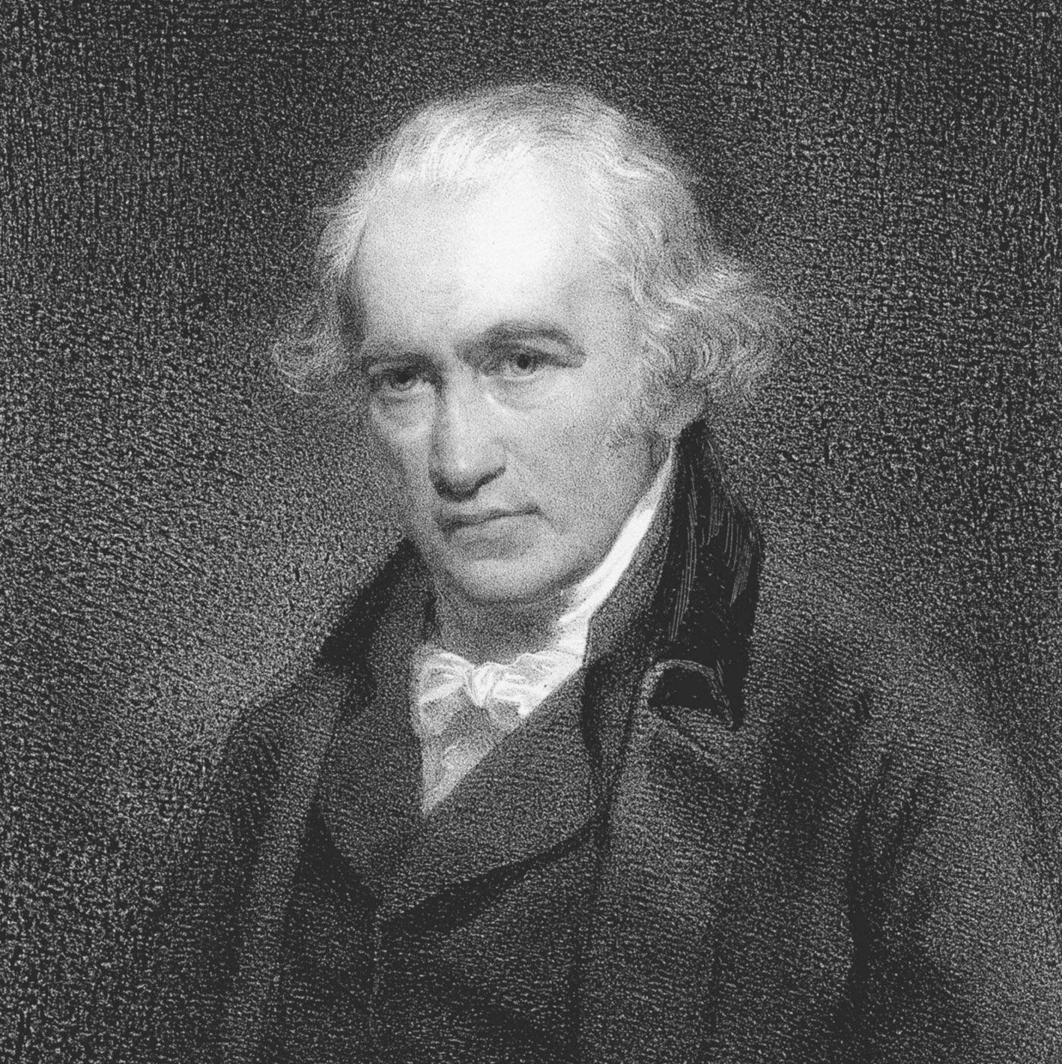
Key Players
Vivian Family – Owned the Hafod copperworks in the late 19th century. (BBC News, 2013)
James Watt – Improved the Newcomen steam engine. (Kingsford & W, 2025).
Lord Vernon – Played a large role in the establishment of copper smelting works in the Hafod area.
(Hafod and the lower Swansea Valley, n.d.)
(Kingsford & W, 2025)

Slide 4
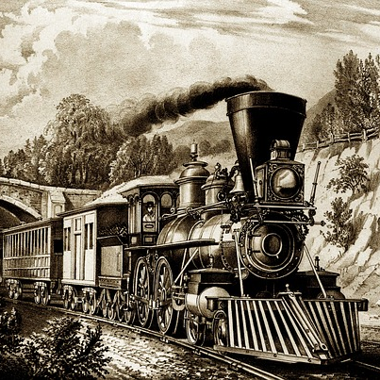
Technological and Industrial Processes
Steam power used significantly in mining, transportation and factory operations.
Steam engine
"Spinning Jenny" for spinning wool.
The Steam locomotive for transportation.
Establishment of factories and mining operations.
The growth of railway and canal networks for transportation of goods and raw materials.
(Duignan et al., n.d.)
(Kelly, n.d.)

Slide 5
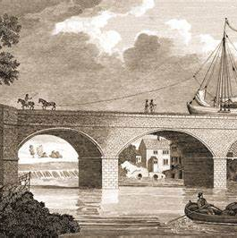
Environment and Natural Resources
Hafod area had good proximity to coal from nearby mines, copper ore from nearby mines and imports, and near river for transports.
Although the industrial operations increased the region's economic activity, they also brought about major environmental problems like pollution and deforestation.
Plantiff at the Great Copper Trial of 1833.
(Hafod and the lower Swansea Valley, n.d.)
(Tappan & Jensen, 2019)

Slide 6
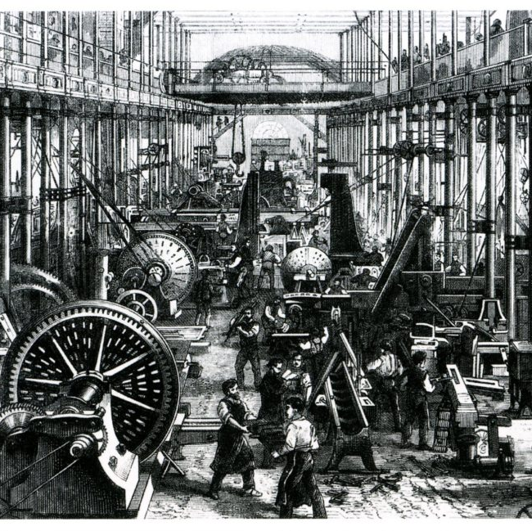
The Workers and their Environment
Harsh conditions – long hours, low wages, dangerous jobs in mines and factories.
Child labour was prominent in mines and factories.
Rapid urbanization led to overcrowding and unsanitary living conditions for the working class.
(Beck, 2016).
(Industrial Revolution – schoolshistory.org.uk, n.d.)

Slide 7
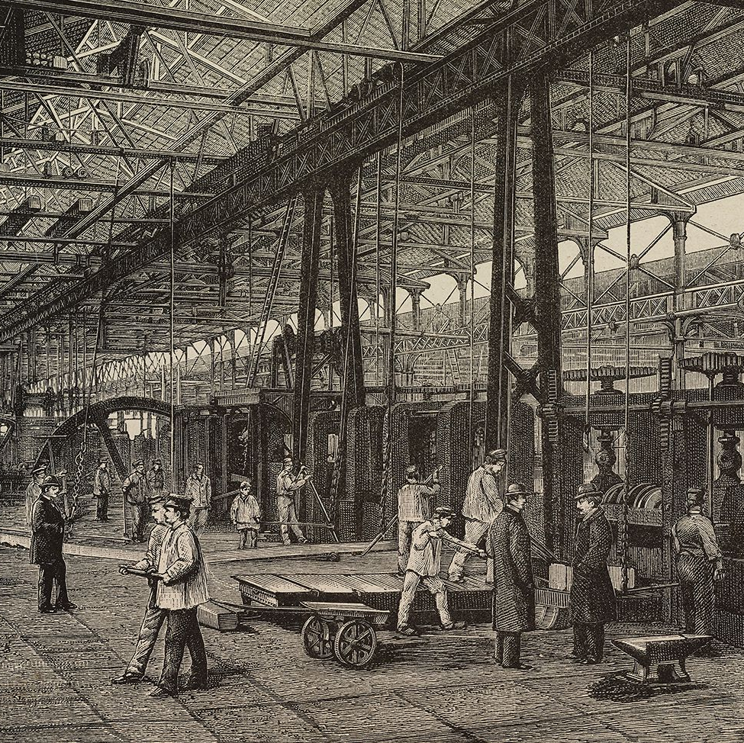
Economic Impact
Local Economy: Wealth rose with the growth of the industry, upper class benefited most as it was unevenly distributed.
National Economy: Hafod and the Lower Swansea Valley helped Britain's status as the world's biggest industrial area through the 19th century.
Expansion of global trade.
Increased productivity.
New job opportunities and industries.
(Adeline, 2023)
(M. Kelly, 2019)

Slide 8
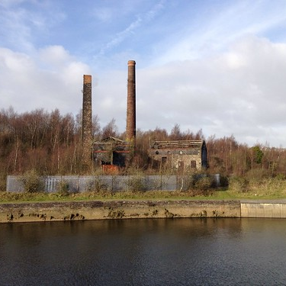
Conclusion: The Legacy of Swansea's Industrial Prosperity
Swansea's industrial success laid a foundation for strong future development.
Environmental and social issues from the industrial period still remain.
(Jack, n.d.)

Slide 9
References
Adeline. (2023, October 22). The Industrial Revolution: Causes and Effects - Pages of History. Pages Of History. https://pagesofhistory.org/the-industrial-revolution-effects/
BBC News. (2013, October 13). Swansea Hafod copperworks preservation begins. https://www.bbc.co.uk/news/uk-wales-south-west-wales-24487743#:~:text=The%20copperworks%20was%20owned%20by%20the%20Vivian%20family,continued%20rolling%20copper%20until%20it%20closed%20in%201980.
Beck, E. (2016, November 26). Working Conditions in the Industrial Revolution. History Crunch. https://www.historycrunch.com/working-conditions-in-the-industrial-revolution.html#/
Bowie, D. (2023, July 18). The Water Frame: Revolutionizing textiles in the Industrial Age. HowStuffWorks. https://science.howstuffworks.com/innovation/inventions/water-frame.htm
Construction, P. /. (2020, November 17). Swansea District will Reflect City’s Rich Welsh and Industrial Heritage. Business News Wales. https://businessnewswales.com/swansea-district-will-reflect-citys-rich-welsh-and-industrial-heritage/
Duignan, Brian, Leong, & Ernest. (n.d.). Inventors and Inventions of the Industrial Revolution: Stories & History | Britannica. Encyclopedia Britannica. https://www.britannica.com/list/inventors-and-inventions-of-the-industrial-revolution
Hafod and the lower Swansea Valley. (n.d.). https://cadw.gov.wales/sites/default/files/2019-05/Hafod and the Lower Swansea Valley- Understanding Urban Character_0.pdf
Industrial Revolution – schoolshistory.org.uk. (n.d.). https://schoolshistory.org.uk/topics/british-history/industrial-revolution/
Jack, A. T. (n.d.). Hafod Copper Works, Swansea, Wales, UK. Flickr. https://www.flickr.com/photos/ynysforgan_jack/6741888211/

Slide 10
References
Kelly, M. (2019, July 2). Significant eras of the American Industrial Revolution. ThoughtCo. https://www.thoughtco.com/significant-stages-american-industrial-revolution-4164132
Kelly, R. (n.d.). Did the Steam engine start the industrial revolution? – Steam trains. https://albernisteamtrain.com/did-the-steam-engine-start-the-industrial-revolution/
Kingsford, & W, P. (2025, February 11). James Watt | Biography, Inventions, Steam Engine, Significance, & Facts. Encyclopedia Britannica. https://www.britannica.com/biography/James-Watt
Misachi, J. (2018, May 17). Who invented the railroad? WorldAtlas. https://www.worldatlas.com/articles/who-invented-the-railroad.html
Newell, E. (1990). “Copperopolis”: The Rise and Fall of the Copper Industry in the Swansea District, 1826-1921. Business History, 32(3), 75–97. https://doi.org/10.1080/00076799000000093
Tappan, N., & Jensen, R. (2019, October 14). The superhighways of the industrial revolution were canals. HistoryNet. https://www.historynet.com/the-superhighways-of-the-industrial-revolution-were-canals/
Team, A. (2022, March 1). Industrial Revolution: AP® US History Crash Course. Albert Resources. https://www.albert.io/blog/industrial-revolution-ap-us-history-crash-course/

