Slide 1






McDonald's Online Group Presentation
Module: Digital Skills And Research Methods BMSW4003
LECTURER NAME: ISAIAH OINO
IOANA STEFANIA URSU 2013620
CRISTINA CRECIUN 2011283
ANDREEA STEFANIA HERTEG 2011620
DENIS DEDIU 2011014
ALEXANDRU IACOVICI 2010831
creativebloq.com
Notes:
Present topic and co-workers.

Slide 2
EXECUTIVE SUMMARY
Introduction
I-Background of the organization
II-Challenges before the introduction of modern technology
III-Insights to the modern technology introduced
IV-The impact of the technology introduced
V-Lessons that can be drawn from the case study
Conclusion
Reference List

Slide 3
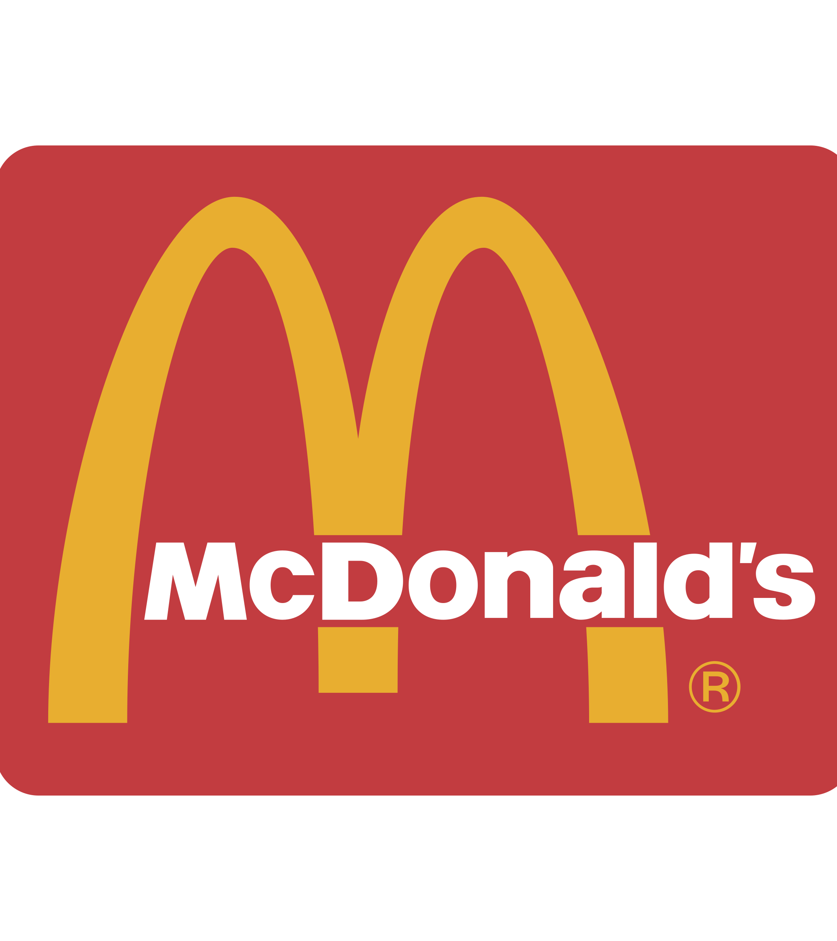
McDonald’s
Background of the organization

Slide 4
Introduction
McDonald’s been founded on 15 October 1974 in Philadelphia, Pennsylvania, USA.
Forty-eight years down the line, they are the world’s largest food-service chain with more than 31,000 restaurants in 119 countries, serving 47 million of customers every day and employing more than 1.5 millions.
Mr. Ray Kroe took over the rights from McDonald brothers and founded The McDonalds Corporation on 15th April 1955 in Des Plaines, Illinois.

Slide 5
U.S.A has 50% of the McDonald’s restaurant in the world.
In their menu, the most caloric food is the Angus Bacon & Cheese with 780 calories, and the less caloric is the Chicken Snack Wrap with Grilled Chicken.
In fierce competition, focusing on existing products is unlikely the way to success.

Slide 6
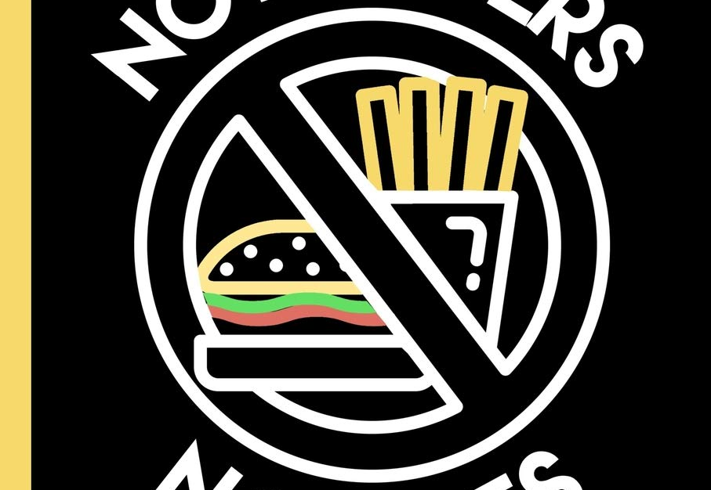
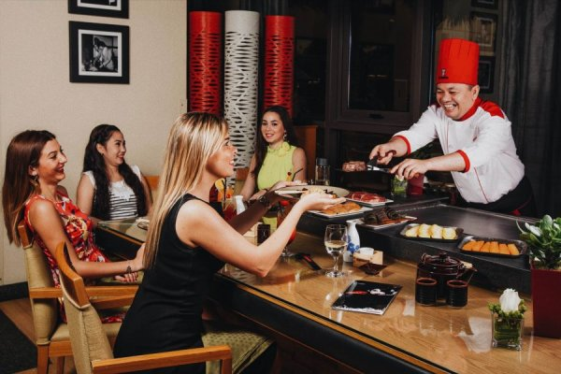
THE CHALLENGES BEFORE THE INTRODUCTION OF MODERN TECHNOLOGY
The increasing dinning services that left behind McDonald’s in the race in attracting the customers.
The challenge arose because people started demanding food that was fresh and healthy and was made with natural ingredients.
Notes:
The very first challenge that the company had to face was that the increasing dinning services that left behind McDonald’s in the race in attracting the customers. Within its own home market US it had to face this challenge the most. When the dinning services and restaurant businesses had fundamental shifts in their business activities the company had to face decline in the customer engagement. The challenge arose because people started demanding food that was fresh and healthy and was made with natural ingredients. The rise of the fine dining restaurants that are offering healthy food options left McDonald’s behind.

Slide 7
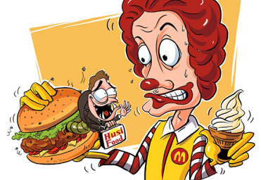
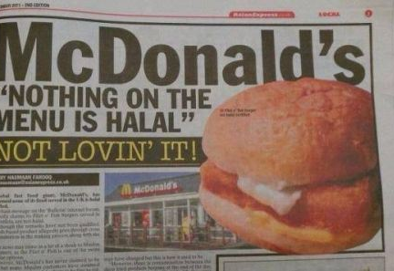
The company was recorded by an undercover agent by investigating that it used expired meat.
Due to this controversial topic the company had to face a decline in overall sales by 4.8%.
Notes:
The second challenge that was faced by the company was concerns related to food safety. Safety of food that is being served to the customers is given the most priority and is at the top of public concerns. This is when the company was recorded by an undercover agent by investigating that it used expired meat. Due to this controversial topic the company had to face a decline in overall sales by 4.8%. The allegation for expired meat in the food items dripped the image of the brand as well. When the customer base got to know about the expired beef and chicken meat used they literally stopped coming to McDonald’s and naturally shifted to another company like Burger king or KFC (Scandal, 2020).

Slide 8
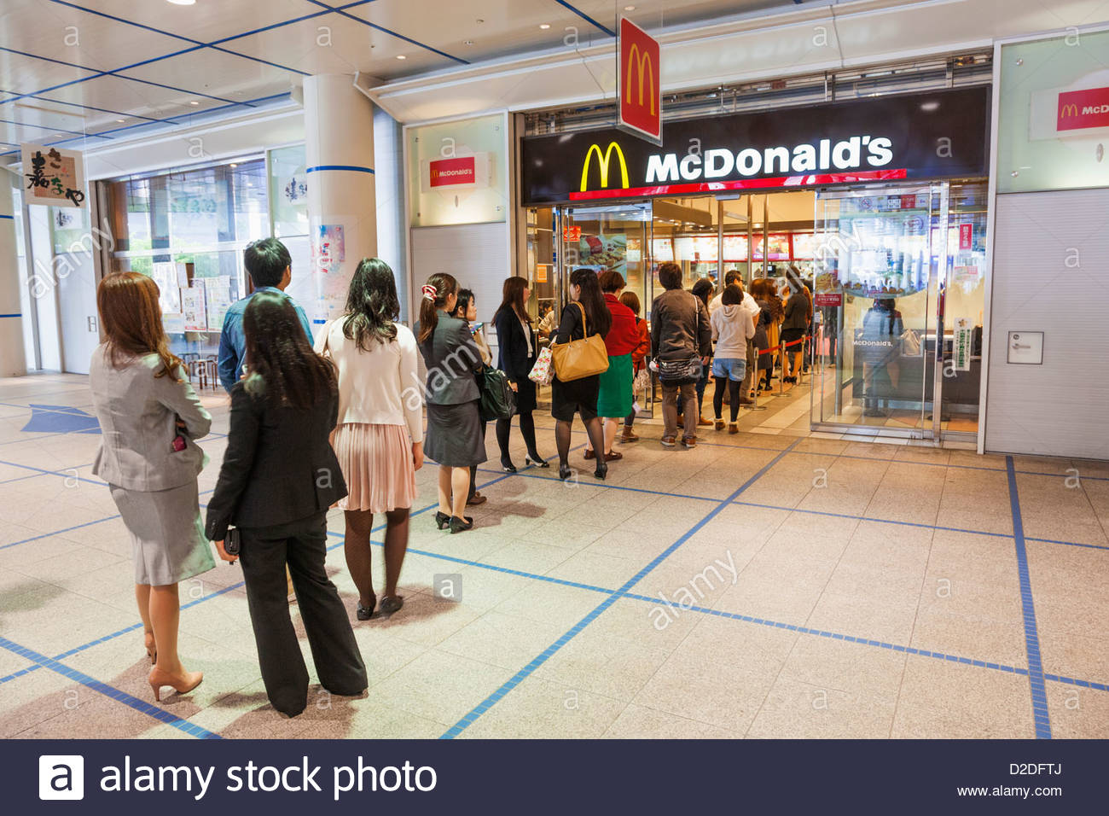
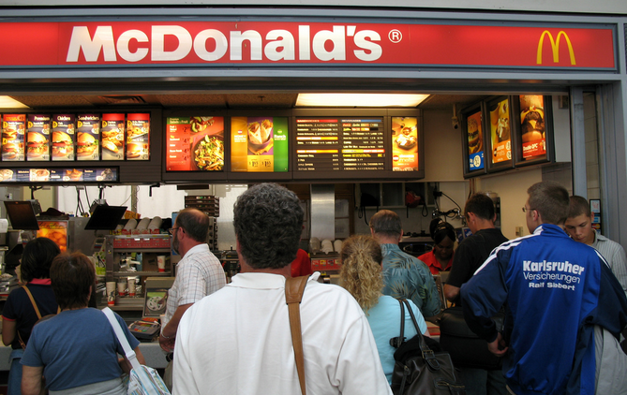
During festivals and events when the stores used to receive the highest customer arrivals the employee base at times was not capable of handling so many at a single times. few customers stood there in the Queue which made the place quite chaotic
Notes:
The third challenge that the company had to face was in sufficiency of adequate employees within the organisation especially during the times of maximum customer interaction. During festivals and events when the stores used to receive the highest customer arrivals the employee base at times was not capable of handling so many at a single times. Due to this many customers returned and few of them stood there in the Queue which made the place quite chaotic.

Slide 9
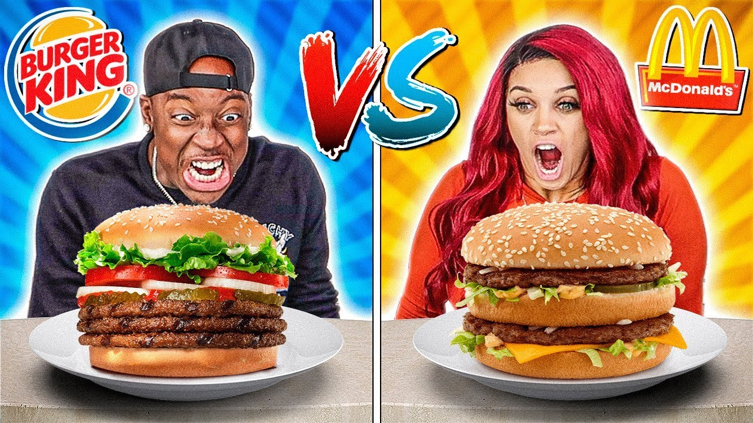
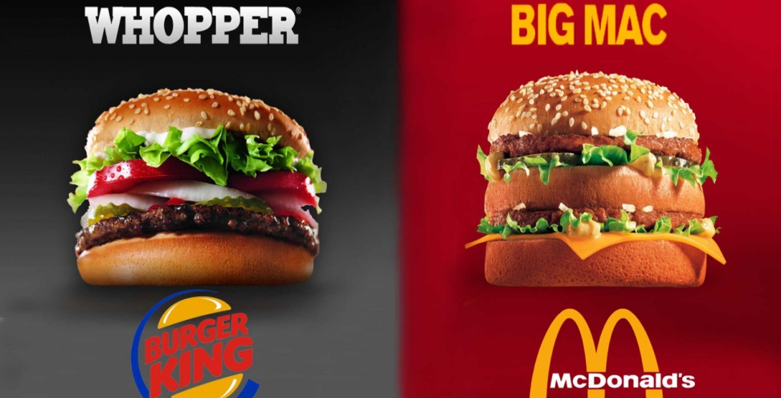
Burger King is the oldest company that has been a threat/ challenge for the company just because it serves almost the same food items as McDonald’s.
Since modern technology was not available McDonald’s was not able to persuade and attract the customers from Burger king to its own stores.
Notes:
The challenge that the company had to face was intensive competition from similar fast food companies. Burger King is the oldest company that has been a threat/ challenge for the company just because it serves almost the same food items as McDonald’s. Moreover both the companies were launched in the mid 90’s and since then Burger King is standing as a major rival company. Since modern technology was not available McDonald’s was not able to persuade and attract the customers from Burger king to its own stores (Dissect et al., 2020).

Slide 10
TECHNOLOGY INTRODUCED
Internet site
Delivery
Kiosks
Drive-thru
Technology for voice
Mobile apps
Kid’s gadgets
Source : (McDonald’s, n.d.)
Notes:
1.In 1996 – McDonald’s Corporate Internet site , so they started technology modernisation. Also, they introduced delivery, kiosks, drive-thru ordering, mobile app and Kid’s gadgets.
2. Delivery is a service that delivers food to the customer's door.
In 2006, firstly McDonald’s introdused kiosks, but 2015 place them in majority of restaurants. It helps customers to place their orders using the ordering machine.
3.Then McDonald’s started drive thru service and later introduced voice command technology . Also, make a mobile app.
4.And finally they introduced Kid’s Gadgets with interactive games from McDonald's. (McDonald’s, n. d. )

Slide 11
INSIGHTS
Adjusting the menu to customer preferences due to the fact that they can analyse data from devices and applications.
Drive-through customers able to order through a voice speaker.
Growth opportunities in emerging markets and number of customers. (Tin-yau, K. 2020)
Customers are more happy due to better quality and fast service due to the adoption of new technology..
Source: (Tin-Yau, K. 2020)
Notes:
1.Through introduces technology they can analyse data to adjusting the menu to customer preferences.
2.Drivethru-in 2017 has been implemented to more than 8,000 stores and the result is satisfactory.(Tin-yau, k. 2020)
3. McDonald's is investing in technology to make life simpler for customers. Also, Expand markets and as result number of customers increase.
4.Contemporary life is often in hurry and people clearly don't have much time, and McDonald's makes life simpler for its customers by making these improvements and makes shopping easier and fun.

Slide 12
CHANGES AFTER INTRODUCTION
Delivery, which typically has a larger digital order check, has risen to $4 billion, about four times more that it was before. (KLEIN, 2020)
With the introduction of kiosks, the number of buyers going up and the waiting time decreased
Drive Thru service has improved services for drivers which has brought in more revenue
Each of us uses mobile phones every day and that's why the phone application has brought more customers to the company.
Notes:
1.Technology is an important factor in progress of McDonald’s, it simplifies its menu for comfort.
2.Delivery, which usually has a larger check through digital orders, has grown to a $ 4 billion, or four times as much as it was three years ago.
3. McDonald's introduced touchscreen kiosks in 2015. With the introduction of kiosks, the number of buyers going up and the waiting time decreased .
4.A drive-thru is a form of take-out service that allows clients to buy products without leaving their cars and this McDonalds service continuously improved for more revenue.
5. McDonald's investment in mobile apps has advantages, as apps usually increase the average order size. Because each of us uses mobile phones every day and that's why the phone application has brought more customers to the company.

Slide 13
The impact of technologies introduced
creativebloq.com
Notes:
We will now discuss the impact of the technologies introduced in McDonald Company.

Slide 14

INVENTORY INTELLIGENT SYSTEM
Better inventory management
.
Less waste
Reduce food cost for customers
.
Good environment impact
Better availability
POSITIVE IMPACTS
SERVICE TILLS
Speedy service
.
Better customer service
.
Increase customer volume
Notes:
We will firstly be considering the positive impact of some of the technologies introduced in McDonald Organisation. We will be mentioning only 2 of them here, but it is important to keep in mind that there are a lot more of them could analyze.
McDonald is using IT systems in order to get stock efficiently to restaurants. Their using forecasting tools to ensure the delivery of products from suppliers to restaurants. Along with this, each restaurant uses a bespoke ordering system to review previous orders and select the products they'll need in their next delivery.
All those tools guarantee permanent availability of raw materials, fresh product at all time and help to avoid waste. By avoiding waste the company can reduce food cost which means cheaper products for the customer. Moreover the time saved thanks to those technologies reducing stock issues gives more time to restaurant managers to focus on customer service and satisfaction as well as cleanness. This new system is definitely a Win Win for Mcdonalds and the environment.
The implementation of the service till provided some good impact such as a better customer service represented by a clear, easy to use, screen. No orders were mistaken anymore and customers could have more details about the products as well as options that they might not have think of if ordering at the counter. The customer is having his meal quicker than before as consequently is more satisfied. Moreover, this new technology also impacted the volume of orders due to the fact that the time use of the machine has been evaluated to be shorter than a usual face to face ordering as per McDonald`s source. An increase in customer volume means more sales, automatically more profits. The profits made by McDonald thanks to this new technology quickly cover the investment cost engaged.

Slide 15

NEGATIVE IMPACTS
SERVICE TILL
No Choices
.
Not convenient for all
.
Unforeseen glitch
Notes:
Now I would like to quickly mention an example of a negative impact of a new technology that has been introduced. I made the choice to focus on the service till once again in order to demonstrate the fact that technologies can be positive and negative at the same time, which is why it is very important to use and implement them cautiously.
McDonald claimed a better customer service provided thanks to those interactive tills. However here are some of the critics and disadvantages that I have collected : The only way to place an order in most of the McDonald branch nowadays is strictly via this till which means : no direct interaction with any staff members anymore/ it is not convenient for everyone (mostly young people are comfortable using it, but previous generations struggle and will have no choice rather than to adapt). Another consequence of this implementation is the card payment only which reduces again the number of users (even if small amount of people do not have card payment nowadays, there is still a minority that could not access to McDonald service anymore). The last argument I wanted to share regarding this new technology is the unforeseen glitch, as it can happen on any technology in general. Once again it is rare but if it does happen the whole restaurant will stop working as there is not other alternatives anymore.

Slide 16
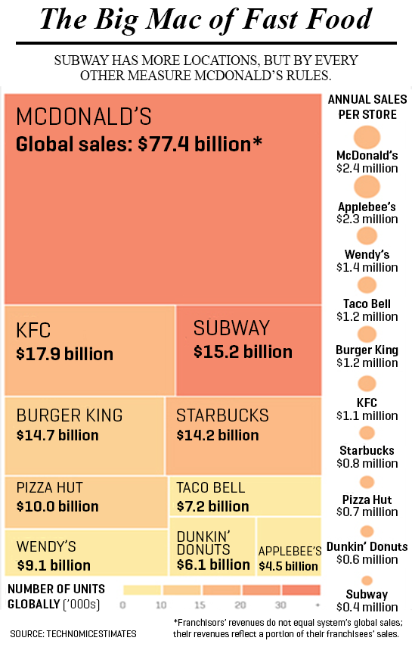
Lessons that can be drawn from the case study
As per the views of Krasnikova et al., (2020, p. 29), the innovations that improved customer loyalty and the end result were then made permanent.
The 'Experience of the Nice' strategy by McDonald looked at the behaviours, and experiential variables that alter the level of satisfaction of its customers
Notes:
In June 2017, analysts in Wall Street noted that McDonald's holdings were up by 26 percent YTD, but many other chains did not experience stock rises, and the owners of the restaurants are now searching for McDonald's to see what they are doing to raise stocks.
. For example, their self-service or self-catering stands in many McDonalds restaurants throughout the UK now have their latest technology. These kiosks worked, as sales increased and the results were poor.

Slide 17
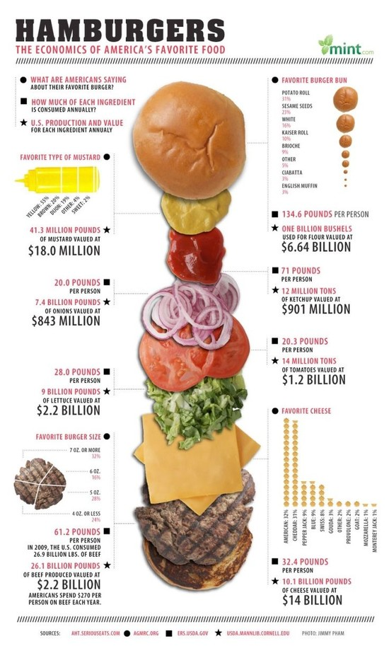
CONCLUDING REMARKS
Technology would continue to drive change and restaurant owners like Mc Donald’s would need to embed technology in their business models or begin to see a decline in income.
Notes:
Therefore, technology has forever changed the hospitality environment and changed the way customers interact in a restaurant completely.

Slide 18
CONCLUSION
Mcdonald took great advantage of New Technologies :
-Benefits the company (profit)
-Benefit staff (employee morale)
-Benefit customer (customer satisfaction)
Recommendations :
- Implementation of radical innovations can take time to be adopted
creativebloq.com
Notes:
This presentation aimed to analyse the company of McDonald. After given a description and background of the company we evaluated the challenges there were facing before the implementation of new technologies. Thanks to new technologies, the organisation benefits on various departments as it has been mentioned previously such as value chain management, customer service, staff allocation... However it has been noticed that the impact of new technologies is not only positive but could generates negative consequences as well. After this study, our recommendations would be to be very careful of the use of new technologies and evaluate properly their potential repercussions on different level of the organisation.

Slide 19
Thank you for your attention.
Notes:
If you have any questions, or constructive feedback please feel free to share it with us!

Slide 20
REFERENCE LIST
Dissect, S., Dissect, S., Dissect, S., Campaigns, T., Follow, S. and Posts, R., 2020. The Best Burger King Vs Mcdonald’S Campaigns - Social Media Dissect. [online] Social Media Dissect. Available at: <https://socialmediadissect.com/the-best-burger-king-vs-mcdonalds-campaigns/> [Accessed 21 November 2020].
Ft.com. 2020. Mcdonald’S And Its Challenges Worldwide: A Market-By-Market Look. [online] Available at: <https://www.ft.com/content/f8ac22fc-a7c1-11e4-8e78-00144feab7de> [Accessed 21 November 2020].
Scandal, M., 2020. Mcdonald's China: The Expired Meat Scandal ^ HK1055. [online] HBR Store. Available at: <https://store.hbr.org/product/mcdonald-s-china-the-expired-meat-scandal/HK1055> [Accessed 21 November 2020].
McDonald’s ( n.d. )The history of McDonald’s[Online] Available at: https://mcdonalds.com.mt/history/[Accessed 07 November 2020].
KLEIN, D. (2020) McDonald's is Getting Even More Serious About Tech. [Online]
Available at: https://www.qsrmagazine.com/technology/mcdonalds-getting-even-more-serious-about-tech[Accessed 09 November 2020].
Tin-Yau, K. (2019) How technology is transforming McDonald's operations [Online] Available at: https://www.ejinsight.com/eji/article/id/2254439/20190919-how-technology-is-transforming-mcdonald-s-operations[Accessed 10 November 2020].

