Slide 1
Developing Emotional Intelligence Skills for the Workplace
Week 4
Management and Leadership
Additional Material
(2 of 2)

Slide 2
Management and Leadership
Management: The planning and organising of time, resources and people to achieve optimum results effectively and efficiently.
Leadership: To motivate, provide direction and guidance to an individual or group of individuals to achieve optimum results
Source: John Adair
Management
Money
Processes
Leadership
People
Structures
Equipment

Slide 3
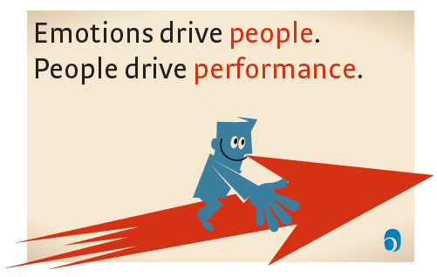

Slide 4
Defining empotional intelligence
If your emotional abilities aren't in hand, if you don't have self-awareness, if you are not able to manage your distressing emotions, if you can't have empathy and have effective relationships, then no matter how smart you are, you are not going to get very far.
Daniel Goleman

Slide 5
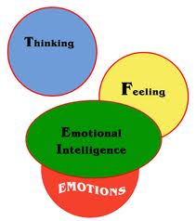
EMOTIONAL INTELLIGENCE

Slide 6
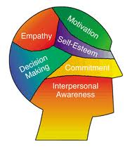

Slide 7
Emotional Intelligence
‘The ability to express your emotions appropriately and clearly in a way that enables you to achieve harmonious and effective outcomes with others.’

Slide 8
What is Emotional Intelligence
What is Emotional Intelligence
The capacity to be aware of, control, and express one's emotions, and to handle interpersonal relationships judiciously and empathetically.
“The rare ability to be angry with the right person, to the right degree, at the right time, for the right purpose and in the right way..” …(Aristotle)

Slide 9
A Brief History of Emotional Intelligence
1975 – Howard Gardner publishes ‘The Shattered Mind’ which introduces the concept of multiple intelligences
1985 –Wayne Payne introduces the term emotional intelligence in his doctoral dissertation entitled "A study of emotion: developing emotional intelligence; self-integration; relating to fear, pain and desire”
1987 – In an article published in Mensa Magazine, Keith Beasley uses the term "emotional quotient.”
1990 – Psychologists Peter Salovey and John Mayer publish their landmark article, "Emotional Intelligence," in the journal Imagination, Cognition, and Personality.
1995 - The concept of emotional intelligence is popularized after publication of psychologist and New York Times science writer Daniel Goleman’s book Emotional Intelligence: Why It Can Matter More Than IQ.

Slide 10
Emotional intelligence
Is IQ the main indicator of destiny? – not nearly as much as we think
Our view of human intelligence is usually much too narrow
Our emotions play a huge role in thought, decision making and success.
Our brains have developed and grown from the emotional part of the brain – completely entwined to influence the functioning of the rest of the brain.

Slide 11
Intrapersonal Intelligence
‘The key to self-knowledge, access to one’s own feelings and the ability to discriminate among them and drawn upon them to guide behaviour.’
Howard Gardner.

Slide 12
SELF-AWARENESS
BEING A WITNESS TO ONESELF

Slide 13
Self Awareness
…is about understanding who you are, what makes you tick, what makes you angry, what makes you happy and motivated…

Slide 14
Johari Window
 | What I see in me | What I don’t see in me
What you see in me | Open/Public self | Blind self | Self disclosure from me
What you don’t see in me | Private self/Facade | Unknown
 | Feedback from you
Based on Joseph Luft and Harry Ingham

Slide 15
Interpersonal Intelligence
‘Capacities to discern and respond appropriately to moods, temperaments, motivations and the desires of other people.’
Howard Gardner.

Slide 16
EMOTION
E-motere
Disturbance or agitation of the mind

Slide 17
What is an Emotion?
What we think: our interpretation of events
What we feel: a way of describing a particular state
How our bodies react:e.g. racing heartbeat
How we behave: e.g. running away, hitting someone
Adapted from ‘Emotional Intelligence Pocketbook’, Margaret Chapman

Slide 18
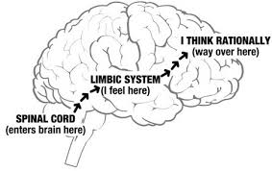

Slide 19
When dealing with people, remember you are not dealing with creatures of logic, but with creatures of emotion.
-Dale Carnegie

Slide 20
Three steps to Emotional Intelligence
Recognise the emotion
What are you feeling?
What are you going to do?

Slide 21
FOUR PRIMARY STATES
ANGER FEAR
SADNESS JOY

Slide 22
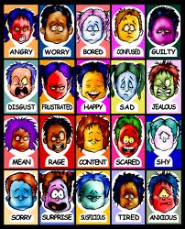

Slide 23
Listen to your body
What is your body telling you when you have:
Butterflies in the stomach
Racing heartbeat
Blushing face
Sinking stomach
How else does your body react to different emotions?

Slide 24
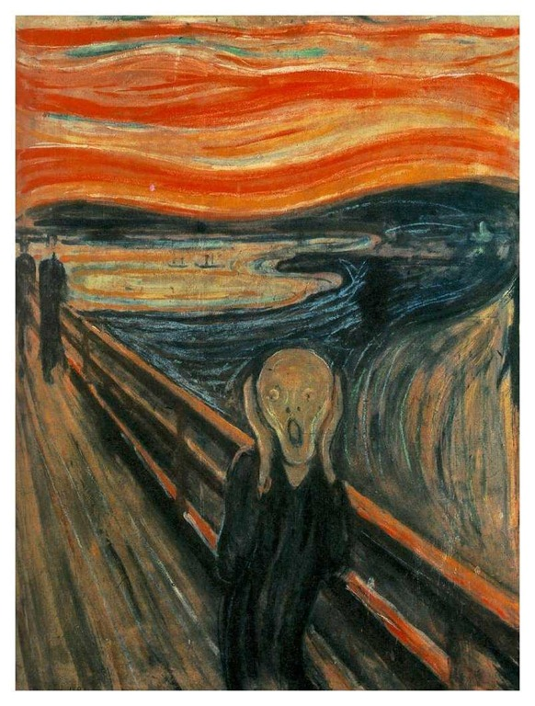

Slide 25
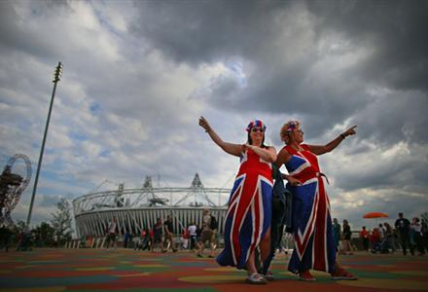

Slide 26
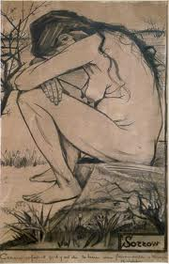

Slide 27
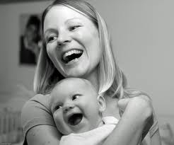

Slide 28
DIMENSIONS
EMOTIONS - anger
MOOD - more mute and last longer grumpy, irritable, sulking.
TEMPERAMENTS – Melancholy, timid, cheerful.

Slide 29
The E.I. Competence Framework
Self Awareness
Self Regulation
Self Motivation
Social Awareness
Social Skills

Slide 30
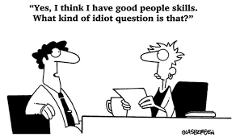

Slide 31
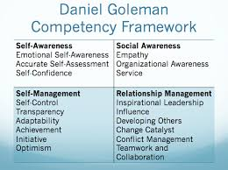

Slide 32
The Resonant Leader
The Resonant leader – attuned to peoples’ feelings – speaks from own values. Empathises and is able to express feelings for the group.
The Dissonant leader fails to empathise and read emotions of group. Sends needless upsetting messages. People feel off-balance and perform badly.
Daniel Goleman – Primal Leadership

Slide 33

Values
“Values aren't buses... They're not supposed to get you anywhere. They're supposed to define who you are.”
Jennifer Crusie

Slide 34

Vision
An effective leader should be able to clearly and simply share the vision they have for their project, team, service or organisation
‘A vision gives meaning and purpose to your actions.
It is the picture on the jigsaw box of life’

Slide 35
Vision to Action

Slide 36
Vision
Breaks down operational silos – every member of staff knows how their work contributes.
Management is how you go about achieving the Vision – objectives and then plans and individual targets.
Needs to inspire, motivate and be memorable
Without it you can’t plan, set targets or know how to prioritise
You might not know how you will get there yet - but at least you know in which direction you are going

Slide 37
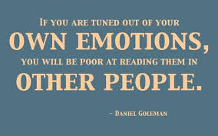

Slide 38
1. How well do you know yourself?
What kind of people do you find it easy to work with?
What kind of people do you find hard?
What does that tell you about you?

Slide 39
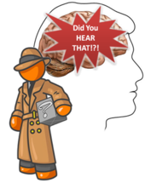
Amygdala Hijack
Due to evolution, our brains have learnt to respond emotionally to certain stimuli (e.g. events, behaviours, etc), without consciously processing the thought and how we should behave.
When we have an immediate emotional response to something and behave in a way that we may later regret, this is known as an “amygdala hijack” i.e. the amygdala part of our brain has “hijacked” the thought-processing parts of the brain and so we respond emotionally rather than thoughtfully. It take around 6 seconds between event and this hijacking response.

Slide 40
Automatic Pilot
1. Event
2. Thought
3. Feeling
4. Action

Slide 41
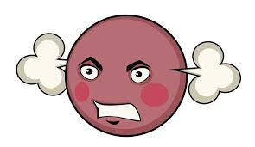
What makes you mad!’
What makes you emotional?
How do you behave?
How does it feel?
Can you tell you’re about to lose it?
How does it affect others?
How do you feel afterwards?

Slide 42
INNER DIALOGUE
The greatest opponent you have is the voice within your head, not what is happening outside.
A positive mental attitude is the key to success.

Slide 43
Every human has four endowments - self awareness, conscience, independent will and creative imagination. These give us the ultimate human freedom... The power to choose, to respond, to change.
Stephen Covey

Slide 44
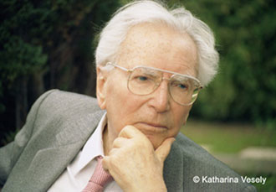
“Between stimulus and response there is a space. In that space is our power to choose our response. In our response lies our growth and our freedom”.
Victor E Frankl, Holocaust Survivor

Slide 45
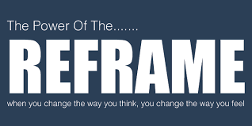

Slide 46
“I can’t stand it!...I can’t do it…This always happens…It’s not fair…Why am I so stupid! There’s too much to do…This is not my job…I shouldn’t have to do this…
I feel terrible…”

Slide 47
“It always works out okay…I can always find an opportunity in there…I always have choices…I’m not afraid of tackling the tough stuff first and then I can do all the easy things…I feel great…today will be just brilliant…I know how valuable I am and take good care of myself…”

Slide 48
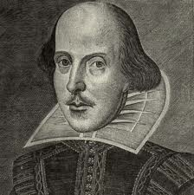
“There is nothing good or bad but thinking makes it so…” Shakespeare, Hamlet

