Slide 1
ECYW6009
05.02.26

Slide 2
Lecture Focus
Summary of findings from Week 1
How can engaging in nature and in physical and mental fitness combat toxicity?
Group Work
Further Assessment Guidance
Personal study time for your assessment preparation

Slide 3
Summary of discussion from Week 1
The 6 social aspects as noted by Palmer (2015) impact on children and young people in a number of ways, leading to what she refers to as childhood becoming increasingly toxic for a number of children:
  Children and young people are spending less time outdoors – resulting in lack of imagination, not developing ‘risk’, impacts their wellbeing, decrease in confidence, lack of socialisation, struggle to deal with their mental health, not developing resilience, less opportunities to build and form relationships
  Children and young people are becoming consumers at a young age due to the commercialisation of childhood. Pressure on parents, children grow up too quickly, highlights their self-awareness
  The schoolification of early childhood results in missing out on other important aspects such as play, socialisation, the rigidity of education at an early age reduces the opportunity for experiential learning, long hours away from home in some instances

Slide 4
Summary of discussion from Week 1
  Screen saturation results in sleep-deprivation, feeling argumentative, opens up bullying in new ways, creates a world which isn’t real, loneliness for some, social exclusion, reduces face to face interaction, no socialisation, not out playing with their friends and connecting with them in that way, leads to low mood, depression, irregular sleep patterns, the development of habits that can be hard to break
  It is a hyper-competitive education system with challenges linked to tests, targets and education. Added stress to wellbeing with too much pressure to achieve and perform. Lives are pressured enough without the need to be the best. Increases anxiety among children and young people, the separation of peer groups (due to being placed in ‘sets’) can impact negatively on some young people, fun is taken out of learning, school doesn’t prepare them for real life
  The decline of listening, language and communication skills can be attributed to a combination of the other social factors noted by Palmer (2015). Additionally, a lack of family interaction can have an impact, along with too much focus on screentime – often resulting in shortened attention span – and also limits the opportunities to communicate

Slide 5
Group Activity Feedback
Research and consider how engaging in nature can combat toxicity…
Research and consider how engaging with physical and mental fitness can combat toxicity…

Slide 6
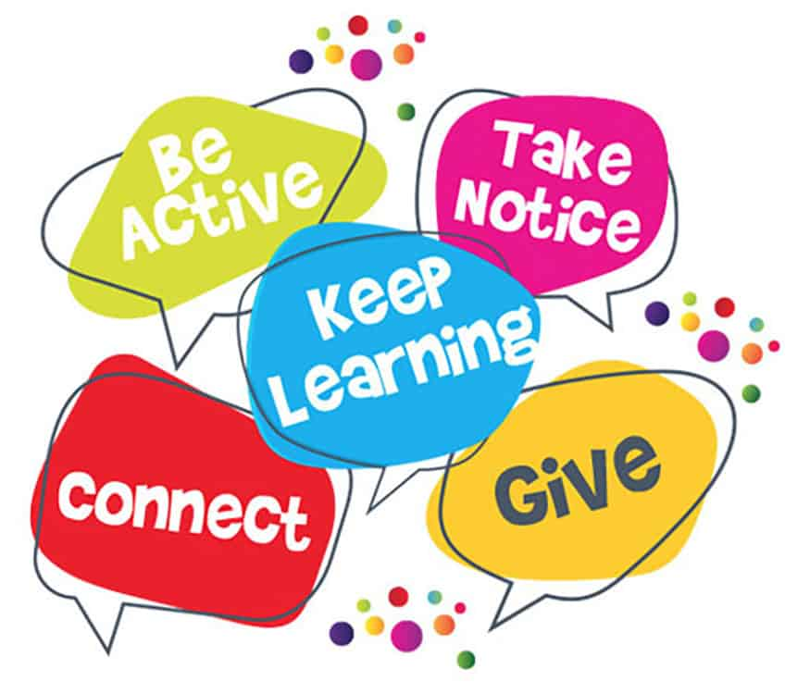
How can nature combat toxicity?
There is much written about how nature can impact positively on our health as a whole.
For example, according to Mind (2021, p. 2) “spending time in green space or bringing nature into your everyday life can benefit both your mental and physical wellbeing. For example, doing things like growing food or flowers, exercising outdoors or being around animals can have lots of positive effects. It can:
improve your mood
reduce feelings of stress or anger
help you take time out and feel more relaxed
improve your physical health
improve your confidence and self-esteem
help you be more active
help you meet and get to know new people
connect you to your local community
reduce loneliness
help you feel more connected to nature
provide peer support.” Figure 1: The Wellbeing Network, 2018

Slide 7
How to spend more time in nature
Mind (2021, pp. 9-10) suggests ways in which you can prepare to spend more time in nature, as follows:
Ask for support:
  For example, if you feel anxious in new places or social situations, you could ask someone you trust to go with you at first.
Plan ahead:
  Check the weather forecast and think about things you might need. This could include warm or waterproof clothing, sun protection, a water bottle or a map.
Fit nature into your routine:
  Spend time in nature doing things that you already do. For example, you could make a phone call while going for a walk in nature. Or you could study, work or exercise outdoors rather than indoors.
Think about timing:
  If you live in a busy area, you may want to go out at when it’s quieter. Or you may feel safer going out when there are more people around.

Slide 8
You can find out more from Mind at this link: How nature benefits mental health – Mind
Or, please see the pdf version of this information which is saved on Moodle

Slide 9
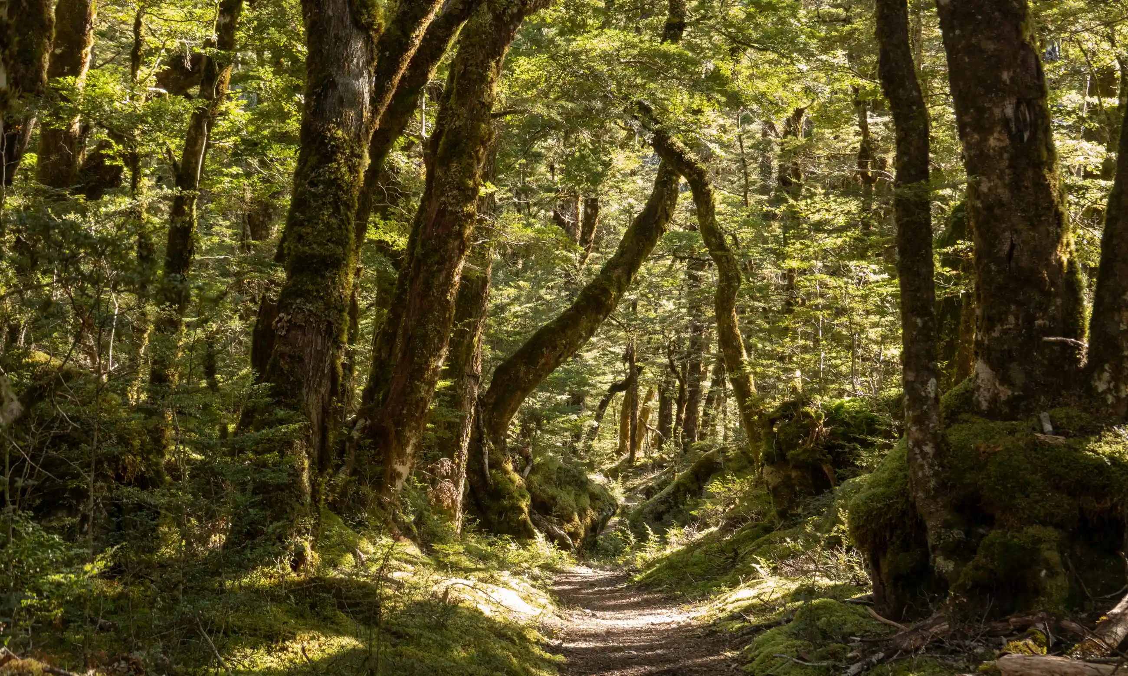
Aldous (2023, np) notes how “it has long been agreed that getting outside, being in open spaces and getting fresh air have a positive impact on how you are feeling. Getting in and around trees and woodlands is better still. Being around trees, or even just being able to see them, can reduce your blood pressure by 10 percent. GPs in the UK are now prescribing time outdoors as a remedy to improve mental health, and in Japan ‘Forest Bathing’ has become a popular wellness activity”.
“Shinrin-yoku”
Find out more here
Figure 2: Murdo MacLeod/The Observer, 2019

Slide 10
How can engaging in physical and mental fitness combat toxicity?
Nature promotes stress recovery, protects from future stresses and improves concentration and ability to think clearly.
It is also well established that regular physical activity has both physical and psychological health benefits. Therefore, knowing that both physical activity and nature independently enhance health, the term Green Exercise was coined to signify the synergistic health benefits derived from being active in green or natural places (Pretty et al., 2005 cited in Barton et al 2016, p. 27).
Figure 1: The Wellbeing Network, 2018

Slide 11
How can engaging in physical and mental fitness combat toxicity?
According to Barton et al (2016, p. 29), “in a review of studies comparing indoor and outdoor physical activity, Thompson Coon et al. (2011) found that compared with walking indoors, outdoor walking was associated with more positive mood, increased self-esteem, vitality, energy and pleasure; alongside reductions in frustration, worry, confusion, depression and tiredness. Running outside was also associated with less anxiety, depression, anger and hostility than running indoors (Thompson Coon et al., 2011)”.
“Natural environments promote physical activity and social contact which in turn also improve health and well- being” (Barton et al 2016, p. 35).
Figure 1: The Wellbeing Network, 2018

Slide 12
Green Education…
Also called outdoor learning, learning outside the classroom, outdoor education, and learning in natural environments
It extends beyond learning about the natural environment and developing positive environmental attitudes.
It is “a situated natural and cultural context for learning any subject or skill, which brings greater opportunities for people to trial different ways of being and learning than when indoors” (Waite, 2013; Waite and Pratt, 2015 cited in Barton et al 2016, p. 53, emphasis added).
Do you see links here to what we do in our roles as informal and non-formal educators?

Slide 13
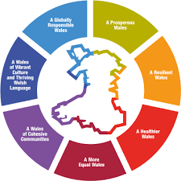
Considering Youth Work and Wider Policy…
“At its core, youth work provides safe environments and supports the development and well-being of young people” (WG, 2019, p. 5)
Youth Work has a role to play in “ensuring equity in physical and mental health outcomes by supporting young people to make healthy lifestyle choices and signposting them to support” (WG, 2019, p. 24)
Well-being of Future Generations (Wales) Act 2015 (WG, 2015) outlines clear goals as can be seen in Figure 3
UNCRC Article 24: Every child has the right to the best possible health. Governments must provide good quality health care, clean water, nutritious food, and a clean environment and education on health and well-being so that children can stay healthy. Richer countries must help poorer countries achieve this.
Figure 3: WG, 2015

Slide 14
Group work
In your groups, think of three activities that can be used in your Youth Work practice that will promote young people’s engagement in nature, and promote their physical and mental fitness. Consider how these activities link to Youth Work policy.

Slide 15
Assessment Recap
Component 1:
Incorporating issues studied in this module, students are required to design an advisory leaflet for parents and guardians focusing on an issue faced by young people in contemporary society.
Component 2:
Students will be required to ‘present’ their advisory leaflet, ensuring they demonstrate how youth workers can best support at risk young people. The presentation should be supported by wider reading, and linked to the Youth Work National Occupational Standards (CLD Standards Council Scotland, 2019).

Slide 16
Component 2 Recap
There are key components to consider:
  You will need to outline the issue that you have chosen to focus upon
  You will need to discuss the advisory leaflet that you have designed for parents and guardians
  You need to demonstrate how Youth Workers can best support at risk young people
  You need to ensure you make links to your wider reading, including the YW NOS (CLD Standards Council Scotland, 2019)

Slide 17
Component 2 Recap
Some ideas for your consideration:
  You could begin by giving an overview of the range of issues that young people may be facing in contemporary society, before identifying the issue you have chosen to focus upon
  Next, you could provide an overview of how your chosen issue impacts upon young people, linking to relevant wider reading/stats etc. Offer relevant definitions, and make links to relevant theory and research
  You will give an overview of the advisory leaflet that you've designed for parents and guardians, running through its content, and drawing on what you feel are the highlights of it, why you have designed it that way etc

Slide 18
Component 2 Recap
  Think of how you would offer information, knowledge and solutions to the parents and guardians, and how you would offer tips for them to use/share with their young people.
  Highlight the services that are available to young people – think back to the activity you engaged in at the end of our first lecture for the module
  What about listing local support, as well as online support/Apps that may be of help
  Can you also list what further support the parents and guardians can access for themselves?
  You can then explain how Youth Work can support young people around the issue that you have chosen, and how Youth Workers can best support at risk young people

Slide 19
Useful Resources
There are useful resources available here around the 5 Ways to Wellbeing for young people: Five ways to wellbeing for young people - Derbyshire County Council
Is youth mental health getting better or worse? | Action For Children
Positive futures: outdoor youth work and mental health in young people (scouts.scot)
How nature benefits mental health – Mind
UNCRC

Slide 20
References & Further Reading
Aldous, A. (2023) ‘Positive futures: outdoor youth work and mental health in young people’, Available at: Positive futures: outdoor youth work and mental health in young people (scouts.scot) (Accessed 8 May 2023).
Barton, J. et al. (2016) Green exercise : linking nature, health and well-being. London: Routledge. Available at: https://doi.org/10.4324/9781315750941.
Mind (2021) Nature and mental health. Available at: How nature benefits mental health – Mind (Accessed: 8 May 2023).
Sherwood, H. (2019) ‘Getting back to nature: how forest bathing can make us feel better’, The Guardian, 8 June. Available at: https://www.theguardian.com/environment/2019/jun/08/forest-bathing-japanese-practice-in-west-wellbeing (Accessed: 8 May 2023).
Figure 1: Home - Wellbeing Network (thewellbeingnetwork.ie)
Figure 2: Getting back to nature: how forest bathing can make us feel better | Trees and forests | The Guardian
Figure 3: 42329 WBFG Essentials Guide (gov.wales)

