Slide 1

Passport to Youth Work
Dana-Louise Jones
1908102

Slide 2

Passport to Youth Work question:
A ten minute seminar in which the writer will reflect on a critical incident in their youth work practices.

Slide 3
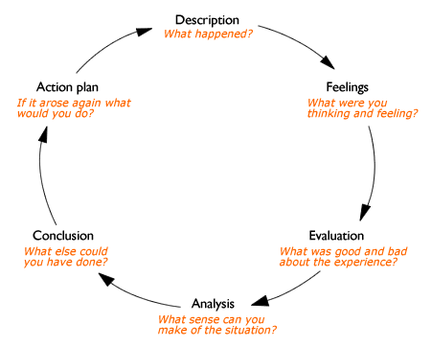
The writer will be using Gibbs reflective cycle (1988).

Slide 4


Description
Outline:
Placement : Choices Carmarthenshire
Shadowing: Thea
Location: * Glan y Mor
Young person:
*Ben
12 Years old
Male
Lives with mother, step-father and two younger half siblings
Regular truant
The Risk Management and Transition’
* Changed for data protection

Slide 5
Description
Ben has numerous Adverse Childhood Experience (ACES) ranging from household substance misuse to an incarcerated biologic parent, Ben having numerous aces will have a negative affect on Ben’s adolescent transition (Felitti, Anda, Nordenberg , Edwards, Koss and Marks, 1998).
Multi-agency work has a critical role if individuals are to be provided with the range of support they may need in a timely manner. Multi-agency work is about providing a holistic response to individuals with complex and multiple needs (Morris, 2018).

Slide 6
Feelings
I used the respond not react technique (James, 2016) recommended to me at my last supervision meeting, I found this really helped me. I was shocked to hear that a young person of twelve had been smoking cannabis with parent’s knowledge and how he was being used in this way to carry drugs.
It was very educational observing Thea at work and how she obtained all the information without Ben realising and closing up.
Reaction
”Something done , felt, or thought in response to a situation”
(Oxford English Dictionary, 2010, pp600).
Response
”A reaction to something “
(Oxford English Dictionary, 2010, pp602).

Slide 7
Evaluation
I do not feel like I can say the session went well due to the nature of information shared by Ben, however it went well in the sense that Ben opened up and trusted us to share this information. Choices and other multi-agencies can now work together to support Ben.
Ben has now been moved to high risk so he will be discussed in the fortnightly multi agencies meetings.
Multi-agencies work is paramount to tailoring support for individual’s needs (Ingram and Harris, 2001).

Slide 8

Analysis
Adverse Childhood Experience (1998)
Under 14 Substance Misuse Theory (Measham and Shiner 2009 )
Bandura Learnt Behavior (1997)
Aces
Youth Worker

Slide 9
Conclusion
This session I observed, only speaking to say who I was and goodbye. I do not feel like this was the time or place for me to do more than observe being my first session, however I do feel like I learnt a lot just observing Thea during and after session.

Slide 10
Action
For my personal growth
Research County lines
Research ACES in more detail

Slide 11
NAOMIE
Action plan for Ben
Needs
Aims
Objectives
Method
Indicators
Evaluate
(Ingram and Harris, 2001).

Slide 12
References
Bandura, A. (1997) Social Learning Theory. Englewood Cliffs, NJ: Prentice Hall.
Felitti, V., Anda, R., Nordenberg, D., Edwards, V., Koss, M., and Marks, J. (1998). "Adverse Childhood Experiences". American Journal of Preventive Medicine. 14 (4) pp. 245–258. doi:10.1016/S0749-3797(98)00017-8.
Gibbs, G. (1988) Learning by Doing: A guide to Teaching and Learning Methods. Oxfords: Further Educational unit , Oxford Polytechnic.
Ingram, G. and Harris, J. (2001) Delivering GOOD Youth Work: A Working Guide to Surviving and Thriving. Dorset: Russell House Publishing Ltd.
James, M. (2016). React vs Respond: What’s the difference.
Available at:www.psychologytoday.com%2Fus%2Fblog%2Ffocus-forgiveness%2F201609%2Freact-vs-respond%3Ffbclid%3DIwAR0kL4c9spk2rnnnI3lroPZ2unLCV6I6sbAs55-DTPb2FihMkqC8KeZmP_c&h=AT2B5Phpza0NjKqysXemQ3Ri7fOtxSHQYdThwUJe7Gfy7tcNhVC_n3wmr-oLEyDnc2sWraQXfGYdZ-h8n7dqNvkQlNPKfZNxUkSUkIsdXWA9KMSoGAxdOR215mU5Wox-ahW606GQvuI
(Accessed 5th December 2019)
Oxford English Dictionary. (2010) Oxford Dictionary of English . Oxford: Oxford University Press
Measham, F. and Shiner, M. (2009) ‘The legacy of ‘normalisation’: The role of classical and contemporary criminological theory in understanding young people drug use’ . International Journal of Drug Policy. 20(6) pp. 502-508.
Doi: https://doi.org/10.1016/j.drugpo.2009.02.001
Morris, K. (2008) Social work and multi-agency working : Making a difference. London: Policy Press.

