Slide 1
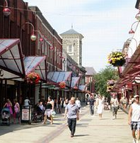

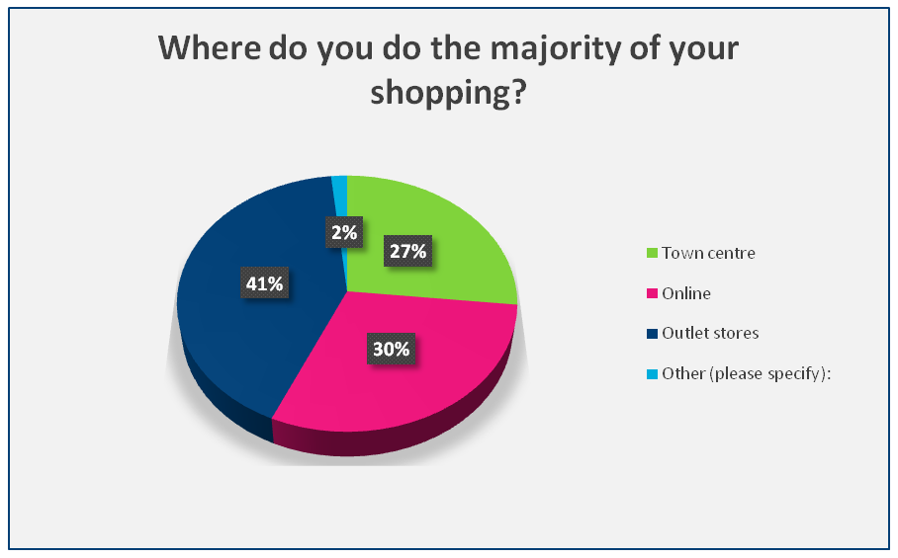
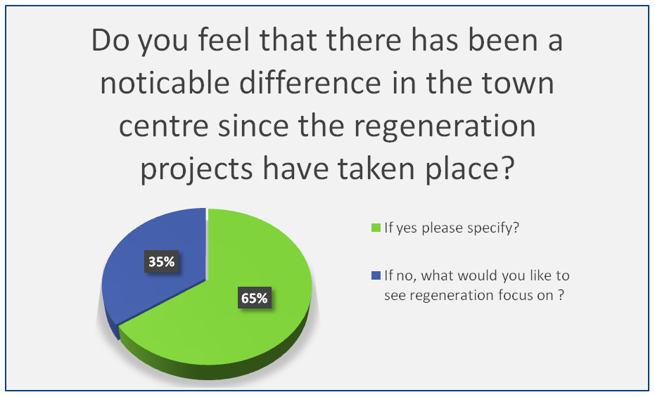
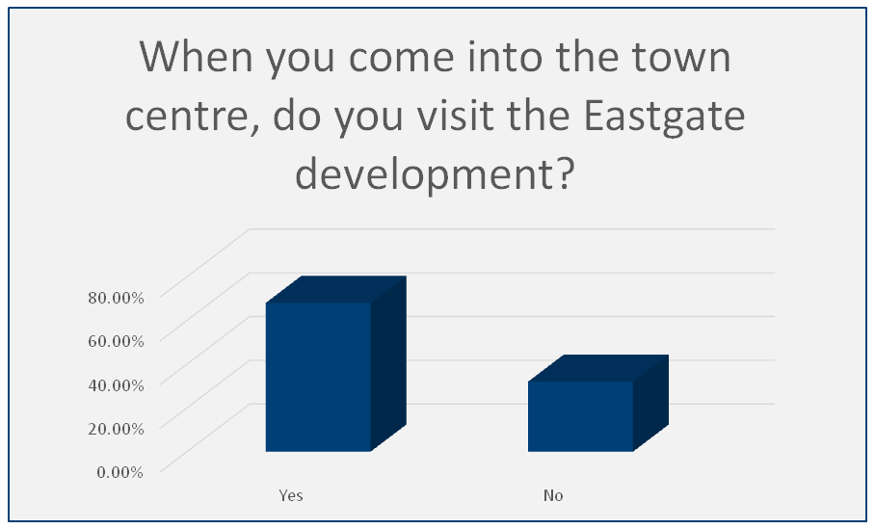
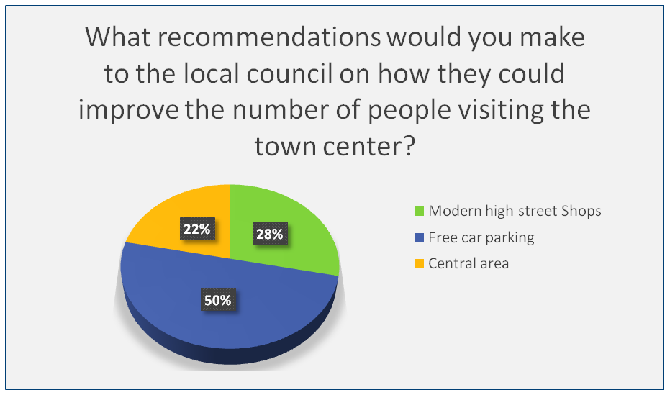
An investigation into the impact of regeneration in Wales, with a primary focus on the recent development within Llanelli town centre.
XXXXXXXX
XXXXXX
Introduction
Findings
Regeneration is defined as a comprehensive process that aims to tackle a combination of social, economic, physical and environmental issues. The focus is on areas of disadvantage and where improvement can be made (Parliament UK, 2011).
Efforts to improve conditions in Britain’s Poorest areas have been underway since at least 1945 (Roberts & Sykes, 2005). The focus on the urban areas and town city centres has been broader since the Labour Government came into office in 1997, this trend has since grown, where redevelopment and the investment into local towns and deprived areas and communities have become an ongoing discussion.
Llanelli town centre is within the county of Carmarthenshire situated in South Wales. In recent years, Llanelli town centre has seen a decline in the number of customers using the shopping facilities with passing trade dwindling significant. The study has looked at regeneration within Wales with a focus on Llanelli town centre. Carmarthenshire County Council, with the help of the Welsh Government, has invested £60 million pound in five areas of Llanelli, as illustrated within table 1.
Four interviews were completed with existing traders, the main concerns raised were:
1. Lower rate rental cost for commercial premises.
2. Quality shops for better footfall
3. Car Parking
4. Liaison Officer
5. Outlook on building
Aim & Objectives
Discussion
The results from the primary research which includes, the questionnaires and interviews conducted with local traders are showing a pattern consistent with the recommendations that were made within the Portas review.
The secondary research shows that the local high street is suffering. The main reasons being due to the recession which hit the economy hard in 2008, the continuing downturn is still having an impact on customers shopping trends. The decline in consumer spending is having a big effect on retailers which leads to too many going out of business as profits are low or non-existent. Another factor is the growing existence for Retail parks and online shopping. Llanelli has experienced this disadvantage for years as new businesses setting up choose the retail park instead of the town centre. This has a detrimental effect on the footfall of shoppers within the town centre.
The Government support through community led regeneration programmes are now taking a new approach in supporting the local communities and TCS. The support is available via the Regional Growth Fund which is the largest programme in the Governments financial tables. All applications are completed to the European Regional Development Fund. The new approach to regeneration and the emphasis being on community initiatives and town centre modernisation now means that the local councils can coordinate the programmes and funding can be allocated accordingly.
Aim
Objectives
An investigation into the impact of regeneration in Wales, with a primary focus on the recent development within Llanelli town centre.
Critical review of current policies and strategies being implemented to regenerate small towns at national and local government levels
To establish if the recent regeneration programme reflects trends in other parts of the country.
A critical literature review of small town regeneration in Wales and locally with regards to rural economic development.
Conclusion
It is clear that regeneration in Wales is not fully evaluated as yet. What is clear is that government investment both in interest and financial backing has seen overall positive results for TC regeneration. The questions falling out of this is whether Wales has gone far enough yet and whether they can learn from counterparts in the rest of the UK.
This investigation has explored the regeneration from a UK, Welsh and local town perspective and there are common themes evident. Firstly, out of town shopping centres predominantly have adverse effects on trade and culture within town centres, attracting shoppers to large branded department stores and supermarkets with free car parking and restaurants and coffee shops to spend a day there rather than a few hours. Secondly, that no matter whether regeneration takes place in town centres or in out of town developments, online trade is having an effect on physical trade across the country and will continue to increase, forcing towns, cities and indeed governments to rethink economic development policies. The third common theme is that regeneration does not always ensure positive outcomes for some areas – some areas need a combination of interventions to improve community resilience first then concentrate on the regeneration schemes that will complement those areas.
What is clear is that government investment both in interest and financial backing has seen overall positive results for town centre regeneration. The questions falling out of this is whether Wales has gone far enough yet and whether they can learn from counterparts in the rest of the UK. Referencing earlier parts of this investigation, Wales’ investment in regeneration is significantly lower than other parts of the UK and this will need to change if economic prosperity is to gain momentum in post-industrial communities.
Make recommendations on future benefits of regeneration projects.
Methodology
To establish why regeneration is a focus area within the UK and what effect new regeneration has had on Llanelli town centre, This study included both qualitative and quantitative research that has been achieved by accumulating both primary and secondary research.
The use of a questionnaire was used as part of the primary research study, this was set up via smart survey UK to enhance a wider audience and accessibility for the study (Wright, et al., 2008). The social media site Facebook was then used as the vehicle to complete the survey. A total of 60 questionnaires were completed.
Two face to face interviews were completed at the traders premises in Llanelli town centre and a further two interviews were completed over the telephone after an initial meeting with the traders. These interviews were completed in February and March 2016.
For secondary data, this study has used newspaper articles, several academic books and published government reports to compile a literature review.
Recommendations
References
Reduce parking charges or offer free parking on allocated days
New retailers within Llanelli town centre
Business Rates
New look on buildings
5. Liaison Officer to be appointed
Carmarthenshire County Council, 2010. Business Plan 2010 Llanelli Town Centre
Carmarthenshire County Council, 2011. The drawing of Llanellis bright future
Mary Portas, 2011. The Portas Review
Local Government, 2012. Department for communities and local Government
National Assembly for Wales, 2012. Enterprise and Business Committee
Business Wales, 2015. Business Wales.
National Assembly for Wales , 2010. Key Statistics for Llanelli.
Parliament UK, 2011. Regeneration, communities and local Government Committees.
Literature review
The Government have committed to supporting local communities. The current strategic roles are:
Mary Portas, conducted an independent review into the state of our high streets and town centres. The report was published in December 2011 stated that “the purpose of the review was to put the heart back into the high streets and be a destination for culture, health, wellbeing and creativity (Mary Portas, 2011) . The Welsh Local Government Association said “There is no doubt that the development of out-of-town retail sites over the last few years has had a detrimental effect on many TCS across Wales.” (National Assembly for Wales, 2012).
Llanelli town centre has an average weekly footfall of 135,000 (Carmarthenshire County Council, 2010) However it is evident from past research by the council that footfall is decreasing and shops are closing.
Reforming and decentralising public services.
Providing powerful incentives that drive growth.
Removing barriers that hinder local ambitions
Providing targeted investment and reform to strengthen the infrastructure for growth and regeneration to support the most vulnerable.

