Slide 1

Planning & Production
My Name is Morgan Jones I am an Electronic engineering student and I will be covering the Electronics and Internal Design side of the project

Slide 2
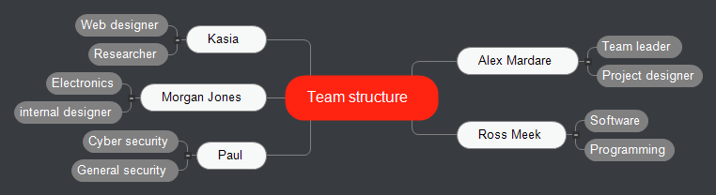
Team Structure

Slide 3
resources (People & Equipment)
People – Morgan Jones, Alex Mardare, Ross Meek, Kasia, Paul
Equipment – Soldering iron, filter fan, Sponge with Soldering iron holder, solder, Visual studio, Command line interface
Components – Raspberry Pi (raspbian), Lithium battery, 240GB SATA SSD, SATA to USB 3.0 cable, Touch screen with case and ports, PiJuice HAT - A Portable Power Platform

Slide 4
how it will be produced
The people doing the construction:- Morgan Jones – Hardware, Ross Meek – Software, Alex Mardare – Hardware and 3D printing
Visual studio professional IDE will be used to create and produce the code that will be installed into the device and be used to create a web application which connects to the device
A Command line interface will be installed to the device to activate the code on start-up of device making a screen not required
A 240gb SATA SSD will be attached to the device via a SATA USB 3.0 cable
The Raspberry Pi with Raspbian OS installed
PiJuice HAT - A Portable Power Platform will be connected to the motherboard
The completed device will be placed in a ready-made case with a touch screen and multiple ports built in
Chromium will be used by raspberry pi to run the web app

