Slide 1
BMHP5016
Principles of Health & Social Care

Slide 2
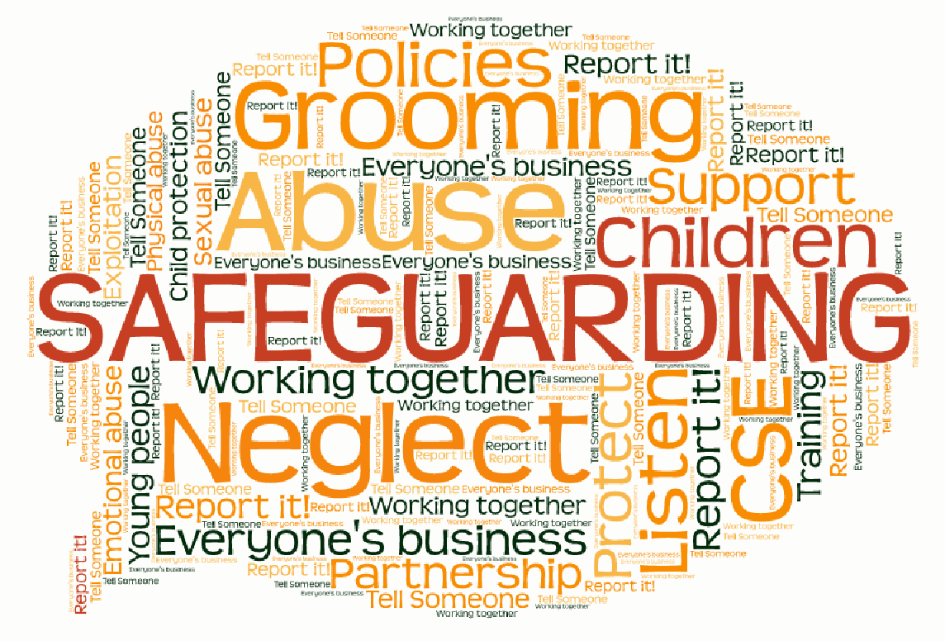
What is safeguarding?
Who are most vulnerable?
•

Slide 3
SAFEGUARDING
Safeguarding means protecting a citizen’s health, wellbeing and human rights; enabling them to live free from harm, abuse and neglect. It is an integral part of providing high-quality health care. Safeguarding children, young people and adults is a collective responsibility.
Those most in need of protection include:
Children and young people
Adults at risk, such as those receiving care in their own home, people with physical, sensory and mental impairments
Those with learning disabilities.
All staff, whether they work in a hospital, a care home, in general practice, or in providing community care, and whether they are employed by a public sector, private, or not-for-profit organisation, have a responsibility to safeguard children and adults at risk of abuse or neglect. ( CQC, 2020)

Slide 4
Children Act 1989 Child Act 2004
Framework for protection and safeguarding of children.
What is best for the child.
Care order – imposed by courts, places child under care of local council to share parental responsibility.
Builds on previous Act.
Requires local authorities to use a multi-agency approach.
Well-being: healthy, safe, able to enjoy & achieve, economic well-being, can make a positive contribution.

Slide 5
Care Act 2014 (129 chapters)
Responsibilities of Local Authority – assessing needs, providing care and support, direct payments, safeguarding, transition for children to adult services
Care standards – quality, CQC, performance ratings
Integration of health and social care

Slide 6
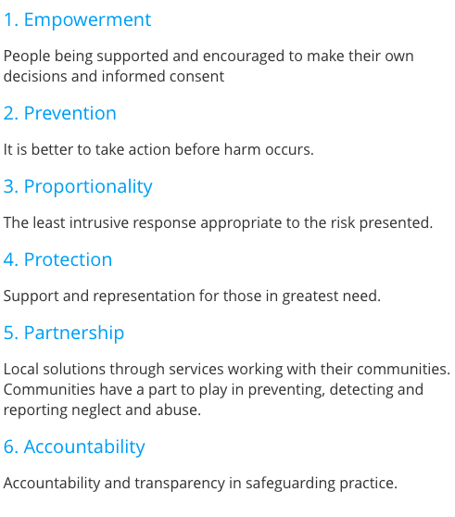
Safeguarding
Principles
The Care Act 2014 encourages caregivers to take a person-centred approach when safeguarding vulnerable adults.
The principles help you directly involve the vulnerable person – and any nominated people who can help reach decisions in the vulnerable adult’s best interest – when managing safeguarding concerns and care plans.

Slide 7
Understanding safeguarding videos
Watch these real stories from Haringey Council
https://www.youtube.com/watch?v=JS33VJcaxjQ
https://www.youtube.com/watch?v=_Ki7XsezOWw
https://www.youtube.com/watch?v=8TTb_Zp43l4
https://www.youtube.com/watch?v=b-ybDjFPDRk (but bear in mind we have different phone numbers)
Do the Quiz on Moodle

Slide 8
What to do?
Contact emergency services if in danger
Report to manager / safeguarding officer
Contact social services – see council website for appropriate phone number https://www.birmingham.gov.uk/info/20019/children_young_people_and_families/602/who_to_contact_if_you_re_worried_about_a_vulnerable_adult_or_child
Make notes on what you have seen

Slide 9
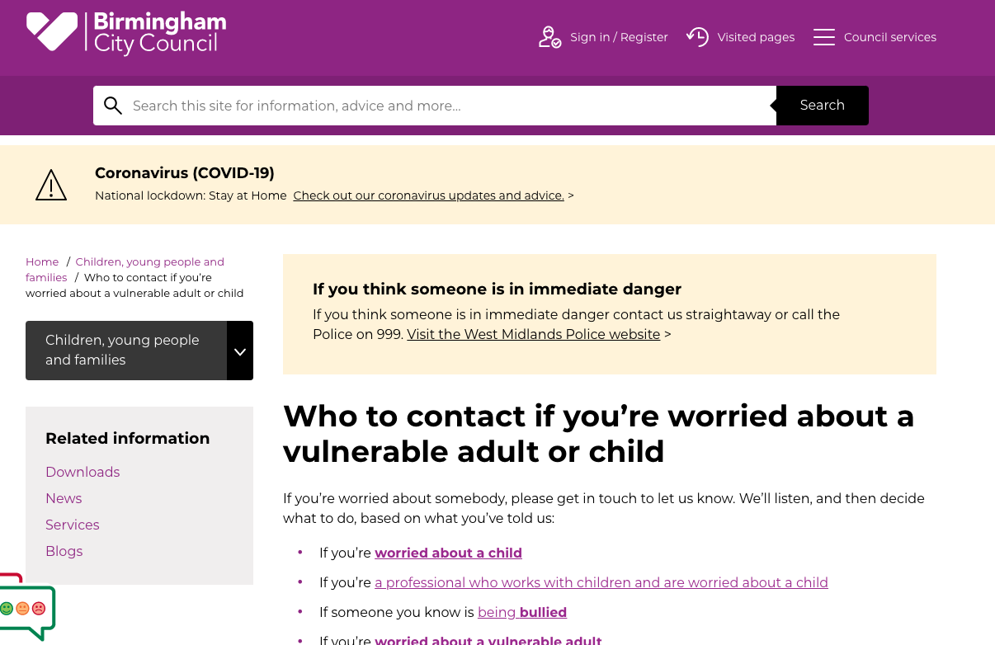

Slide 10
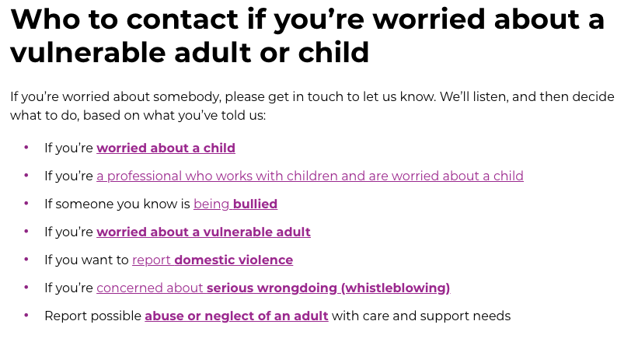
Birmingham City Council website

Slide 11
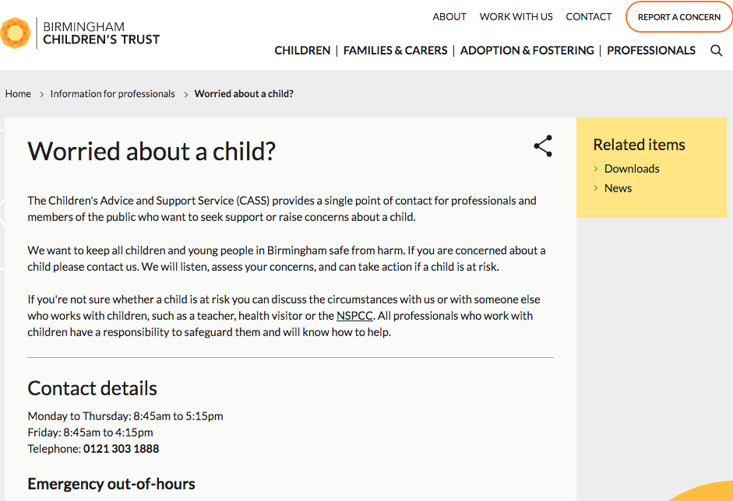

Slide 12
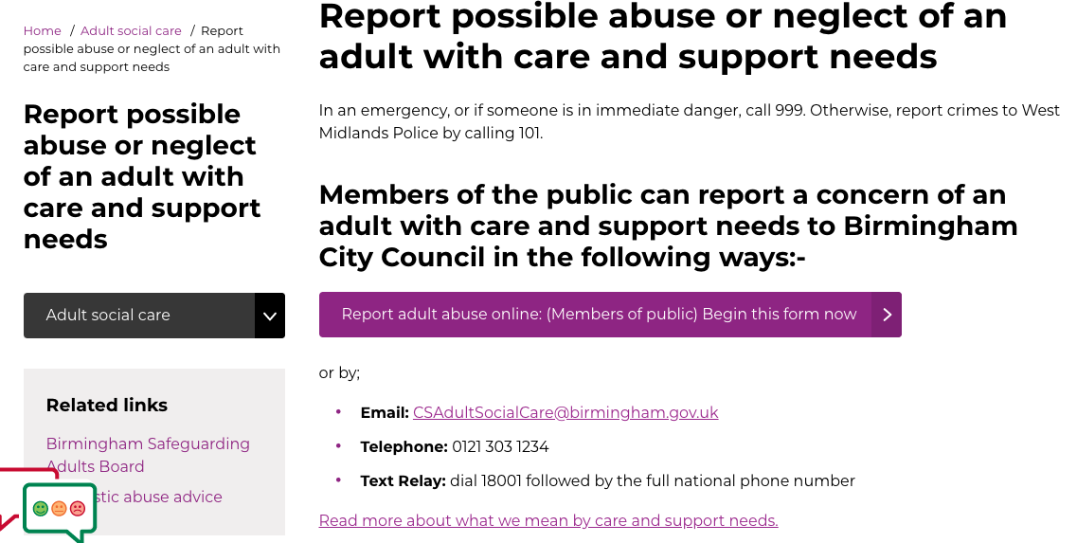

Slide 13
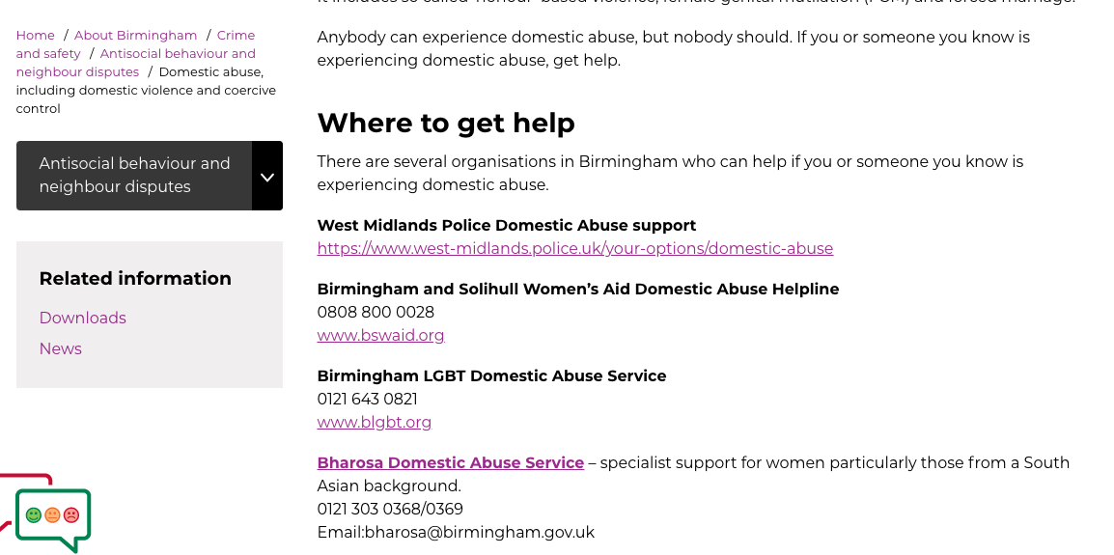

Slide 14
What to do?
Recognise
Respond
Report
Record
Refer

Slide 15
REFERENCES
https://www.cqc.org.uk/what-we-do/how-we-do-our-job/fundamental-standards
www.skillsforhealth.org.uk
Principles of safeguarding
https://www.scie.org.uk/safeguarding/adults/introduction/six-principles
HM Government (2018) Working Together to Safeguard Children
https://assets.publishing.service.gov.uk/government/uploads/system/uploads/attachment_data/file/942454/Working_together_to_safeguard_children_inter_agency_guidance.pdf

