Slide 1
BMSW5013 Creativity and Innovation
Research and Development

Slide 2
What we’ll cover today
The concept of R&D
The R&D Process
The Product Lifecycle
Managing R&D
Current priorities – the Metaverse
How this relates to the assignment

Slide 3
What is R&D?
Research and development (R&D) are two related processes through which new products and new versions of old products are created.
Innovations usually have their roots in R&D and have gone from laboratory idea, through pilot or prototype and initial manufacturing, through to full-scale production and marketing.
The process of inventing includes both systematic enquiry and trial and error.
It can be basic (general, aimed at advancing technology) or applied (uses the findings of basic research to address a specific need).
Development involves bringing the product or process into production.

Slide 4
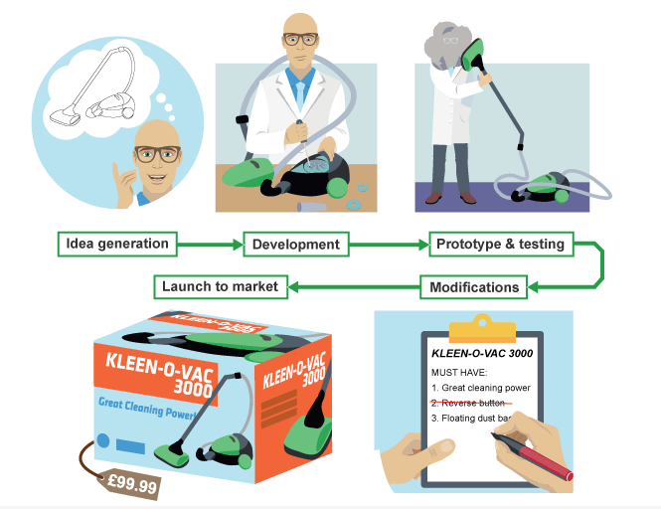
Stages of New Product Development
Patents and copyrights might also be sought to prevent others from copying idea
(BBC, 2024)

Slide 5
Product Lifecycle
The Product Life Cycle describes the period of time over which an item is developed, brought to market and eventually removed from the market.
Development
Introduction
Growth
Maturity
Decline
Notes:
Not all products reach this final stage. Some continue to grow and the maturity phases of the life cycle is extended to delay the decline phase.

Slide 6
Extension strategies
To prevent decline, organisations can change the following:
Product version
Price
Place they are sold
Promotion
Packaging
Usage
Name

Slide 7
Activity – Crib Gough
This is an example of how some companies are working with other organisations to develop ideas. Watch the video and answer the following questions:
What was the problem/need/opportunity they identified?
What was the first stage of the process?
What technology did the research team use to speed up the process and reduce the costs of R&D?

Slide 8
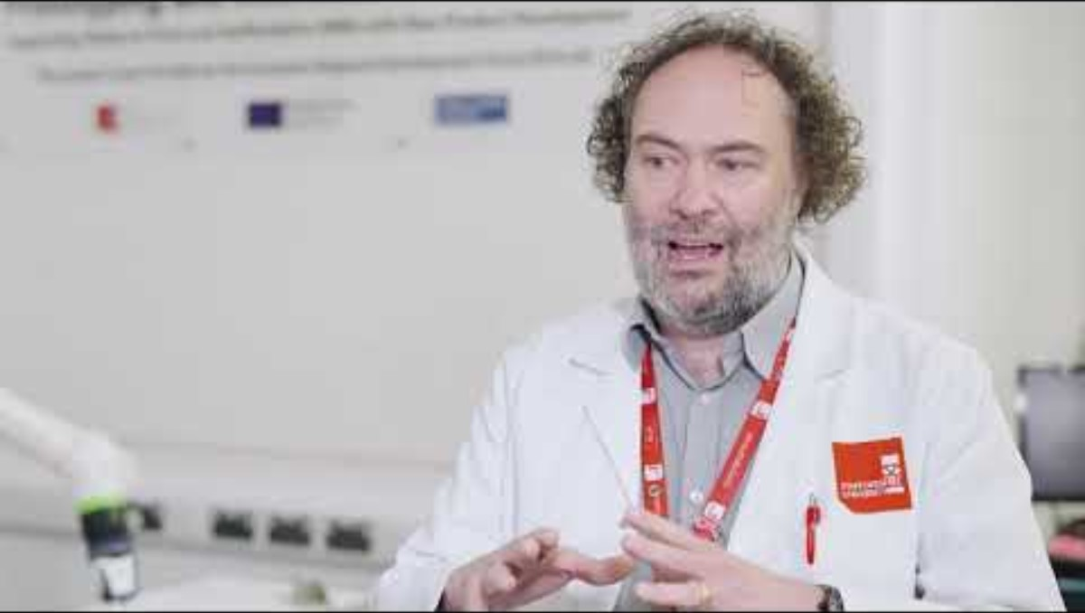
The R&D Process – Crib Gogh

Slide 9
The R&D Process
Idea generation: Brainstorming, literature review, market trends
Concept development: Feasibility study, market analysis
Prototype development: Designing, testing, and refining the product/service
Product development: Finalising the product/service for market introduction

Slide 10

Case Study – The Body Shop
Notes:
The Body Shop: What went wrong? - BBC News

Slide 11
Group Activity
Why did the Body Shop fail?
What could have been done to prevent this?
What could be done to save it now?

Slide 12
R&D Management
Organising for R&D: Centralised versus decentralised R&D
Project selection and portfolio management
Managing the R&D workforce: Motivation, team dynamics, and leadership

Slide 13
Costs
Raw materials
Employee costs – scarce skills
Site costs
Any other costs?
How could organisations reduce costs?

Slide 14
Complexity
Competition is on a global scale
Metaverse – virtual or augmented reality, combining human and digital elements
Ensuring social equality
Ensuring environmental sustainability
Difficulties of collaborating with other organisations
Notes:
The metaverse is digital space where users can socialise, learn, play or purchase goods and services. It can be experienced through virtual or augmented reality. You could access it using a headset or enter a virtual world. Often you would have a 3D avatar whilst using it.

Slide 15
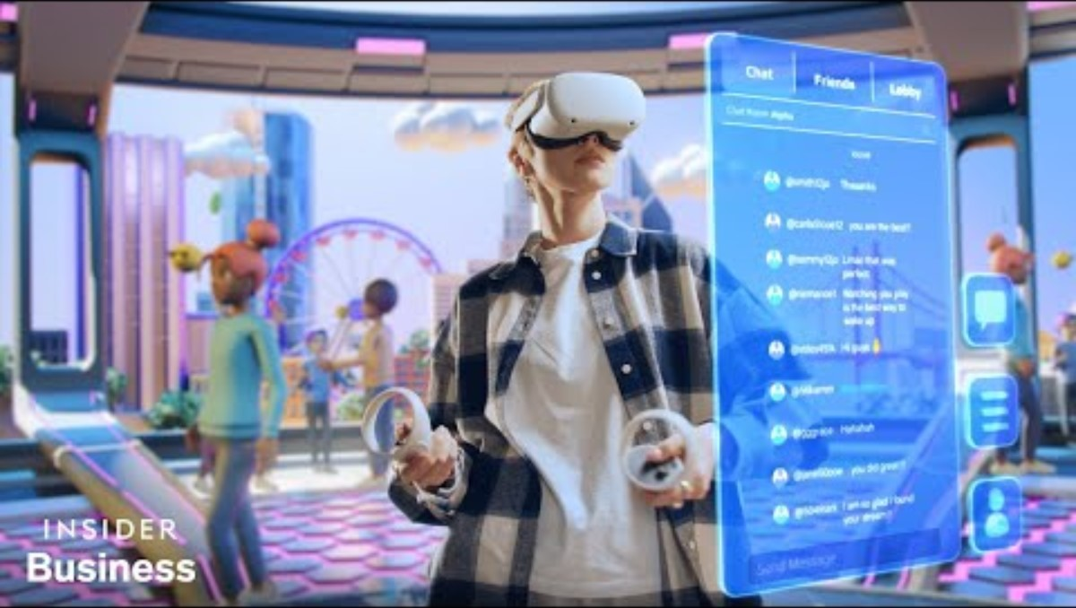
The Metaverse

Slide 16
Metaverse – What roles will these people play?
CEOs and boards
Chief operating officer (COO)
Chief marketing officer (CMO)
Chief financial officers (CFOs)
Chief human resource officers (CHROs)
Legal Team
Tax leaders
Notes:
These non-tech executives will need to work closely with each other and with chief digital, chief innovation, chief information and chief information security officers, who will be creating (and protecting) your company’s metaverse infrastructure, experiences and data pipelines.
CEOs and boards: Set strategic priorities, prepare the business for changing customer and employee expectations and get ahead of new threats and risks.
Chief operating officer (COO): Help operationalise new tools and technologies.
Chief marketing officer (CMO): Rethink customer engagement, experience design and brand building for an immersive digital world.
Chief financial officers (CFOs): Watch for the rising use of digital assets (such as cryptocurrencies and NFTs) in the metaverse, understand the new third parties that may be processing critical transactions, carefully assess investment allocations and update SOX controls over financial reporting.
Chief human resource officers (CHROs): Deploy metaverse tools for recruitment, onboarding, training, connectivity and collaboration.
Legal Teams: Respond to legal discovery for data and assets in the metaverse.
Tax leaders: Obey the fast-changing rules — and find new tax value. (PWC, 2023)

Slide 17
What we’ve learnt today
What is R&D
The R&D Process
How R&D can be managed, costs and complexity
Current/possible future priorities of R&D

Slide 18
How this relates to the Assignment
The theory and knowledge we have learnt today can be included in task 1.
To what extent is research and development happening in your organisation? Are there dedicated departments? This will give an indication of the importance that the organisation attaches to creativity and innovation.

