Slide 1
BMIH5003 FOREIGN LANGUAGE AND CULTURE AWARENESS
Student name Alina Elena Craciun
Student Number 2212851
Module lecture Giulia Chifari
PRESENTATION
Recording-20231026_232735.webm

Slide 2

THE CONCEPT OF MULTILINGUALISM
Multilingualism is an ability to use more than one language, individual carrying understanding of two or more than two language fall under this criteria (Duarte and Günther-Van der Meij, 2018).
Multilingualism indicate ways in which a person communicates with the people while using different language and ability to present and viewpoint or convey a message through common or native language.
For example, A Chinese individual is able to speak Chinese as well as English or an Arab individual person is able to speak Arabian as well as English language.

Slide 3

THE BENEFIT OF MULTILINGUALISM
The benefit of multilingualism lies understanding other person who find difficult to communicate due to cultural differences or language difference.
Hotel staff members need to have multilingualism, this means staff member of hotel should know more than one language to address those guest who visit from different nation (Kelly-Holmes, 2019).
Or from those areas where English and common European language is not spoken.
For example, Modern European Language may include Russian, French, Italian, German and English, these are modern languages of Europe that are widely spoken.

Slide 4
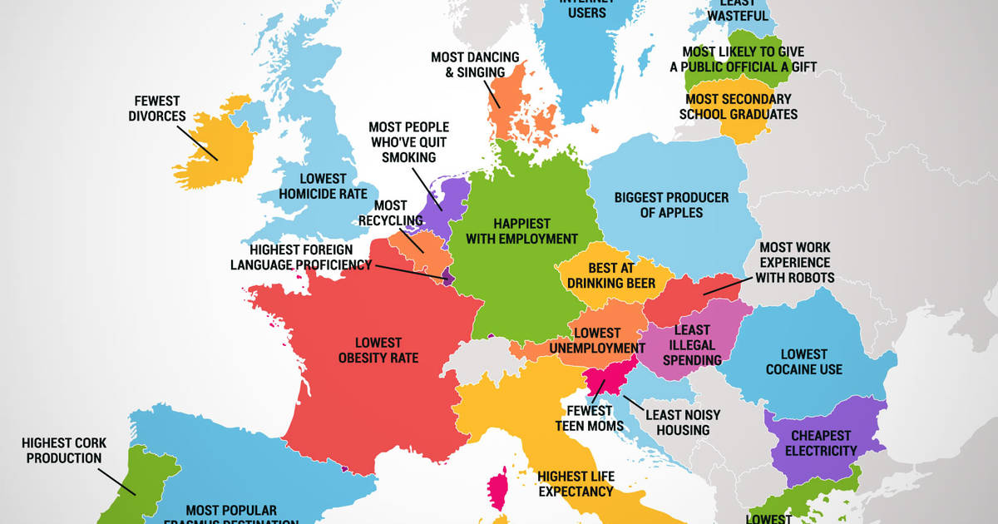
MODERN EUROPEAN COUNTRY
FRANCE
France is a Modern European Country, people within France speak French which is most common language in the whole Europe as well.
French is spoken in several European countries, this is one of the most difficult language to be learned (Berthele, 2021).
However, French is polite language, this means hotel staff can understand French if they were aware about other European languages in the process.
Hotel staff can learn French or can learn few important keywords from the French language to address guest.
For example, Bonjour, comment puis-je vous aider.

Slide 5

THE IMPORTANCE OF LANGUAGE AWARENESS FOR THE HOTEL STAFF
It is significantly important for hotel staff to remain aware about different languages that are spoken within the Europe to address the requirement of guest accordingly.
Importance of language awareness lies in understanding guest and their requirement and to avoid any misunderstanding that appears due to change in language.
As a hotel manager of DIVERSITY HOTEL & SPA LONDON, it is important to consider one of the modern European language that is widely spoken such as Russian and French.
These languages are most commonly spoken in France, Germany, Italy and even within the Britain (Coulmas, 2018).
The importance of language awareness for hotel staff allow them to avoid any sort of conflict with the guest and avoid impacting their experience.
Here, the benefit of multilingualism lies where hotel staff carrying more than one languages are preferred in the organization and ways in which hotel staff can handle the guest experience accordingly (Gramling, 2021).
Hotel staff member with ability to speak more than one language can address guest requirement and deliver high quality of service to these guest.

Slide 6

CONTINUE……
Furthermore, it is important for hotel manager and management to educate employees about multilingualism and awareness about different languages.
In hotel industry, management provide training to staff member regarding the guest experience management.
Companies provide training about most common spoken language in the country and ways in which staff member can address the requirement.
Overall, training for different language is challenging task for the firm, many hotel companies consider hiring those employees who have knowledge for different languages in the process.

Slide 7

REFERENCES
Books and journals
Duarte, J. and Günther-Van der Meij, M., 2018. A holistic model for multilingualism in education. EuroAmerican Journal of Applied Linguistics and Languages. 5(2). pp.24-43.
Kelly-Holmes, H., 2019. Multilingualism and technology: A review of developments in digital communication from monolingualism to idiolingualism. Annual Review of Applied Linguistics. 39. pp.24-39.
Coulmas, F., 2018. An introduction to multilingualism: Language in a changing world. Oxford University Press.
Gramling, D., 2021. The invention of multilingualism. Cambridge University Press.
Berthele, R., 2021. The extraordinary ordinary: Re‐engineering multilingualism as a natural category. Language Learning. 71(S1). pp.80-120.

