Slide 1
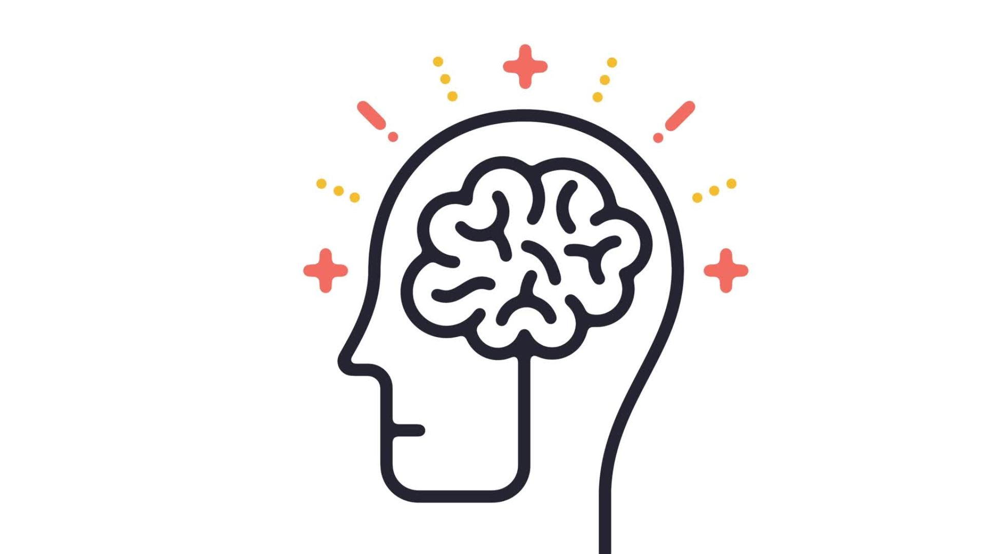
Lifespan development and psychology theories
Sherelle Remzi

Slide 2
Introduction to lifespan development
Lifespan development is the study of growth and change throughout life.
Baltes (1987) explained that development involves multiple dimensions including biological, cognitive, social, emotional, and behavioural. These dimensions interact and influence each other
Psychologist such as Erik Erikson, Jean Paiget have created theories which consider cognitive development and emotional social development that occurs during different stages of an individual's life span, from birth right up until death.
In this presentation I will be discussing the Erik Erikson psychosocial development theory and Jean Piaget's cognitive theory. I will discuss some of the strengths and weakness from both theories and relate back to the case study demonstrating why it is important understand the psychological factors which influence human behaviour throughout the lifespan.

Slide 3
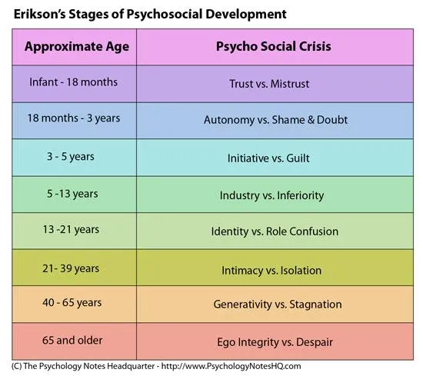
Stage theory refers to a psychological or developmental model that proposes human development occurs in distinct, sequential stages.
In short - Individuals move through stages in a specific order
Each stage presents a psychological conflict (“crisis”) that must be resolved, and unresolved conflict from one stage will affect an individual's development.
Erikson highlights the role of both parents (and other adults) and the impact that may have from ages 0-18 months -
Core question: Can I trust the world?
Parental role: Providing consistent, responsive care builds trust.
Neglect, inconsistency, or abuse fosters mistrust.
The experiences in the first 4 stages of a childs life influence personality in adulthood.

Slide 4
Strengths of Erikson’s Psychosocial Theory
Clear Structure -The eight distinct stages provide a useful framework for understanding developmental challenges at different ages.
Emphasizes Social and Cultural Influences- Erikson highlighted how social relationships, culture, and environment shape development—not just biological
Focus on identity - The theory's focus on identity (especially during adolescence) is especially influential in education, counseling, and youth development. (The experiences in the first 4 stages of a childs life influence personality in adulthood.)

Slide 5
Weakness of Erikson’s Psychosocial Theory
Vague - Concepts like “trust,” “identity,” or “integrity” are abstract and subjective, making them hard to measure or test.
Cultural bias While Erikson included cultural context, his stages were based largely on Western, middle-class experiences, which may not apply universally.
Erikson minimises the biological aspects of development, Erikson saw social interaction and culture as the primary forces shaping development—not genetics or biology.

Slide 6
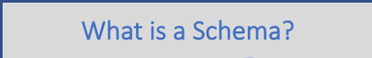

Jean Piagets cognitive development theory
Piagets theory is focused on how thinking and reasoning develop.
It focuses on how children actively construct knowledge as they interact with their environment, emphasizing the stages of cognitive growth from infancy through adolescence.
Piaget saw children as “little scientists” they are active learners and children learn by exploring and manipulating their world.
They don’t just absorb information — they build mental models (schemas) through experience.
cognitive constructivism: we learn as a direct result of our experiences.

Slide 7
A mental structure or framework for understanding the world (e.g., a child’s schema for “bus” might include four wheels and the colour). Assimilation is fitting new information into existing schemas (e.g., calling a car a “bus” because it has four wheel).
Schema are concepts associated with experience, because of our experience we can learn which changes or creating new schemas when new information doesn't fit (e.g., learning that both cars and buses have four wheels, but they are not the same).This concept is called accommodation

Slide 8
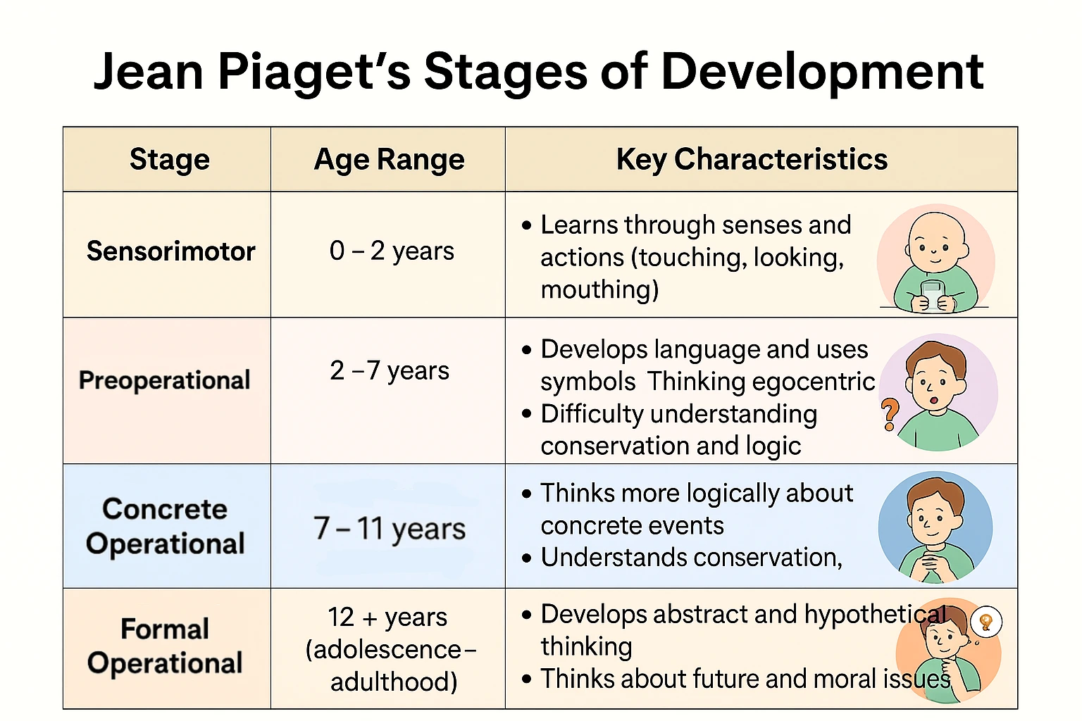

Slide 9
Strengths of Jean Piagets cognitive theory
Introduced Key Cognitive Concepts
Based on detailed naturalistic observations of his own children.
Emphasizes Active Learning - Piaget recognized that children are not passive learners—they actively construct knowledge by exploring their environment.

Slide 10
Weakness of Jean Piagets cognitive theory
Piaget's theory proposes fixed, universal stages that all children go through in the same order. However, cognitive development can be more flexible and uneven.
Piaget placed little emphasis on the role of culture, social interaction, and language in shaping cognitive development. - Vygotsky says children also learn through social interaction.
Piaget’s theory primarily focuses on cognitive development (thinking, reasoning) and largely ignores emotional, social, or motivational aspects of learning.

