Slide 1

Sports Facilities
Thursday 3/12/15

Slide 2
Key Points from Last Lecture?

Slide 3
Liberty Stadium
Re-cap activity
Artificial Surfaces in Wales
Reasons for Demand / Drivers
Potential Barriers
The Future
In your Tables consider all the above and be prepared to feedback to the Room

Slide 4
Sport Wales
Sport Wales have produced a report ‘Acting today for an active tomorrow’ to influence Sporting policy moving forward between now and 2026
http://www.walesonline.co.uk/news/wales-news/sport-wales-report-warns-we-8181911

Slide 5
4 Possible Futures identified
A – Talk the Walk
B – SportTopia
C – Couch Culture
D – Against all odds

Slide 6
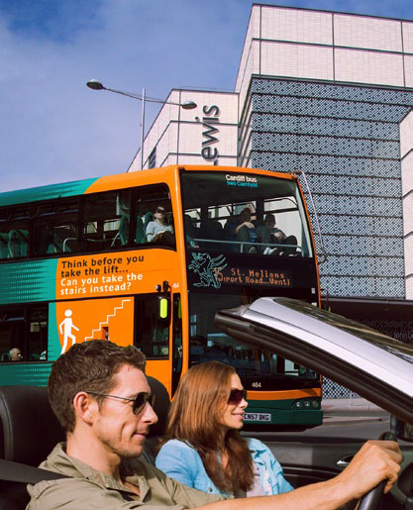
Talk the Walk
Public Policy to support Sport and Physical activity
Huge Health and well being agenda
Appropriate facilities
Range of activities
Lack of Public ‘buy in’
Low activity levels recorded

Slide 7
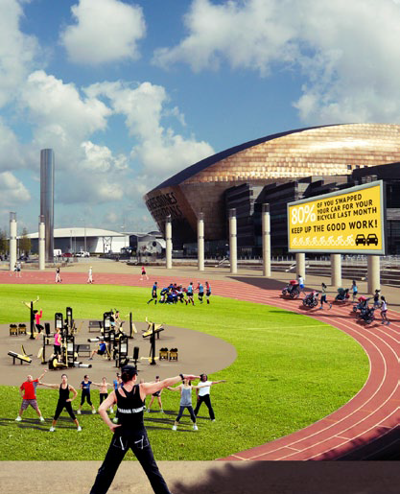
SporTopia
Optimal opportunities in Wales
Strong Collaborations with barriers removed
Positive active ‘mindset’ in wales

Slide 8
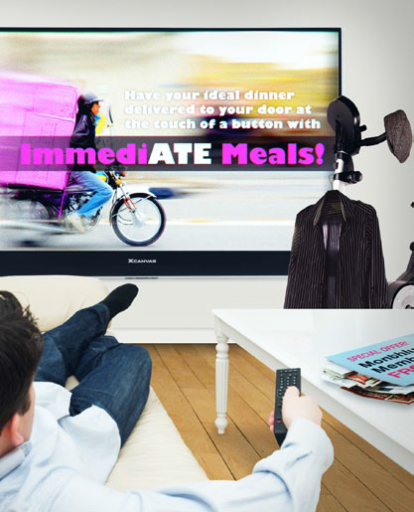
Couch Culture
Inactive mindset
Inactivity the norm
Policy disjointed and lack of clear strategy
Participation at all time low

Slide 9
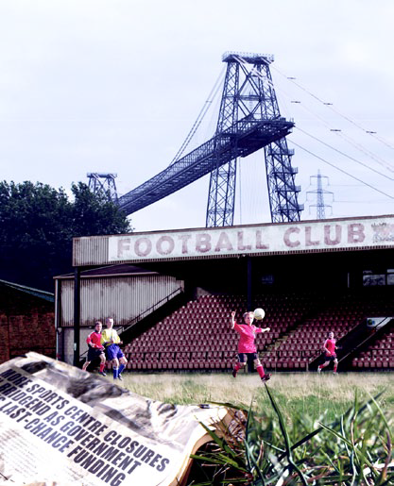
Against all Odds
Active lifestyles
Little support from Government
Private sector leading
Uneven development in small pockets – Postcode lottery

Slide 10
Current State in Wales?
Where do you feel Wales is at the moment?
Reasons?
Viewpoints?
Solutions / ideas?

Slide 11
Trends affecting Future of Sport
Shifting Economic & political landscape
Changing identities
Switched on Society
Digital Revolution
Healthier Lives
Engaging the 21st Century
Changing Society

Slide 12
Activity
In 7 groups, discuss the documentation for a specific trend. Feedback on
- Overview of the trend
Specific Examples
Implications on future of Sport in Wales
Ideas / suggestions?

Slide 13
Conclusion
Implications on all of us within Industry
Possible routes
Future of Sport in Wales
Questions / application going forward

