Slide 1

Critical skill – Belief, Value and Attitude.
Week 4 – BMSW5101 Developing Workplace Critical Skills

Slide 2



During this session we will discuss…
Define what Belief, Value and attitude are.
Examine how these are formed and how they differ
Discuss how belief, value and attitude can impact the workplace.

Slide 3
Attitudes, beliefs and values, what is the difference?
Furnham (2008, p268) outlines that every employee in an organisation will possess a set of attitudes, beliefs and values. However, there will exist individual differences between each member of staff. It is important to acknowledge this, in order to engage and empathise with staff and to predict their responses and behaviours.
Belief
Value
Attitude
Notes:
Each of these are distinct and different but combine together to form a basis for staff behaviour, bias and approach to situation, problems and decision making.

Slide 4
Belief
Beliefs are thoughts about concepts, events, objects or people; or about the relationship between these things
Beliefs do not have an evaluative (good/bad, like/dislike) component.
Strong beliefs can lead to bias and errors in judgement
How can beliefs impact our work? Griggs & Jackson (2020, p261) outlines ‘belief perseverance’ the tendency to cling to a belief even when evidence contradicts it.
Notes:
A belief is an internal feeling that something is true, even though that belief may be unproven or irrational.
Belief perseverance, occurs when a belief is considered integral to someone’s identity, for example – believing that all staff are honest and want to do their best at work, this may not be true of all employees and managers may find it challenging to discipline to reprimand a member of staff that is not being effective, punctual or focused as they belief that there must be a reason or barrier that is causing a member of staff to fall short of expectations.
A manager may belief that they have a good, strong and trusted relationship with their customers and that all customers will pay their invoices as they value the service/product provided. This manager may find it hard to challenge a customer that has not paid an invoice as they belief the customer will pay and the relationship is strong and long lasting and should not be put at risk with petty invoice queries.

Slide 5
Value
Values are related to belief systems; values are groups of beliefs about a particular object or process.
Everyone has certain implicit and explicit values that reflect their unique upbringing, their education and the wider culture within which they live.
Some of their values are overtly materialistic, others completely spiritual
How can values impact our work? A person may choose to work for a particular organisation due to the values of the company that are stated in their mission statement align to their own values.
Notes:
Values shape a person’s attitude to work and behaviour at work. Everyone has certain implicit and explicit values that reflect their unique upbringing, their education and the wider culture within which they live. Some of their values are overtly materialistic, others completely spiritual. These values about freedom, equality and altruism are very relevant in the workplace. For instance, they are partly responsible for where people choose to work. We often hear of people boycotting organisations and products that are associated with specific values antithetical to their own. They would clearly never work for these organisations. Many people seek out organisations whose values (expressed in their mission statement, or known by reputation) fit their own. Values are related to belief systems, that is values are groups of beliefs about a particular object or process.

Slide 6

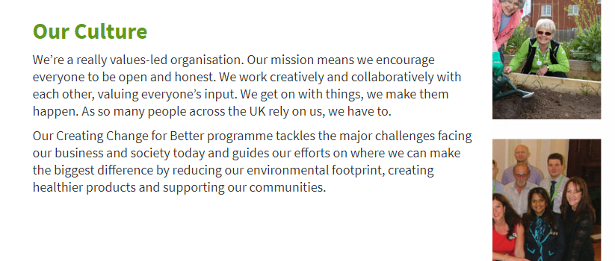
Example – Values at
Notes:
This is an extract from the ASDA careers home page - https://www.asda.jobs/about/
Ask students – why do you think ASDA display their values here, like this, on their careers page?

Slide 7
The three-component model of attitude.
Attitude
Affective
There are three components of an attitude being: Thought (cognitive), Feeling (Affective) and Action (behavioural).
cognitive
behavioural
How can attitudes impact our work?
Job satisfaction is essentially an attitude to the job. People also have very specific attitudes toward work schedules and physical working conditions.
Attitude
Notes:
Traditionally, social psychologists are interested in attitudes to things like work, one’s boss, or the organisation. Attitudes are usually relatively, stable affective or evaluative dispositions towards a particular person, situation or thing. Therefore, attitudes are challenging to change. They have three components: cognitive, affective and behavioural. They form into bundles, constellations or theories. Thus, job satisfaction is essentially an attitude to the job. People also have very specific attitudes like those toward work schedules, or the labour unions or physical working conditions.

Slide 8
How are attitudes formed?
Direct experience
Classic conditioning
Observational learning

Slide 9


Attitudes formed via Direct experience
Attitudes can be developed by means of direct experience. For example, if you had a bad experience with a manager, this may lead to a negative valence of attitude towards all managers.
Conversely, a positive experience with a particular department, for example, a member of the logistics department delivering some urgent stock rapidly, this may lead you to have a positive attitude towards all staff in that department.
What kind of direct experience could lead individuals developing a positive or negative attitude towards seeking changes in their working conditions? Discuss as a group.

Slide 10


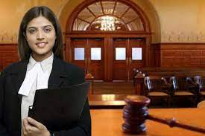


Attitudes formed via Classic conditioning
Conditioning has repeatedly been explored as a means of manipulating attitude formation
Individuals may have an attitude towards a particular job role or company due to the way in which that role or company has been discussed at school or been represented on television.
Consider how a friend or family member’s opinion about a company or job role might influence our attitudes?
Does this kind of conditioning occur in our everyday lives?

Slide 11

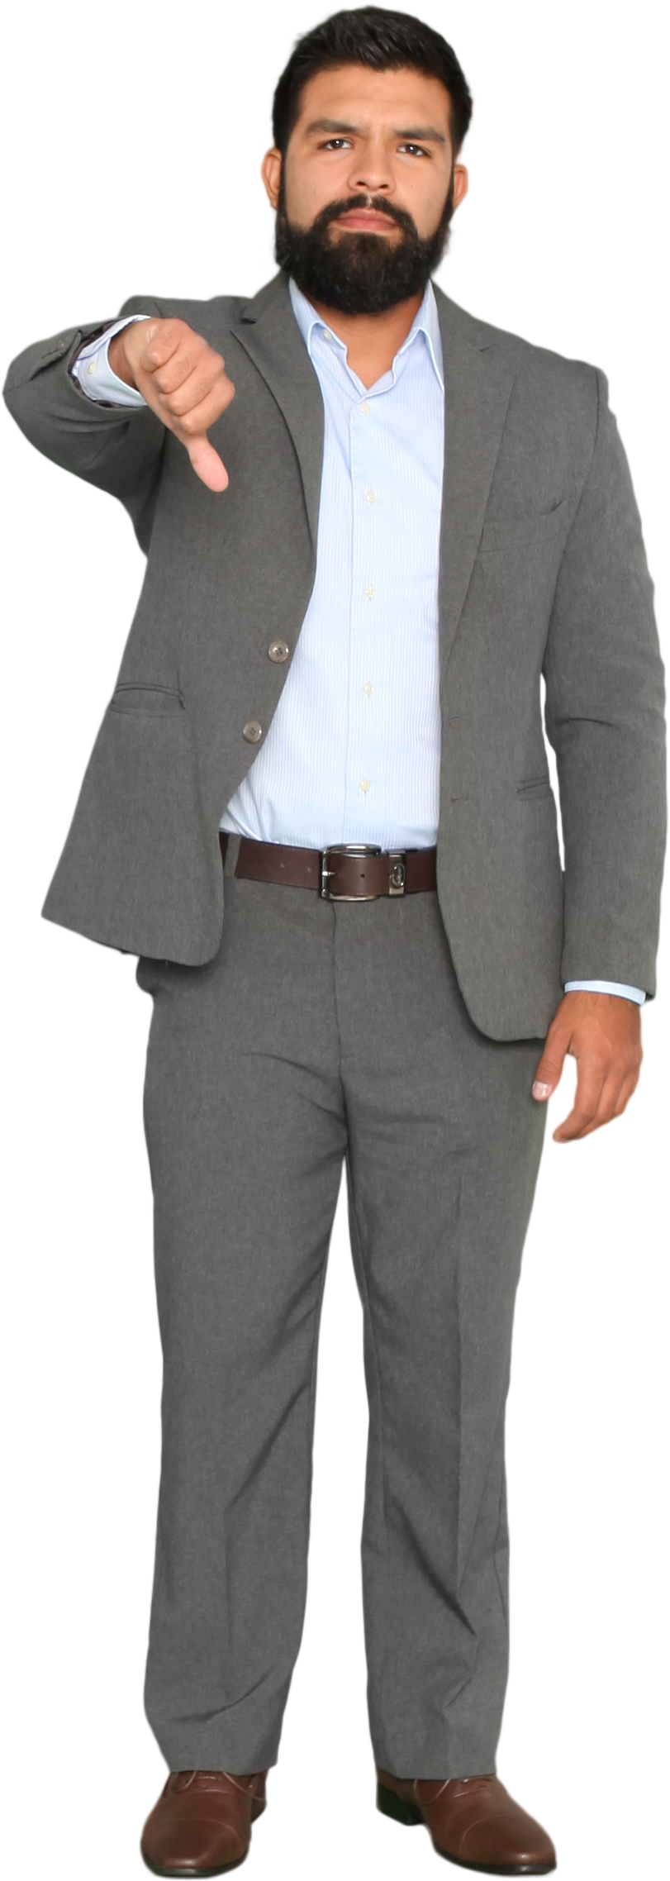

Attitudes formed via Observational learning
Observational learning can impact and influence our attitudes.
Observation learning happens when a person watches and/or empathises with the emotional response of another person to a stimuli. (Bandura et al, 1969)
Have you ever had your attitudes influenced by observational learning? E.g towards a colleague, a task, a department or whole company?
Could observational learning influence the attitude of a member staff has towards a customer?

Slide 12
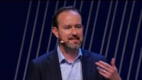
Expressing beliefs, values and attitudes
Notes:
https://www.youtube.com/watch?v=2y8SA6cLUys
This Ted Talk – explains the manner in which staff might express their values and conflicting attitudes to managers in their company.
This links with our week 1 question about preventing strike action. Discuss as a group some of the points raised in the TedTalk.

Slide 13
Summary
We have described the differences between belief, value, attitude
We have discussed how staff belief, value and attitudes might impact the workplace.
We have highlight examples of how companies express values and deal with disagreements in values/attitudes.
We have identified the importance of expressing and addressing values.

Slide 14
Reference
Griggs, R.A. and Jackson, S.L. (2020) Psychology : a concise introduction. Sixth edition. New York, NY: Worth Publishers.
Furnham, A. (2008) Personality and intelligence at work : exploring and explaining individual differences at work. Hove [England: Psychology Press. Available at: https://doi.org/10.4324/9780203938911.

