Slide 1
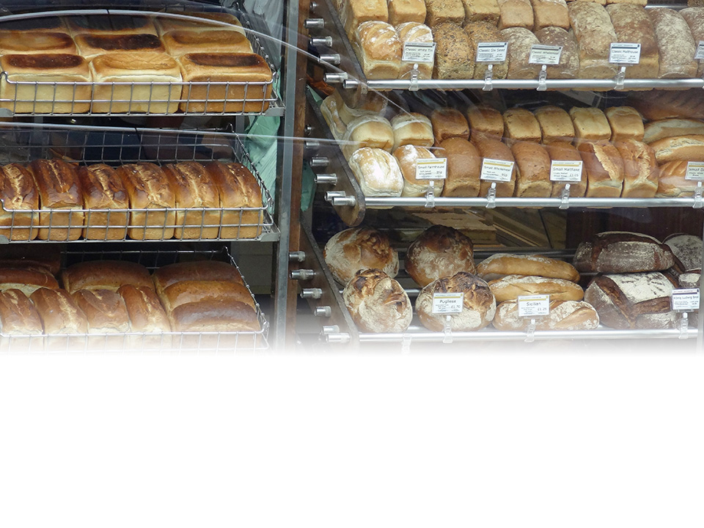
Costs of
Production

Slide 2
Costs of Production
The Meaning of Costs

Slide 3
The Meaning of Costs
Opportunity costs
  meaning of opportunity cost
  examples
Measuring a firm’s opportunity costs
  factors not owned by the firm: explicit costs
  factors already owned by the firm: implicit costs
  irrelevance of:
    historic costs
    replacement costs

Slide 4
Costs of Production
Production in the Short run

Slide 5
Production in the Short run
Production functions
  factors of production
    labour
    land and raw materials
    capital
    entrepreneurship
  the relationship between inputs and output
    TPP = ƒ(F₁, F₂, F₃, … F_{n})
Notes:
2

Slide 6
Production in the Short run
Long-run and short-run production
  fixed and variable factors
  distinction between short run and long run
The law of diminishing returns
The short-run production function:
  total physical product (TPP)
  average physical product (APP)
  marginal physical product (MPP)
  graphical relationship between TPP, APP and MPP
Notes:
2

Slide 7

Wheat production per year from a particular farm
Number of
workers
0
1
2
3
4
5
6
7
8
TPP
0
3
10
24
36
40
42
42
40
Tonnes of wheat produced per year
Number of farm workers

Slide 8
Wheat production per year from a particular farm
Number of
workers
0
1
2
3
4
5
6
7
8
TPP
0
3
10
24
36
40
42
42
40
Tonnes of wheat produced per year
Number of farm workers

Slide 9
Wheat production per year from a particular farm
d
TPP
Maximum output
Diminishing returns
set in here
Tonnes of wheat produced per year
b
Number of farm workers

Slide 10
Wheat production per year from a particular farm
TPP
Tonnes of wheat per year
ΔTPP = 7
Number of
farm workers (L)
ΔL = 1
Tonnes of wheat per year
MPP = ΔTPP / ΔL = 7
Number of
farm workers (L)

Slide 11
Wheat production per year from a particular farm
TPP
Tonnes of wheat per year
Number of
farm workers (L)
Tonnes of wheat per year
Number of
farm workers (L)
MPP

Slide 12
Wheat production per year from a particular farm
TPP
Tonnes of wheat per year
Number of
farm workers (L)
APP = TPP / L
Tonnes of wheat per year
APP
Number of
farm workers (L)
MPP

Slide 13
Wheat production per year from a particular farm
TPP
Tonnes of wheat per year
b
Diminishing returns
set in here
Number of
farm workers (L)
b
Tonnes of wheat per year
APP
Number of
farm workers (L)
MPP

Slide 14
Wheat production per year from a particular farm
d
TPP
Maximum
output
Tonnes of wheat per year
b
Number of
farm workers (L)
b
Tonnes of wheat per year
APP
d
Number of
farm workers (L)
MPP

Slide 15
Wheat production per year from a particular farm
d
Slope = TPP / L
= APP
c
TPP
Tonnes of wheat per year
b
Number of
farm workers (L)
b
c
Tonnes of wheat per year
APP
d
Number of
farm workers (L)
MPP

Slide 16
Costs of Production
Costs in the Short run

Slide 17
Costs in the Short run
Costs and inputs
  costs and the productivity of factors
  costs and the price of factors
Fixed costs and variable costs
Total costs
  total fixed cost (TFC)
  total variable cost (TVC)
    TVC and the law of diminishing returns
  total cost (TC = TFC + TVC)
Notes:
9

Slide 18
Total costs for firm X
Output
(Q)
0
1
2
3
4
5
6
7
TFC
(£)
12
12
12
12
12
12
12
12

Slide 19
Total costs for firm X
Output
(Q)
0
1
2
3
4
5
6
7
TFC
(£)
12
12
12
12
12
12
12
12
TFC

Slide 20
Total costs for firm X
Output
(Q)
0
1
2
3
4
5
6
7
TFC
(£)
12
12
12
12
12
12
12
12
TVC
(£)
0
10
16
21
28
40
60
91
TFC

Slide 21
Total costs for firm X
Output
(Q)
0
1
2
3
4
5
6
7
TFC
(£)
12
12
12
12
12
12
12
12
TVC
(£)
0
10
16
21
28
40
60
91
TVC
TFC

Slide 22
Total costs for firm X
Output
(Q)
0
1
2
3
4
5
6
7
TFC
(£)
12
12
12
12
12
12
12
12
TVC
(£)
0
10
16
21
28
40
60
91
TC
(£)
12
22
28
33
40
52
72
103
TVC
TFC

Slide 23
Total costs for firm X
Output
(Q)
0
1
2
3
4
5
6
7
TFC
(£)
12
12
12
12
12
12
12
12
TVC
(£)
0
10
16
21
28
40
60
91
TC
(£)
12
22
28
33
40
52
72
103
TC
TVC
TFC

Slide 24
Total costs for firm X
TC
TVC
Diminishing marginal
returns set in here
TFC

Slide 25
Costs in the Short run
Marginal cost
  marginal cost (MC) and the law of diminishing returns
  the relationship between MC and TC
Average cost
  average fixed cost (AFC)
  average variable cost (AVC)
  average (total) cost (AC)
Notes:
10

Slide 26
Total, average and marginal cost for firm X

Slide 27
Total, average and marginal cost for firm X

Slide 28
Total, average and marginal cost for firm X

Slide 29
Total, average and marginal cost for firm X

Slide 30
Total, average and marginal cost for firm X

Slide 31
Total, average and marginal cost for firm X

Slide 32
Total, average and marginal cost for firm X

Slide 33
Costs in the Short run
Marginal cost
  marginal cost (MC) and the law of diminishing returns
  the relationship between MC and TC curves
Average cost
  average fixed cost (AFC)
  average variable cost (AVC)
  average (total) cost (AC)
Relationship between average and marginal cost
Notes:
10

Slide 34
Average and marginal costs
MC
Costs (£)
Diminishing returns set in here
x
Output (Q)

Slide 35
Average and marginal costs
MC
AC
AVC
Costs (£)
z
y
x
AFC
Output (Q)

Slide 36
Costs of Production
Production in the Long run

Slide 37
Production in the Long run
All factors variable in long run
The scale of production:
  constant returns to scale
  increasing returns to scale
Notes:
4

Slide 38
Short-run and long-run increases in output

Slide 39
Short-run and long-run increases in output

Slide 40
Short-run and long-run increases in output

Slide 41
Short-run and long-run increases in output

Slide 42
Production in the Long run
All factors variable in long run
The scale of production:
  constant returns to scale
  increasing returns to scale
  decreasing returns to scale
Notes:
4

Slide 43
Production in the Long run
Economies of scale
  specialisation and division of labour
  indivisibilities
  container principle
  greater efficiency of large machines
  by-products
  multi-stage production
  organisational & administrative economies
  financial economies
Economies of scope
Notes:
5

Slide 44
Production in the Long run
Diseconomies of scale
  managerial diseconomies
  effects of workers and industrial relations
  risks of interdependencies
External economies of scale
External diseconomies of scale
Location
  balancing the distance from suppliers and consumers
  importance of transport costs
Notes:
6

Slide 45
Production in the Long run
Optimum combination of factors
  MPP_{a}/P_{a} = MPP_{b}/P_{b} ... = MPP_{n}/P_{n}
Decision making in different time periods
  very short run
  short run
  long run
  very long run
  decisions can be made for all time periods at the same time
Notes:
6

Slide 46
Costs of Production
Costs in the Long run

Slide 47
Costs in the Long run
Long-run average costs
  shape of the LRAC curve
  assumptions behind the curve
Notes:
11

Slide 48
Alternative long-run average cost curves
Economies of Scale
Costs
LRAC
O
Output

Slide 49
Alternative long-run average cost curves
LRAC
Diseconomies of Scale
Costs
O
Output

Slide 50
Alternative long-run average cost curves
Constant costs
Costs
LRAC
O
Output

Slide 51
A typical long-run average cost curve
LRAC
Costs
O
Output

Slide 52
A typical long-run average cost curve
Economies
of scale
Constant
costs
Diseconomies
of scale
LRAC
Costs
O
Output

