Slide 1

Fayol’s 14 Principles of Management
Week 6 – BMSW5101 Developing Workplace Critical Skills

Slide 2



During this session we will discuss…
fayol’s theory - The 14 principles of management
When would this theory be relevant to use?
How would this theory be used?

Slide 3
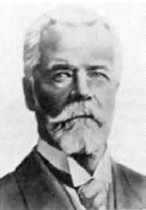
Henri Fayol
Henri Fayol was a French mining engineer; he became a manager in his mining company by 25years and CEO by 44years. In 1916, he wrote a book called ‘Administration industrielle et generale’ or ‘General and Industrial Management’
Management needs to do more than increase production, it involves planning and organising as well as command, co-ordination and control.
Notes:
Introduce Henri Fayol and note if Fayol’s view of management matches those discussed in last sessions – highlight how ground breaking this approach was at the time of 1916, the idea of short and long term goals, unity and common cause of a company.
Sometimes, his theory is referred to as Administrative Management. Fayol’s 14 Principles fit into the broad umberella of Classical Management theory. However, acknowledge that many of his fundamentals will still apply to the workplace in the 21st century and that his view of management has stood the test of time. Emphasis that Fayol was a practicing manager when he developed these principles, he was not a social psychologist or an academic.

Slide 4
Fayol’s 14 Principles
Fayol believed that managers should:
Exercise authority
Ensure that unity of command exists
Ensure that there is a clear chain of command within the organisation.
Provide unity of direction to all staff.
Manage the supply of human and other resources.
Exercise staff discipline.
Coordinate key activities through centralisation.
McGrath and Bates (2017, p4)
Notes:
Seven of 14 principles on this slide. 8 – 14 on next slide.
Extend a brief explanation of each principle.

Slide 5
Fayol’s 14 Principles
Fayol believed that managers should:
Seek efficiency through the division of work
Put the company first - Subordinate their needs and those of their team to the needs of the company.
Ensure that staff are fairly renumerated.
Ensure equity of treatment for all staff
Provide job security as far as possible
Encourage staff initiative
Establish a sense of spirit de corps (team spirit)
McGrath and Bates (2017, p4)
Notes:
8 – 14
Extend a brief explanation of each principle. Are some of these principles more challenging than others to maintain? In 21st century UK? What challenge do zero hour contract provide to job security?

Slide 6


When to use?
This theory is over 100years old, but it can still have relevance.
Use the principles to remind you that as a manager you must use your authority to ensure that the organisation’s structure and systems for managing staff and resources work effectively.

Slide 7
How to use it - examples
.
Exercise authority
  As a manager, you have the right to exercise authority and to expect compliance. If someone fails to comply with your request, don’t ignore it. Repeat your request and if they continue to ignore you look at what sanctions you can apply.
.
Ensure a clear chain of command
  Organise your team on the basis that everyone reports to a single line manager. If someone has two managers, disputes over work priorities will arise.
.
Ensure fair pay
  Your pay and that of your staff should be comparable with others doing a similar job. Wide differentials cause resentment and undermine teamwork. Monitor pay rates and take action when required.
Notes:
Consider other examples of as well – students may have examples of good and bad practice.

Slide 8
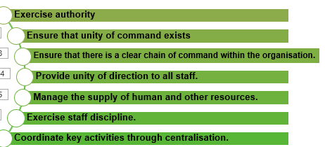
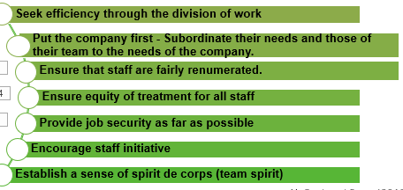

Which three principles are most important?
In pairs, decide which three principles you feel are the most important of Fayol’s 14 principles.
Notes:
In pairs. Discuss and decide your top three principles. Use the QR code to post on the board via padlet. https://padlet.com/rstewart122/three-top-principles-1uv5v0atrgvwk0g3
Display the padlet page on the screen.
Discussion similarities and differences.

Slide 9
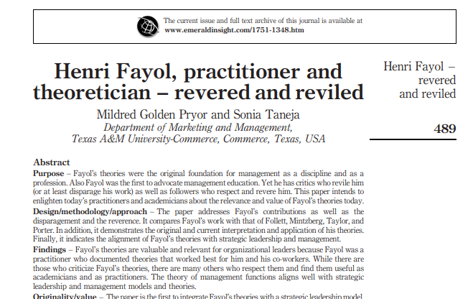
Further reading.
See Moodle Week 3 Golden Pryor & Taneja (2010)
Notes:
Set the reading as a class task or homework task.

Slide 10
Summary
We have introduced Fayol’s 14 principles of management
We have discussed when the theory has relevance.
We have highlight examples of when these principles can be used in practice.
We have discussed which we feel are the most important to us.

