Slide 1
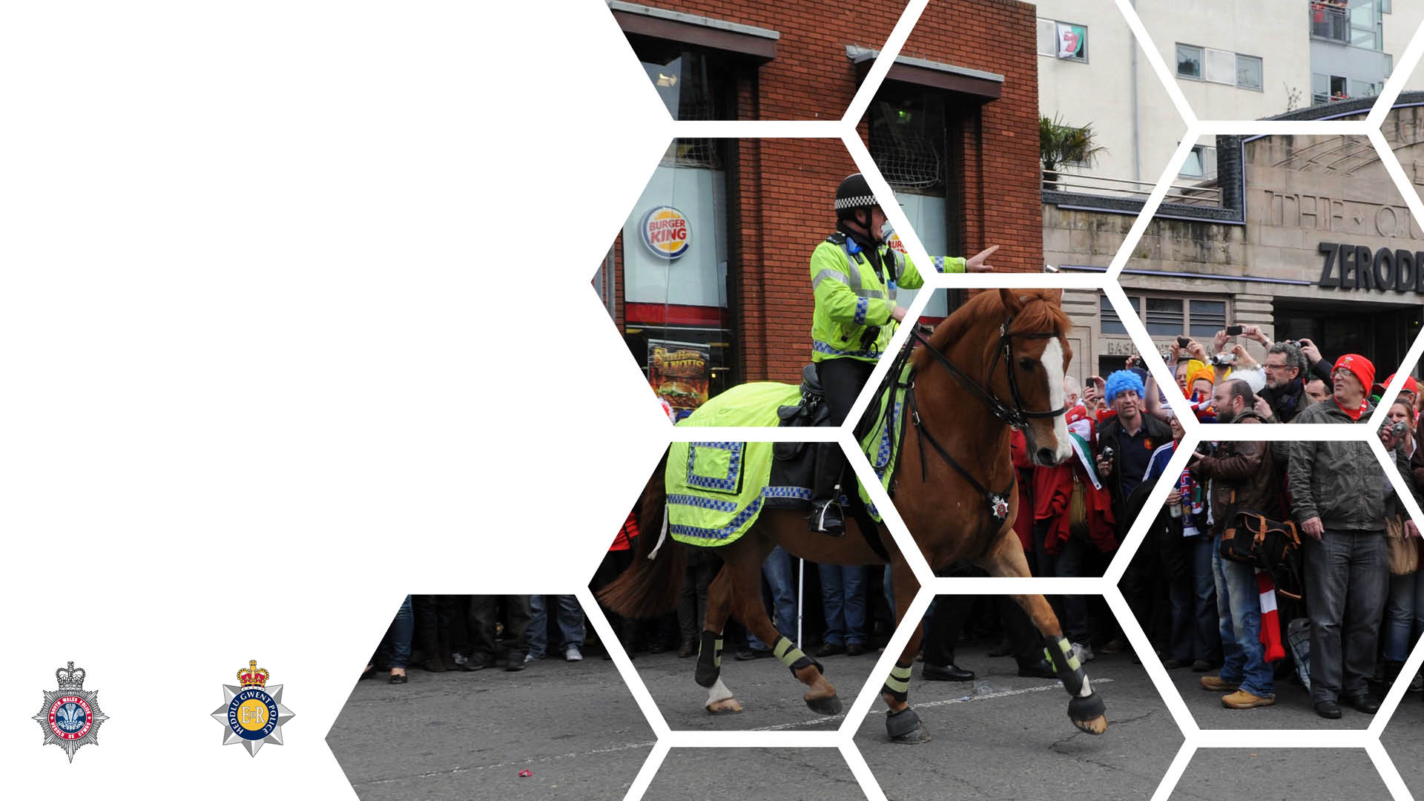

Confiscation of Alcohol & Licensing Offences
Notes:
By the end of this lesson you will be able to:
Identify the signs of drunkenness
Explain the difference between drunk and incapable and drunk and disorderly.
Identify occasions when a police officer may need to enter a licensed premises.
Identify ages and circumstances when Police Powers would apply to the confiscation of tobacco.
Identify the dangers associated with alcohol consumption.

Slide 2

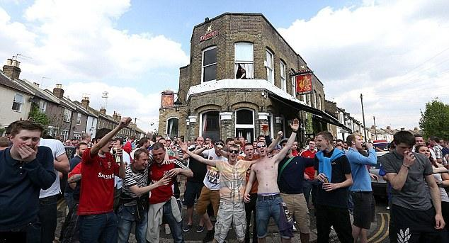
Alcohol and Offending
Alcohol and crime and disorder
50% of all crime
90% of offences involving public disorder
Notes:
It is difficult to separate alcohol from crime and disorder – it accounts for a significant proportion of incidents the police deal with…
There are strong links between the consumption of alcohol and crime, domestic abuse, nuisance and other public order offences.
Alcohol related violence and disorder are a highly visible part of the night time economy.
Research has found that alcohol had been consumed prior to the offence in nearly three-quarters (73%) of domestic violence cases and was a ‘feature’ in almost two-thirds (62%).
Furthermore, almost half (48%) of these convicted domestic violence offenders were alcohol dependent.
A minimum of 1 in 5 people arrested by police test positive for alcohol.
An All Party Group of MPs investigating alcohol and crime was recently advised by the British Medical Association that alcohol is a factor in:
60-70% of homicides
75% of stabbings
70% of beatings
50% of fights and domestic assaults

Slide 3
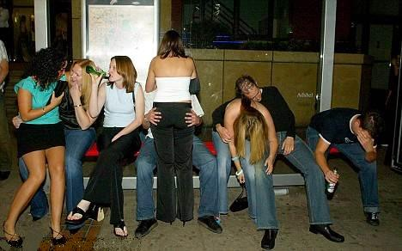
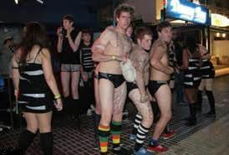
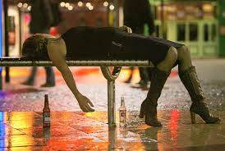
Public Drunkenness
Notes:
Drunkenness means where the defendant has taken intoxicating liquor (alcohol) to an extent that affects his/her ‘steady self control’.
Persons who are found drunk may well be committing offences, but a police officer’s primary responsibility is for their well-being.
If a person is so drunk that they cannot be roused then they should be taken to hospital rather than a police station.
Police officers are recognised as being expert witnesses in relation to drunkenness. It is the only time that an officer can offer an opinion on a person’s state as evidence for court.
Caution needs to be exercised as the symptoms of drunkenness can easily be mistaken for those of illness and injury or mental health.
A person who is drowsy and slurring their speech may not be intoxicated but may be suffering from diabetes, epilepsy, have a head injury, experiencing a drug intoxication or overdose or stroke.
The more obvious signs of a person appearing drunk are:
Lack of physical coordination
Slurred or incoherent speech
Breath smelling of intoxicating liquor
Eyes watery, bloodshot or glazed
Complexion flushed and sweaty
Clothing may be dishevelled, dirty or stained with vomit
If there is any doubt, assume that the person is suffering from an illness or injury and summon medical assistance or arrange for the person to be conveyed to hospital without delay. Think NDM and JPLANE. A delay in treatment could be serious.

Slide 4
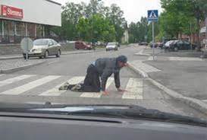
Being Drunk and Incapable in a Public Place
Any person found drunk and incapable in a
highway or other public
place, whether a building or
not, or on licensed premises
who appears to be incapable of
taking care of themselves’
commits an offence
Section 12 Licensing Act 1872
Notes:
Licensing Act 1872 creates a commonly used offence that of being ‘drunk and incapable’
Eg: a person has collapsed to the floor in High Street. They have vomit down their front and have urinated in their trousers. They smell of intoxicating liquor and responds, when spoken to and shaken, by giggling and turning over on the floor as if they may be in bed. Their eyes are red and bloodshot and they don’t seem to be able to focus on anything.
Penalties - Summary: fine not exceeding £200 or a Penalty Notice for Disorder.
A person arrested for this offence may be taken to an approved alcohol treatment centre.
The purpose of this offence is to prevent a nuisance being caused by persons who are drunk in a public place and ensure they are safe.
‘Drunk’ has been taken to mean - intoxicated with alcohol to the extent of losing control over normal physical and mental functions or having drunk intoxicating liquor to an extent which affects steady self control.
‘Incapable’ Oxford Dictionary defines it as an inability, or being unfit, to undertake a specified purpose or activity.
‘Highways‘ shall be understood to mean all roads, bridges, carriageways, cartways, horseways, bridleways, footways, causeways, churchways, and pavements.
‘Public place’ means any highway or other premises or place to which at the material time, the public have, or are permitted to have, access, whether on payment or otherwise.
Drunkenness can be proved by a description in the reporting officer's statement, e.g. ‘I found the defendant crawling along the pavement in Lime Street’
Alcohol related violence and disorder are typically fuelled by:
Individual reactions – Alcohol impairs cognitive and motor skills. People, who drink can often misread situations, react aggressively and have accidents.
The supply of alcohol – Premises where there is little seating, loud music, large numbers of young customers, poorly trained staff and excessively cheap promotions are particularly likely to fuel disorder.
The surrounding infrastructure – At night, fights and disputes occur at locations such as food outlets, taxi stands and bus stops.

Slide 5
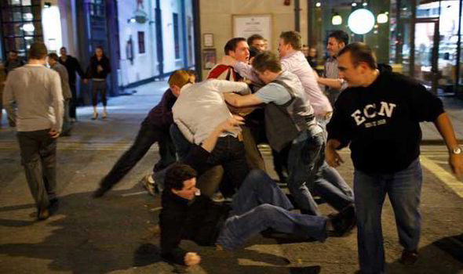
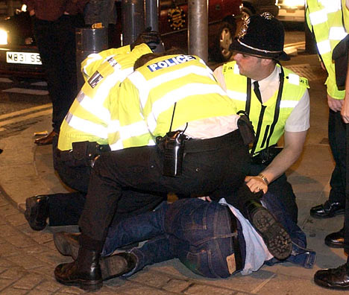
Drunk and Disorderly
Any person who in any public place
is guilty, while drunk, of disorderly behaviour
shall be guilty of an offence
Section 91 of the Criminal Justice Act 1967
Notes:
‘Drunk’ has been taken to mean - intoxicated with alcohol to the extent of losing control over normal physical and mental functions or having drunk intoxicating liquor to an extent which affects steady self control.
‘Public place’ means any highway or other premises or place to which at the material time, the public have, or are permitted to have, access, whether on payment or otherwise.
It does not apply to a person who is disorderly as a result of sniffing glue or is on drugs. The common meaning of 'drunk' does not cater for such conduct.
Disorderly behaviour -This is defined by the Oxford Dictionary as 'unruly, unrestrained, turbulent, riotous or offensive behaviour'.
Eg: A person is stood outside a pub displaying signs and symptoms of drunkenness. They are swaying and appear to be finding it difficult to stand still and upright. They are calling out to passers-by saying they are going to ‘Kick their ****ing head in’ and ‘Come on then’ whilst waving their fists about.
This offence is considered to be more serious than ‘simple drunk’ as the behaviour is more likely to affect other people. Noisy, aggressive, violent or quarrelsome behaviour could be seen as some examples of disorderly behaviour.

Slide 6
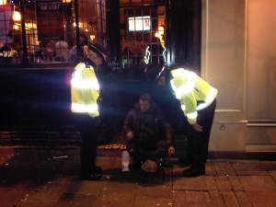
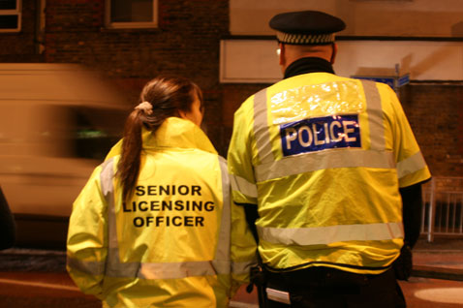
Reasons for Entering Licensed Premises
Investigate offences
or
check that the premises is complying with licence conditions…
or
assist to eject a person
Notes:
There are three reasons a police officer might enter licensed premises, to investigate offences, deal with licensing offences or to assist in the removal of a person.
Section 180 of the Licensing Act 2003 gives a constable (or authorised person) the right to enter and search any premises if they have reason to believe that an offence has been, is being or is about to be committed or simply to make sure the licensee is complying with the Act.
This power could be used in circumstances where you have reasonable belief that offences such as serving alcohol to people under the age of 18 years was taking place or allowing staff to serve drinks to persons who were acting in a disorderly manner.

Slide 7

Licensed Premises Legislation
Responsible staff who knowingly allow disorderly conduct on licensed premises commits an offence.
S140 Licensing Act 2003
A drunk and disorderly person commits and offence if without reasonable excuse they fail to leave the relevant premises when requested to do so by a police officer or staff member. S143 Licensing Act 2003
Responsible staff who knowingly sell (or attempt to sell) alcohol to a person who is drunk on relevant premises commits an offence. S142(1) Licensing Act 2003
It is an offence for a person to obtain or attempt to obtain alcohol for a drunken person on relevant premises. S142(2) Licensing Act 2003
Notes:
https://www.youtube.com/watch?v=XUFc3TF9eu0
https://www.youtube.com/watch?v=4wcUXEWmxIc
https://www.youtube.com/watch?v=Y7K4pdjew2s
https://www.youtube.com/watch?v=Frj6T19acNk
https://www.youtube.com/watch?v=dAX2RlZPdAY (Phil Mitchell)
https://www.youtube.com/watch?v=GDUR-EOuURw (short video showing effects of alcohol)
Section 143 of the Licensing Act 2003 states that a person who is drunk and disorderly commits a summary offence, if they fail without reasonable excuse to leave the relevant premises or they enter or attempt to enter after being requested not to enter the relevant premises at the request of a police constable, any person who works at the premises in a capacity which authorises them to make such a request, the premises licence holder or the designated premises supervisor under the premises licence
A police constable must help to eject drunk or disorderly individuals from the premises, or help to prevent them entering if requested to do so by any of those persons listed above.
It is always advisable to enter licensed premises only when accompanied by another officer, preferably a supervisor, unless the need is urgent.
If you do need to enter a premises urgently make sure you inform your supervisor
Alcohol cannot be legally sold to a child.
It is an offence to:
Sell alcohol to a person under 18 years in any place (s146 Licensing Act 2003)
Knowingly allows the sale of alcohol on relevant premises to an individual aged under 18 years (s147 Licensing Act 2003)
It is an offence for a person under 18 years to be in possession of alcohol without reasonable excuse in any relevant place on three or more occasions within a year (S30 Police and Crime Act 2009)
Summary only offence

Slide 8
Power of Entry
An constable has a power of entry to
gain entry to any place if there is
reason to believe that an offence
under the Licensing Act 2003 is being
committed or is about to be
committed.
S180 Licensing Act 2003
Notes:
There is a power of entry to gain entry to any place if there is reason to believe that an offence under the Licensing Act 2003 is being committed or is about to be committed
S180 Licensing Act 2003
Reasonable force can be used.
The term ‘any place’ is defined in section 193 and includes vehicles, vessels or moveable structures licensed or not.

Slide 9
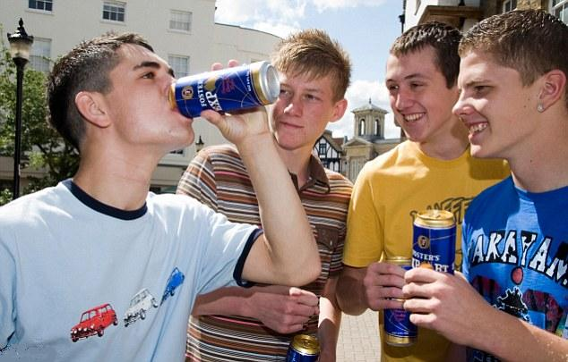
Confiscation of Alcohol
(Young Persons)
Act 1997
Notes:
In addition to the legislation to tackle drunkenness in a public place, there are a number of other pieces of legislation which gives the police the powers to proactively assist in preventing alcohol related crime and disorder in order to ensure public safety, prevent public nuisance and protect children from harm.
This Act was introduced to address the problem of under eighteen year olds drinking alcohol on the streets.
Section 1 allows a constable (and PCSO) to confiscate alcohol from individuals under the age of 18.
Alcohol can also be confiscated from an adult who has supplied, or intends to supply, an under 18 year old with alcohol.
Concern about young people drinking alcohol has increased considerably over the past few years. Current legislation addresses this in relation to young people on licensed premises. Other legislation is available to help limit alcohol consumption in other places to which the public has access.
Under Section 5 of the Children and Young Persons Act 1933 it is illegal to give alcohol to a child under 5 unless under medical supervision or in an emergency (alcohol can include some medicines)

Slide 10
Confiscation of Alcohol (Young Persons) Act 1997
Where a Constable reasonably suspects that a person in a relevant place is in possession of alcohol and that
EITHER
They are under 18
OR
It is intended to be consumed by a person under 18
OR
  A person under 18 who is, or has recently been, with them has consumed alcohol in that or any other relevant place
Notes:
Having discussed the confiscation of alcohol in designated public places, we are now going to move on to look at your powers when it come to alcohol and young persons.
On a practical note, this is where a lot of your confiscation work is likely to take place as there are links to anti-social behaviour.
Reasonably suspects – note that with this power, the level of evidence required is less (suspects v believes) – Why do you think this is?
This power is designed first and foremost, to protect young people from the issues surrounding the use of alcohol and so in order to effectively do this the level of suspicion required by officers before they can act is less.
Relevant place – we will come to this shortly
Alcohol – again we will discuss this shortly.
Having satisfied yourself of these things, you then have to make a decision about the person(s) you are dealing with, namely:
Under 18 - how are you going to determine this? Can you ask for ID? What if, even though they have provided ID, you still form the opinion that they are under 18?
Intended to be consumed by person under 18 - Why do you think this is included? – to prevent the under 18s giving the alcohol to an over 18 to hold for them.
Person under 18 recently been with… - this covers a situation where they may not even be drinking but you have concerns, based on the behaviour of others, that they may do so.

Slide 11

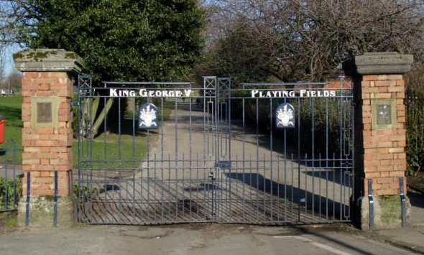
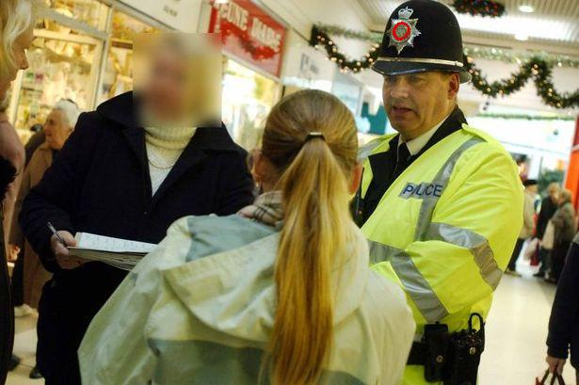
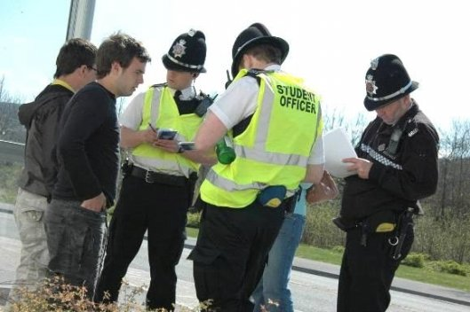
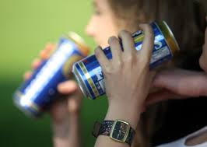
Notes:
1. Who?
The law states that the offence will be committed by anyone who:
is under the age of 18, or
intends that any of the alcohol should be consumed by a person under the age of 18 in that or any other relevant place or
is a person under the age of 18 who is, or has recently been, with them & has recently consumed alcohol in that or any other relevant place.
2. Where?
Where an officer reasonably suspects that a person is in possession of alcohol in any relevant place, other than licensed premises but including any place where the public has access, on payment or otherwise by right or virtues of express or implied permission or any place, other than public, to which the person has unlawfully gained access.
Relevant Place includes
any public place other than licensed premises eg streets, parks, shopping centres or
any other place to which the person has unlawfully gained access. This could be any private place for example in a garden which is not their family home or where they have gate-crashed a party they were not invited to, or a public place which, at the time of the offence is closed to the public. A good example of this is a park which gets closed. Many public parks close at dusk and if there is a closed gate then anyone entering the park will have gained unlawful access.
3. What?
A Constable (or PCSO) may require them to:
surrender anything in their possession which is, or which the Constable or PCSO reasonably believes to be, alcohol or a container for such, (including sealed/unsealed containers)
A constable who imposes this requirement shall also require the person to state their name and address
This power allows an officer to take action even though what they believe to be alcohol is contained in an innocuous container
If the constable reasonably suspects that the person is under the age of 16, they may remove the person to the person's place of residence or a place of safety.
The term possession may be interpreted as actual and knowing possession on the person or in the immediate vicinity (such as in a car by which the young person is standing).
4. Why?
The Act was designed to allow the Police to deal with situations where drinking might cause a nuisance to others or may lead to further bad behaviour.
The officer should therefore use their powers with discretion according to the circumstances
For example, it may not be necessary where a young person is in possession of alcohol, in a public place due to the nature of their employment, when assisting family member transport alcohol or as part of wider group enjoying a family picnic.
5. And if….
If a person fails without reasonable excuse to either:
surrender the alcoholic drink; or
state their name and address when required to do so,
they commit an offence of failing to comply with a requirement imposed on them under S1 of the Confiscation of Alcohol (Young Persons) Act 1997 for which they may be arrested.
Suggested wording (not exact but the final warning is essential)
"I have reason to suspect that you are in possession of alcohol
and that you are under 18 years of age / you intend that any of the alcohol should be consumed by a person under the age of 18 in this or any other relevant place / a person under the age of 18 who is, or has recently been, with you has recently consumed alcohol in this or any other relevant place
you must stop drinking immediately (only required if applicable)
please give me that can/bottle/plastic cup/etc.
please what is your name and address.
I must warn you that failure to comply without reasonable excuse with my request is an offence for which you can be arrested."
Notifying Parents
There is no requirement to notify the parents of those who have come to the attention of the police in these circumstances. However, local arrangements between the Police and Social Services Departments etc. are often made so as to apply these provisions in conjunction with other measures to deal with underage drinking
Disposal of the alcohol
Any alcoholic drink surrendered to an officer may be disposed of in a way the officer considers appropriate.
This could mean that it is immediately poured away or it may be more appropriate to remove drink from scene and dispose of later.
A PNB entry should be made of all the circumstances and how the alcohol was disposed of.

Slide 12
Powers
The Constable may require them to surrender
anything in their possession which is, or which the Constable reasonably believes to be, alcohol or a container for such,
The container can be OPEN or CLOSED
AND
To state their name and address.
Notes:
In relation to the seizure of alcohol, the guidance is that you should only seize what you can see.
This power does not afford any powers of search and therefore you cannot look in pockets, bags etc. in an attempt to locate the alcohol.
Even asking the person “What’s in the bag/your pocket” would constitute a search in the eyes of the law.
To avoid any potential issues for yourselves, stick to “only seize what you can see”
NOTE: There is no power for a PCSO to search for alcohol
This power is wider than that for ‘designated places’ as it allows you to seize anything you reasonably believe to be alcohol or a container for such.
QTS: Why do you think it mentions containers?
A: Because in lots of cases young people will try and conceal the fact that they are drinking alcohol by hiding it in other things such as soft drinks bottles etc.
QTS; So, if that is the case, how are you going to determine whether it is alcohol or not?
A: Its all about communication – you can ask to smell it and if they are reluctant to let you do so, is this going to increase your level of suspicion or decrease it?
In addition to confiscation, you also have the power to require a person’s name and address.
This is a ‘require’ not a ‘request’ which means that if they fail to provide it they commit an offence.
Again, communication is key as in most cases you can persuade a reluctant person to provide their details as the alternative can be far more serious.

Slide 13
Relevant Place
Any public place other than licensed premises
Any place other than a public place, to which the person has unlawfully gained access
Notes:
Any public place other than licensed premises – self explanatory
Any place, other than a public place, to which the person has unlawfully gained access – What sort of circumstances/places do you think this could be?
This would cover the local park, where persons have climbed over the fence after the parked has been locked up.
It would also cover locations such as sheds, huts and pavilions that persons may have gained access to for the purposes of drinking alcohol.

Slide 14

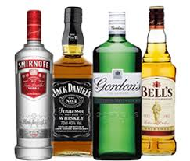
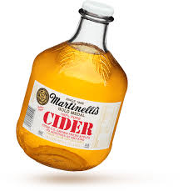

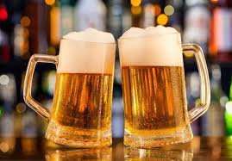
Alcohol
Notes:
Under Section 191 of the Licensing Act 2003, the term ‘alcohol’ means
spirits,
wine,
beer,
cider, or
any other fermented, distilled or spirituous liquor.
It does not include:
alcohol the strength of which is 0.5 % or less at the time of sale or supply,
perfume,
flavouring essences recognised by the Commissioners of Customs and Excise as not being intended for consumption as or with a dutiable alcoholic liquor,
the aromatic flavouring essence commonly known as Angostura bitters,
alcohol which is, or is included in, a medicinal product,
denatured alcohol,
methyl alcohol,
naphtha, or
alcohol contained in liqueur confectionery.
denatured alcohol- methylated spirits
Methyl alcohol/naphta – methanol or alcohol distilled from wood
dutiable alcoholic liquor
has the same meaning as in the Alcoholic Liquor Duties Act 1979;
liqueur confectionery
means confectionery which -
(a) contains alcohol in a proportion not greater than 0.2 litres of alcohol (of a strength not exceeding 57%) per kilogram of the confectionery, and
(b) either consists of separate pieces weighing not more than 42g or is designed to be broken into such pieces for the purpose of consumption;
medicinal product
has the same meaning as in section 130 of the Medicines Act 1968; and
strength
is to be construed in accordance with section 2 of the Alcoholic Liquor Duties Act 1979.
veterinary medicinal product
has the same meaning as in regulation 2 of the Veterinary Medicines Regulations 2006.

Slide 15
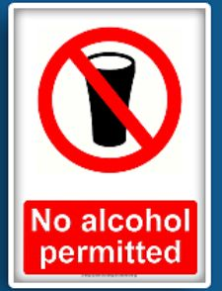
Section 63
Anti-social Behaviour, Crime and Policing Act 2014
Alcohol Consumption in Breach of Public Spaces Protection Order (PSPO)
Notes:
Section 59 Anti-social Behaviour, Crime and Policing Act 2014 gives a local authority the power to make a Public Spaces Protection Order (PSPO).
These orders are intended to deal with a particular nuisance or problem in a particular area that is detrimental to the local community's qualify of life, by imposing conditions on the use of that area. The order could also be used to deal with likely future problems.
Egs: prohibiting the consumption of alcohol in public parks - when used as such it is intended to reduce the incidence of disorder and public nuisance arising from alcohol consumption in designated public places.
Section 63 Anti-social Behaviour, Crime and Policing Act 2014 deals with the actions to be taken when the consumption of alcohol in breach of the prohibitions in the order has occurred.
Where a constable or an authorised person reasonably believes that a person (P)
(a) is or has been consuming alcohol in breach of a prohibition in a public spaces protection order, or
(b) intends to consume alcohol in circumstances in which doing so would be a breach of such a prohibition.
(authorised person means a person authorised for the purposes of this section by the local authority that made the PSPO and includes PCSO’s
The constable or authorised person may require (P)
(a) not to consume, in breach of the order, alcohol or anything which the constable or authorised person reasonably believes to be alcohol;
(b) to surrender anything in P's possession which is, or which the constable or authorised person reasonably believes to be, alcohol or a container for alcohol.
A constable or an authorised person who imposes this requirement must tell P that failing without reasonable excuse to comply with the requirement is an offence.
A requirement imposed by an authorised person is not valid if the person -
(a) is asked by P to show evidence of his or her authorisation, and
(b) fails to do so.
A constable or an authorised person may dispose of anything surrendered under in whatever way he or she thinks appropriate.
A person who fails without reasonable excuse to comply with a requirement imposed on him or her commits an offence
Notes
The section provides that breach of an order prohibiting the consumption of alcohol is only an offence when an individual does not cease drinking or surrender alcoholic drinks when challenged by a police officer, PCSO or local authority officer. This ensures that officers are able to exercise discretion in each situation. Where there is no threat of anti-social behaviour, they need not challenge the individuals, for example a family picnic with a bottle of wine.

Slide 16
PSPO: Restricting Alcohol
Local authorities may issue a PSPO to
restrict the consumption of alcohol in any public space where the behaviour is having, or is;
likely to have a detrimental effect on the quality of life of those in the locality
is persistent or
is continuing in nature and is
unreasonable
Notes:
Councils will issue a public spaces protection order (PSPO) after consultation with police, Police & Crime Commissioner & other relevant bodies.
These can be blanket restrictions/requirements or can be targeted against certain behaviours by certain groups at certain times.
Can restrict access to public spaces where that route is being used to commit anti-social behaviour.
These orders are intended to deal with a particular nuisance or problem in a particular area that is detrimental to the local community's qualify of life, by imposing conditions on the use of that area. The order could also be used to deal with likely future problems.
Examples of where a new order could be used include prohibiting the consumption of alcohol in public parks - when used as such it is intended to reduce the incidence of disorder and public nuisance arising from alcohol consumption in designated public places.
S 27 Violent Crime Reduction Act 2006 - power to direct a person away from area of alcohol related crime & disorder

Slide 17
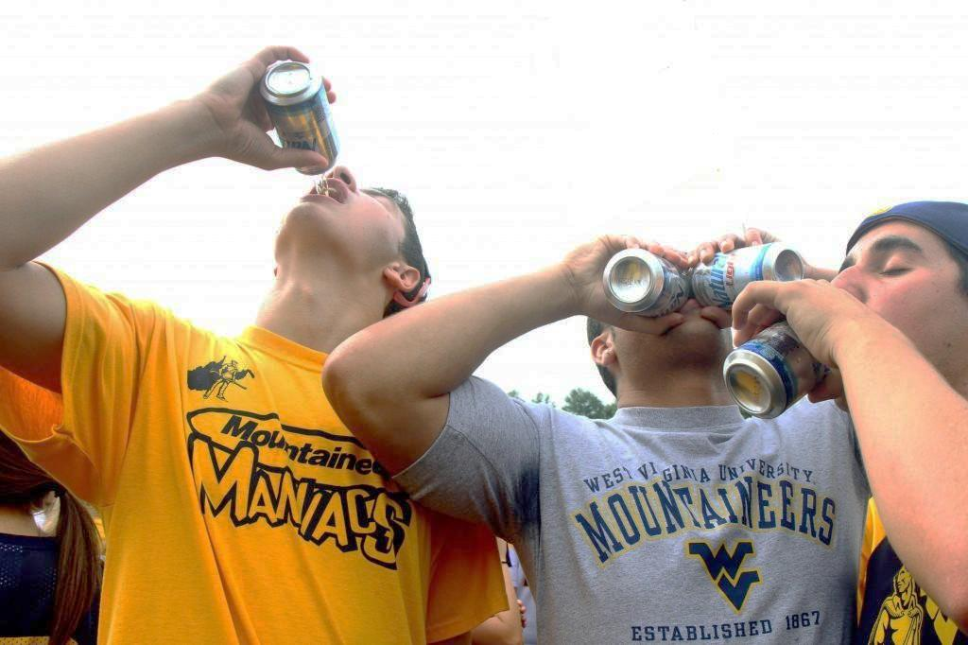
Definition
Where an officer or an authorised person
reasonably believes
that a person
is or has been
consuming alcohol in
breach of a prohibition in a
PSPO
or intends to do so
they can:
Notes:
Authorised person means a person authorised for the purposes of this section by the local authority that made the PSPO and includes PCSO’s
Section 63 Anti-social Behaviour, Crime and Policing Act 2014 deals with the actions to be taken when the consumption of alcohol in breach of the prohibitions in the order has occurred.
Where a constable or an authorised person reasonably believes that a person (P)
(a) is or has been consuming alcohol in breach of a prohibition in a public spaces protection order, or
(b) intends to consume alcohol in circumstances in which doing so would be a breach of such a prohibition.
(authorised person means a person authorised for the purposes of this section by the local authority that made the PSPO and includes PCSO’s
Notes
The section provides that breach of an order prohibiting the consumption of alcohol is only an offence when an individual does not cease drinking or surrender alcoholic drinks when challenged by a police officer, PCSO or local authority officer. This ensures that officers are able to exercise discretion in each situation. Where there is no threat of anti-social behaviour, they need not challenge the individuals, for example a family picnic with a bottle of wine.

Slide 18
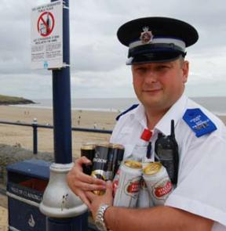
Definition
require a person to
cease drinking alcohol
(or anything they reasonably believe to be alcohol)
and
confiscate
and
dispose of the alcohol
and
its container.
Notes:
The constable or authorised person may require (P)
(a) not to consume, in breach of the order, alcohol or anything which the constable or authorised person reasonably believes to be alcohol;
(b) to surrender anything in P's possession which is, or which the constable or authorised person reasonably believes to be, alcohol or a container for alcohol.
The person must be informed that failure to comply with the request, without reasonable excuse, is an offence for which the person may be arrested.
A requirement imposed by an authorised person is not valid if the person -
is asked by P to show evidence of his or her authorisation, and
fails to do so.
A constable or an authorised person may dispose of anything surrendered under in whatever way he or she thinks appropriate.
Whether a particular excuse is reasonable is a question of fact for the magistrates or jury, as appropriate, to decide, after considering the facts.
A requirement imposed by an authorised person is not valid if the person -
(a) is asked by P to show evidence of his or her authorisation, and
(b) fails to do so.
A constable or an authorised person may dispose of anything surrendered under in whatever way he or she thinks appropriate.
A person who fails without reasonable excuse to comply with a requirement imposed on him or her commits an offence
Note
The section provides that breach of an order prohibiting the consumption of alcohol is only an offence when an individual does not cease drinking or surrender alcoholic drinks when challenged by an enforcement officer. This could be a police officer, PCSO or local authority officer. This ensures that officers are able to exercise discretion in each situation. Where there is no threat of anti-social behaviour, they need not challenge the individuals, for example a family picnic with a bottle of wine.
This picture is of PCSO Wayne Chant seizing cans from people drinking on Barry Island beach.

Slide 19

Power to Seize and Dispose of Tobacco and Cigarettes Papers
Section 7(3) Children and Young Persons Act 1933
Notes:
The Children and Young Persons Act 1933 was introduced to prevent children and young persons being exposed to moral and physical danger.
Section 7 of the Children and Young Persons Act 1933 creates an offence if tobacco products and/or cigarette papers are sold to persons under 18 years old.
Section 7(3)
It is the duty of a constable to seize any tobacco or cigarette papers in the possession of any person apparently under the age of 16 years whom the officer finds smoking in any street or public place, and these items will be disposed of as the police authority directs.
These powers also apply to park keepers in uniform and accredited persons in uniform (PCSO’s) who must dispose of any seized items as provided for by their authority or employer.
For the purposes of this section the expression tobacco includes cigarettes, any product containing tobacco and intended for oral or nasal use and smoking mixtures intended as a substitute for tobacco.
The expression ‘cigarette’ includes cut tobacco rolled up in paper, tobacco leaf, or other material in such form as to be capable of immediate use for smoking.
Please note
With regards to ‘e-cigarettes’, there is currently no legislation in the UK in relation to the possession, use or sale to persons under the age of 18 years.
There is suggestion however, that legislation covering ‘e-cigarettes’ will be adopted by the UK in the near future.

Slide 20
Confiscation of Tobacco
It shall be the duty of a Constable in uniform to seize any tobacco or cigarette papers in the possession of any person apparently under the age of sixteen years whom he/she finds smoking in any public place
AND
Seize any tobacco or cigarette papers which can be disposed of in such a manner as you see fit.
Notes:
Power to seize tobacco from a person aged under 16 and to dispose of that tobacco. Paragraph 7 of Schedule 4 to the Police Reform Act 2002
Paragraph 7 of Part 1 of Schedule 4 to the Police Reform Act 2002 endows a community support officers with the same powers of a constable or a uniformed park keeper under section 7(3) of the Children and Young Persons Act 1933 to seize tobacco or cigarette papers from any person who appears to be under 16 whom he finds smoking in any street or public place. The CSO may then dispose of any seized material in a manner as the relevant police authority provides.
The term public place has the same definition as for confiscation of alcohol.
On 1-10-2007 the age at which a person is legally allowed to purchase cigarettes/tobacco changed from 16yrs to 18yrs
(Section 7 of the Children and Young Persons Act 1933 prevents the sale of various tobacco products and/or cigarette papers to persons under eighteen years old.)
This has created an anomaly in that the age for confiscation has not been changed to reflect the change in purchase age.
Therefore, it is important to remember that you are only able to seize cigarettes/tobacco from persons apparently under the age of 16yrs
If you find a person over 16yrs but under 18yrs, whilst you have no power of confiscation, you may wish to find out where they purchased the cigarettes from.

Slide 21
Sale of Tobacco to Under 18s
Any person who sells to a person under the age of eighteen years any tobacco or cigarette papers, whether for his own use or not, commits an offence
Contrary to Section 7 Children & Young Persons Act 1933
Notes:
The previous age in relation to this offence was 16yrs, however, in 2007 the age was amended to 18yrs.
Please note this offence related to the sale of tobacco/cigarette papers and not the possession of them.
Confiscation powers apply to under 16s, therefore persons between the age of 16yrs and 18yrs can be in lawful possession of items.
(Consideration should be given to ascertaining where they have acquired them from in light of the above offence)
For the purposes of this offence tobacco includes, cigarettes, any product containing tobacco and intended for oral or nasal use. It also includes mixtures intended as a substitute for tobacco. The term cigarette includes cut tobacco rolled up in paper, tobacco leaf, or other material in such form as to be capable of immediate use for smoking.
It shall be a defence for a person charged with the offence to prove that they took all reasonable precautions and exercised due diligence to avoid the commission of the offence.
Any questions?

Slide 22
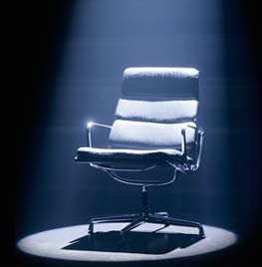
Stage 1: ‘Mastermind’
This is when you suddenly become an expert on every subject in the known universe.
You know you know everything and you want to pass on your knowledge to anyone who will listen
At this stage you are ALWAYS right and of course, the person you are talking to is always WRONG.
This makes for an interesting argument when both parties are at Stage 1!

Slide 23

Stage 2: ‘Looking Good’
This is when you realise that you are the Best Looking person in the entire bar and that people fancy you.
You can go up to a perfect stranger knowing that they fancy you and really want to talk to you.
Bearing in mind at this stage you can talk to this person about any subject under the sun.

Slide 24
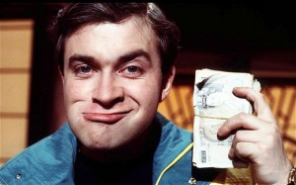
Stage 3: ‘Rich’
This is when you suddenly become the richest person in the world.
You can buy drinks for the entire bar because you have an armoured truck full of money parked behind the bar.
You can also make bets at this stage, because of course you’re still smart, so naturally, you win all your bets.
You will buy drinks for everyone you fancy, because you are now the BEST LOOKING person in the world

Slide 25
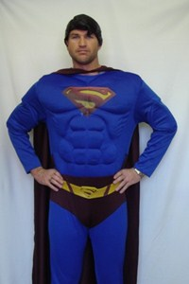
Stage 4: ‘Bullet Proof’
You are now ready to pick fights with anyone and everyone, especially those with whom you have been betting or arguing with, this is because nothing can hurt you
At this point you can also go up to the partners of the people who you fancy and challenge them to a battle of wits or money.
You have no fear of losing this battle, because you are smart, you’re RICH and you’re BETTER LOOKING than them anyway!

Slide 26
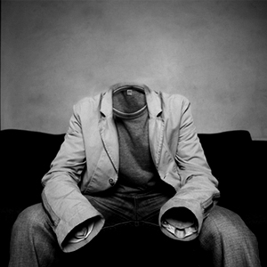
Stage 5: ‘Invincible!’
This is the final stage of drunkenness. At this point you can do anything, because NO ONE CAN SEE YOU, you dance on a table to impress the people who you fancy because the rest of the people in the room cannot see you.
You are also invisible to the person who wants to fight you. You can walk through the street singing at the top of your voice because no one can see or hear you and because you’re still SMART you know ALL the words.

Slide 27
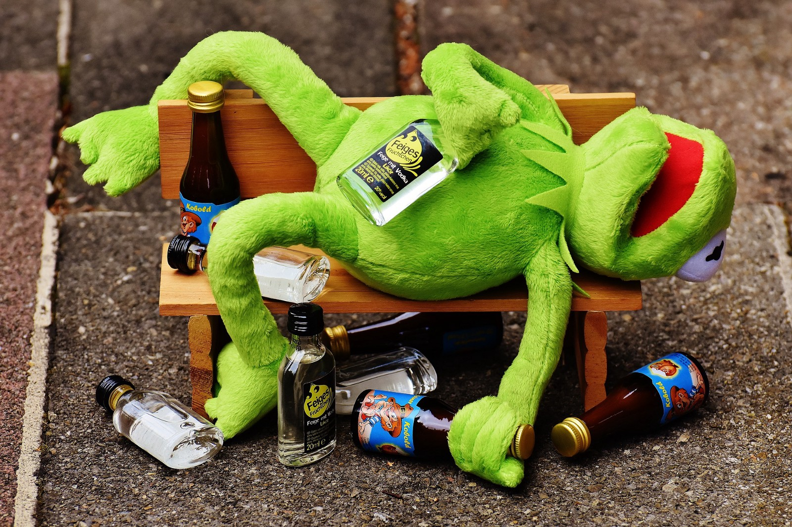
The Drunkest Man – EVER!!!
Notes:
https://www.youtube.com/watch ?v=JZQsA7G 0hvQ (this doesn’t seem to be available anymore!)
https://youtu.be/e6Dk_Cy2zHY

Slide 28
Kahoot
Notes:
Click on Kahoot to link to site
Kahoot Quiz Instructions
Kahoot Points of Interest –
1. Alcohol/drugs etc . PLAY GAME- TRAINER CHOICE.
2. You need one device and one website for the presentation machine. This is where the trainer controls the game.
3. To get a free account to create a Kahoot go to this website. https://www.getkahoot.com/
Kahoots Solo – If students play on their own, they will each need a game response board like this. Each player submits their own player name and votes for each question.
Kahoots – In Partners –
Partners Select a name -
If Students play in partners, you may consider using
• One device for researching the answers to the quiz. Keep this window open on that one device so that they can search for answers.
• And one device to input the partnership response.
• You might have students research the answers on Pioneer Online, or on a .pdf or website, primary source material, or information you have provided.
Kahoot Quiz Instructions
Kahoot – To Play
1. Open the game on your presentation machine.
2. Student devices Go to kahoot.it.com – or down load app, They will be asked for a Game Pin.
3. Students refer to the presentation board (in front of room) for a Game Pin.
Game
1. Students Enter the Game Pin – Click Enter
2. Students enter their name, or their anonymous name or their partnership name.
3. The player names will show up on the screen on the presentation machine. The game board on your 2nd device will look like this.
4. The length of time you will have to answer each question will depend on the question. (Quiz
creators make this decision as they create the quiz.) It could be from 5 seconds to 60 seconds.

Slide 29


