Slide 1
MSc Policing (O&SL)
10 .06. 25
Referencing & Plagiarism

Slide 2

Learning outcomes
By the end of the session students should:
Understand what referencing is
Explain why we reference
Be able to reference
  In-text citations
  Complete Reference lists/Bibliographies

Slide 3

What is ‘Referencing’?
A term used to describe the use of a source in a research paper.
Process of acknowledging other people’s work.
Taking ideas or words from something you have read, listened to or watched and putting them in your assignment, then stating where you got them from.
Allows reader to locate your source material.
Verifies the validity of your arguments.
Provides link between what you write and the evidence on which it is based.

Slide 4
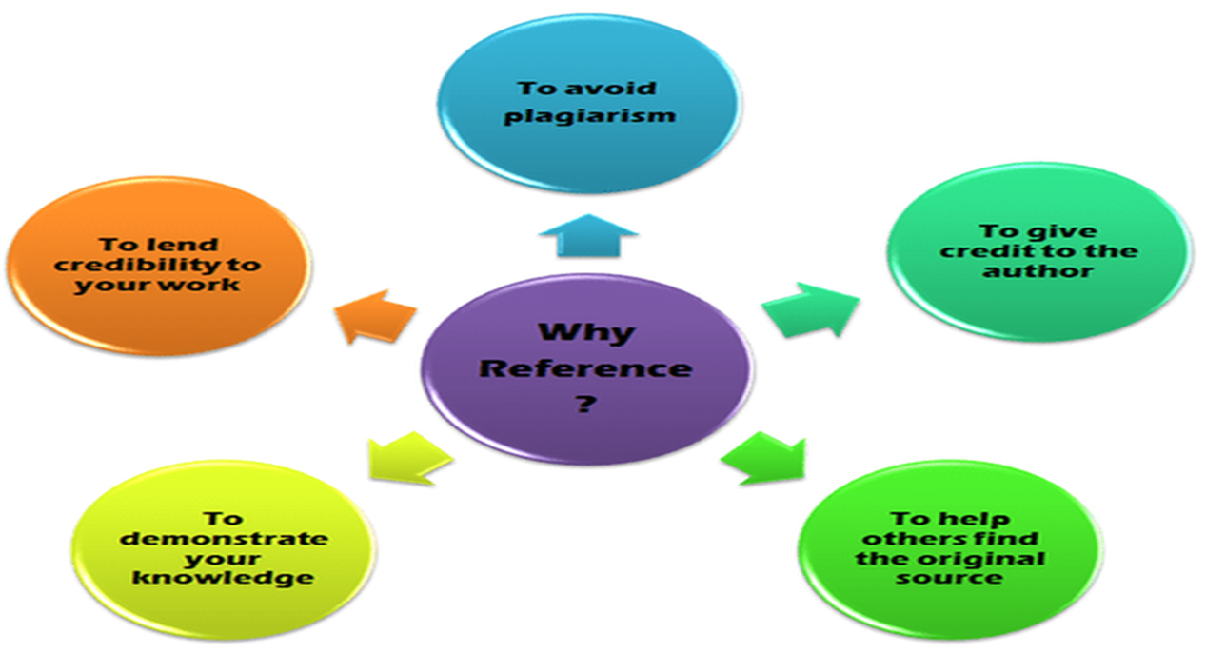
Why do we reference?

Slide 5
Why reference?
Demonstrates you have read widely on the subject
Shows evidence of research
Establishes the credibility and authority of your ideas and arguments
Enables the reader to locate the original material used
Gives credit to the original author
Enable the reader to form their own views on the value of your sources and how you have interpreted them
Distinguish between your own ideas and opinions and those of others
Highlight relevant points by quoting, paraphrasing or summarising from original text
Achieve a better mark/grade
Avoid Plagiarism

Slide 6
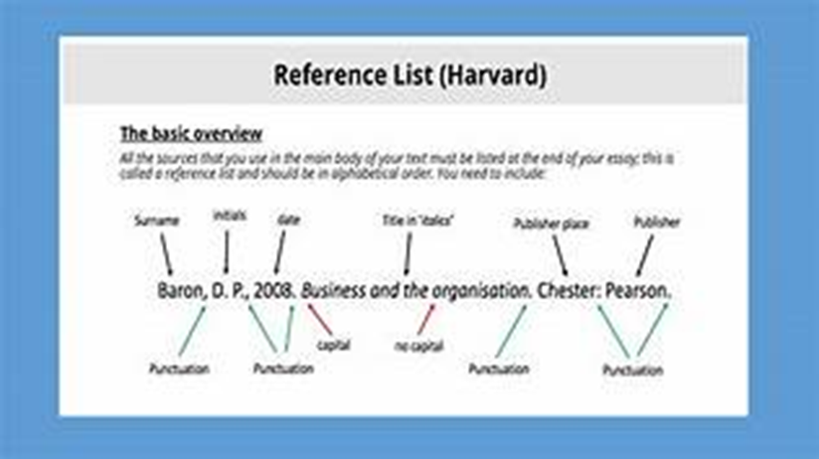
Component parts of a reference
Different components to a reference
All must be correct for the reference to be correct:
  1. In-text shorthand citations
  2. List of references at the end of assignment

Slide 7
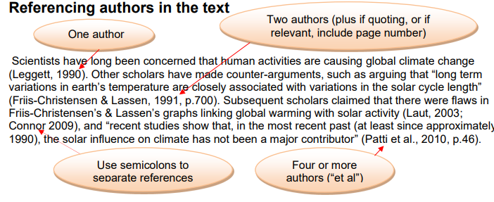
Referencing example in a text

Slide 8

Types of Referencing Styles
Lots of different styles
  Footnotes
  Numbered references
  Harvard and Harvard (British Standard)
  APA & MLA
  Specific style for academic journals and certain subjects
  Harvard style* - Find page on Moodle or library pages Or www.citethemrightonline.com
Notes:
APA – American Psychological Associaition
MLA – Modern Language Association

Slide 9
In-text Citation
When using another person's work in your own work, either by referring to their ideas, or by including a direct quotation, you MUST acknowledge this in the text of your work!
Direct & Indirect?
DIRECT – where you are mentioning the authorship in your sentence; you need to add the date in brackets after their name e.g. Greenbaum(1998)
INDIRECT – where you add both the author and date in brackets when you are mentioning the information you got from this source e.g. (Shaw,2017)

Slide 10
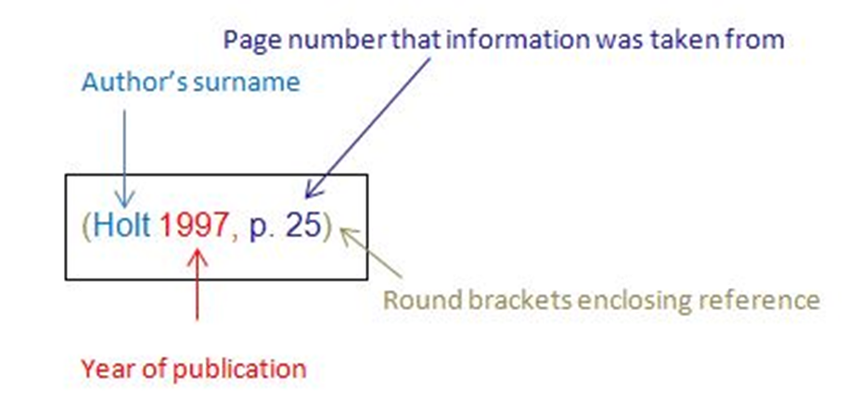
In-text Citation
This is known as an in-text citation and when Harvard referencing, your in-text citation should include:
The author
The year of publication
Page number if a direct quote

Slide 11
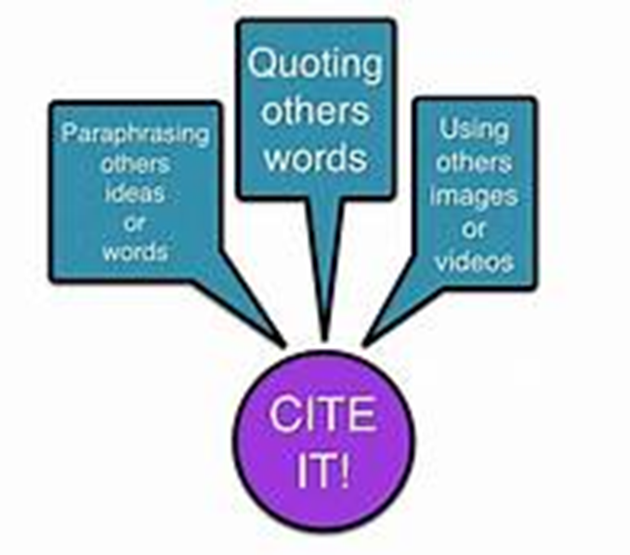
The ‘What if’s...’ of Referencing
You use multiple citations (i.e. to show more than one author discusses the same topic/data)
- Either put in alphabetical order, or in year order (be consistent)
  (Richards 1996, p.33; Thomas 1993, p. 45) or
  (Thomas 1993, 45; Richards 1996, 33)
You want to refer to a figure (image) in book:
  (Richards 1996, Fig. 5)
You want to refer to a newspaper/online source:
(BBC News, 2016) (name of source, date of article/page updated)

Slide 12
1,2,3, or …….
When citing one author:
A recent study investigated the effectiveness of Google Scholar to find criminal law cases (Henderson, 2015).
Or
Henderson (2015) investigated the effectiveness of Google Scholar in finding criminal law cases
Citing two or three authors:
e.g.
Recent research indicates a number of policing journals have been published (Anderson & Garner 2018).
Evidence shows that providing virtual laboratory exercises enhances the learning process (Barnes, Matthews & Read, 2008).

Slide 13

…..more authors……
Citing more than four authors:
If the work has four or more authors, the abbreviation 'et al.' should be used after the first authors name. It is also acceptable to use 'et al.' after the first author if the work has three authors.
e.g.
It is claimed that the communication of science in the media has increasingly come under focus (Alphen et al., 2017).

Slide 14
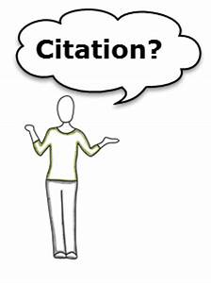
Authors who reference authors…
Walklate (2011, quoted in Smith, 2015, p. 15) argues that “the relationship between personal troubles and public issues is an intriguing one”.
Walklate (2011, cited in Smith, 2015, p. 15) argues that it is important to consider vulnerability when thinking about victimisation.

Slide 15
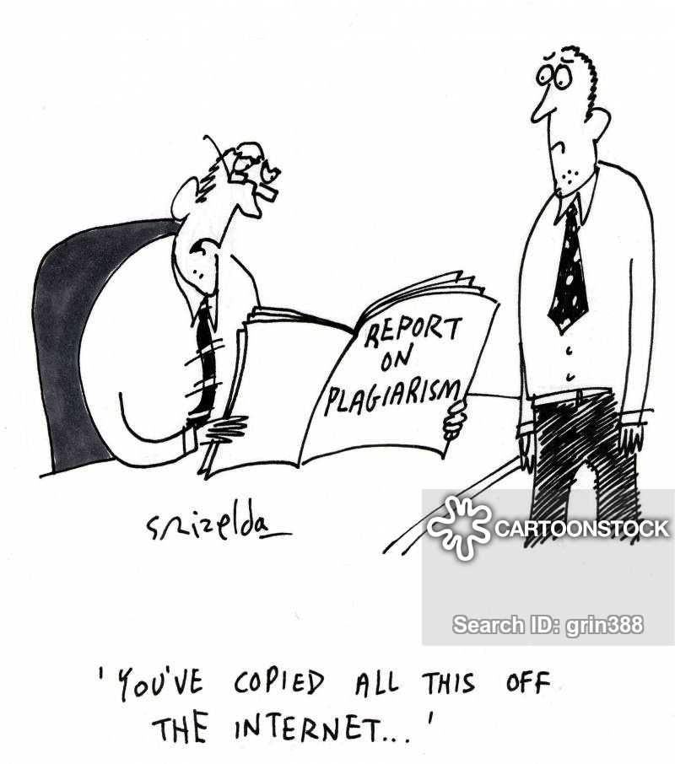
When to use?
Every time you cite/paraphrase someone else’s idea in your work you must include an ‘in text citation’
You will use them throughout papers, presentations, critiques…
  Not just at the end of paragraphs
Includes author surname(s), date of publication and, if using a direct quotation, also use page numbers
E.g. (Smith, 2006) for non-direct (i.e. paraphrasing)
(Smith, 2006, p. 4) for direct

Slide 16

How to reference……. Legislation
When referencing legislation do not put (legislation.gov.uk, 2018).
Always reference the Act of Parliament
e.g. if discussing the Human Rights Act 1998 in your essay you would in-text reference (Human Rights Act 1998).
Your reference list would show:
Human Rights Act 1998, article 6(2). Available at: http://www.legislation.gov.uk/ukpga/1998/42/schedule/1/part/I/chapter/5 (Accessed: 4th December 2019).

Slide 17

How to reference….Websites
When citing material found on a website, you should identify the authorship of the website.
This may be a corporate author - an organisation or company; a clue to this can be found by looking at the URL or web address. To find the date of publication, reference to this might be found at the bottom of a web page relating to copyright, or from a date headline.
Example:
In-text (CPS, 2018).
Reference list:
Author OR Organisation. Date created, or last revised. Title of website.[online]. URL. Accessed date page

Slide 18
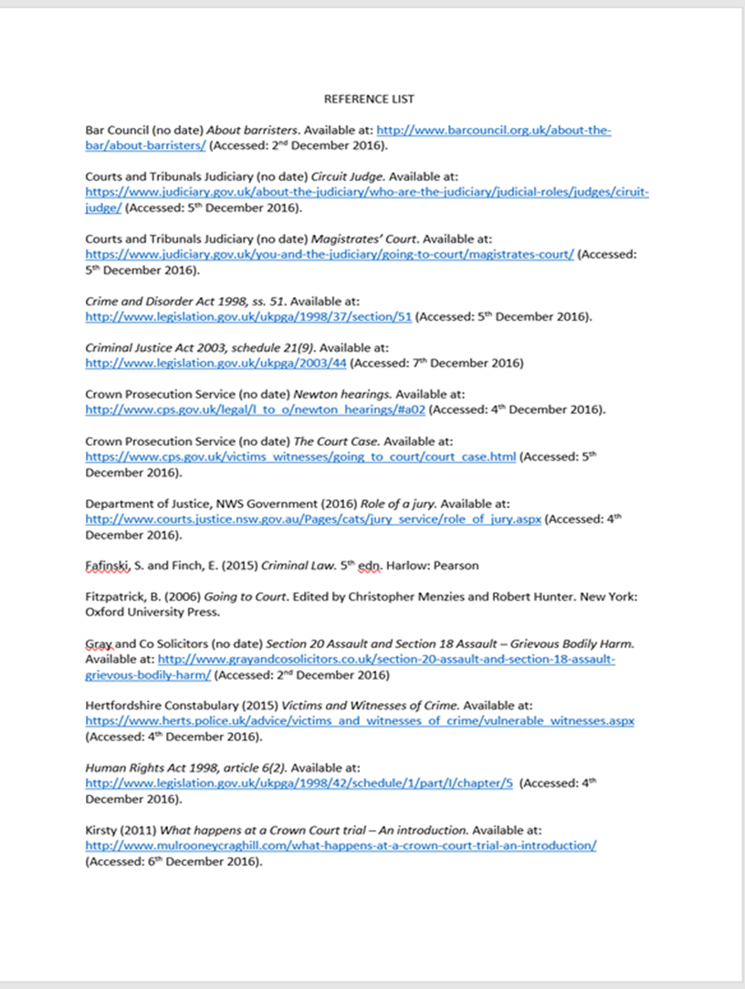
Reference lists/Bibliography
Always needed at the end of an assignment
Helps to show readers what sources you have accessed and where you got your information from
Complete list of all the references used in your work or used as part of your research
Must have all relevant information in order for anyone to be able to find these references again
  Like an address

Slide 19
Reference list/Bibliography
The list should be in alphabetical order by author/editor.
• Books, paper or electronic journal articles, etc., are written in a particular format that must be followed.
• Your reference list contains all the items you have cited or directly quoted from.
A Bibliography lists all the items you have researched.
• When you have used more than one piece of work by the same author, in your reference list you should list the works in date order, beginning with the most recently published work.

Slide 20
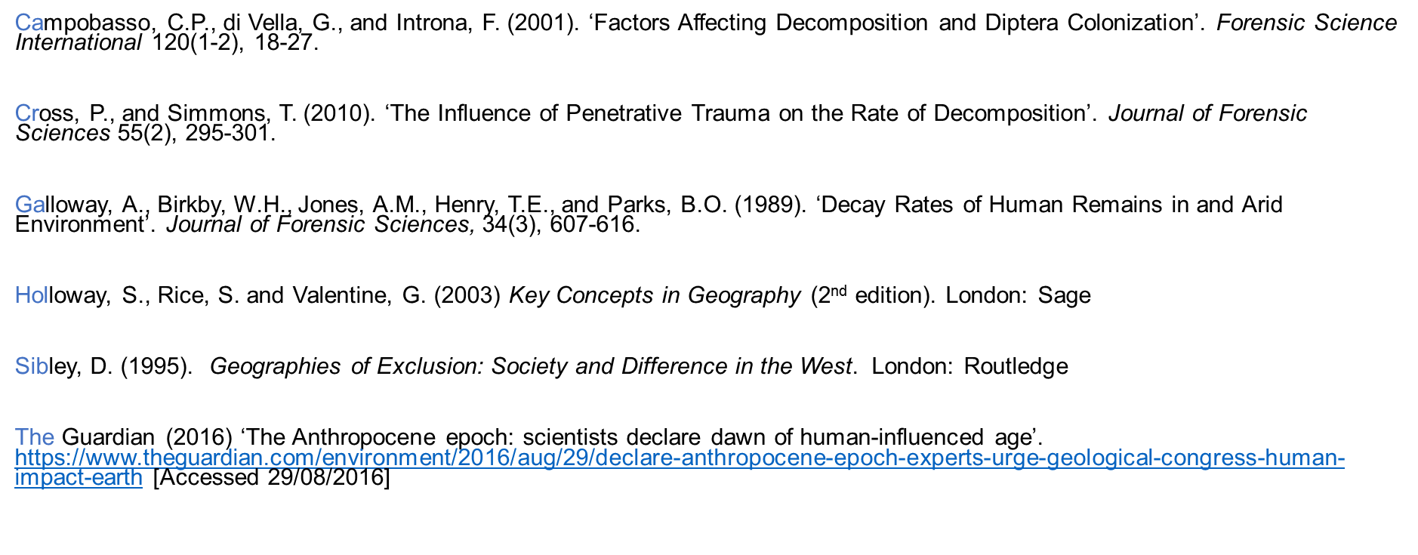
Example

Slide 21
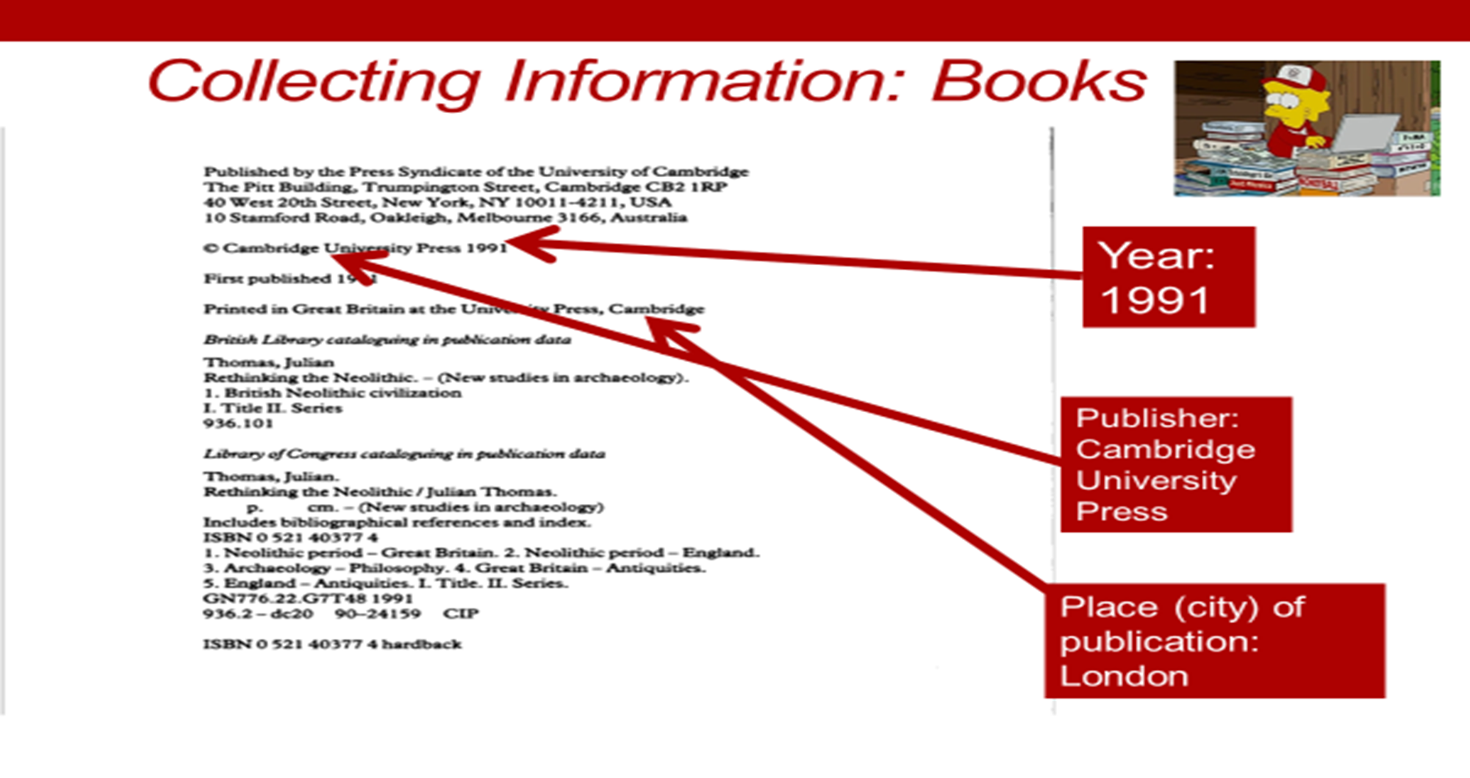
Compiling your Reference List/Bibliography – collecting the right information

Slide 22
Books
Author(s) (surname, initials.) (date of publication). Title of book (in italics). Place of publication: publisher.
Bell. J. (2014). Doing your research project. Maidenhead: Open University Press.
If more than one author: J., Smith, D., Leighton, M., and Bracewell, T. (date). Book Title… etc

Slide 23
Books
Edited Volume → same information as books but:
  After name/s use (ed.) or (eds.)
  After title give edition
  E.g. Thomas, J. (ed.) (1999). Rethinking the Neolithic (2nd edition). London: Routledge.
Chapter in an edited volume
  Chapter Author, date, chapter title. In: Editor/s titles, Volume Title, (edition number), Place of Publication: Publisher, page numbers for chapter
E.g. Smith, J. (1999). ‘On the origins of cursus monuments’. In: Thomas, J. (ed.) Rethinking the Neolithic (2nd edition). London: Routledge, pp. 229-242

Slide 24
Journal Articles
Author(s), year of publication. Article title. Journal Title (in Italics), Volume, issue number & page number(s)
Brody, J. and Bawden, D.(2005) Is Google enough?: comparison of an internet search engine with academic library resources. Aslib Proceedings, 57 (6), pp 498-512

Slide 25
Websites
Author(s) ( this could be an organisation), Year of publication (when was it updated). Title of the webpage (in Italics) followed by [online] The full web address (URL) of the webpage used and the [date accessed]
V&A Museum,2015. Introduction to English embroidery.[online] Available at : http://www.vam.ac.uk/content/articles/i/English-embroidery-introduction/ [Accessed 8 August 2019].

Slide 26
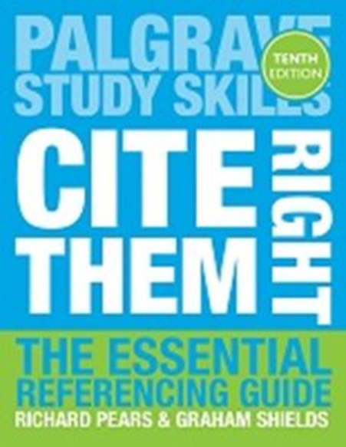
Cite them Right
The Essential Referencing Guide, 10th edition
by Richard Pears and Graham Shields
Series: Palgrave Study Skills
Pears, R. & Shields, G. (2016) Cite them right: the essential referencing guide. Palgrave study skills. 10th ed. Basingstoke, Palgrave Macmillan

Slide 27

Plagiarism
Plagiarism means:
‘Representing someone else’s work as your own or using someone else’s work without acknowledgement. It is a form of cheating and therefore constitutes a serious breach of University rules’.
(Bangor University, (2019).
See UWTSD Student handbook for guidance

Slide 28
What is ‘Plagiarism’?
taking someone else’s ideas and passing them off as your own and/or not referencing correctly
Varies in severity
  Lifting whole passages of text/sound
  Odd phrases/sentences
  Excessive rewording
  Note: You can self- plagiarise – so avoid using content from previously submitted assignments.
  Turnitin – will pick up on previously submitted assignments – check your similarity scores!

Slide 29
How to avoid plagiarism
Referencing correctly is an important skill
  Key component of every piece of work you do at university
  Makes a massive difference to your marks
Must be considered in written work, presentations, posters etc.
Future careers.
NOTE: you will not do well if you do not use references correctly

Slide 30
For any assignment that requires research, you will be reading a lot of information
Any and all information you use must be accompanied with a citation and linked to a reference/source
Paraphrasing is a key (find balance)
  Reading a lot of information , understanding it and using your own words to put it into an assignment still needs a reference because you are borrowing/using another person’s ideas
Good note –taking is key

Slide 31
How to paraphrase
Reread the original text until you understand it and its meaning
Note any words or phrases that are too specific to that piece of writing. Words that you need to avoid
Set aside the original text and write your phrase on a separate piece of paper
Check your interpretation with the original to make sure that your version accurately expresses all the essential information. Look at the words or phrases to avoid from step 2 above
Use quotation marks to identify any unique terms you have exactly borrowed from the source
Record the source so that you can give credit to it and use in your reference list/bibliography

Slide 32
Too many v Too few
Too many references
Demonstrates research
Shows understanding
Demonstrates the difference between what other academics say and think
Indicates what you DO know rather than what you DON’T know
Too few references
Check your assignment brief
Get someone else to read it
Would adding another opinion strengthen your argument?
Have you paraphrased properly
Have you acknowledged ALL sources of information?

Slide 33
When to cite an author/source
Direct quotes
Slight change of words
Paraphrased text/paragraphs
Mainly your own thoughts but contains a reference to another author/source
You mention an author/source by name

Slide 34
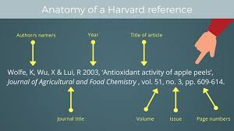
Harvard Guidance Documents
The Harvard Referencing system used for your course is available through the UWTSD library and is on your course Moodle.

Slide 35

Sources
Some of the information used within these slides have been taken from the following University study skills lessons:
UWTSD
Bangor University
University of Central Lancashire
University of Newcastle

Slide 36

Questions/concerns?

