Slide 1
LCBB4004
Marketing Fundamentals
Week 9
Consumer Behaviour

Slide 2


Consumer Behavior
Consumer Behavior: a wide spectrum of things that affect, derive from, or form the context of human consumption.
Perspectives:
Consumers are Systematic decision makers
  Maximize the benefits from purchases defines the response
Consumers are Active interpreters
  Cultural/social membership defines response

Slide 3

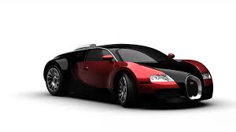
High Involvement Products
A high involvement purchase exists when a consumer has to buy a product or service that is expensive, or that poses the risk of significant emotional consequences if a mistake is made.
Source: http://classroom.synonym.com/high-involvement-purchases-10584.html

Slide 4
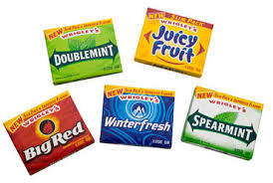
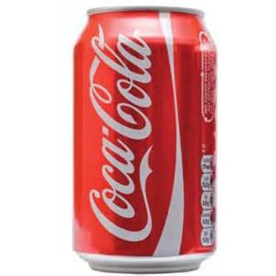
Low Involvement Products
Consumable items that entail minimal effort and consideration on the part of the consumer prior to purchase since they do not have a substantial effect on the buyer's lifestyle and hence are not that significant an investment. A low involvement product can also be an item that is habitually purchased and so the decision to do so requires little effort.
Source: http://www.businessdictionary.com/definition/low-involvement-product.html

Slide 5

Consumer Decision-Making: The Systematic Decision Maker
I think, therefore I buy

Slide 6
The consumer decision-making process
Need recognition
    --Actual state, desired state.
Information Search
--Sources of information
3. Evaluation of Alternatives
4. Purchase
5. Post-purchase evaluation
Customer satisfaction
Cognitive dissonance

Slide 7
Definition of Perception
Sensory receptors take in stimuli, when the stimuli is ordered and interpreted perception occurs.

Slide 8
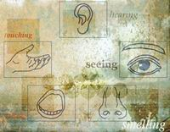

Slide 9
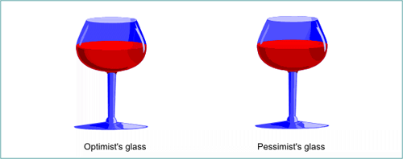

Slide 10

Perception

Slide 11

Perception

Slide 12

Perception

Slide 13
Sensory adaptation
The term adaptation refers specifically to ‘getting used to’ certain sensations, becoming accommodated to a certain level of stimulation.

Slide 14
Your attitude to something is the way that you think and feel about it, especially when this shows in the way you behave.
Source: https://www.collinsdictionary.com/dictionary/english/attitude

Slide 15
Structural Models of Attitudes
Motivated by a desire to understand the relationship between attitudes and behaviour, psychologists have sought to construct models that capture the underlying dimensions of an attitude.
Tricomponent Attitude Model: Attitudes consist of three major components: A cognitive component, an affective component, and a conative component.

Slide 16
A Simple Representation of the Tricomponent Attitude Model
A Simple Representation of the Tricomponent Attitude Model
Conation
Affect
Cognition

Slide 17
The Cognitive Component
Consists of a person’s cognitions, that is, the knowledge and perceptions that are acquired by a combination of direct experience with the attitude object and related information from various sources.
This knowledge and resulting perceptions commonly take the form of beliefs.

Slide 18
The Affective Component
A consumer’s emotion or feelings about a particular product or brand constitute the affective component of an attitude.
These emotions and feelings capture an individual’s direct or global assessment of the attitude-object.
The extent to which the individual rates the attitude object as ‘favourable’ or ‘unfavourable’

Slide 19
The Conative Component
Conation is concerned with the likelihood or tendency that an individual will undertake a specific action or behave in a particular way with regard to the attitude object.
Conative component linked to the consumer’s intention to buy.
Intention to buy scales.

Slide 20
Question
How can marketers change consumer’s attitudes?

Slide 21
Motivation

Slide 22
Maslow’s Hierarchy of Needs
Self-Actualisation
(Self-fulfilment)
Ego Needs
(Prestige, Status, Self -Esteem)
Social Needs
(Affection, Friendship, Belonging)
Safety and Security Needs
(Protection, order, stability)
Physiological Needs
(Food, Water, Air, Shelter)

Slide 23
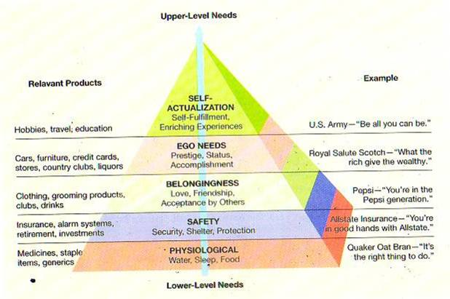

Slide 24

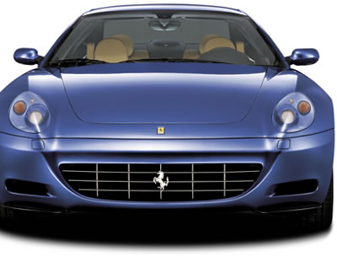

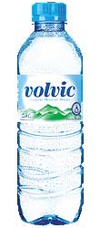


Slide 25

Hierarchy of Needs
Appeal to the Safety Need

Slide 26

Hierarchy of Needs
Appeal to the Social Need

Slide 27
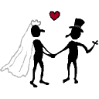
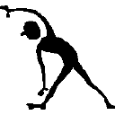
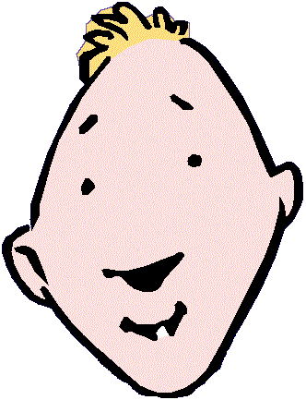
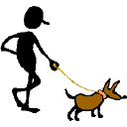
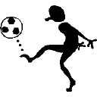
Consumer as Social Being
I buy what I am

Slide 28
Sociocultural Consumption
Values
Object
Meaning
Family
Social
class
Rituals
Community
Gender
Culture
Society
Race /
Ethnicity
Reference
Groups

Slide 29
Factors Affecting Decision Making
REFERENCE
GROUPS
VALUES / ATTITUDES
CULTURE
SITUATIONAL
FACTORS
NEEDS
CONSUMER
DECISIONS
EDUCATION
PLEASURE
PERSONALITY
GENDER
MARKETER-
CONTROLLED
STIMULI
FAMILY
MEDIA
SOCIAL
CLASS
NEWS
MAGAZINES
RADIO
TELEVISION
DIRECT MEDIA
PAST
EXPERIENCE
PRICE
PACKAGING
ADVERTISING
PROMOTION
PERSONAL SELLING
LIFE-STYLE
SUBCULTURES

Slide 30
Conclusion
Ultimately, buyers want to get the greatest rewards and minimize the potential for negative outcomes in a highly involving purchase. A successful purchase can lead to maximum personal or professional gains from the use of the product or service, and to long-lasting results. A bad purchase leads to wasted money, negative impressions in social or professional groups, and the need to purchase another solution to better meet your needs.

