Slide 1
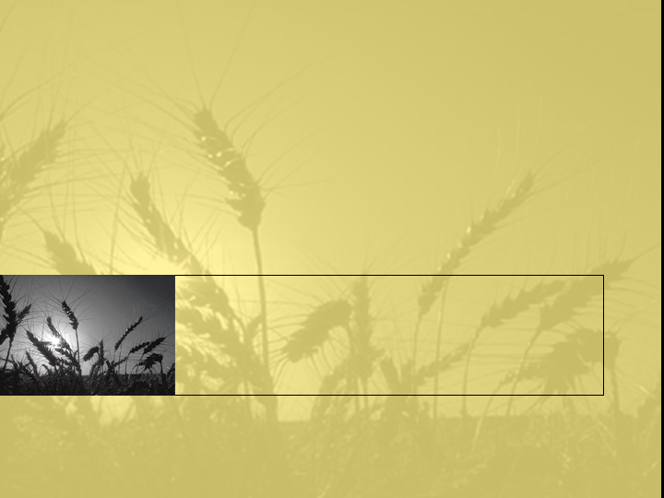
Biological and Psychological explanations of offending
Lecture 3. This lecture is rather lengthy, therefore we will skip some slides and I trust that you will go over them in your own time.

Slide 2
Part 1: Biological explanations
Phrenology
Atavistic qualities
Somatotype explanation
Genetics
Neuroanatomical explanations
Neurochemical explanations

Slide 3
Franz Gall (1800) - Phrenology
The size and shape of your head effects your brain growth.
The shape of your head therefore determines your mental abilities
This is innate, and therefore fixed

Slide 4
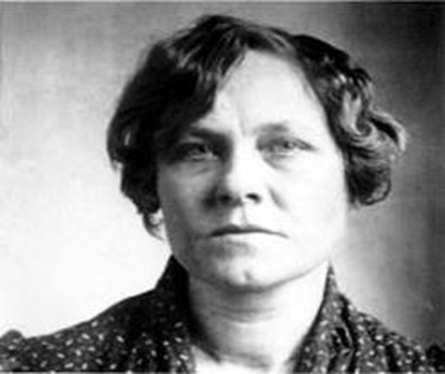
Phrenology as an explanation for criminality.
Attempts were made to legitimize phrenology by using it in America's courtrooms. In 1927 phrenologist, Dr. Edgar Beall was called in to perform a reading on Ruth Snyder, accused of murdering her husband.
Dr. Beall decided that Snyder's chin "tapered like the lower face of a cat" which proved her "treachery" and "ingratitude." Her mouth was as "cold and hard and unsympathetic as a crack in a dried lemon." Beall's final analysis, after studying Ruth Snyder's face, was that she had "the character of a shallow-brained pleasure seeker...murderous passion and lust."
These descriptions were printed in newspapers of the time and treated as fact.

Slide 5
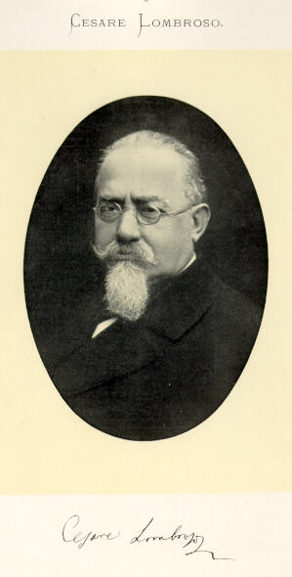
Cesare Lombroso (1876)
The criminal is a separate species, a species that is between modern and primitive humans.
The physical shape of the head and face determined the "born criminal".

Slide 6
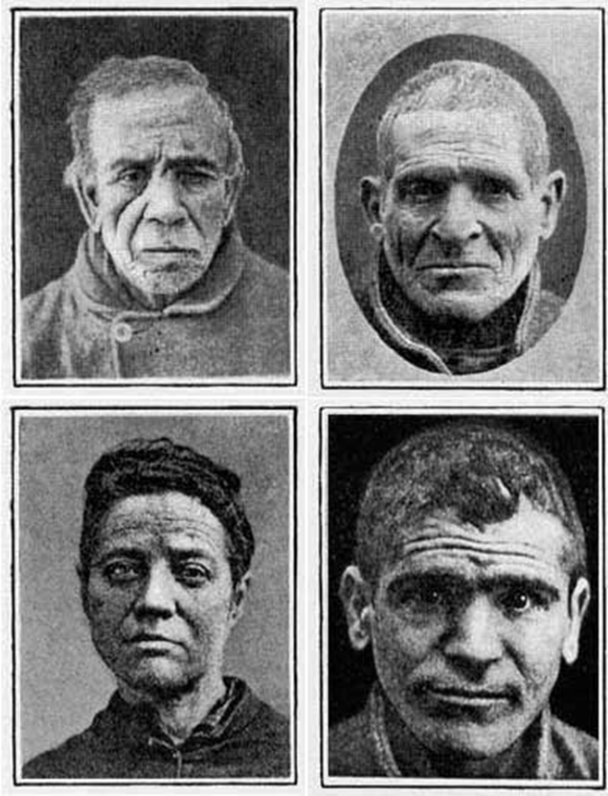
Biological explanations for criminality.
Written by Cesare Lombroso in 1876.
Using Darwin’s theories, Lombroso thought criminals were a separate species of mankind.
He professed that criminals could be identified by a series of distinguishing physical characteristics such as :
  Asymmetrical face
  Unusually large or small ears
  A low receding forehead
  Prominent eyebrows, jawbones or cheekbones

Slide 7
Biological explanations for criminality.
A number of significant flaws:
Lack of a control group for comparison
Sample included people with psychological/physiological disorders
‘Crime’ is a social construction
‘Single defective gene’ theories – doubtful
No evidence to support these claims
Criminals often mentally disturbed or deformed
Goring (1972) compared 3000 convicts with 3000 others and found no difference in features
He was however considered:
`The Father of Criminology`

Slide 8
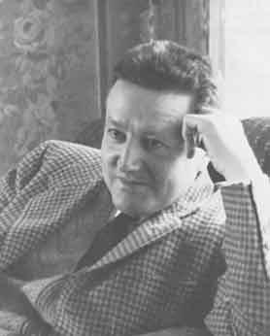
William Sheldon (1949)
The Varieties of Delinquent Youth
There is a strong correlation between body morphology (shape) and criminal behaviour in teenagers

Slide 9
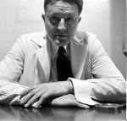
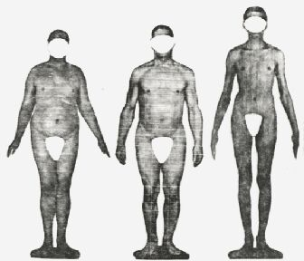
Convicts were most likely to mesomorphic, and least likely to be ectomorphic

Slide 10
Biological explanations for criminality (Sheldon).
The body types are associated with specific traits:
Ectomorph-(thin and fragile), Solitary, Restrained and Self-conscious.
Endomorph-(fat and soft),Relaxed and pleasure loving; Enjoy food and others company.
Mesomorph- (muscular and hard),Aggressive, High pain tolerance; Callous and uncaring.

Slide 11
Body type
Each body is rated according to how much of the 3 types they contain
Sheldon rated 200 students and 200 criminals and found:
Body build | Students | Delinquents | Criminal delinquents
Endomorph | 3.2 | 3.5 | 3.4
Ectomorph | 3.4 | 2.7 | 1.8
Mesomorph | 3.8 | 4.6 | 5.4

Slide 12
Sheldon (1949)critique…
Sheldon’s constitutional psychology is no longer taken seriously
But there is a small association between bodily build and criminality. How could this be explained?
  Influence of testosterone on body and behaviour?
  Effects of stereotyping and labelling?
  Social class? Delinquents from this class?
  Cause & Effect?

Slide 13
Genetic explanations for criminality.
The role of genes:
Does crime run in families? If so, is that because of genes or upbringing?
As you know, to explore the contribution of genetics, researchers have used twin studies.
Genes hold the traits to build and maintain their cells and pass genetic heredity to offspring. BUT…
Just how much of our behaviour is determined by our genes?

Slide 14
Why genetics?
Children are born with a range of genetic make up predispositions and temperaments.
The increasing development of sophisticated technologies has shown that the adolescent brain keeps developing into the twenties (Beckman 2004).
But also we do know that it is not simply biology, but a lack of contact, stimulation and social responsiveness that can alter the developmental path considerably (Dahlberg & Potter 2001).
And, temperament is crucial for three areas- emotional expression, motor activity and sensitivity to stimulation.

Slide 15
Genetic explanations for criminality.
Theilgaard (1984) looked for a ‘criminal gene’.
Studied blood samples of over 30,000 men born in the 1940s.
Found two chromosome abnormalities – XXY chromosome pattern and XYY chromosome pattern.
Found that XYY males had slightly lower levels of intelligence than average and tended to be more aggressive towards people than normal men.

Slide 16
Genetic explanations for criminality.
Similarly, Jacobs et al., (1965) suggested that men with the XYY syndrome were more aggressive than normal 'XY' men.
XYY men are over-represented in the prison population. There are 15 sufferers per 1,000 in prisons and 1 per 1000 in the general population.
‘Extra Y’ syndrome was suggested to lead to:
  High testosterone levels
  Powerful bodily build
  Heightened aggression
  Propensity for violent crime
Implications?

Slide 17
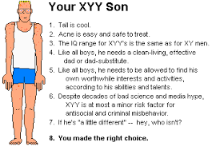
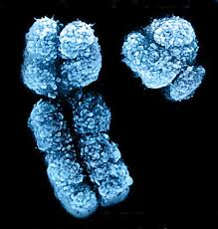
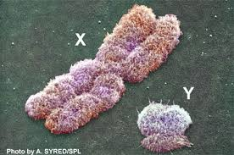
But…
XYY males not actually as predicted (Graham et al., 2007):
  Normal testosterone levels
  Normal aggression levels
  Taller, but not necessarily more powerful
  Prone to developmental disorders and learning difficulties
  XYY males are rare in the general population and over-represented in the offender population
  However, their crimes are not violent ones
  So why are XYY men at a greater risk of offending?

Slide 18
Using twin studies as explanations for criminality.
Cloninger and Gottesman (1987):
Heritability for property offences was found to be .78
Heritability for violent offences was .50
The data also suggest that violent offences may have a heritable underlying component.
But…

Slide 19
Twin studies as explanations for criminality.
Christiansen (1977) studied 3586 sets of Danish twins.
Concordance rates:
MZ male twins = 35%
DZ male twins = 13%
MZ female twins = 21%
DZ female twins = 8%
Thus there appears to be some connection, but concordance rates are low.
Other factors?
Another limitation is that MZ twins not only share a common environment but, because they are identical, often are treated more similarly than DZ twins are.

Slide 20
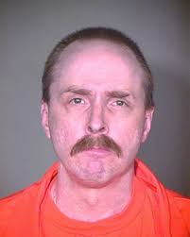
MISTRA-The Minnesota Study of Twins Reared Apart
The largest study of twins that were reared apart. (Bouchard et al., 1979-1990).
They reported that at least 70% of the variance in IQ was due to genetics.
Although this study did not specifically look at criminality, it has enormous implications…
See the case of JEFFREY LANDRIGAN (link below)
http://www.nature.com/nrn/journal/v15/n1/box/nrn3640_BX1.html?foxtrotcallback=true

Slide 21
How exactly do genes influence our behaviour?
Genes influence our behaviour via the amino acids for which they code, which in turn leads to behavioural responses to the environment (both internally and externally).
Behaviours are usually polygenic and genes are often pleiotropic (Plomin 1990; one gene influences two or more seemingly unrelated phenotypic traits).
However, there are specific genes associated with certain traits.

Slide 22
Some examples:
Contemporary twin studies demonstrate-
Hyperactivity in boys and girls aged 8-16 has heritability of .70 (Silberg et al., 1996)
For Conduct disorder similar results (Maes et al., 2007)
For ADHD it is .76 (Faraone et al., 2005)
For aggression it is .65 (Burt 2009)
And for self control it is .64 (Beaver et al., 2010)

Slide 23
Family studies.
Osborn & West (1979) 40% of sons of criminal fathers go on to get criminal record compared to sons of non criminal fathers.
This is supported by West (1982) and Cloninger et al (1978).
But, what about a third variable such as social class, unemployment or poor education.
Criminality might be generated by some other means…

Slide 24
Family studies
Size of family: Larger families - less attention. Also younger siblings model their behaviour on that of older siblings - the 'contagion effect'.
Interactions within the family: Correlation between crime and poor interaction within the family. Parental conflict, poor use of language and communication, mistrust of other family members.
Lack of parental supervision is associated with inconsistent punishment. Harsh punishment is effective in the short term, but in the long run can lead to violent delinquency (Straus, 1991).

Slide 25
Child rearing practice (Offman,1984) found that 'power assertion' style of child rearing was associated strongly with delinquency.
Physical punishment encourages the child to consider aggression as acceptable, given that an authority figure uses it.
Inconsistent punishment has a profound effect on criminal behaviour. Coopersmith (1968) found that inconsistent punishment was linked to very low self-esteem and delinquent behaviour.

Slide 26
Adoption studies.
Heston (1996) studied 47 children born to schizophrenic mothers and then adopted.
23% of these children were imprisoned for violent offences.
As they were not raised by schizophrenic mother, this suggested the possibility that mental illness and criminal violence may share a common genetic basis…but the implications here are huge…
Crowe (1972) reported that when a biological mother had criminal record, so did 50% of adoptees by age 18, compared to control group with 5% criminality.

Slide 27
Bohman (1982) found that when biological father was alcoholic so was son and often involved in violent crime. Criminality of sons and non alcoholics also correlated, but for smaller/petty crimes.
So are criminal tendencies inherited?
Stot (1982) cannot ignore prenatal influences and socio-economic status, in turn linking with stress.
Stress in pregnancy is linked with a variety of developmental disorders…

Slide 28
Hutchings and Mednick (1975)
Findings:
  If both biological and adoptive father had criminal record, 36.2% of sons had a criminal record
  If only the biological father had a criminal record, 21.4% of sons had a criminal record
  If only the adoptive father had a criminal record, 11.5% of sons had a criminal record
  If neither father had a criminal record, 10.5% of sons had a criminal record.
This clearly shows the importance of environmental factors, in combination with genetic factors, in determining behaviour.
Limitations of adoption studies include: Children are placed in an environment similar to the one from which they were adopted. Some children are adopted years after birth, raising the possibility that early experience with the birth-family may have contributed to later behaviour.

Slide 29
Genes, criminality and free will
The debate regarding criminality and free will is a fundamental part of the explanation of causality of criminal activity.
It is inherently linked to responsibility and legal sanction.
This notion of `free will` must consider the individual`s ability to choose from an endless array of life options (Carson et al., 2007).
That offenders exhibit a rational cost-benefit analysis before making their decision to engage in crime is often a problematic notion which does not acknowledge the role of biological and environmental factors in shaping their decisions (McGuire, 2004).
However, an individual is not a passive reflection of external influences and biological influences; we must also consider their personal constructs by which they interpret, predict and control their world.
It is these constructs that largely guide our behaviour.

Slide 30
Other biological considerations

Slide 31
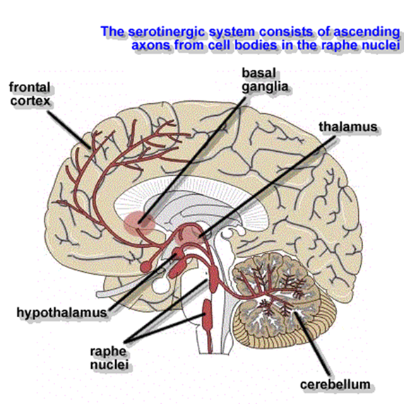
Neurotransmitters and hormones.
Research into these seems to best explain the significant gender differences in crime.
90.1% of apprehended murderers are male, 82.1% of people arrested for violent crime are male. (FBI Uniform Crime Report 2004).

Slide 32
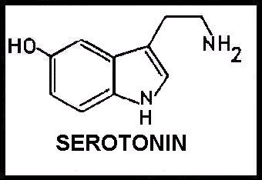
Serotonin and Testosterone
Low levels of serotonin have been linked to antisocial and impulsive behaviour.
Men generally have lower levels of serotonin.
James Dabbs (2001) demonstrated that violent criminals have higher testosterone levels than non-aggressive criminals.
However, all of these are correlational studies and do not show cause and effect.
Are these chemical imbalances genetic or the result of environmental factors?

Slide 33
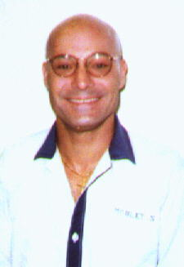
The Case of Stephen Mobley
1991 – shot and murdered a pizza store manager.
His lawyers requested he be tested for a specific genetic mutation related to the production of serotonin.
Claimed his violent behavior was genetic and thus he should be exonerated.
Two courts rejected this claim – not enough scientific evidence.
But...BRUNNER (1993) might disagree with them.
The role of the gene MAOA…

Slide 34
Animal studies show that by giving MAOI`s or SSRI`s to increase the amount of 5-HT available will reduce aggression (Nelson & Trainor 2007).
Eisenberger (2007) found all of the aggressive males in one family had a MAO deficiency.
Also there are reported reduced levels of 5-HT in victims of violent suicides.
Furthermore, low levels of dopamine in the FC have been linked to poor self regulation and faulty executive functioning.

Slide 35
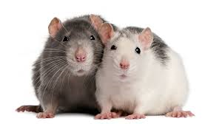
Testosterone-
Animal studies show that castrated rats will only become aggressive when given testosterone if they were previously aggressive before castration.
What does this imply?

Slide 36
The role of MAOA
A relationship between the enzyme monoamine oxidase A (MAOA) and antisocial behaviour provides some convincing evidence (Carson et al., 2007) of a biological basis for aggression.
A New Zealand longitudinal study found children who had low MAOA activity and a history of severe child maltreatment exhibited significant increases in antisocial behaviour (Carson et al., 2007).
In contrast, children with the same histories of maltreatment but who had high MAOA activity did not exhibit increased levels of antisocial behaviour (Caspi et al., 2007).
Does this imply that some people are born with nervous system characteristics that affect their ability to conform to social expectancies and rules?

Slide 37
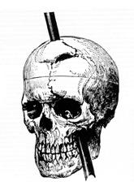
The Brain
Remember – emotions are in the limbic system, decision making is in the frontal lobe.
It is the interaction between these two parts of the brain that may help us gain insight into criminal behaviour.

Slide 38
Blair et al., (1999).
Looked at the brains of convicted psychopaths.
PET scans revealed impairment of the pathways between the amygdala and the frontal lobe
Blair suggests this impairment makes it difficult for the individual to moderate emotional reactions. This difficulty will have a significant effect on how the individual will interact with others.
Because social relationships are difficult, he or she never appropriately develops empathy or feelings of guilt, and thus acts more impulsively, without regard for consequences.

Slide 39
Frontal Brain Hypothesis.
I.e. A malfunctioning relationship between the PFC and limbic system may cause criminal behaviour?
As well as studying convicted offenders, research has been carried out on patients with brain damage.
For example, Damasio looked at the effect of brain trauma in children on later development.
A 3 month old infant who had a tumour removed from the frontal cortex, by the age of 9 was demonstrating behavioural problems in school.
He was socially isolated and inattentive. His free time was spent alone in front of the TV. At times he would lose control of his emotions and physically threaten others.

Slide 40
Raine (1994).
Using the PET neuroimaging technique 41 Pp`s completed a cognitive task which involved sustained attention.
This involved watching a screen for 32 minutes and responding every time a `0` appeared.
Result: The impulsive killers missed many of the `0`s.
Damage was also found in the pre-frontal cortex, which controls impulsive behaviour.

Slide 41
Raine (1997 onwards)
Ongoing longitudinal studies.
Raine believes that sudden, unpremeditated murder could have a biological cause – abnormality in brain’s metabolism.
Low physiological arousal might mean an individual seeks ‘thrills’ in increasing measures = criminal behaviour.
The PET scan studies revealed that a less active forebrain and corpus callosum (executive control) will fail to put the 'brakes' on for potential criminal behaviour.
This may be coupled with low amygdala activity which can also equal criminal tendencies i.e. lack of fear = likely criminal behaviour.
Yeudall (1982) in a study of 2000 offenders (post-mortem), found that 90% had some damage to frontal or temporal regions.

Slide 42
Yet more discoveries...
Criminal psychopaths show less active emotional brain – seen in lack of empathy, compassion for victims.
21 anti-social and psychopathic Pp's: 11% less grey matter in PFC and low arousal on embarrassment.
Damage to PFC can lead to lifespan crime.
Teacher convicted of paedophilia – had a tumor in PFC area.
Paedophilia only emerged at same time as tumor.

Slide 43
Points to remember:
Plomin (1990,1994) has argued that genetics alone cannot explain adult behaviour and we should focus on the way genes interact with the environment.
He suggests that the environment cannot be taken as a constant and that the ‘non-shared environment' is a crucial factor in determining adult outcomes for children in the same family.
I.e. what most affects children are the things they do not share with their siblings, their own unique individual experiences.
Parents think they raise their children in the same way but families alter over time, sometimes quite significantly, e.g. chronic illness, unemployment, high mobility, divorce, etc.
Children’s experiences vary too, e.g. having an influential teacher, developing a new interest, losing a friend, etc. Plomin suggests that it is these differences and the way they interact with genetic make-up, which produce personality differences.

Slide 44
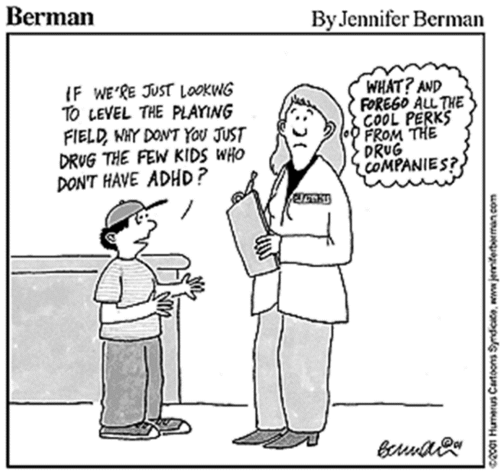
Emotions, ADHD and the Amygdala
The AMYGDALA is associated with EMOTIONS.
In people with ADHD their LACK OF EMOTION is believed to be due to a lack of stimulation of the AMYGDALA.
Another suggestion is that certain individuals, either as a result of a genetic predisposition or brain damage at birth, suffer from a cluster of symptoms which render them incapable of moral control and because of cortical under arousal, they are constantly seeking stimulation.

Slide 45
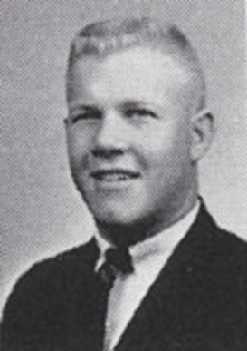
For example: Charles Whitman
In 1966 – killed 14 and wounded 32 during university shooting
Murdered his mother and wife at home first
Post-mortem found large tumour in amygdala
He had been receiving drugs for headaches and mood swings
Charles Whitman

Slide 46
Charles Whitman
Charles Whitman – large tumour in amygdala.
However, how can we establish cause and effect?
Is it all biological? What about psychological explanations?
Charles Whitman visited doctors and psychiatrists for help with severe headaches and irrational thoughts.
Murdered mother and wife – left notes to say he had freed them from the tortures of this world.
Wrote a suicide note asking for a post-mortem to help find what was wrong with his mind and to donate all his money to mental health charities.

Slide 47
However,
Charles Whitman had:
An abusive father.
High achiever at school but dismissed from university following a prank.
Joined marines and promoted quickly, but-
Court martialed for gambling, demoted then discharged.
Returned to university and got a job as a traffic surveyor,
Parents divorced – mother moved away.
Contributory factors?

Slide 48
An evaluation of biological explanations of crime.
Knowledge of biological causes would lead to better treatments.
Whilst biological evidence exists, it is impossible to separate the effects with those of the environment.
We are long way from understanding biological basis of crime.
Biological explanations have serious ethical implications and do not necessarily address the issues of rehabilitation and treatment.
Moir and Jessel (1995) have suggested that brain dysfunction can account for impulsive and seemingly irrational crimes, some of which involve violence.
Moreover, they suggest that brain scans could identify the disorder in young children who are already showing behavioural problems and that treatment (Ritalin (a stimulant), biofeedback and parental training) could possibly prevent these children growing up to be seriously antisocial.
Again, think of the potentially significant ethical issues raised with this…

Slide 49
Part 2: Psychological explanations
Intelligence and crime
Developmental elements of criminality
Executive function and crime
Interpersonal skills and crime
Abuse and neglect
Addiction and crime
Traditional Psychological explanations
Social factors in criminality
Familial factors and crime

Slide 50
Intelligence and Crime
Many researchers believe the causes of crime are sociological; poverty, ethnicity, etc., while other researchers stress the importance of intellectual functioning.
Some studies purport that low intelligence is directly associated with poor performance in school, business achievements, social adaptation and integration, and thus indirectly with delinquency.
Herrnstein and Murray (1994) propose that cognitively limited individuals will turn to social ills.
Cullen et al., (1997) have integrated the research on IQ and crime and found a modest correlation of 0.3.
Meta analyses suggest a correlation between IQ and delinquency of around 0.2, with risk factors at around 0.5.
What are the initial implications of this?

Slide 51
Intelligence and crime
Thus, the correlation between criminality and crime is weak, but it continues to exist. Why?
Guay et al., (2005) showed that the findings become greater between the more severe crimes and violent/sexual offences and non violent offences, even when economic and social factors are taken into account.
Proulx et al (2001) proposes that this is because low IQ is another facet of poor impulse control, thus combining both individual and social contributory factors together.
However, the research above is with a very specific sub-population of offenders, therefore generalising from the findings may be problematic.

Slide 52
Towards some conclusions…
The relationship between IQ and crime is not straightforward, confounded by factors such as- large family, low income, school failure and impulsive behaviour.
Those who do badly at school often cannot foresee the consequences of their behaviours.
It has been reported that many offenders have marked neurological impairments in executive function; problems with attention, concentration, abstract reasoning, goal formation, planning, self monitoring etc (Raine 2005).
Hence it is likely that IQ and criminality are part of a much wider combination of factors contributing to crime.

Slide 53
Language development:
Verbal deficits and impaired language development are associated with crime and delinquency (Leech et al., 2008)
Antisocial behaviour and aggression are linked to low language proficiency as young as age 2 and continue throughout the lifespan (Dionne, 2005).
Why might this be?
Language is used to solve problems, to negotiate and to empathise. The development of language is associated with an important pro social interactive tool (Dionne, 2005)

Slide 54
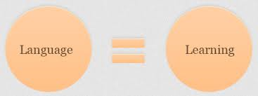
Delayed language acquisition is associated with increased stress and frustration (Keenan and Shaw 2003).
Language delay is observed in Males with disruptive behaviour in preschool and later but not in females.
Why?
Coren (2001) postulates that language is a crucial tool for regulation of our own behaviours, impulses and emotions.

Slide 55
Self-regulation skills
This is considered to be one of the most important skills in the prevention of anti social behaviour.
It refers to the capacity of controlling and altering behaviour and emotions to shift focus and attention. (Eisenberg et al., 2004).
An inability to self-regulate has been found to relate to early onset aggression, violence and substance abuse.
A degree of self regulation is related to temperament, but it is also learned as a result of social interactions and the environment (Buckner et al., 2003).
In addition, research demonstrates that low levels of dopamine in the FC are linked to poor self regulation and faulty executive function (Gogtay et al., 2004). *Remember that the FC is one of the last brain structures to mature.
The symptoms take time to develop and largely follow a biologically determined pathway. E.g. 17 months, adolescence and early adulthood.
In most healthy individuals, they learn to redirect their aggression appropriately.

Slide 56
Executive function-
Closely related to self regulation, this refers to deliberate problem solving and the regulation of thoughts, behaviour and emotions.
It is crucial in understanding criminality as these individuals are les able to override maladaptive responses and maintain personally beneficial behaviour (Zeier et al., 2012).
Why is there this dysfunction?
Nigg et al., (1999) proposes a problem with the PFC, which is also the hallmark of ADHD (Buckner et al., 2003).

Slide 57
ADHD-
This refers to three basic behaviours-
  Excessive motor activity
  Impulsivity
  Inattention
These result in the inability to regulate and organise behaviour.
But…
ODD must not be included with this; these individuals are often spiteful, vindictive and annoying, separating it from ADHD.

Slide 58
Whilst ADHD is most diagnosed disorder in childhood, the actual prevalence is-
  USA 5% (APA)
  Worldwide 5-10%
  Adult population 3-9%
But, all people have some elements of these behaviours.
Therefore, diagnosis should be of persistent and pronounced behaviours (Root & Resnick, 2003).

Slide 59
Causal factors and ADHD
These are varied; genetic, environmental factors that damage the nervous system and toxic exposure (Loeber, 1990).
Research suggests that the primary causal factor is inhibitory problems due to neuropsychological deficits (Barkley, 1997) affecting motor control.
However there is much mis-diagnosis.
Why is ADHD associated with criminality?
The behaviour is often annoying, inappropriate, irritating and frustrating.
This leads to rejection from peers and particularly so if perceived to be aggressive.

Slide 60
The most common problem is delinquency and substance abuse.
There is also the high risk of lengthy, serious criminal careers (Mannuzza et al., 1998).
Approximately 50% of youths incarcerated are believed to suffer from ADHD (Young et al., 2010), whilst other studies estimate from 14-72%...
Cahill et al., (2012) prevalence in prison is much higher than in general population.
But… Problems in early diagnosis for prospects in children…

Slide 61
Conduct Disorder-
Often co-occurs with ADHD, with 50% of disruptive children having both. (Coid, 2003).
Conduct disorder increases the symptoms of ADHD and having both is a powerful predictor of violence, criminal behaviour and substance abuse (Flory et al., 2003).
According to the APA (2013):
It is a precursor of adult crime and is a repetitive and persistent pattern of behaviour, violating the rights of others.

Slide 62
Deficient Interpersonal skills and
Peer rejection:
Peer rejection is also one of the strongest predictors of involvement with serious offending, especially violence (Cowan & Cowan 2004).
Rejection starts early, around the age of 5 where these children show signs of behavioural, emotional and social deficits, particularly violence or aggression.
Peer acceptance is crucial for an individual`s development and a lack of this can lead to anti-social behaviour in later life.
A problem arises due to research being almost exclusively in males.

Slide 63
Furthermore,
Low empathy is reported, specifically for low cognitive empathy as opposed to emotional empathy, with a strong correlation being reported between cognitive empathy and offending behaviour (Jolliffe & Farrington 2004).
Most subsequent research is the same.

Slide 64
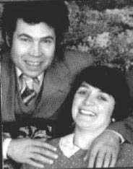
Wansell (1996)
Fred and Rosemary West
Frederick and Rosemary West
Fred was known to be of a low level of intelligence and cognitive functioning, but- Both Fred and Rosemary suffered terrible emotional & sexual abuse in their childhood
Could this be what created these 'serial killers‘?
What do you think?

Slide 65
Early Abuse and criminality
Findings strongly support the relationship between child abuse and neglect and delinquency, adult criminality, and violent criminal behaviour.
Abused and neglected children are 4.8 times more likely to be arrested as juveniles; 2 times more likely to be arrested as an adult, and 3.1 times more likely to be arrested for a violent crime than matched controls (English, 2002).
`The violent children of the future are now babies`
(Gerhardt 2004: p167)

Slide 66
Child sexual abuse & criminal behaviour?
Ressler et al., (1988) - Out of 36 sex murderers interviewed, 42% were found to have been sexually abused as youngsters.
Dietz & Warren (1995) found 76% of the 41 serial rapists that they interviewed were abused when young.
For consideration-
  The FBI and others have attempted to classify sex offenders.
  There will be more details of the causes and classification of sex offenders in a separate lecture later on in this module.

Slide 67
Substance abuse and crime
Police estimate that half of crime is drug related.
A number of factors link substance abuse to crime, not just the substance itself.
Different drugs are associated with different crimes, but the main options to support drug habits quickly move from theft to drug dealing and prostitution.
The relationship between alcohol and crime is less clear, but findings suggest that:
  Murders are committed by people under the influence of alcohol 65% of the time,
  Stabbings 75% of the time,
  Assaults 70% of the time and
  Domestic assaults 50% of the time.

Slide 68
A Addiction and crime
Hodge, McMurran & Hollin (1997) propose that crime has many similarities to behaviours that are classified as addiction.
BUT… few would agree that there is a pure model for addiction per se.
Rather, addiction is a combination of personal and environmental factors.
Addiction, substance abuse and alcoholism all occur in offender populations, which has led many to propose a personality type or an underlying predisposition…
But there is little if any evidence of this…
However…

Slide 69
There is evidence of risk factors and antecedents being the same for addiction and criminality,
AND
Persistence and escalation can be similar amongst some.
For the majority of individuals, crime declines with age, whereas for some it is a lifelong relationship.
Change and rehabilitation using CBT has similar outcomes for addiction and criminality.

Slide 70
Research: Kilpatrick (1997)
The characteristics of addiction were found in Irish joyriders.
Juvenile`s convicted of car related offences were found to have 6 characteristics of addiction observed in their behaviour/attitudes:
Tolerance
Salience
Conflict
Withdrawal
Craving
Relapse

Slide 71
Addiction and risk taking behaviours-
There are four ways in which addiction and risk behaviours are related-
Interactive: both careers develop simultaneously (Pudney, 2002).
Shared: both have common single reinforcing factors which could be psychological, social or environmental (Bennett & Holloway (2005).
Multivariate: crime and abuse are linked to macro and micro factors which are complex (Seddon, 2000).
Spurious: unconnected and happen coincidentally by accident.

Slide 72
Eysenck`s biosocial theory of personality and crime
Eysenck is not saying that criminals are born, but that a combination of neurological, environmental and personality factors increase the likelihood of antisocial behaviour.
According to his theory, three main factors relate to temperament: extroversion, neuroticism and psychoticism.
Extraverts need much stimulation, which lends itself to criminal risk taking. The RAS arouses the cortex and keeps it responsive to stimulation. In extroverts the RAS is under aroused.
Whereas extraversion is related to the CNS, neuroticism is related to the ANS; it becomes aroused easily and remains aroused for longer. I.e. the ANS of a neurotic is highly labile.

Slide 73
Eysenck
Criminality is an interaction between genes and environment:
Three dimensions to personality:
  Extraversion – Introversion
  Neuroticism – Stability
  Psychoticism – Normality
Eysenck claims that most criminals are extraverts – they gain arousal from crime, and if also neurotic, they would not learn from their mistakes. He later added Psychoticism to criminal behaviour due to their cold and uncaring behaviours.
Hare (1982) suggests that there is no relationship (using extravert type ‘sensation seeking’) but links between N and P!
Others argue that extraverts are simply more aroused, and nothing else!
Would this link to addictive behaviours?

Slide 74
You could argue that Eysenck is further supported by the research on joyriders (Kilpatrick 1997,Kellett & Gross 2006)
Additionally, McGuire (1997) found relationship between shoplifters and drug addicts- key characteristics:
Salience
Arousal
Tolerance
Withdrawal
Relief
Cessation
BUT, whilst this explains continual engagement with criminality, is it any better than other theories? Flaws?

Slide 75
An evaluation of Eysenck`s theory
Lack of practical application- does not differentiate between type of crime or criminal.
The effects of social influence are underestimated.
Farrington et al., (1982) reviewed 16 studies for evidence of a relationship between E, N, P and criminality in convicted criminals. They found evidence for a relationship between N, P and crime but not E.
Hollin (1989) reported the same, and Putwain & Sammons (2002) suggest it is because E scales are measuring both impulsiveness and sociability, with criminals only possessing the former, hence affecting the results.
Self-report scales.
But good attempt to bring together multiple causes of crime (genetic, social, learning etc.)
Underlying tendencies will be present in childhood, therefore be identifiable and enable early intervention.

Slide 76
The Traditional Psychological Theories…
Psychodynamic theories.
Attachment theory.
Social learning theories.
Rational choice theory.
Differential association theory.

Slide 77
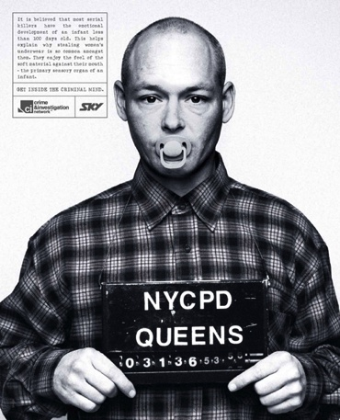
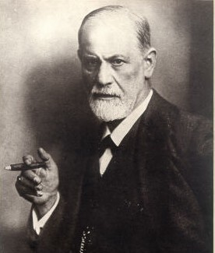
Can we use Freud’s theories to explain criminal behaviour?
ID ?
SUPEREGO ?
EGO ?

Slide 78
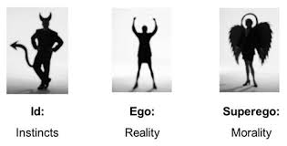
Tripartite Personality
Strong id and weak superego= criminal
Harsh punishment no good because it simply encouraged violence
Traumatic event leads to underdeveloped superego and a lack of morality.
Alternately, a child might develop normal superego, but the superego itself is deviant from an internalization of the same sex parent.
Consequently, a son raised in family with criminal father develops superego that does not react to criminal acts that the father would do.

Slide 79
Alexander and Healy (1935)
  Children need to progress from the pleasure principal to the reality principle.
  How does the child do this?
  Freud - The child needs a stable home environment to successfully make this transition.
Criminals are those children who do not make this transition.

Slide 80

Privation and deprivation hypotheses?
Bowlby`s research on 44 juvenile delinquents, compared with 44 controls led him to conclude that:
Maternal separation/deprivation in the child’s early life caused permanent emotional damage. He diagnosed this as a condition and called it Affectionless Psychopathy

Slide 81
Child rearing
Poor parental supervision is the strongest and most replicable predictor of offending (Smith & Stern, 1997).
Parental discipline and how parents react to their child predicts later convictions. Harsh punitive parents at age 7-11 were responsible for 40% of the convictions in later life.
The same was found for erratic or inconsistent parents too.
Likewise, cold rejecting parenting styles predicted later violence convictions, even more so if the parents were punitive and cold compared to punitive and warm.

Slide 82
Authoritarian parents were second most influential factor for predicting violent convictions.
Maxfield & Widom (1996) children who were abused up until age 11 were significantly more likely to offend within 15 years.
McCord (1983) half of neglected/abused boys that were convicted for serious crimes became alcoholic, mentally ill or died before they were 35.
Back to the idea of early childhood abuse in the form of inappropriate punishments.

Slide 83
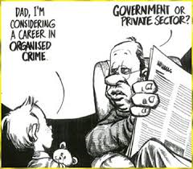
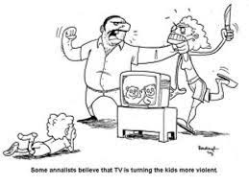
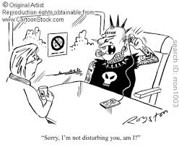
Learning Theories.
Classical conditioning.
Operant conditioning.
Differential Association Theory.
Social Learning Theory.

Slide 84

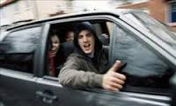
Classical conditioning.
Classical conditioning explains how we learn criminal activity through associating the criminal act with particular positive rewards and feelings.
Once the association is made, operant conditioning reinforces the behaviour and the pattern is set.

Slide 85
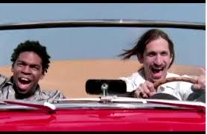
Operant Conditioning
Rewards – what might be the motivation for crime?
Material gain
Power
Peer respect
Competence
Increased self-esteem
Excitement and thrill

Slide 86
Sutherland (1939)
Behaviourism & Crime
The learning of criminal behaviour is no different from the learning of any other behaviour.
Most learning takes place within close personal groups.
Learning includes:
Techniques to carry out certain crimes.
Specific attitudes and motives conducive towards committing crime.

Slide 87
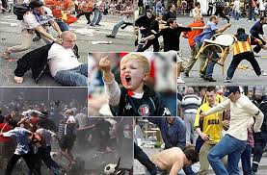
Differential Association Theory
Criminal behaviour is learned.
Learning happens through association with peers.
Close friends and family influences.
Social norms are stronger than law.
Operant conditioning – too simplistic.
Why doesn’t punishment stop crime?
Social organisations we are socialised into Sub-cultures.

Slide 88
Bandura on crime:
Where does the motivation come from to commit crime?
Who/where are children more likely to learn criminal behaviour from?
How would he explain the many gender differences we see reported in crime?
Research evidence to support the SLT of criminal behaviour comes from the Cambridge study (later on).

Slide 89
More from Social Learning Theory
Based on the principles of operant and classical conditioning, social learning theory would expect most criminals who commit a second crime to have committed the same crime twice, rather than two different crimes.
Observational learning is another aspect of social learning theory which uses the principles of vicarious reinforcement.
Modelling explains how observational learning can only take place where someone identifies with another person in some way.

Slide 90
Rational Choice Theory
Rational choice theory originates from criminology, and holds that people freely choose their behaviour and are motivated by the avoidance of pain and the pursuit of pleasure.
Individuals evaluate their choice of actions in accordance with each option's ability to produce advantage, pleasure and happiness.
Rational choice provides a micro perspective on why individual offenders decide to commit specific crimes; people choose to engage in crime because it can be rewarding, easy, satisfying and fun.
The central premise of this theory is that people are rational beings whose behaviour can be controlled or modified by a fear of punishment.

Slide 91
This perspective assumes that crime is a personal choice, the result of individual decision-making processes.
This means that individuals are responsible for their choices and thus individual offenders are subject to blame for their criminality.
Assumptions about the decision-making process and behavioural motivations-
It is held that people decide to commit crime after careful consideration of the costs and benefits of behaving in a certain manner.
This involves considering both personal factors, which may include a need for money, revenge, or entertainment, and situational factors such as the target/victim’s vulnerability and the presence of witnesses, guardians, or the police.
Rational choice focuses on the opportunity to commit crime and on how criminal choices are structured by the social environment and situational variables.

Slide 92
Social and family influences
The Cambridge Study
Farrington (1996) – looked at males in London over period of 24 years.
Interviewed the boys at age 8, 10 and 14 and interviewed the parents and teachers.
Followed them up through the Criminal Records Office.
At age 32, 37% of them held a criminal record.
There were 400 families overall, but only 4% of them accounted for 50% of the crimes.
Farrington et al., suggests that this demonstrates a link between family and crime. There was evidence of intergenerational crime across three generations.

Slide 93
And…
The Farrington study is a key study, as it clearly shows the interaction between genes and socialisation (environment).
It demonstrates that not only is there a genetic component to crime, but that parental modelling, monitoring and disciplining practices and the tendency to mate with similar individuals all contribute to intergenerational crime.
It also shows that the environment places limits on an individuals ability to exercise their free will.
In support of this, Walters (1992) concluded from a meta-analysis of 38 studies of twins, families and adoptions, that genetics played a small but significant part in determining criminality.

Slide 94
Other important considerations
Size of family: Larger families - less attention. Also younger siblings model their behaviour on that of older siblings - the 'contagion effect‘ (Bailey, 2005).
Interactions within the family: Correlation between crime and poor interaction within the family. Parental conflict, poor use of language and communication, mistrust of other family members.
Disruption of family home: Bowlby (1946) maintained that `coming from a broken home led to delinquency`.
However, Rutter (1971) argued that it was the amount of discord and distress rather than the 'broken home'.
Loss of a parent through death does not necessarily lead to delinquency.

Slide 95
Hoffman (1984) found that 'power assertion' style of child rearing was associated strongly with delinquency.
Power assertion involves physical punishment and criticism with little rewarding or praise. Physical punishment encourages the child to consider aggression as acceptable because an authority figure uses it.
Inconsistent punishment has a profound effect on criminal behaviour (Coopersmith,1968). He found that it was linked to low self-esteem and delinquency.
Lack of parental supervision is associated with inconsistent punishment. Harsh punishment is effective in the short term, but in the long run can lead to violent delinquency (Straus, 1991).

Slide 96
P Parental conflict, Disruption
Plethora of results to support this, with most of the research being focused on the loss of the father, as it is far more common.
The explanations usually fall into 3 categories; Trauma/attachment issues, life course/multiple stressors and selection theories/disruptive families.
The Cambridge study (Farrington 1996) concluded that life course and multiple stressors had the most support.

Slide 97
Criminal parents and delinquent friends.
Therefore there are intergenerational continuities in exposure to risk factors, which could be exacerbated by criminal parents contributing to lack of supervision. However it is also possible that there are official biases towards certain families.
Delinquent friends are taken as a predictor of later offending (Battin 1998) because delinquent acts most often occur in small groups and not alone. Usually, by the age of 17, criminal activity will decrease, as gang friendships have broken down.
Thornberry (1994) identified 3 main variables as the main predictors of juvenile delinquency: poor parental supervision, low parental reinforcement and low involvement in family activities.

Slide 98
School and Community influences
Delinquency rates and non attendance in school is a reliable indicator of later juvenile delinquency and particularly, troublesome behaviour in primary school around ages 8-10.
However, the type of school was also an important contributory factor.
Are urban areas more violent?
Sampson (1997) identified 3 key predictors:
Concentrated economic disadvantage.
The proportion of female headed families.
Residential instability.

Slide 99
Social Factors: Poverty
Messner (1988) – positive correlation with crime and low income, one-parent families, poor education, high infant mortality.
Benyan (1994) – correlation between unemployment and crime: low self-esteem, boredom, isolation, social company.
The powerless versus the powerful? Durkheim (1893) Anomie, developed into Strain Theory (Merton 1938).
Following on from this: The Chicago School and Social Disorganisation Theory, Control Theory and Gottfredson & Hirschi`s General Theory of Crime (1990).
But…POVERTY and crime are not intimately linked – only correlation – other factors associated with poverty.

Slide 100
What can we conclude?
Psychobiological explanations of criminality, once unpopular are now widely accepted under the rubric of behavioural genetics.
There is strong evidence that crime runs in families.
The cause of this is likely to be a complex mixture of heredity, parenting, social and economic factors.
Both learning and personality theory have been applied to crime.
Social learning theory, incorporating cognition and emotion is the predominant contemporary theory applied to understanding crime.

