Slide 1

Certificate of Higher Education Skills for the Workplace BMSW4001_LON
Presentation about my future career
Graduate Accountant/Finance graduate
Presented by Tharsiny Ravi
Student ID 2112265
Lecturer: Sylvia Hoffmann
university of wales trinity saint-David

Slide 2


Graduate Accountant/Finance Graduate
Job adverts
Job description
Skills needed
Self analysis
SWOT analysis
Personal development plan
References

Slide 3
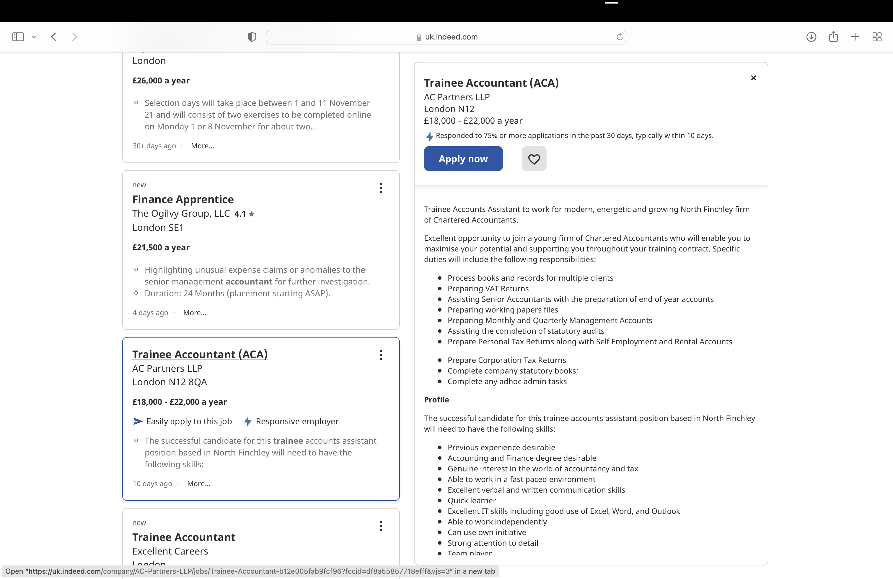
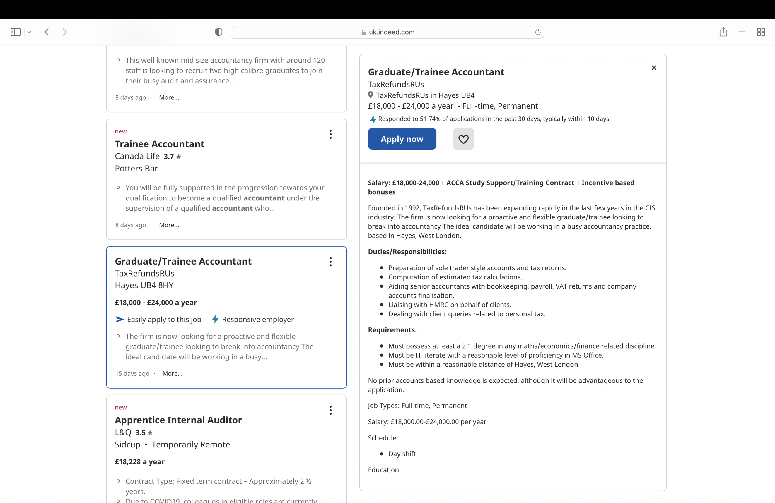
Job Adverts
Graduate/Trainee Accountant (Indeed.com,2021)
Trainee Accountant (ACA)(Indeed.com,2021)

Slide 4



Graduate Accountant job description
Process books and records for multiple clients
Preparing VAT returns and working files
Preparing monthly and quarterly management Accounts
Preparing accounts and tax returns
Accounting and finance degree desirable
Dealing with client queries related to personal tax
Genuine interest in the world of accountancy and tax
Skills needed
Excellent verbal and written communication skills
Quick learner
Excellent IT skills (Excel, word, outlook)
Strong attention to detail.
Team player
Analytical skills

Slide 5
Self analysis
Skills (and qualification) needed | My proficiency | Evidence
Able to learn quickly | Yes | I have always excelled in my studies
Excellent IT skills | Yes | Obtained: certificate in Microsoft office, Certificate in Level 2 in IT
Strong attention to detail | Yes | In my workplace I found and solved many discrepancies
Analytical skills | Yes | In my workplace I use critical thinking to solve problems
Excellent verbal skills | No
Excellent written skills | No
A finance degree | No

Slide 6



SWOT Analysis
Strength | Weakness | Opportunities | Threats
Good at Mathematics | Verbal skills | Enroll finance degree | Lock down
Quick learner | Written skills |  | Child illness
Good at time management and punctual | No knowledge of finance skills |  | Family issues
Team player Analytical skills | Lack of undergraduate degree

Slide 7
My weakness
Ways to develop them
Verbal skills
Written skills
No knowledge of finance skills
Lack of undergraduate degree
Reading books , taking part in class activities,
group-works, Presentation etc..
Reading books, taking part in class activities, group-works, writing reports.
Enrolling on an undergraduate finance program and taking on bookkeeping responsibilities
Enrolling and completing on an undergraduate degree

Slide 8

How can I make use of it
Opportunity
By completing Level 4 I could get a key to enrolled in Finance degree

Slide 9
How to minimize the impact if it arises
Threats
Lock down- Make arrangement to study from home, knowing about how to access online. Having a laptop etc…
Child illness- Take regular test and arrange someone or relative to take care of child
Family issues- solving the problems or consider a counselling service

Slide 10
Personal development plan | Short-Term Time Frame What do I want to accomplish in the next three to six months? | Mid-Term Time Frame What do I want to accomplish in the next six months to two years? | Long-Term Time Frame What do I want to accomplish in the next two to three years?
Section 1 - My Goals What are my overall goals that I want to accomplish in this time period? | I will be able to Finish Term 1 and Term 2 in Level 4 | Level 4 will be completed and Enrolling on an undergraduate degree | Completing undergraduate degree to become a graduate accountant
Section 2 - Skills and Knowledge to be Learned What specifically do I need to learn? What project do I need to work on? | Good writing skills Good Verbal skills Team working Time management Good analytical skills Good assessment writing | Excellent writing Excellent verbal skills Excellent analytical skills Excellent assessment writing Team working | Excellent writing Excellent communication Excellent use of finance application Excellent management Excellent analytical skills

Slide 11
Personal development plan
Section 3 - Next Steps How am I going to acquire the skills and knowledge? How am I going to do this project? | Attending workshops Reading books Consider learning supports Online library Use Moodle a lot By following module guidelines Good attendance Learning modules | Attending workshops Reading books Consider learning support Use online library Complete assessments Learning modules | Attending undergraduate lectures Learning modules Completing undergraduate assignments Assisting the bookkeeping tasks at the workplace Completing an undergraduate finance degree

Slide 12

PDP | Short-Term Time Frame What do I want to accomplish in the next three to six months? | Mid-Term Time Frame What do I want to accomplish in the next six months to two years? | Long-Term Time Frame What do I want to accomplish in the next two to three years?
Section 4 Resources What resources do I need? | Allocate two days to go Campus Time to do homework or time to study after I need to pay to university Need money for travelling | Allocate four days to go university once enrolled(under graduate) Time to study after I need to pay to university Need money for travelling and living expensive | Should allocate 4 days to go university Time to study after I need to pay for university Travel cost and living cost
Section 5 Time Schedule What is my time schedule? | Term 1 three months, term 2 in 6 months | Level 4 in one year Enrolling to a finance degree with in one and half year | First year finance degree- in 2 years Second year finance degree- in 3 years Completion of finance degree- in 4 years
When will I start? | Term 1 In progress Term 2 February 2022 | June 2022 to October 2022 Enrolling to finance degree 2022 Sept | 1st year-Sept 22 2nd year-Sept 23 3rD year –sept 24
When do I expect to finish? | Term 1 Finished by January 2022 Term 2 finished by May 2022 | Level 4 October 2022 | 1st year-July 23 2nd year-July 24 Completion- Sept 25

Slide 13
References
Indeed.com (2021) Trainee Accountant (ACA). Available at: https://uk.indeed.com/jobs?q=trainee%20accountant&l=London&advn=7110528457566081&vjk=b12e005fab9fcf96 (Accessed on: 06/12/2021)
Indeed.com (2021) Graduate/Trainee Accountant. Available at: https://uk.indeed.com/jobs?q=trainee%20accountant&l=London&vjk=aa34f1685dcf7577 (Accessed on: 06/12/2021)

Slide 14

Thank you for listening
Q&A

