Slide 1
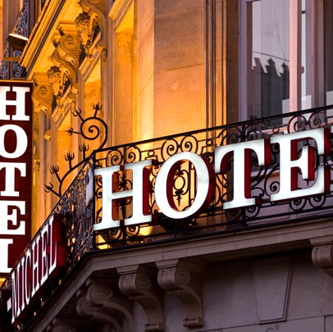
Comparison between two multinational hotels international Marriott Inc & Best Western
By BIGDELOO

Slide 2
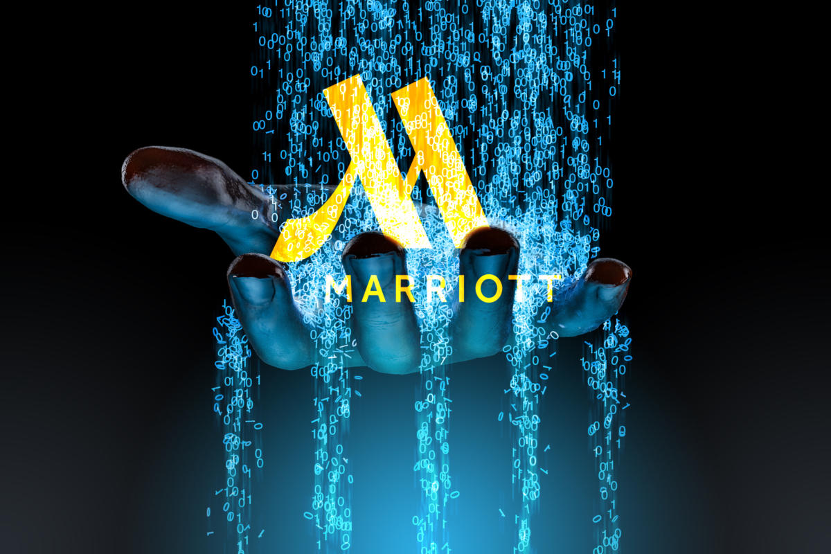
About Hotel international Marriott Inc
Marriott international Inc ,Is an multinational company . Founded in 1924. Founded the company were by John Willard Marriott and his wife Alice Marriott. Now, their son is the head of this large collections. They have the right to a license and a residence permit from hotel and residential properties. To this day, the Marriott family retains ownership of most of the company. Marriott with 1,423,044 rooms in 131 countries and 30 mark commercial with 7,642 features , is the largest hotel chain in the word. Of this 7,642 personal property 2,149 the family are managed and 5,493 managed by others based on their contracts. n 1995, Marriott was the first hotel company to offer online reservations .
Marriott: Marketing Strategy
Marriott has been successfully in the hospitality industry for many year. And surely their strategy in this case has helped them to be the best. The Marriott Marketing Strategy involves the Marriott Marketing Mix consisting of the 4Ps which are product, price, place and promotions. For example, the places that the hotel chooses the best place is the a city .Which means that it is the best place in terms of geographical location. About products, they are very obsessed with products as they know their customers well and know what level of product their customers are satisfied with. And this is because they are very actives in the digital world. Also they care about the hospitality marketing. The opinions and impression of their customers are very important to them , they have a very strong management so that all clients . Therefore , they attach importance to , the 3 marketing mixes , include: before ,during , after . Performs these services in the best way. They treat customers in such a way that they are the real home. They receive their customers in a very pleasant place with very beautiful and appropriate designs, so their customers remember great memories and like to spend a lot of time on their hotel. To have a very strong management , they use very good psychologists, very good relationship with the clients. Hospitality is an important part of he management of Marriott hotels.

Slide 3
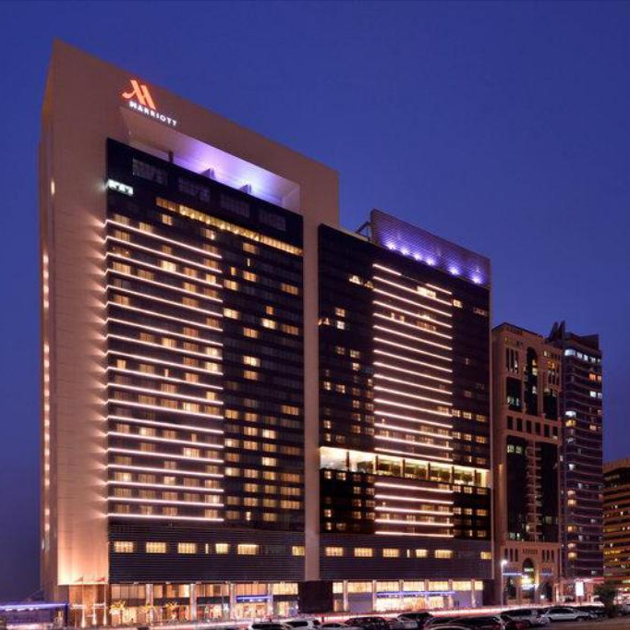
Comparison
Marriott is ,publicly traded , public company , ,listed company. held And a large company operating the Marriott sells its products and services in the hotels industry. Marriott is very active brand when it comes to discounting and offering promo codes. Because Marriott chain hotels have a high quality of work, the cost of accommodation in them is also higher than ordinary unknown hotels. However ,the management of this multinational American hotel has established different brands of this hotel chain around the word. Therefore , travelers of all tastes can choose and stay in a hotel that fits their budget. They also care about the hospitality marketing. The opinions and impression of their customers are very important to them , they have a very strong management so that all customers. Therefore , they attach importance to , the 3 marketing mixes , include: before ,during , after . They use the best to satisfy their customers. They create great memories for their customers with hospitality. Marriott hotels due to how they interact and respect their clients, they are also very considerate towards their customers needs .Not only are they very caring but they are very welcoming which make people enjoy their stay that much more making it a stay they will never forget! Taking care of people and their well-being is our most precious cultural inheritance

Slide 4
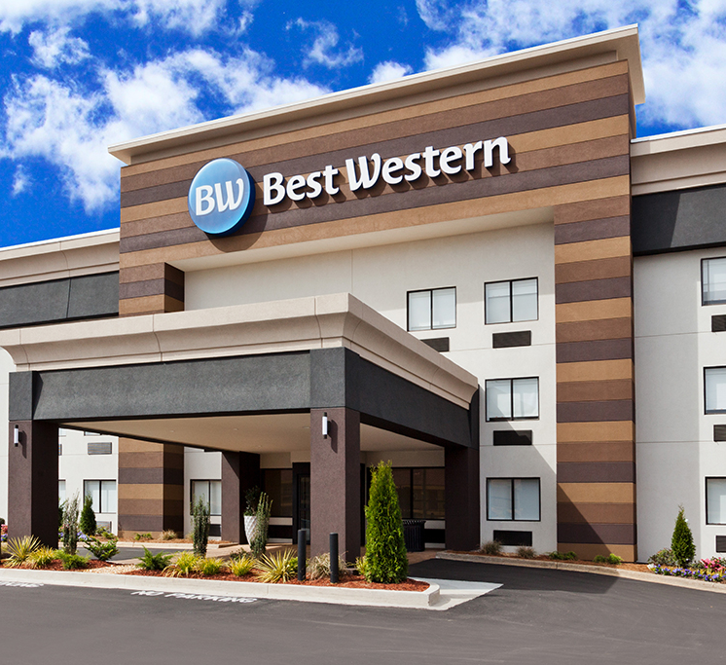
About Hotel Best Western
Best Western International, Inc. owns the Best Western Hotels Resorts brand, they give it licenses to over 4,700 hotels worldwide. The company is headquartered in Phoenix in Arizona, they have more than 2000 hotels in north America. The brand was founded by M.K. Guertin in 1946. From of May 2019, David Kong is the president and CEO of Best Western and Dorothy Dowling is the leader marketing officer. When Canadian hotel owners joined the system Best Western then expanded to Mexico, Australia, and New Zealand in 1976. Best Western International In 2002, start up Best Western Premier in Europe and Asia. The other hotels in the string were known as Best Western. In 2011, the string is branding system broad changed to a three tiered system: Best Western, Best Western Plus, and Best Western Premier. There are many marketing strategies like product service innovation, marketing investment, client experience etc. which have helped the brand grow. Marketing Mix of Best Western analyses the brand company which covers 4Ps (Product, Price, Place, Promotion) and describe the Best Western marketing strategy. Marketing strategies helps companies achieve business goals & objectives, and marketing mix 4Ps is the widely used framework to define the strategies. This article elaborates the product, pricing, advertising & distribution strategies used by Best Western. Although for Best Western brands product and price are important. Because Best Western brands have extensive advertising to attract their customers. Their customers are from all cortex of world. They to keep their customers satisfied ,they should use products with reasonable price and reasonable rooms price. They were able to attract a lot of customers from the all world with the reasonable prices of their products and the relatively low prices their rooms. And one of the Best Western policy policies is to give discount coupons to their customers. And it has been able to attract their customers.
Best Western hotel is retailers cooperative is a type of cooperative which employs economies of scale on half of its retailer members. A mind size company. All the hotels this company are all on the same level. All people can use.

Slide 5

The hotel plans after covid-19
After my research I have found out that their plans after Covid-19. They are moving towards a digital economy. The two hotels have began to do much more advertisement and offer discounts and vouchers to those who had bookings.
They have started to provide very safe and clean services towards their clients, particularly hotel Marriott as they feel the need to make sure every single one of their customers expectations are reached.

Slide 6
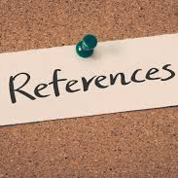
https://swotandpestleanalysis.com/swot-analysis-of-Marriott. And Best Western.
Marketing (Biythe 2006 )
Hospitality management education ( Clayten W Barrows and Robert H Bosselman 1999 )
Journal of hospitality and tourism management 2002 . https://www.bestwestern.co.uk/our-hotel-brands. https://www.marriott .co.uk ///
Integration of data mining in business intelligence systems ( Manuel Filipe Santos , Ana Azevedo 2015 ) Dictionary

Slide 7
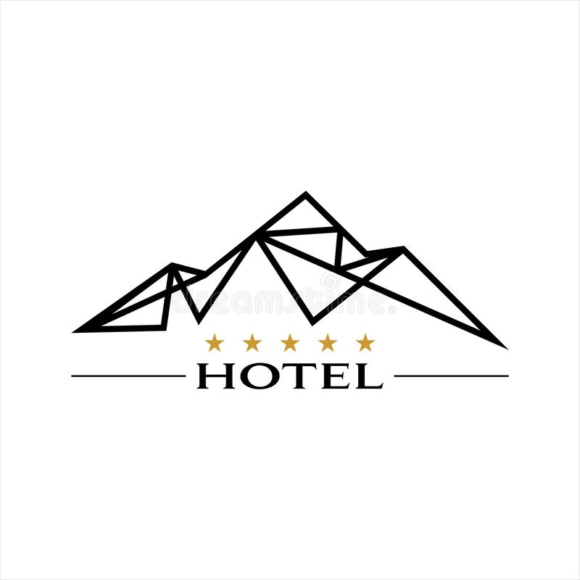
Thank you!
Name: Zhanita Bigdeloo
Student ID Number: 2019352
The module title: Marketing Essentials BMIH4005
Lecturer: Neil Dyer

