Slide 1
Assessment for Learning
Practical strategies
ECAD5008
AfL in action

Slide 2
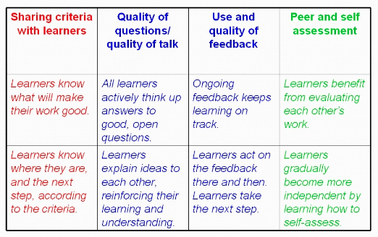

Slide 3
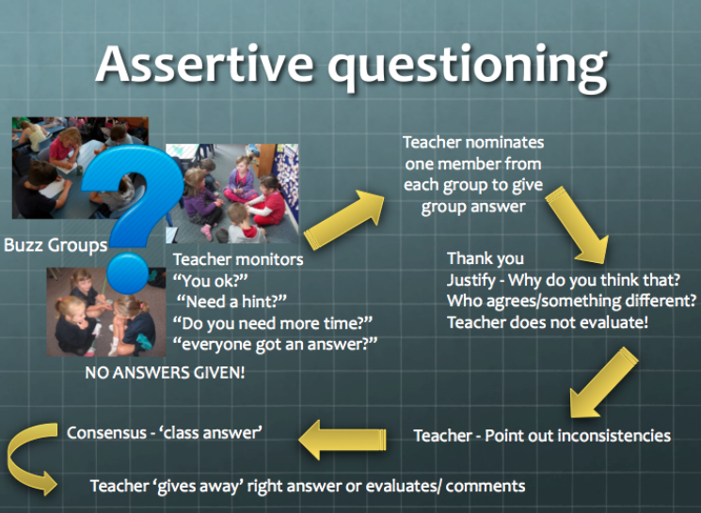
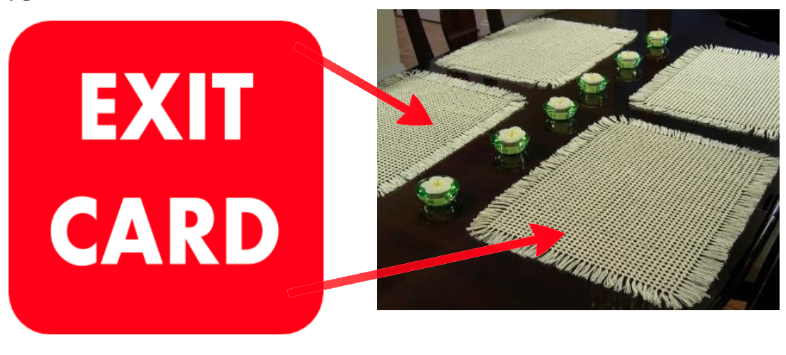
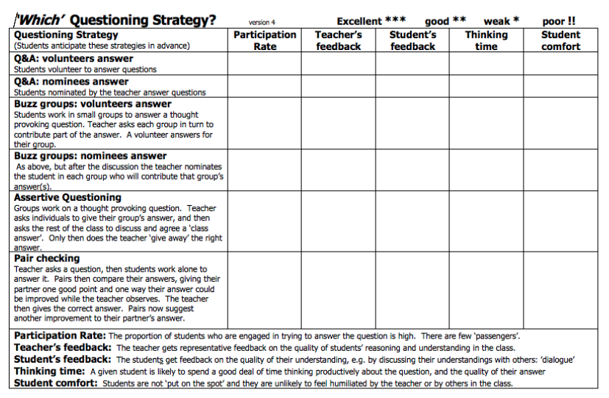

Slide 4
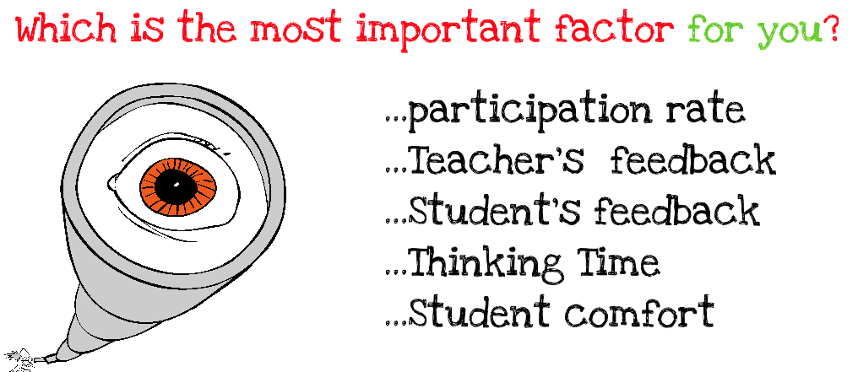

Slide 5


Slide 6

We need to get away from IRE!
Notes:
Times of transistion

Slide 7


Slide 8
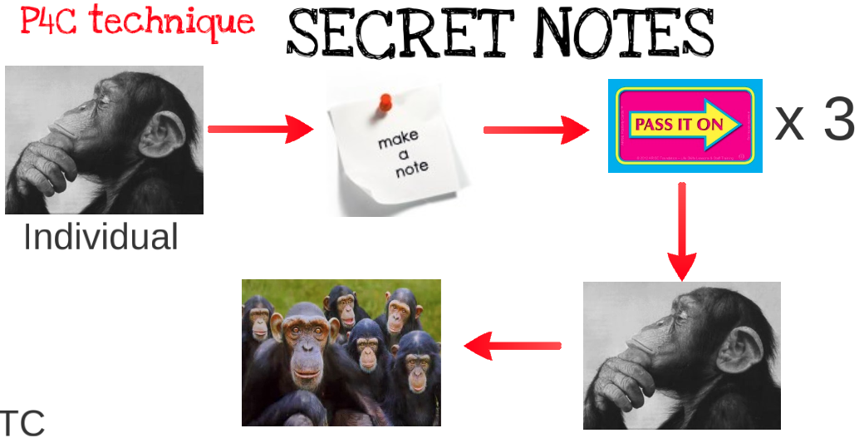


Slide 9


Slide 10


Slide 11


Slide 12
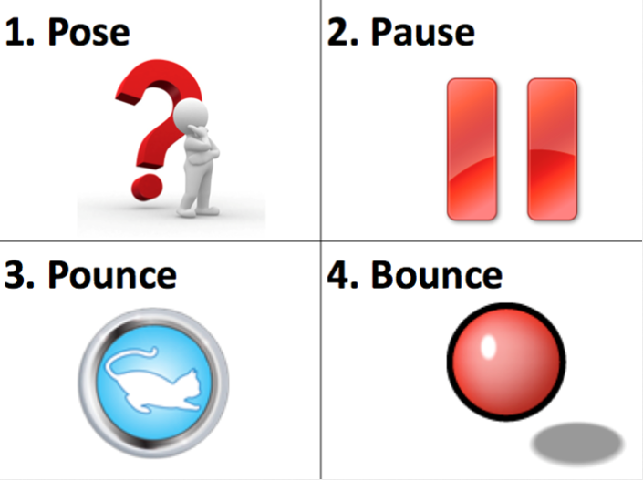

Slide 13
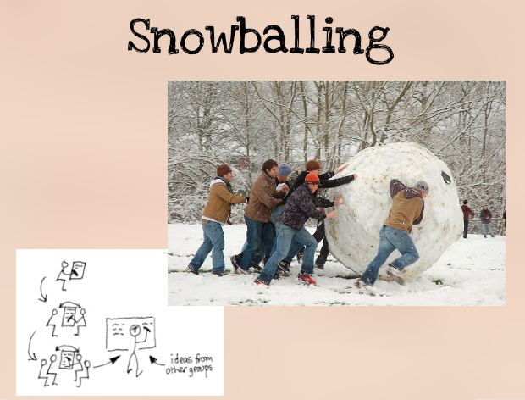

Slide 14


Slide 15


Slide 16
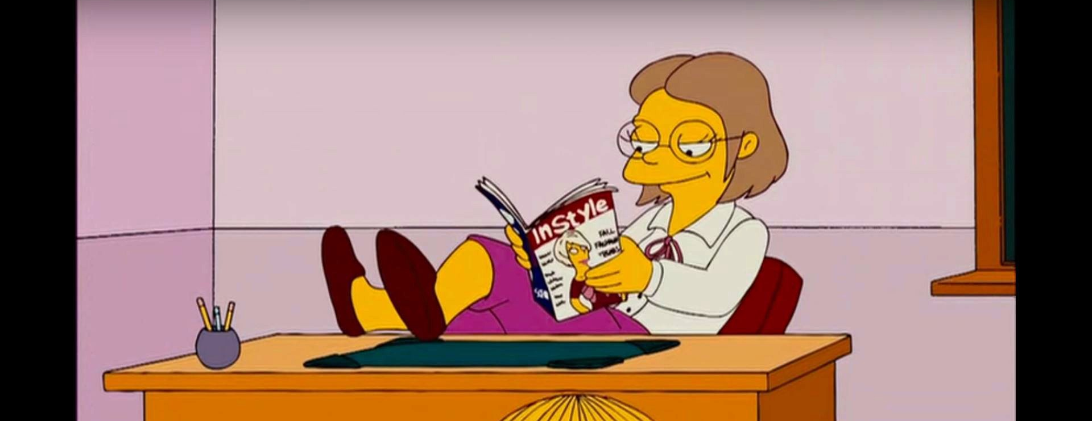
On average, how long does a teacher wait after asking a question until they elicit a response?

Slide 17
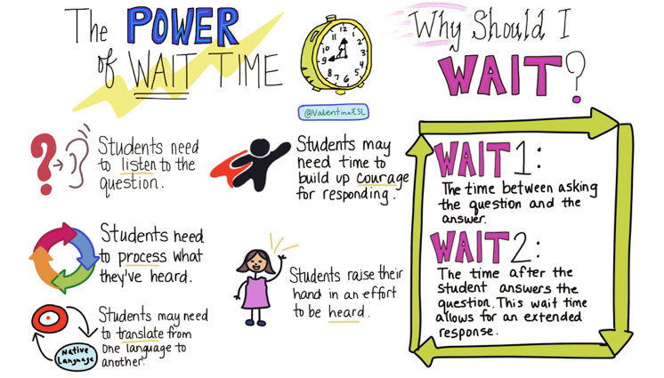
0.9 sec!

Slide 18
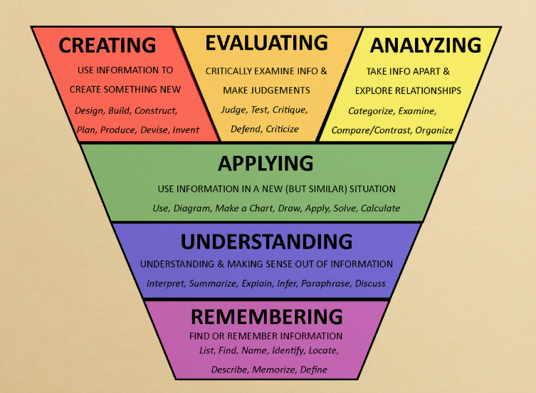

Slide 19


Slide 20
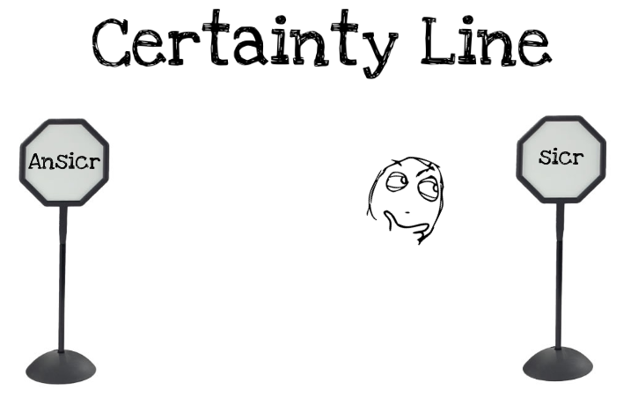

Slide 21
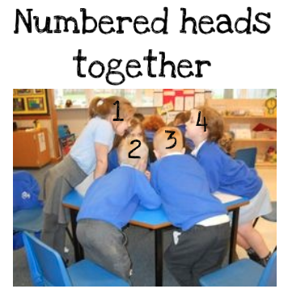

Slide 22
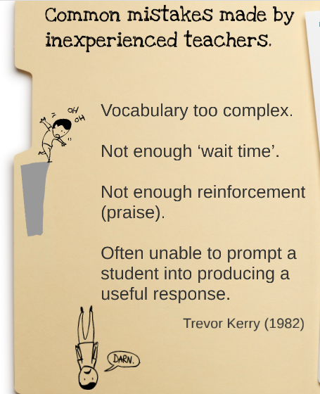


Slide 23
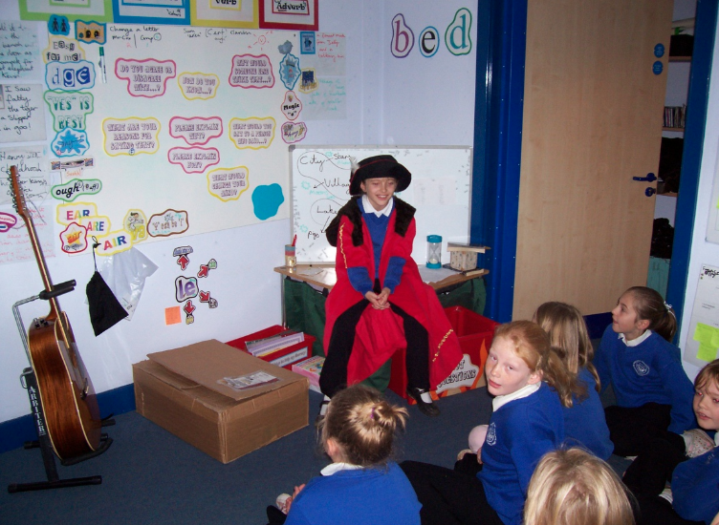

Slide 24


Slide 25
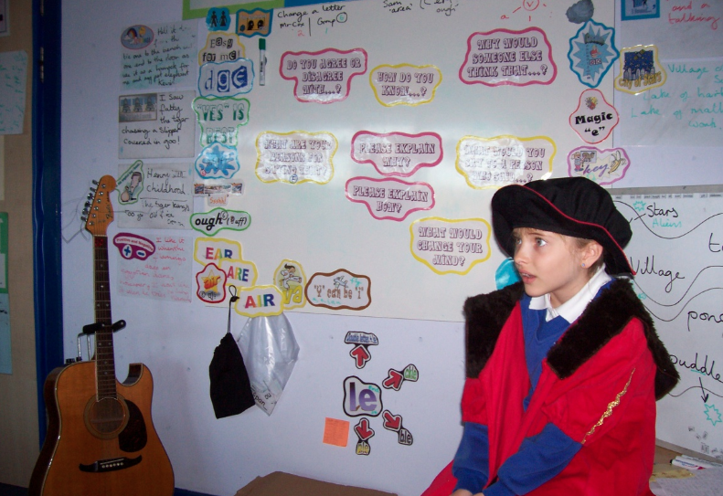

Slide 26
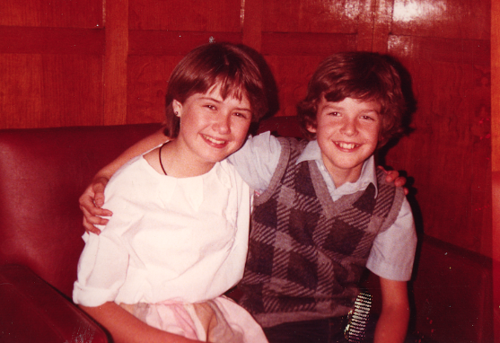

Slide 28


Slide 29
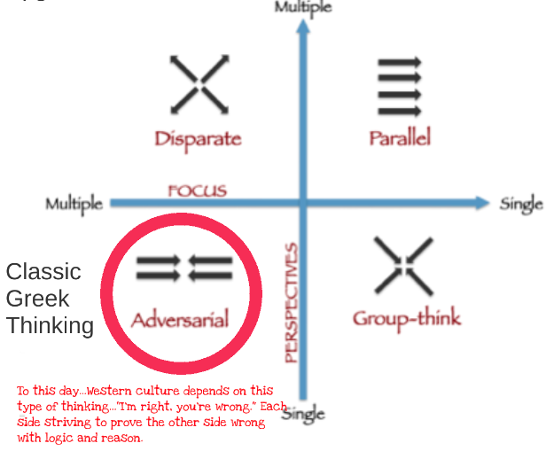

Slide 30
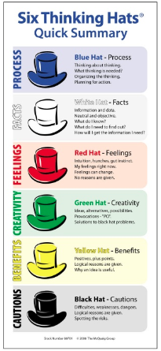
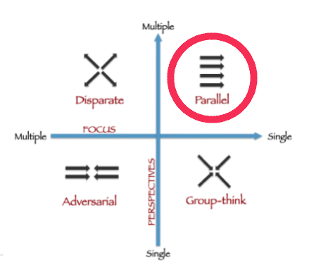

Slide 31


Slide 33


Slide 34


Slide 35


https://edpuzzle.com/assignments/603e220413932a426b488f20/watch

Slide 36
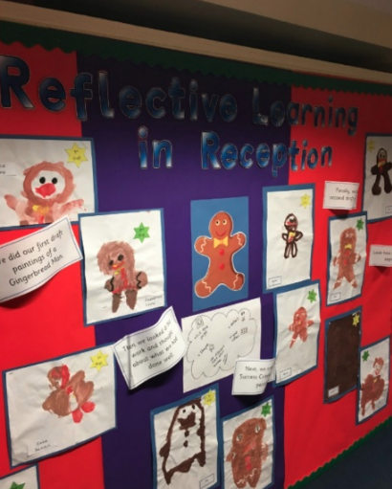

Slide 37
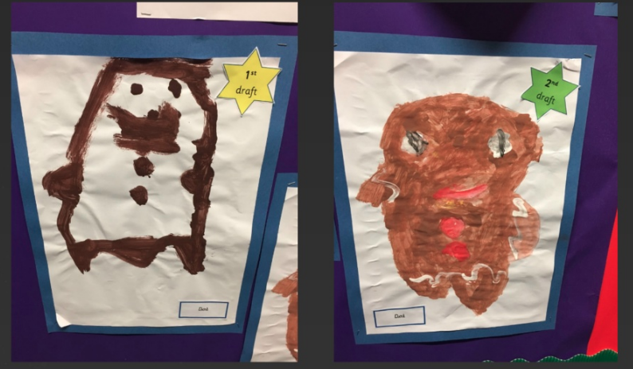

Slide 39
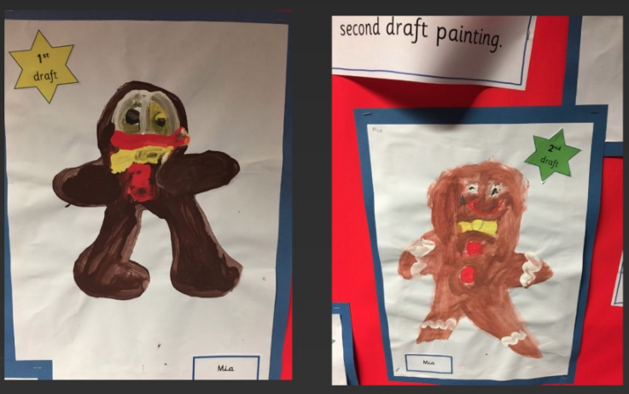

Slide 41
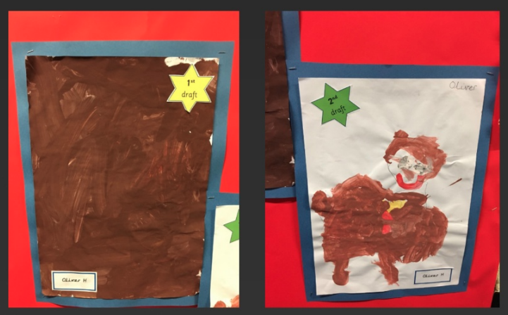

Slide 43
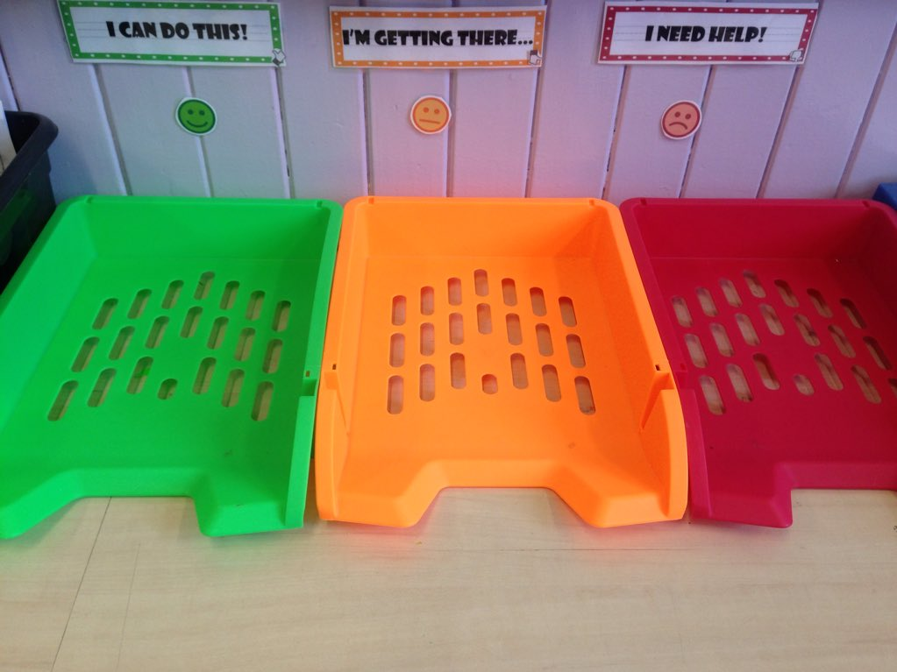



Slide 44


Slide 45


Slide 46


Slide 47


Slide 48
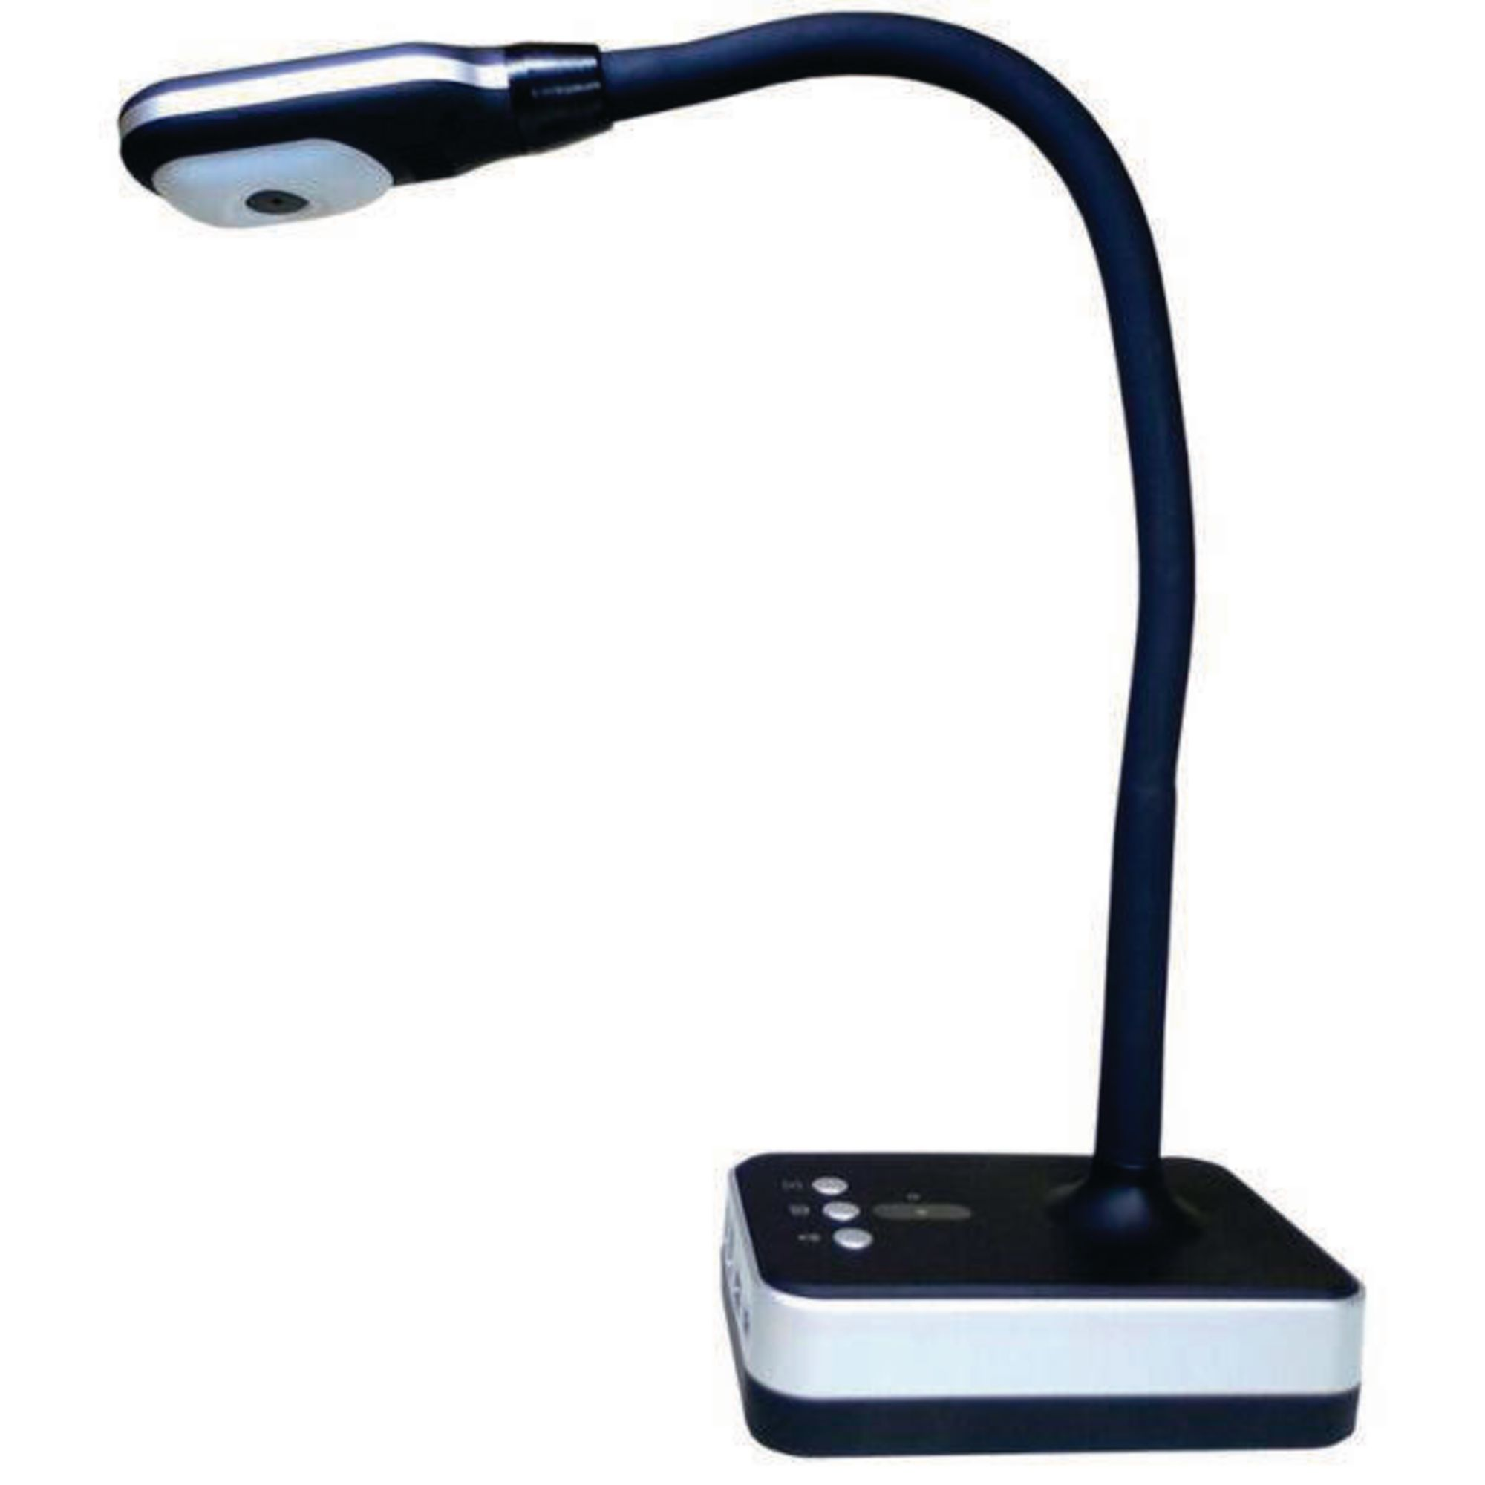

Slide 49


Slide 50
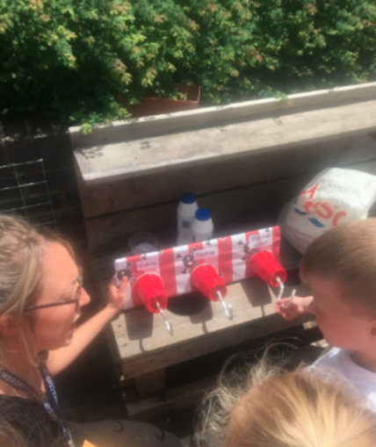

Slide 51
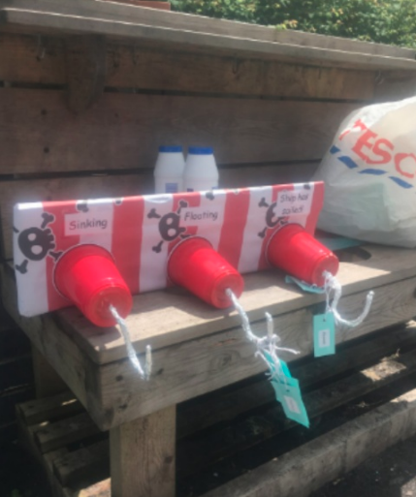

Slide 52


Slide 53
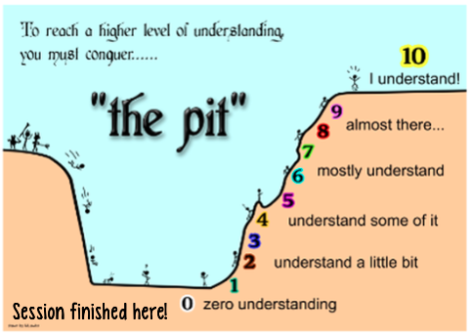

Slide 54


Slide 55



Slide 56
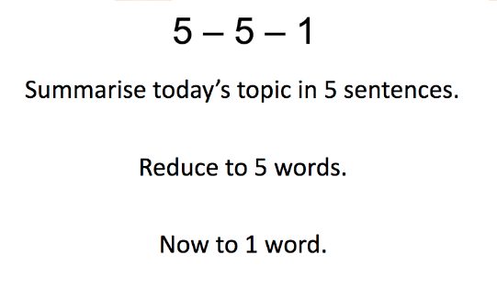

Slide 58
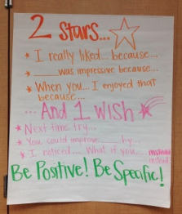

Slide 59
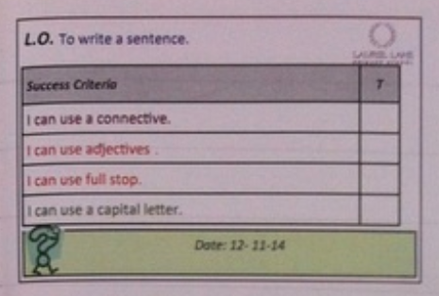
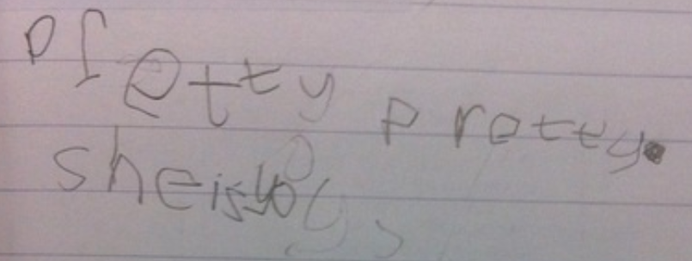

Slide 60


Slide 61
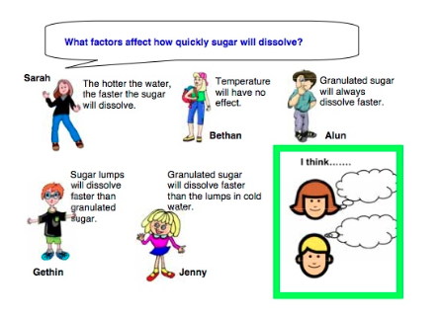

Slide 62
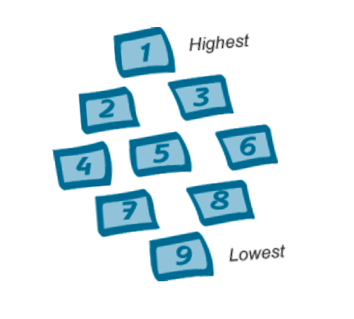

Slide 63
Assessment for Learning
Practical strategies
ECAD5008

