Slide 1
UWTSD LAMPETER
Level 5/6
Module Code: HPCL5007/HPCL5006
Chinese 7
Writing Portfolio
Coursework (作文)
STUDENT NUMBER: 1701163
STUDENT NAME: Catherine Hanna

Slide 2
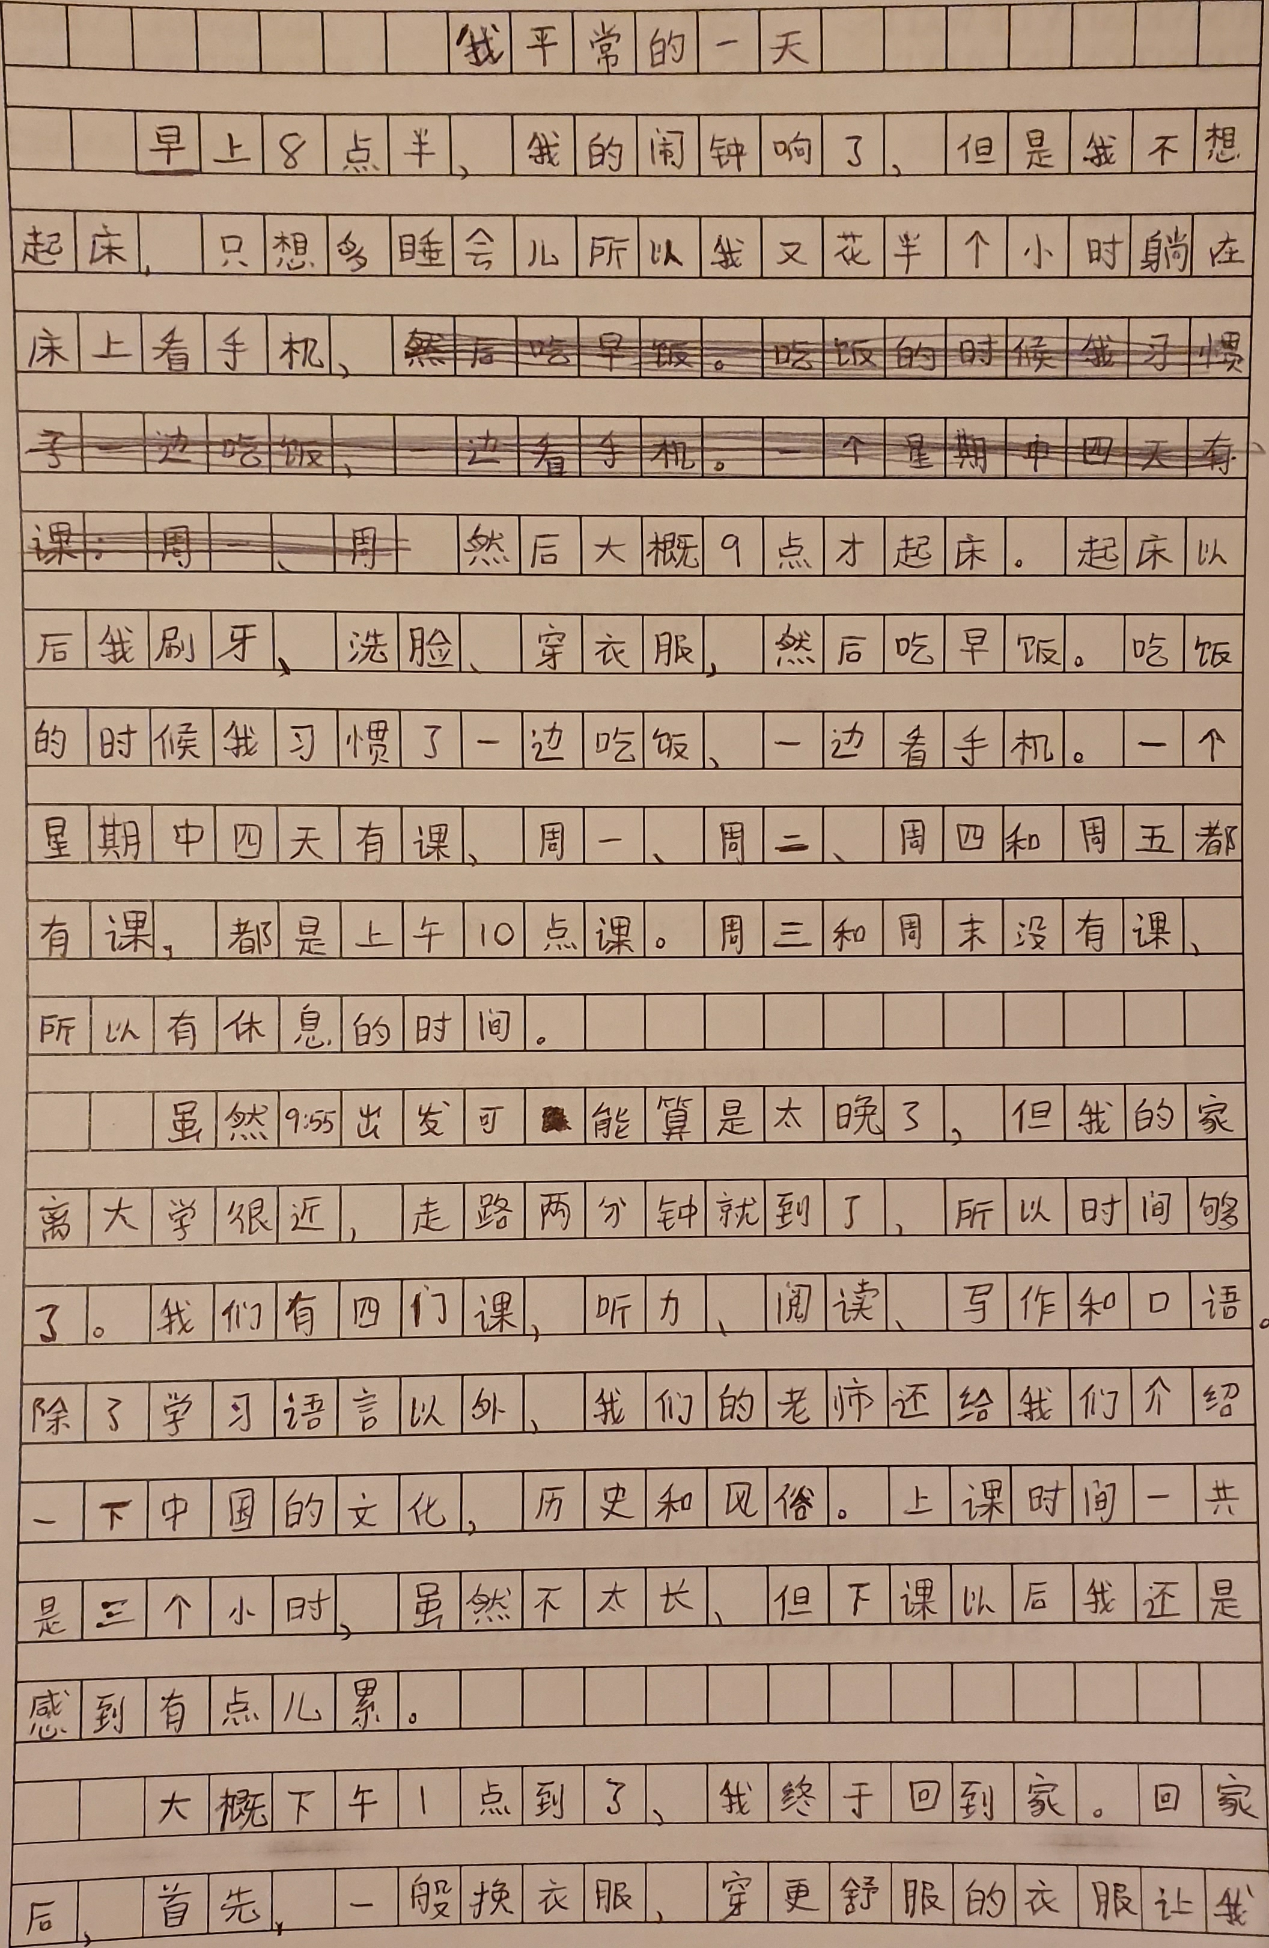

Slide 3
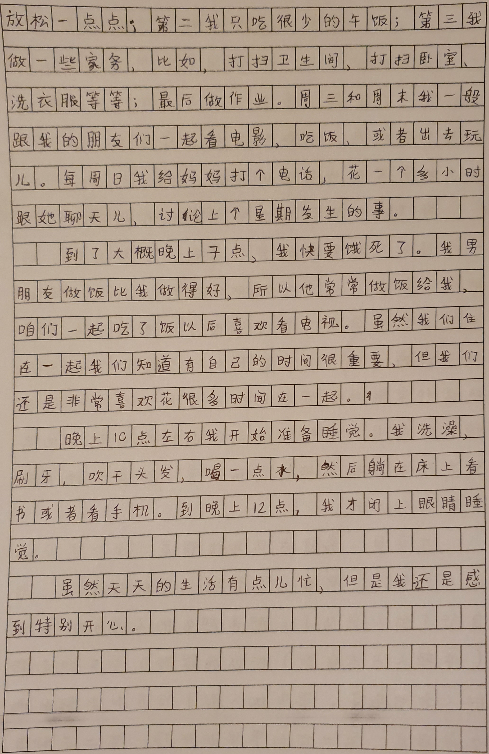

Slide 4
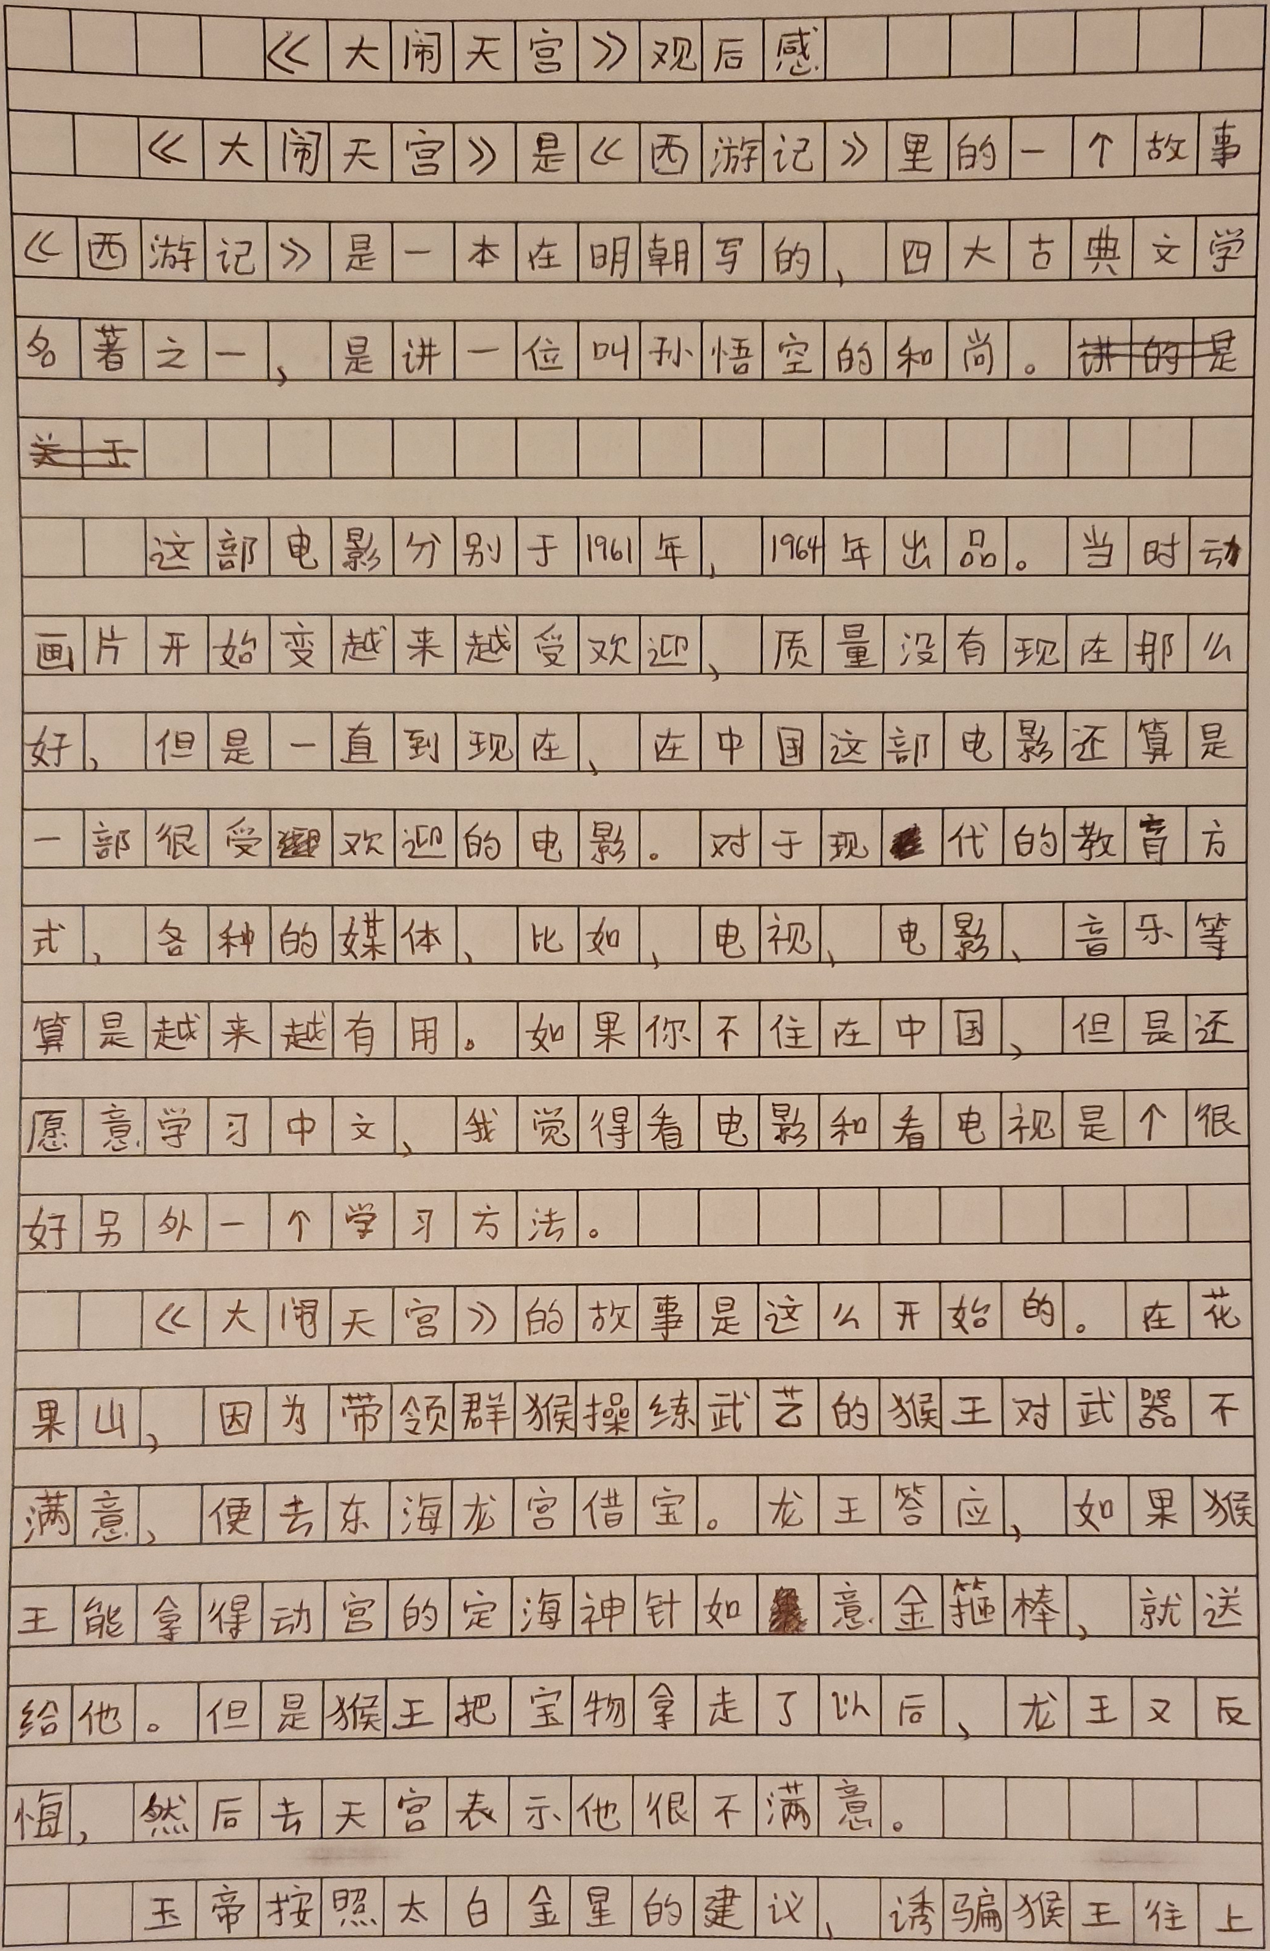

Slide 5
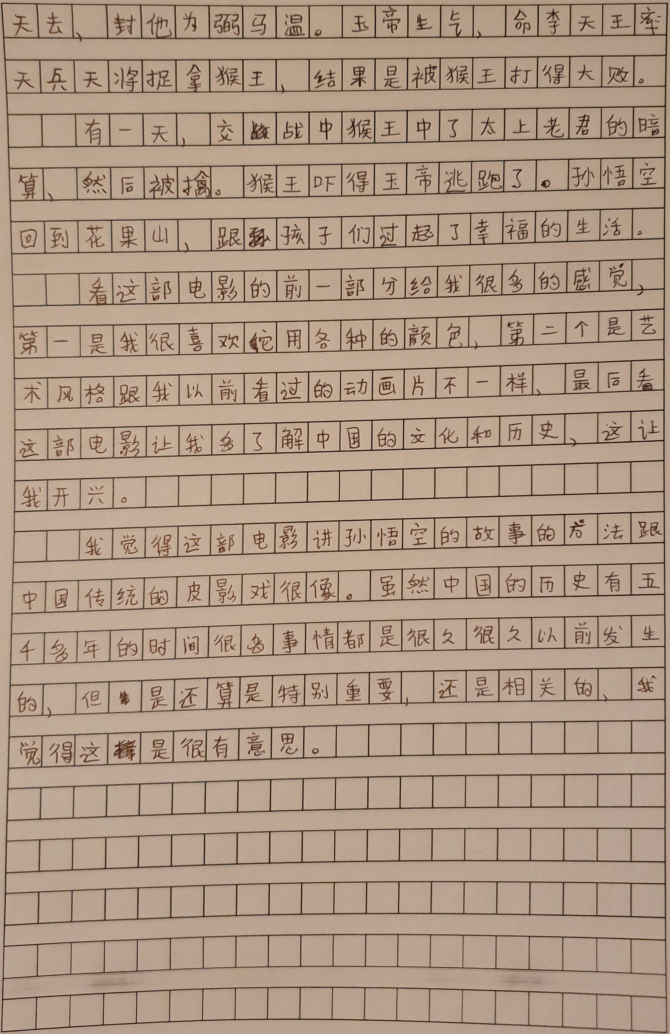

Slide 6
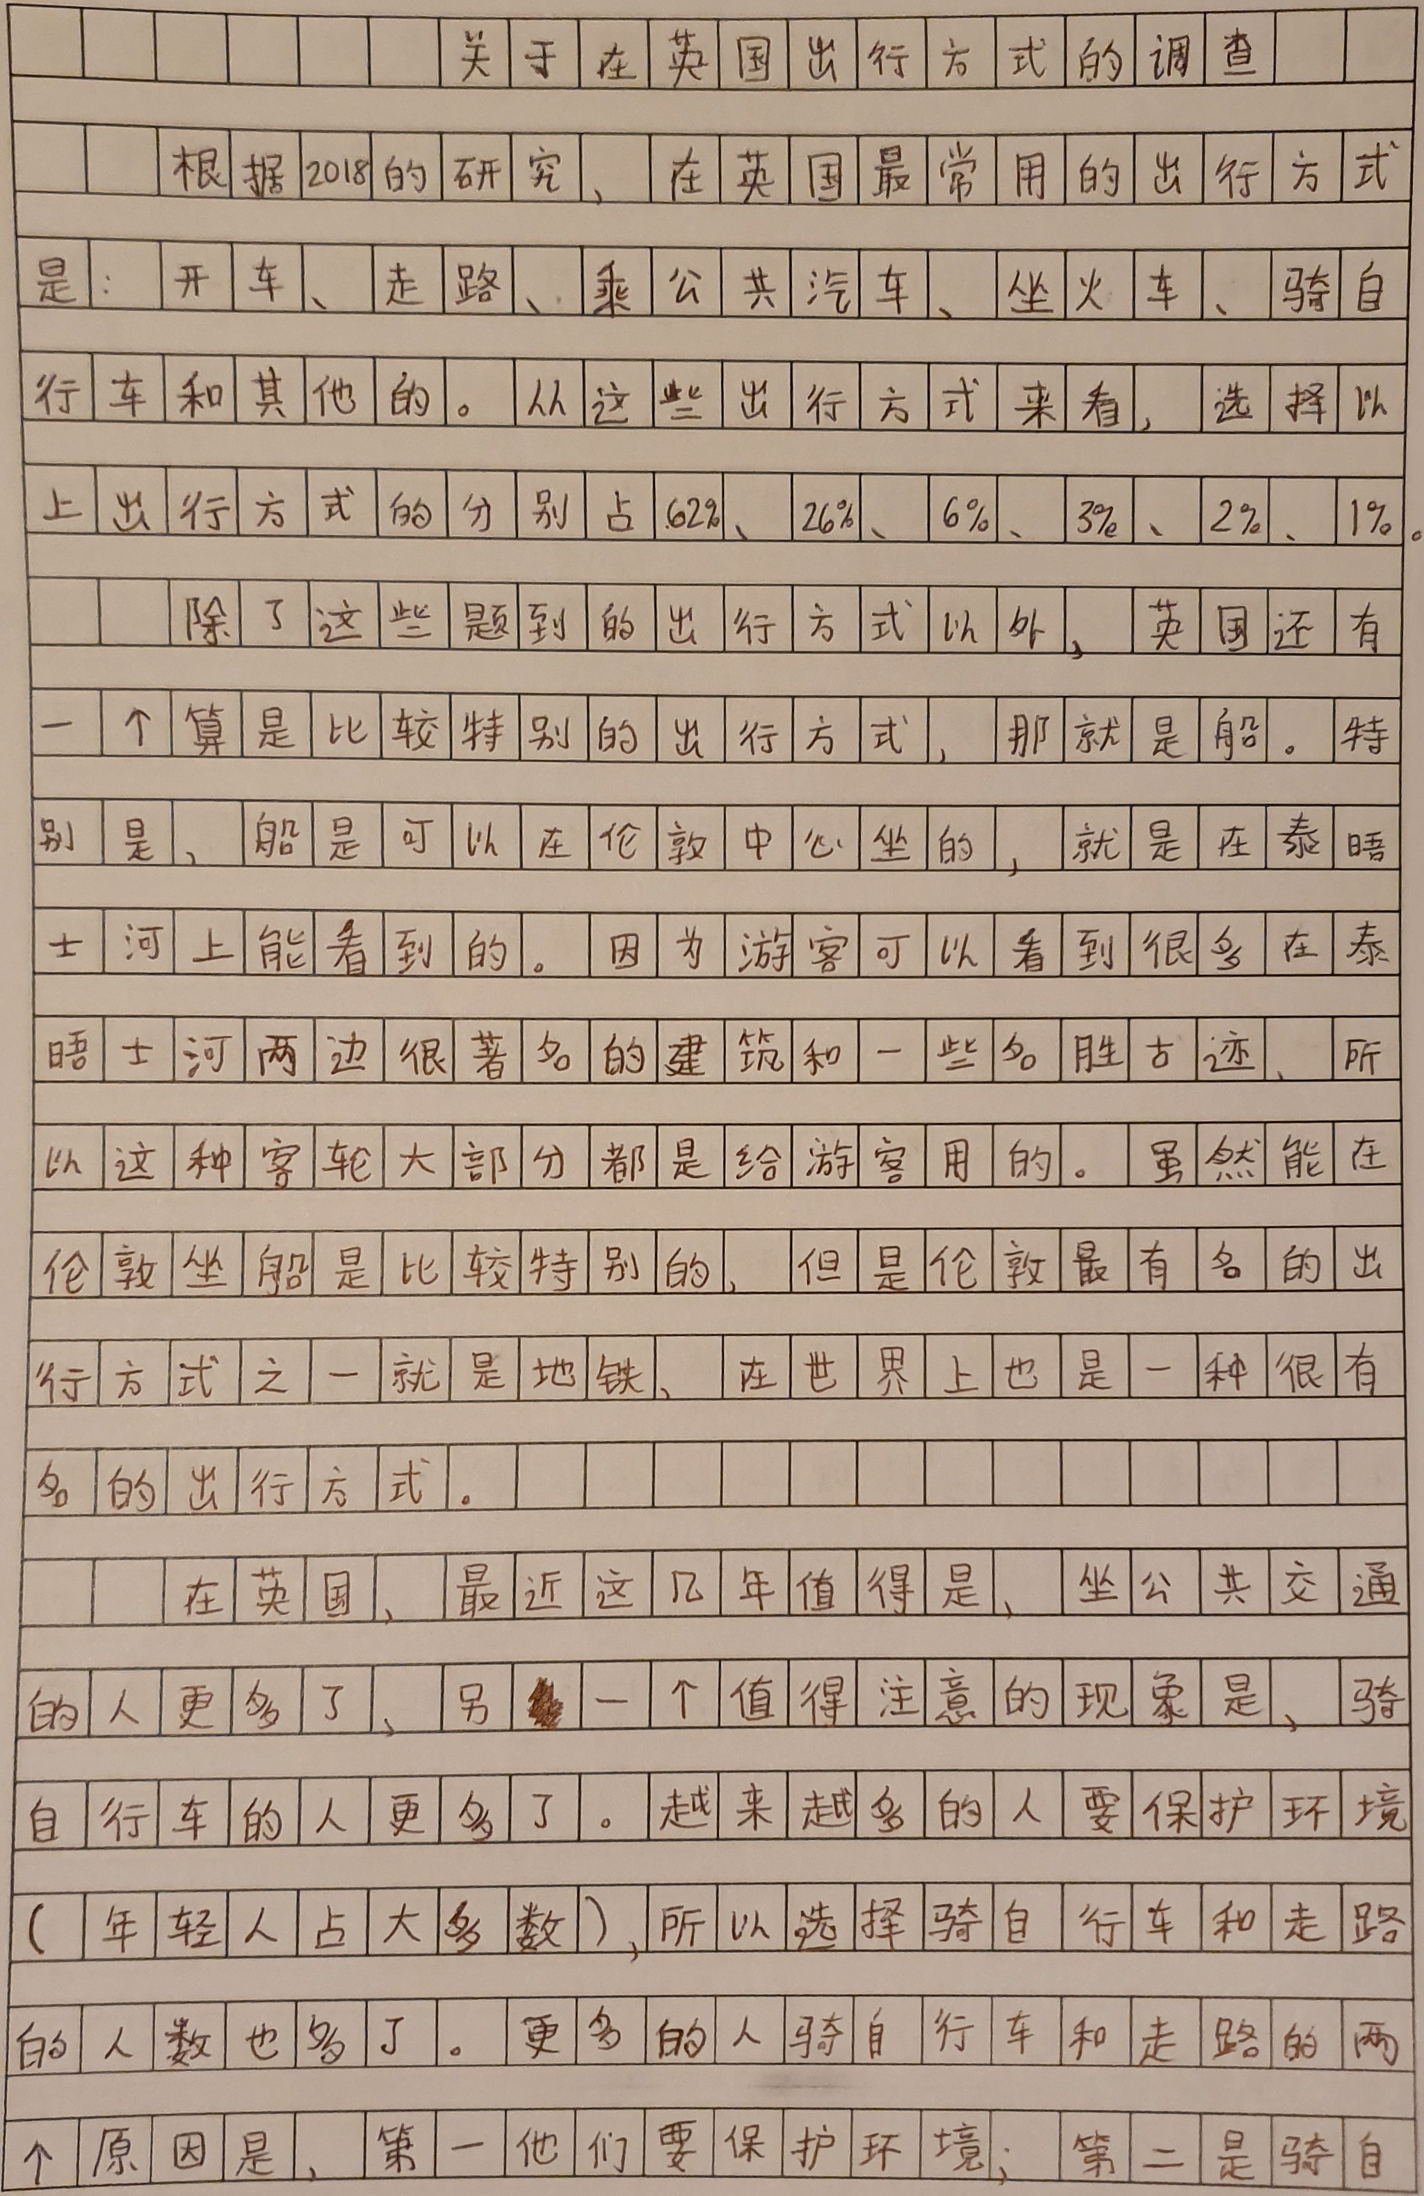

Slide 7


