Slide 1

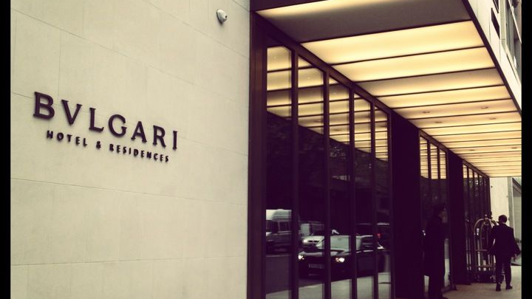
Bvulgari Hotel
Ioana mirela bumbu

Slide 2

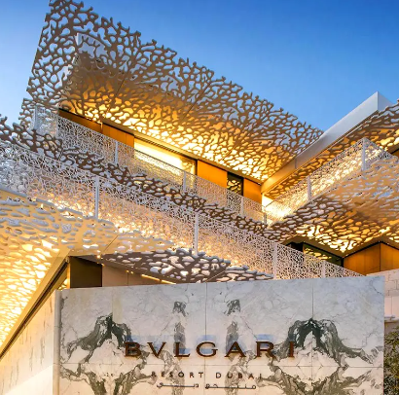
The Role And Importance Of Quality
Service, Hospitality, And Guest
Services Within The Hotel Industry
Bvlgari Hotel & Resorts

Slide 3
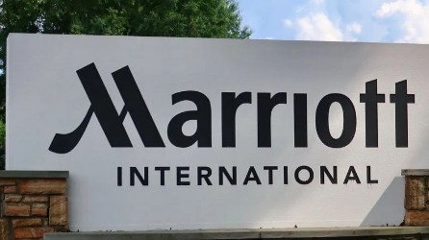
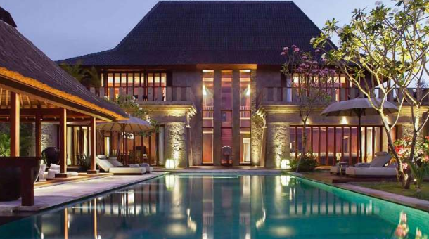
Introduction
Bvlgari hotel & resorts is the chosen hotel company for the presentation.
The hotel is owned by Marriott International.
Marriott international is an american multinational company that has a total of 31 brands around 138 countries (marriott international, 2023).
The aim of the presentation is to discuss the role and importance of quality services, hospitality and guest services in bvlgari hotel & resorts.
Source: marriott international, 2023
Source: Bvlgari Hotel & Resorts, 2023
Notes:
Bvlgari Hotel & Resorts is the chosen hotel company for the presentation. The hotel is owned by Marriott International. The presentation mainly aims to discuss the importance of quality services and guest services within the selected hotel that is Bvlgari Hotel & Resorts. The hotel brand is owned by an American company Marriott International.

Slide 4

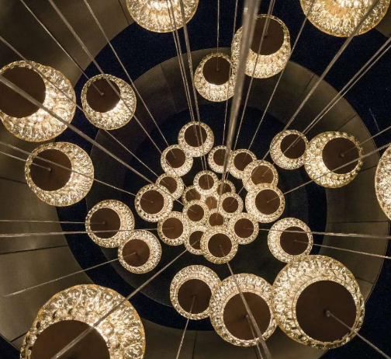
Executive Summary
The presentation focuses on highlighting the role and importance of the chosen hotel brand.
The presentation outlined the nature, scope, and importance of guest services in the hotel brand.s
The hotel offers luxury spas and top-class restaurant services.
The hotel mainly target business class society.
Notes:
The brand selected for the presentation is associated with Marriott International. Bvlgari Hotels & Resorts are the main consideration of this presentation. The presentation discussed the importance of hospitality and determined how the hotel meets guest expectations.

Slide 5
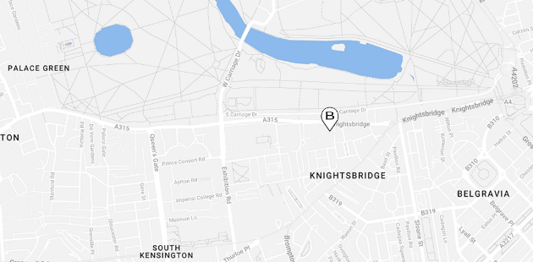
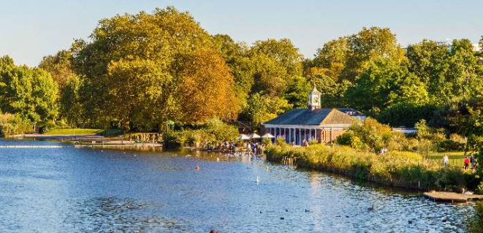
Main Body
Bvlgari Hotels & Resorts, owned by Marriott International, in popular as a luxury collection founded in the year 2004 (Bvlgari Hotel & Resorts, 2023).
Bvlgari Hotel & Resorts is situated in Knightsbridge at the edge of Hyde Park (Bvlgari Hotel London, 2023).
The hotel offers high-standard and individual tailored services to guests, like; a full gymnasium, exclusive spas etc (Amatulli et al., 2017).
Source: Bvlgari Hotel & Resorts, 2023
Source: Bvlgari Hotel & Resorts, 2023
Notes:
Bvlgari Hotel & Resorts is designed with elegant modern architecture along with legendary flair that is perfectly matched for high-class and elite customers. Bvlgari London Hotel is reachable for everything London offers, including; attractive sites such as Buckingham Palace, Big Ben the galleries, London Eye, and many more.

Slide 6
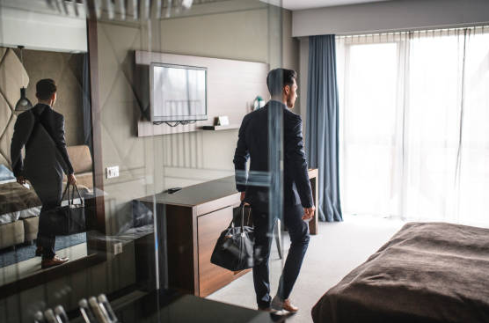
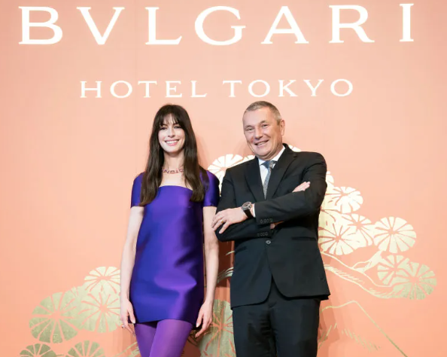
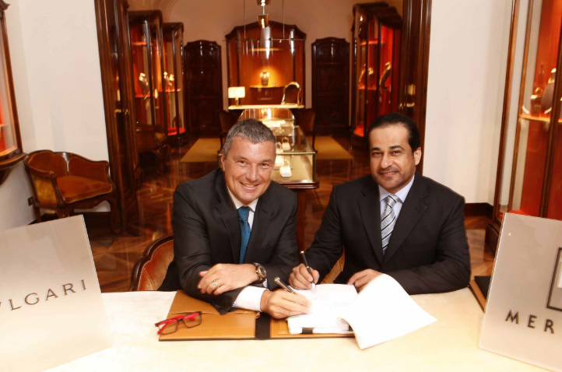
The main consumers of Bvlgari Hotel & Resorts are;
Corporate executives
Celebrities
Business tycoons (Bvlgari Hotel London, 2023)
Tourists
(Source: Bvlgari Hotel London, 2023)
(Source: Bvlgari Hotel London, 2023)
(Source: Bvlgari Hotel London, 2023)
Notes:
Being a luxury hotel, Bvlgari targets upper-class society. The main target consumers of Bulgari Hotel are celebrities, corporate executives, tourists and business tycoons (Bvlgari Hotel London, 2023).

Slide 7
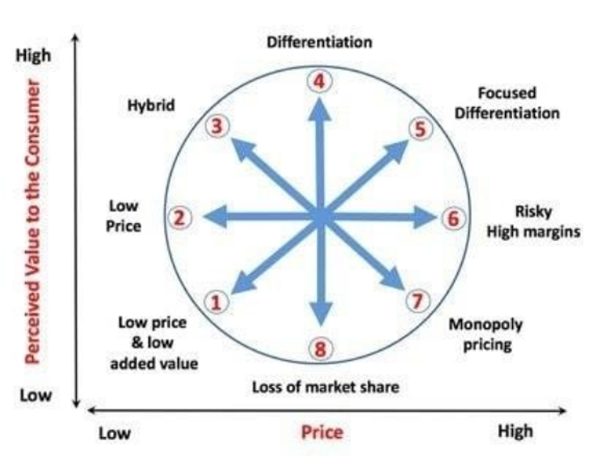
Notes:
Number 5-6

Slide 8
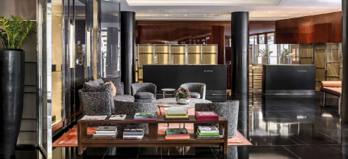
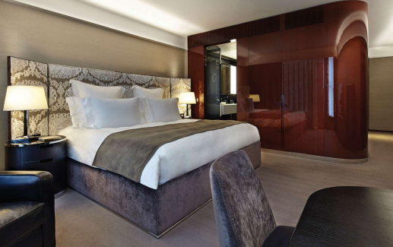
Bvlgari Hotel & Resorts facilitates customers with its flawless services like;
Dining
A warm welcome from the arrival of guests to the valet parking (George, 2021).
Exclusive spa treatments
Discrete security (Bvlgari Hotel London, 2023 d)
Expert concierge with cultural and social knowledge of London
Exclusive restaurants
Events
Exhibitions
(Source: Bvlgari Hotel London, 2023 d)
Notes:
The Bulgari Hotel & Resorts is a luxury place that offers proportioned rooms and exclusive suits that are combined with unrivalled facilities. The brand facilitates customers with the knowledge of London culture and society (Bvlgari Hotel London, 2023 d).

Slide 9
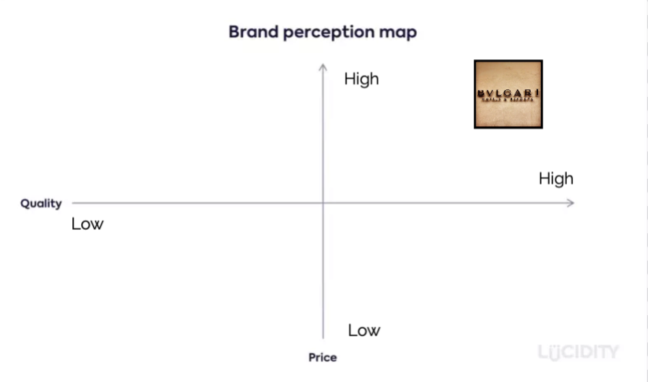
Perception map

Slide 10

Rooms and suites: 160 to 220 square meters Bvlgari Suites, 85 light-filled suites, furnished with exquisite marbles, fine quality wood, along with Sapele Mahogany wood panels (Bloomberg, 2023).
Private Cinema: 47-seat cinema along with screening room, HD vision and sound, 300 classic films and news, 4K resolution in the 3D lobby (Bvlgari Hotel London, 2023 b).
(Source: Bvlgari Hotel London, 2023 b)
(Source: Bvlgari Hotel London, 2023 b)
Notes:
The Ballroom: Design with the latest classy technology and lighting, specialized Bose loudspeaker, high-speed WiFi, ambient music system, ceiling lined with white gold mosaic, glass and mirrors, 150 guests for lunch and dinner as well as 280 guests for a reception (Bvlgari Hotel London, 2023).

Slide 11
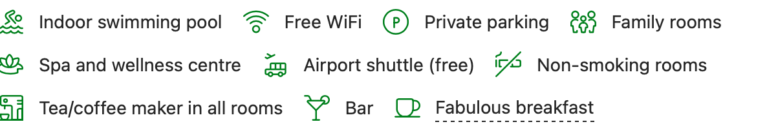
(Source: Booking,2023)

Slide 12
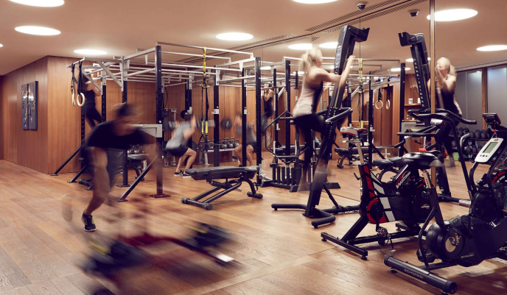
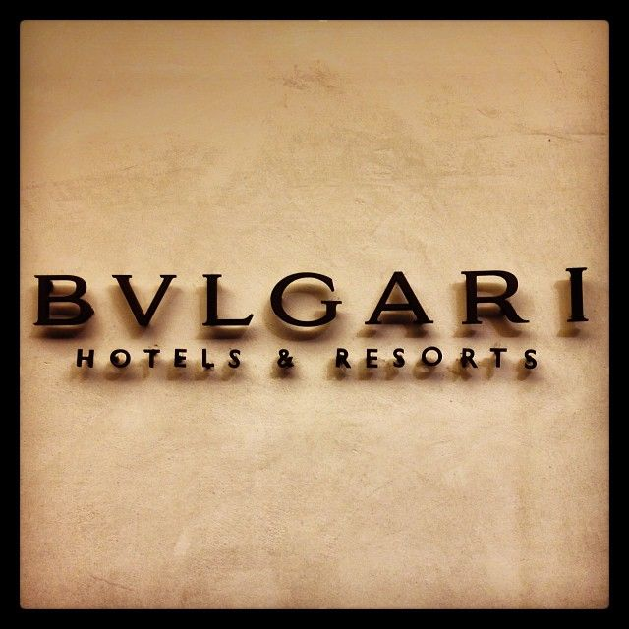
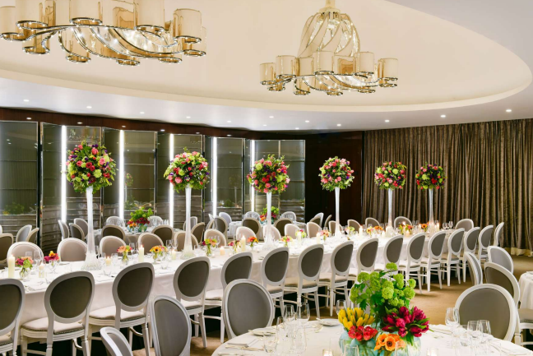
The Ballroom: Design with the latest classy technology and lighting, specialized Bose loudspeaker, high-speed WiFi (Annual Report, 2022).
The services and facilities for guests include
Elite room and suits
A ballroom
Gymnasium and physical training centre (Bvlgari Hotel London, 2023 b).
(Source: Bvlgari Hotel London, 2023)
(Source: Bvlgari Hotel London, 2023)
Notes:
The services and facilities for guests include an elite room and suits, a ballroom, gymnasium and physical training centre, fitness rooms, screening rooms, a cigar shop and sampling room, private cinema and a stunning ballroom (Bvlgari Hotel London, 2023 b). In Bvlgari, the staff is highly trained to ensure flawless services that include luxurious, exceptional, and discrete services.

Slide 13
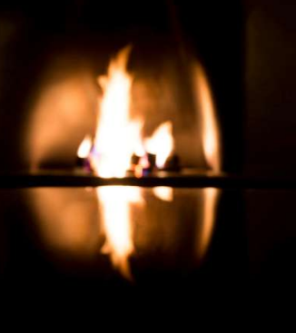
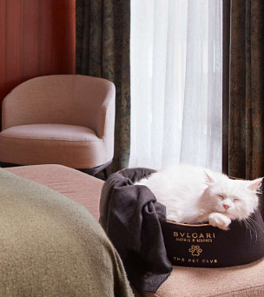
To facilitate guests, the hotel specifically focuses on different services like;
The Sunday reset experience
Half price rooms for family
A gem of a weekend
A Bvlgari gem
Destination Knightsbridge
London charm, Italian style.
Pet services
(Source: Bvlgari Hotel London, 2023)
Notes:
To attract guests, Bvlgari pet club makers launch attractive pet amenities includes; blankets, beds, tents, bowls, dog brush, carriers, and water bottles.

Slide 14
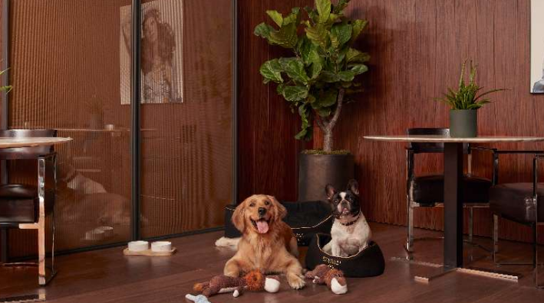
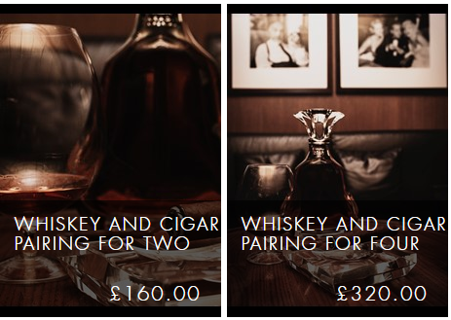
To attract pet lovers, the Bulgari Pet Club offer special services for pets along with all the necessities and accessories (Bvlgari Hotel London, 2023 h).
For business tycoons, the hotel offers exclusive discounts and gifts such as
Whiskey and Cigar pairs in the private lounge
Luxury Spa Day
The Diamond Experience and Cellular High-tech Exclusive Lifting (Bvlgari Hotel London, 2023 f).
(Source: Bvlgari Hotel London, 2023 h)
(Source: Bvlgari Hotel London, 2023 h)
Notes:
Bvlgari Hotel & Restaurants focus on offering guests a warm welcome and kind services. To meet guest expectations, the hotel give different gift and discounts to customers in the area, including; Bulgari Spa, Bulgari Dining, and Bulgari Cigar Lounge (Bvlgari Hotel London, 2023 g).
For business tycoons, the hotel offers exclusive discounts and gifts such as Whiskey and Cigar pairs in the private lounge, Luxury Spa Day, The Diamond Experience and Cellular High-tech Exclusive Lifting (Bvlgari Hotel London, 2023 f).

Slide 15
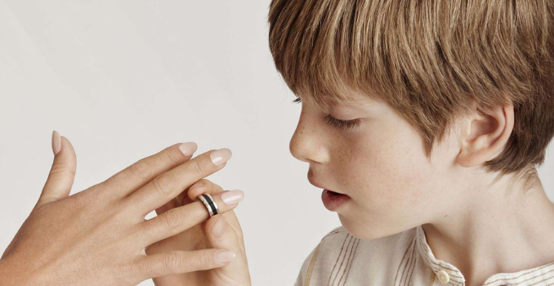
Bvlgari Hotel & Restaurants focus on offering guests a warm welcome and kind services. The hotel works on the My Wish for You Campaign, which mainly aims to save children and fulfil their dreams and hopes (Bvlgari Hotel London, 2023 i).
(Source: Bvlgari Hotel London, 2023 i)
Notes:
The hotel works on the My Wish for You Campaign, which mainly aims to save children and fulfil their dreams and hopes (Bvlgari Hotel London, 2023 i).

Slide 16
A Good relation with the customer
Factors to measure the level of customer service
Intimacy(intensity of the interaction)
Duration of time spent with the customer
Quick service restaurant or retail employee simply takes the customer's order and packages the product, so the employee's relationship with the customer is limited. However, a physician or a luxury hotel operator must know every detail about the client to provide the expected level of service; consequently, these interactions involve a high level of intimacy with the customer.
The customer spends a few minutes with the rapid service restaurant or retail employee, while she or he spends approximately thirty minutes with a physician or tax accountant, hours in an aeroplane or full-service restaurant, and possibly days in a luxury hotel.
(Sources: Tesone,2010)

Slide 17
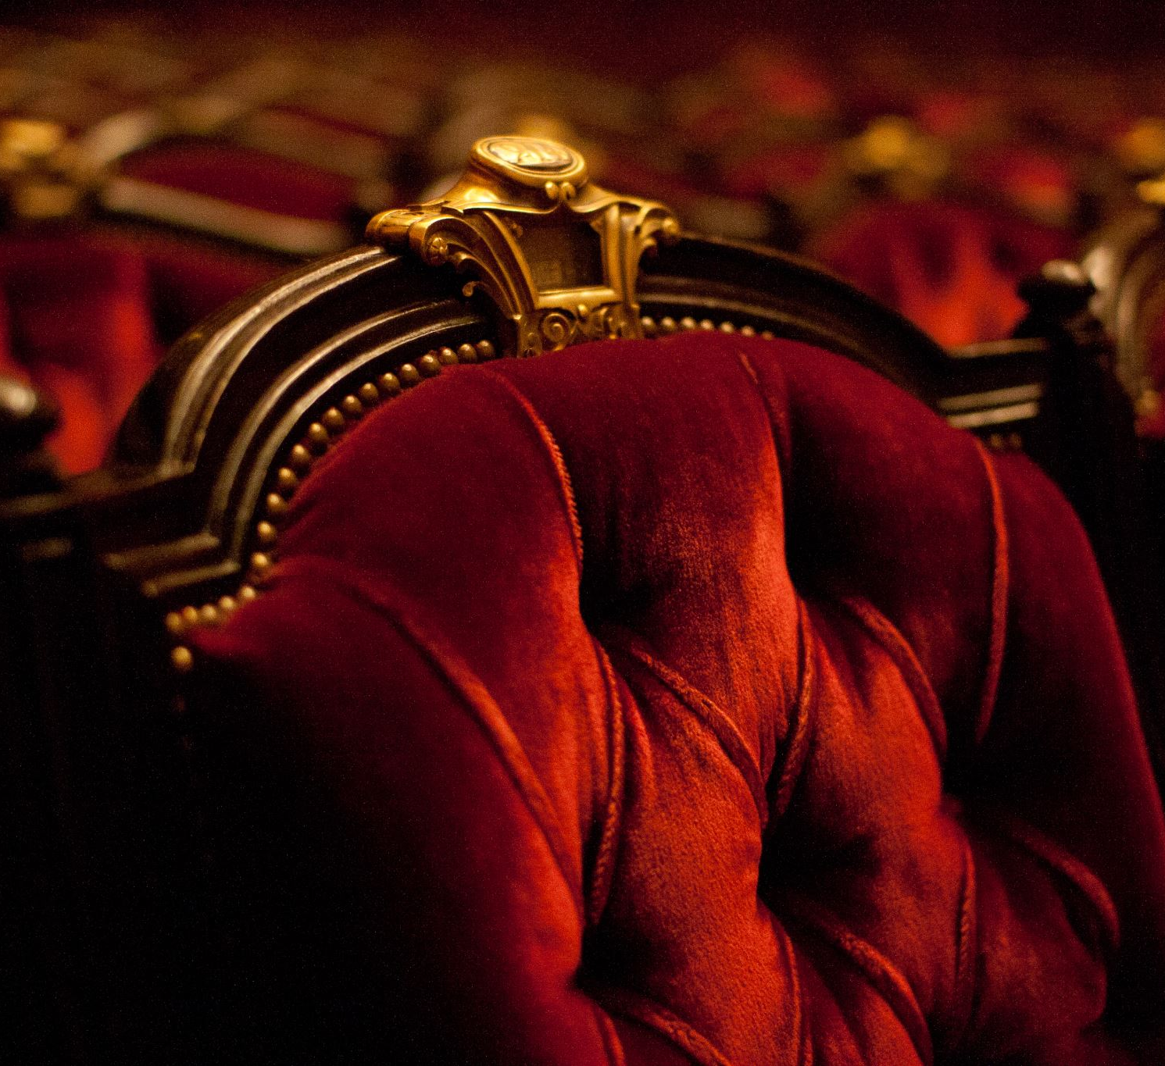
Conclusion
The presentation discussed the role and importance of quality services at Bvlgari Hotel & Resorts.
Bvlgari is in the category of 5-star hotels.
The hotel is located in the calm and attractive location of the city of London.
Since 2012, Bvlgari set new standards for the luxury hotel industry in the UK.
Notes:
The presentation discussed the role and importance of quality services at Bvlgari Hotel & Resorts. Bvlgari is in the category of 5-star hotels. The hotel is located in the calm and attractive location of the city of London. Since 2012, Bvlgari set new standards for the luxury hotel industry in the UK.

Slide 18
Thank You
Ioana Bumbu

Slide 19

References
Amatulli, C., De Angelis, M., Costabile, M. and Guido, G., 2017. Sustainable luxury brands: Evidence from research and implications for managers. Springer.
Annual Report, 2022. Bvlgai-Celebrating 125 years. [Online] Available at https://files.investis.com/bulgarigroup/anintrep/ar2009.pdf [Accessed on20th May 2023].
Booking.com, 2023 Bulgari hotel London [online] available at <
https://www.booking.com/hotel/gb/bulgari-hotels.en-gb.html > [Accessed on 20th May 2023]
Bloomberg, 2023, Bulgari Hotels & Resorts BV. [Online] Available at < https://www.bloomberg.com/profile/company/0307842D:NA#xj4y7vzkg> [Accessed on 20th May 2023].
Bvlgari Hotel & Resorts, 2023. About us. [Online] Available at < https://www.bulgarihotels.com/en_US/london> [Accessed on 19th May 2023].
Bvlgari Hotel London, 2023 a. What’s on? [Online] Available at https://www.bulgarihotels.com/en_US/london/whats-on [Accessed on 19th May 2023].
Bvlgari Hotel London, 2023 b. Explore the hotel. [Online] Available at https://www.bulgarihotels.com/dam/jcr:0c01b395-57ce-4a33-b45b-dd6d4b03b511/BvlgariHotelLondonBrochure-2022.pdf [Accessed on 19th May 2023].
Bvlgari Hotel London, 2023 c. The Bulgari Spa. [Online] Available at https://www.bulgarihotels.com/en_US/london/spa-and-fitness/the-bulgari-spa [Accessed on 19th May 2023].

Slide 20
Bvlgari Hotel London, 2023 e. Ballroom. [Online] Available at https://www.bulgarihotels.com/en_US/london/meetings-and-events/ballroom [Accessed on 19th May 2023].
Bvlgari Hotel London, 2023 f. Gifts for Her. [Online] Available at https://bulgarihotellondon.giftvouchers.uk.com/tags/gifts-for-her/ [Accessed on 19th May 2023].
Bvlgari Hotel London, 2023 g. Edward Sahakian Cigar Lounge. [Online] Available at https://bulgarihotellondon.giftvouchers.uk.com/edward-sahakian-cigar-lounge/ [Accessed on 19th May 2023].
Bvlgari Hotel London, 2023 h. The Bulgari Pet Club Makes It Easy To Travel Together. [Online] https://www.bulgarihotels.com/en_US/london/whats-on/article/london/at-the-hotel/The-Bulgari-Pet-club-makes-it-easy-to-travel-together [Accessed on 19th May 2023].
Bvlgari Hotel London, 2023 i. Bulgari And Save The Children Unveil New "My Wish For You" Campaign. [Online] https://www.bulgarihotels.com/en_US/london/whats-on/article/london/at-the-hotel/Bulgari-and-Save-the-Children-Unveil-New--My-Wish-for-You--Campaign [Accessed on 19th May 2023].
Bvlgari Hotel London, 2023. Overview of the hotel. [Online] Available at < https://www.bulgarihotels.com/en_US/london/the-hotel/overview> [Accessed on 19th May 2023].
George, R., 2021. Tourism and Hospitality Products, Branding, and Pricing. In Marketing Tourism and Hospitality: Concepts and Cases (pp. 249-283).
Marriott International, 2023. About us. [Online] Available at < https://news.marriott.com/> [Accessed on 19th May 2023].
Tesone,V., 2014 Principles of Management for the Hospitality Industry,APA 7th Edition (American Psychological Assoc.) Butterworth Heineman, Oxford

