Slide 1
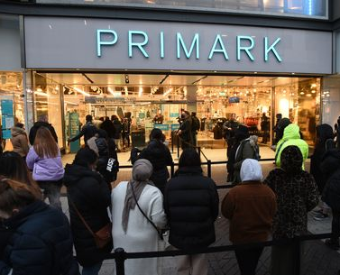
Primark Click & Collect
By: Mona Hussien
Student number: 2211516
Tutor: Marie Pitson
Notes:
NOTE:
To change the image on this slide, select the picture and delete it. Then click the Pictures icon in the placeholder to insert your own image.

Slide 2
Introduction
What is change?
Primark Stores Limited: The lates fashion items at modest Prices
Recent changes on Primark Stores Strategies
Click& Collect : a trial in move into online Sales
Morgan and Brightman (2001)
Primark.com(2022)
(corporate.primark.com, n.d.)
,Primark.com(2022)
(Primark boss tells BBC why it is finally going online, n.d.)

Slide 3
Case Study
Click & Collect: Transformational planned change
Drivers of change:
External force: Impact of lockdown on Primark stores
- Internal force: to give more details of in-store ranges = bring more customers to shop = increase profits
Brotman, R. (1958)
ABF Corporate. (2021)
BBC News (2022).

Slide 4
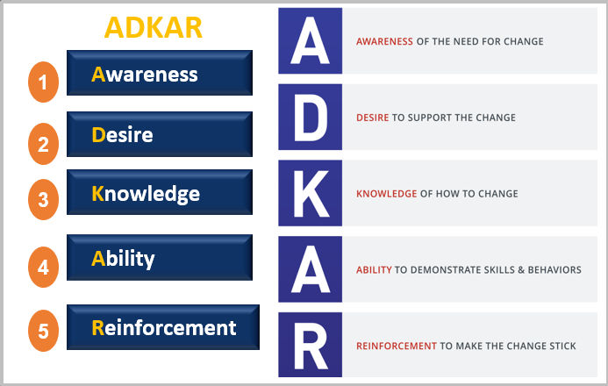
ADKAR change management model
Definition: Prosci (2019)
Awareness: impact of lockdown on stores .ABF Corporate. (2021)
Desire: Trial is supported and monitored. How much easier it would be to have an online store
Knowledge: on going
Ability: on going
Reinforcement: on going

Slide 5
Conclusion
•beneficial:
By providing more reasons for customers to visit stores, click and collect will increase profits. A designated collection area allows customers to try on items they have ordered online and to pick up additional items from the store if they wish.
Effectiveness of change:
Partially strong-On going

Slide 6
References:
MORAN, J.W. and BRIGHTMAN, B.K., 2001. Leading organizational change. Career Development International, 6(2), pp. 111-119.
Primark (2022). About Us | Primark. [online] www.primark.com. Available at: https://www.primark.com/en-gb/about-us.
corporate.primark.com. (n.d.). Sustainability Report | Primark Cares (UK). [online] Available at: https://corporate.primark.com/en-gb/primark-cares/sustainability-report.
Primark boss tells BBC why it is finally going online. (n.d.). BBC News. [online] Available at: https://www.bbc.co.uk/news/av/business-63587132 [Accessed 18 Feb. 2023].
Brotman, R. (1958) ‘The Dynamics of Planned Change’, American Sociological Review. American Sociological Society, pp. 341–342. Available at: The Dynamics of Planned Change - University of Wales Trinity Saint David (uwtsd.ac.uk)
ABF Corporate. (2021). Annual Report 2021. [online] Available at: https://www.abf.co.uk/annual-report-2021.
BBC News (2022). Primark finally goes online in new click-and-collect trial. Nanji, N. . [online] 20 Jun. Available at: https://www.bbc.co.uk/news/business-61863413.
Prosci (2019). ADKAR Model Overview - Prosci. YouTube. Available at: https://www.youtube.com/watch?v=oRDd9umVFT8 [Accessed 21 feb. 2023].

