Slide 1

Dealing with concerns from people who use care services in Wales NHS hospitals
Student Name:IUSTINA MAJORANT
Student Number:2005323
Module Code:BMSK6007

Slide 2
Dealing with concerns from people who use care services in Wales NHS hospitals
This research aims to analyze the importance of strategic management for the success of small and medium enterprises such as NHS HEALTH BOARDS
Further objectives of this research are:
To explore and define strategic management.
To conduct literature on the use of strategic management in the current business world.
Management of Concerns from People Who Use Care Services in Wales NHS Hospitals

Slide 3
Dealing with concerns from people who use care services in Wales NHS hospitals
Strategic management in healthcare is the process of defining the future of your organization, setting goals that will move you toward that future, and determining the major projects you’ll take on to meet those goals. It also includes sustaining that strategy focus over a period of three to five years.

Slide 4
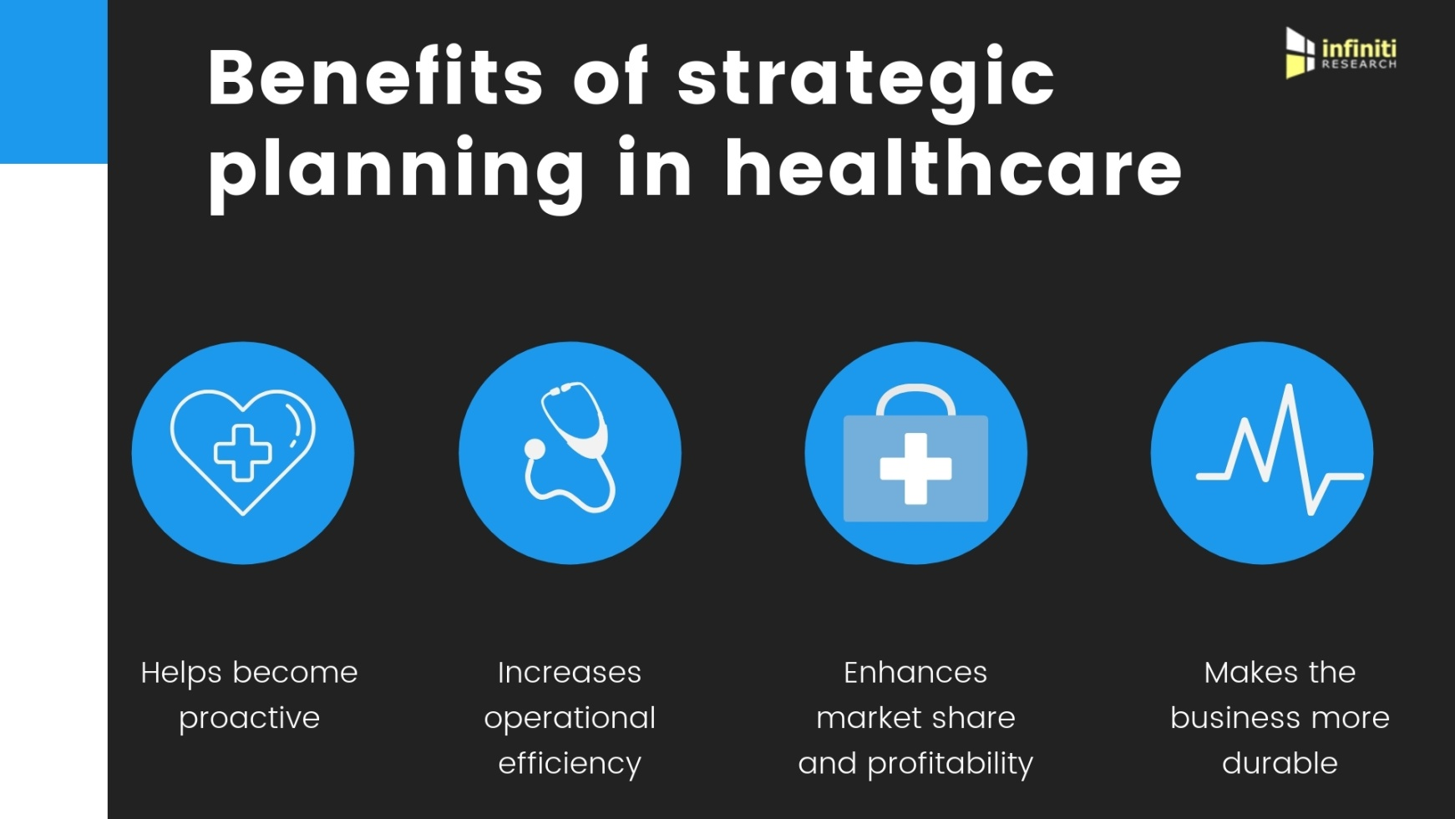
Dealing with concerns from people who use care services in Wales NHS hospitals

Slide 5
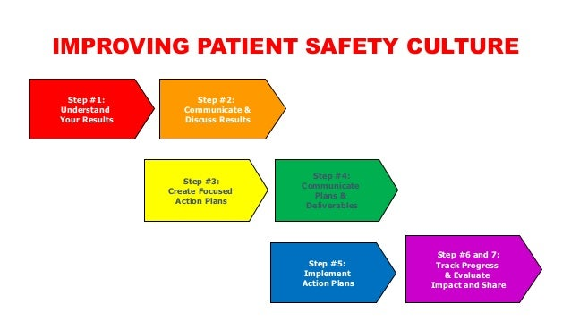
Dealing with concerns from people who use care services in Wales NHS hospitals

Slide 6
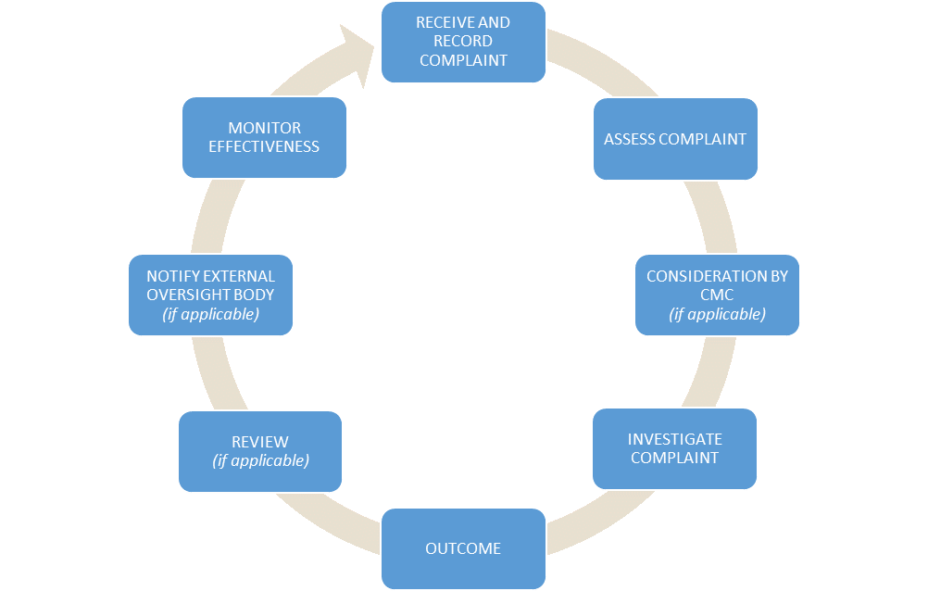
Dealing with concerns from people who use care services in Wales NHS hospitals
COMPLAINS PROCESS

Slide 7
Dealing with concerns from people who use care services in Wales NHS hospitals
Reporting and learning system model that will help improve the ability:
to improve the ability of all healthcare-related organisations to report more ;
• to develop better learning that supports more improvement;
• to increase transparency of patient safety data • to reduce risks associated with;
• duplication and omission ;
• lack of standardisation ;
• the gap between the capabilities of the NHS, patients, and other users ;

Slide 8
Dealing with concerns from people who use care services in Wales NHS hospitals
For the leaders of health care, leadership can be defined as a dynamic process of seeking a vision for change in which the leader is supported by two main groups: fans within its own organization, and influential agents external organizations that work to the outside of leader environment.
In the NHS there is lack of leadership skills and developing methods but it has been recognized and their development is a high priority. Leaders are the key to the delivery of quality care in an organization.

Slide 9
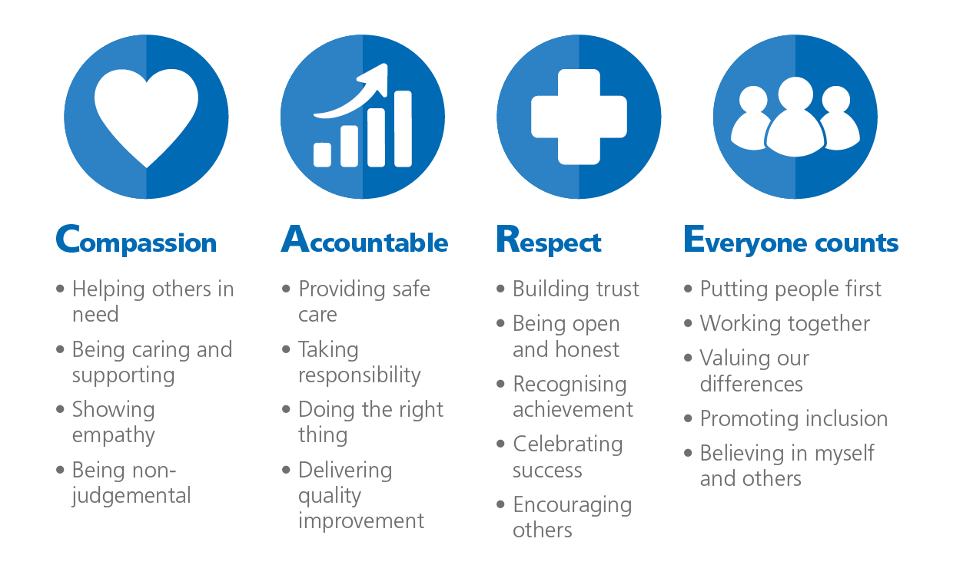
Dealing with concerns from people who use care services in Wales NHS hospitals
CORE VALUES HEALTH PROFESSIONALS

Slide 10

Dealing with concerns from people who use care services in Wales NHS hospitals

